Slide 1
Java vs. C++
CSCI 1730
January 8th, 2014

Slide 2
Outline for today
Development environment
Background
Java
C++
Simple programs
Java
C++

Slide 3
Machine Languages, Assembly Languages and High-Level Languages
Programmers write instructions in various programming languages
some directly understandable by computers
others requiring intermediate translation steps.
These may be divided into three general types:
Machine languages
Assembly languages
High-level languages

Slide 4
Machine Languages, Assembly Languages and High-Level Languages
Machine language
language that computer can directly process
defined by its hardware design
strings of numbers (ultimately reduced to 1s and 0s) that instruct computer to perform most elementary ops one at a time.
Machine dependent—a particular machine language can be used on only one type of computer.
Assembly languages:
English-like abbreviations to represent elementary operations.
Assemblers:
translate assembly-language to machine language.

Slide 5
Machine Languages, Assembly Languages and High-Level Languages
High-level languages
Single statements can accomplish substantial tasks
Compilers:
convert high-level language to machine language
Programmers write instructions that look almost like everyday English and contain commonly used mathematical notations.
A payroll program written in a high-level language might contain a single statement such as
grossPay = basePay + overTimePay

Slide 6
Machine Languages, Assembly Languages and High-Level Languages
Compiling a high-level language program into machine language can take a considerable amount of computer time
Longer in the past than now
Interpreter programs developed to execute high-level language programs directly
But run slower than compiled programs

Slide 7
Typical Java
Development Environment

Slide 8
Typical Java Development Environment
Java programs normally go through five phases:
Edit
Compile
Load
Verify
Execute

Slide 9
Typical Java Development Environment
Phase 1: Editing
Type a Java program (source code) using the editor.
Make any necessary corrections.
Save the program.
Result:
A filename ending with the .java extension

Slide 10
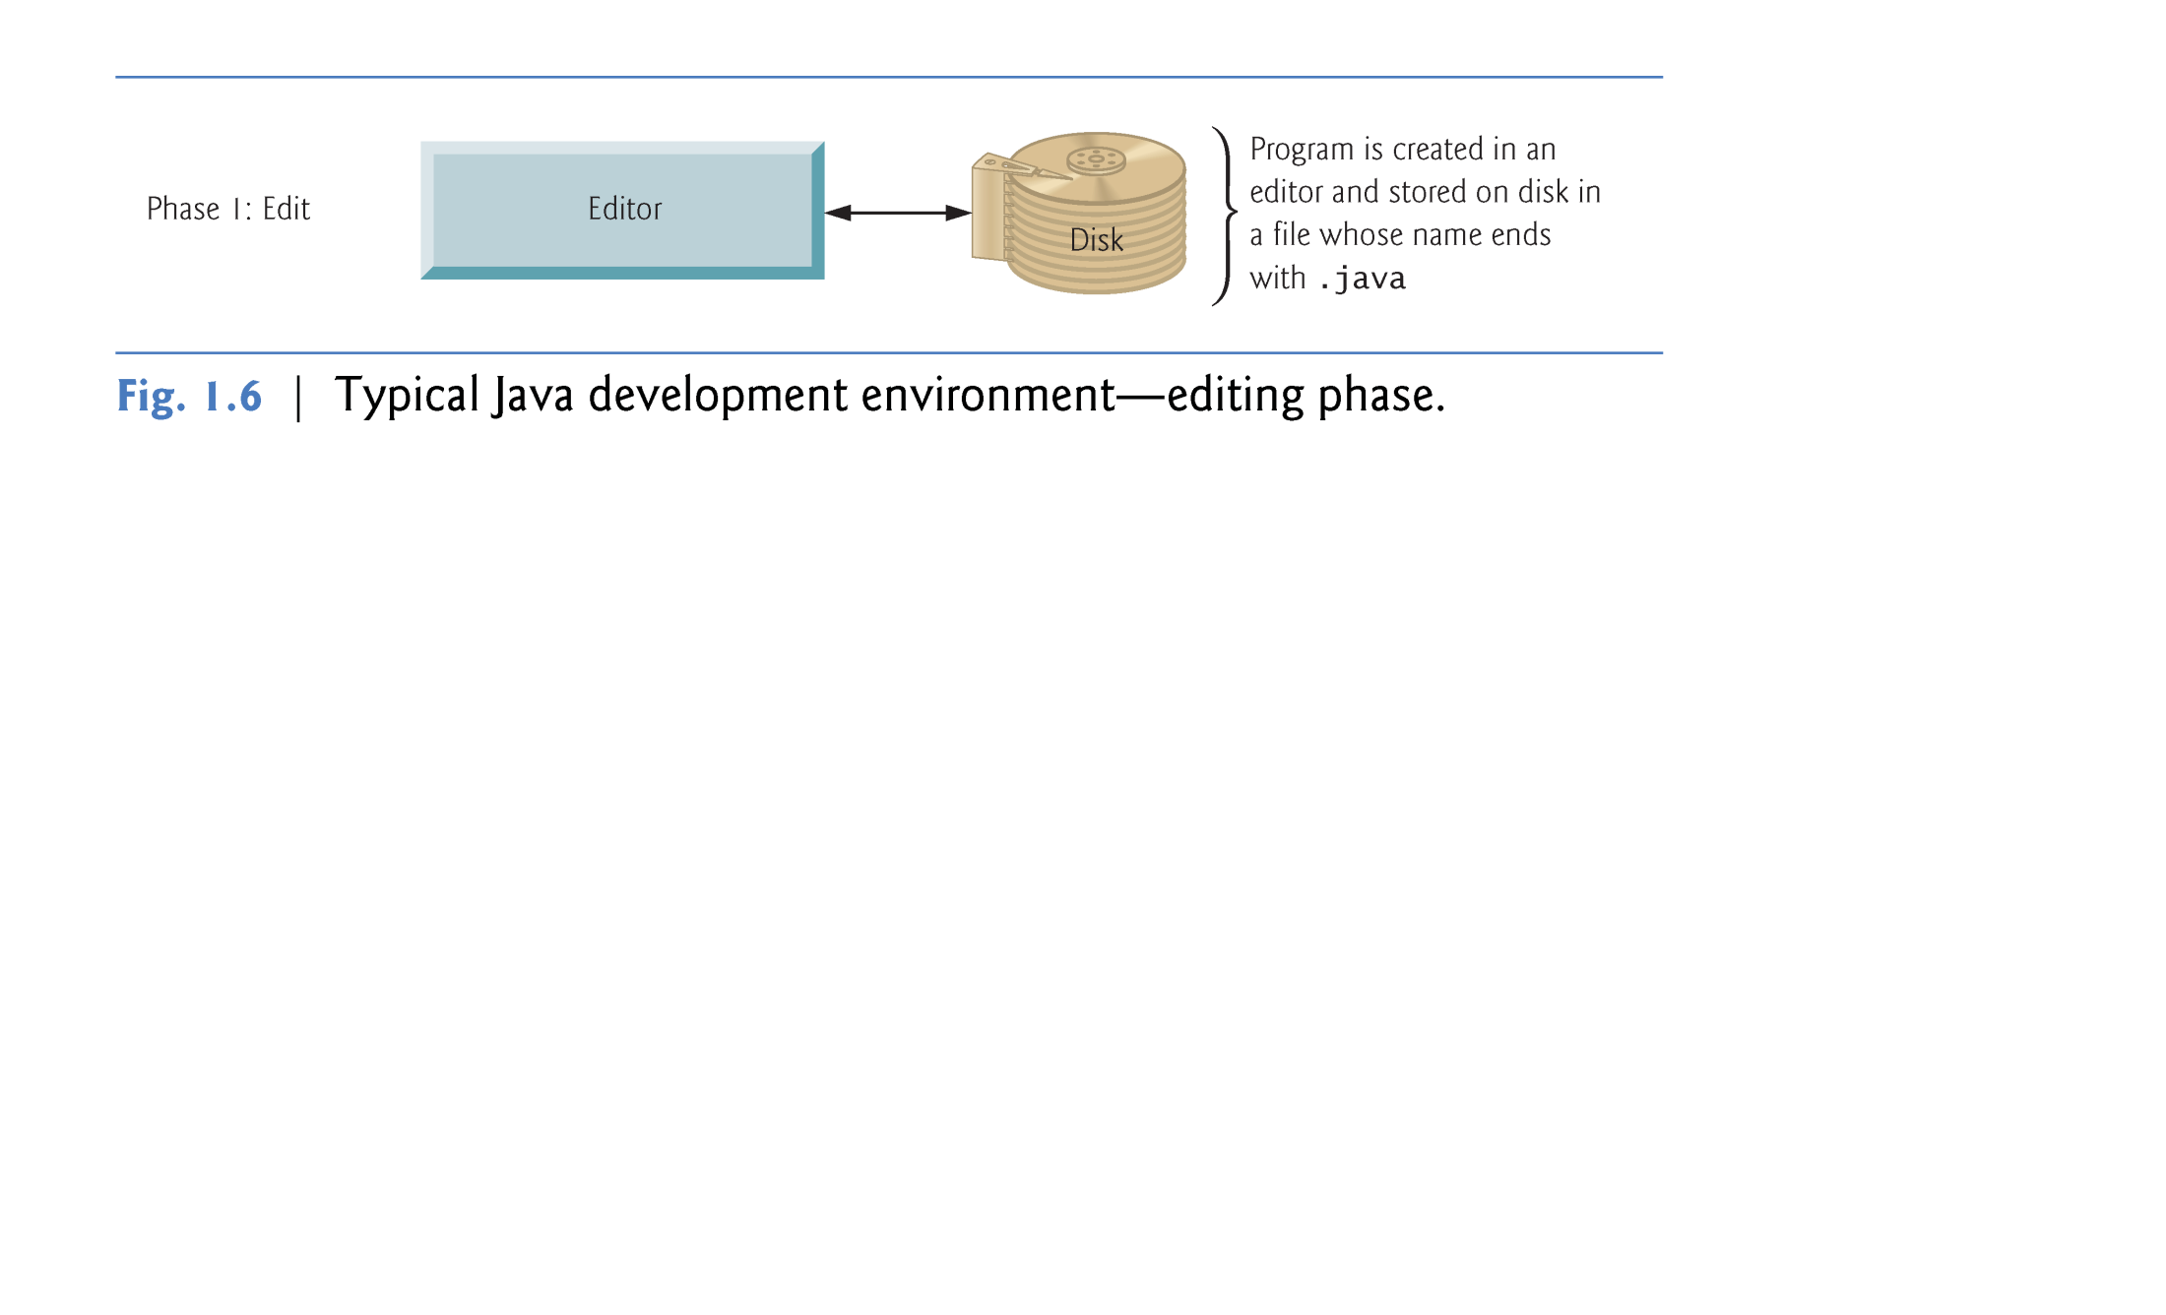

Slide 11
Typical Java Development Environment
Phase 2: Compile
Compile the java program into Bytecodes
javac Welcome.java
If the program compiles, the result is:
a .class file called Welcome.class that contains the compiled version (bytecodes) of the program

Slide 12
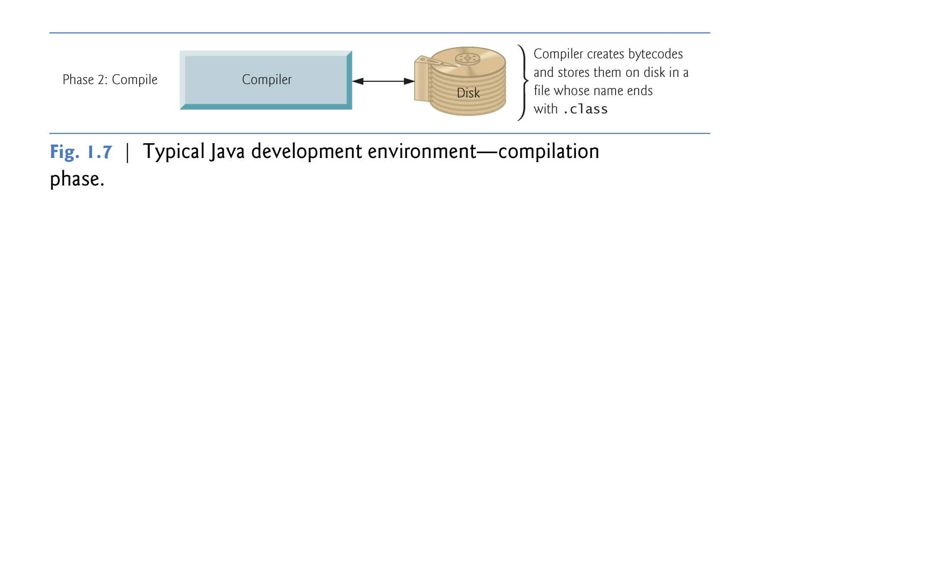

Slide 13
Typical Java Development Environment
Java bytecodes represent the tasks to execute, but are not directly executable on the hardware
Bytecodes executed by the JVM
Java Virtual Machine (JVM)—a part of the JDK and the foundation of the Java platform.
Virtual machine (VM)—a software application that simulates a computer
Hides the underlying operating system and hardware from the programs that interact with it.
Because the JVM is implemented on many computer platforms, applications that it executes can be used on all those platforms.

Slide 14
Typical Java Development Environment
Bytecodes are platform independent
They do not depend on a particular hardware platform.
Bytecodes are portable
The same bytecodes can execute on any platform containing a JVM that understands the version of Java in which the bytecodes were compiled.
The JVM is invoked by the java command. For example, to execute a Java application called Welcome, you’d type the command
java Welcome

Slide 15
Typical Java Development Environment
Phase 3: Loading
Loading a Program into Memory
JVM Class loader takes the named .class files containing the program’s bytecodes and transfers them to primary memory
Incrementally loads additional .class files your program uses
.class files can be loaded from a disk or over a network

Slide 16
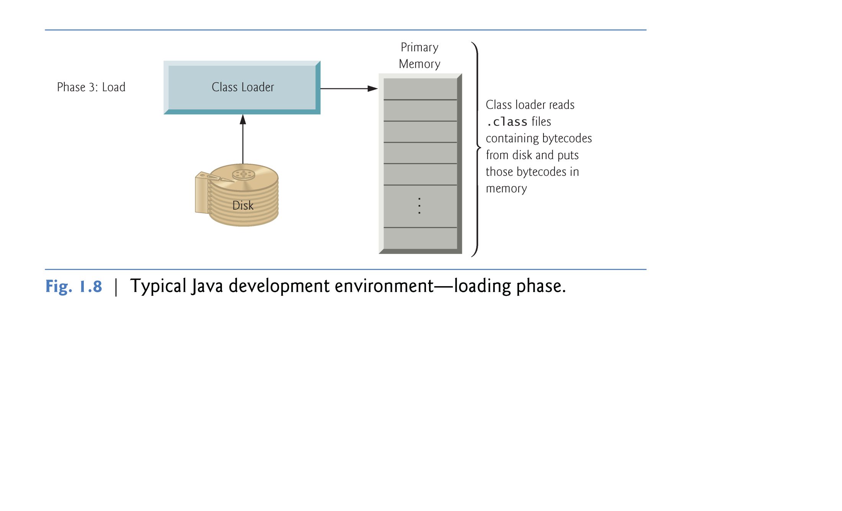

Slide 17
Typical Java Development Environment
Phase 4: Bytecode Verification
As the classes are loaded, the bytecode verifier examines their bytecodes
Ensures that they’re valid and do not violate Java’s security restrictions.
Java enforces strong security to make sure that Java programs arriving over the network do not damage your files or your system (worms, viruses, etc.)

Slide 18
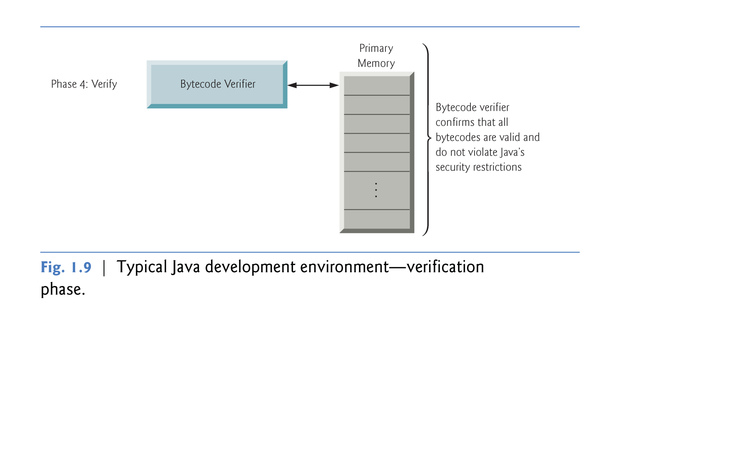

Slide 19
Typical Java Development Environment
Phase 5: Execution
The JVM executes the program’s bytecodes
JVMs typically execute bytecodes using a combination of interpretation and so-called just-in-time (JIT) compilation
Analyzes the bytecodes as they’re interpreted
A just-in-time (JIT) compiler—known as the Java HotSpot compiler—translates the bytecodes into the underlying computer’s machine language.
When the JVM encounters these compiled parts again, the faster machine-language code executes.

Slide 20
Typical Java Development Environment
So, Java programs go through two compilation phases
One in which source code is translated into bytecodes (for portability across JVMs on different computer platforms)
A second, during execution, in which the bytecodes are translated into machine language for the actual computer on which the program executes.

Slide 21
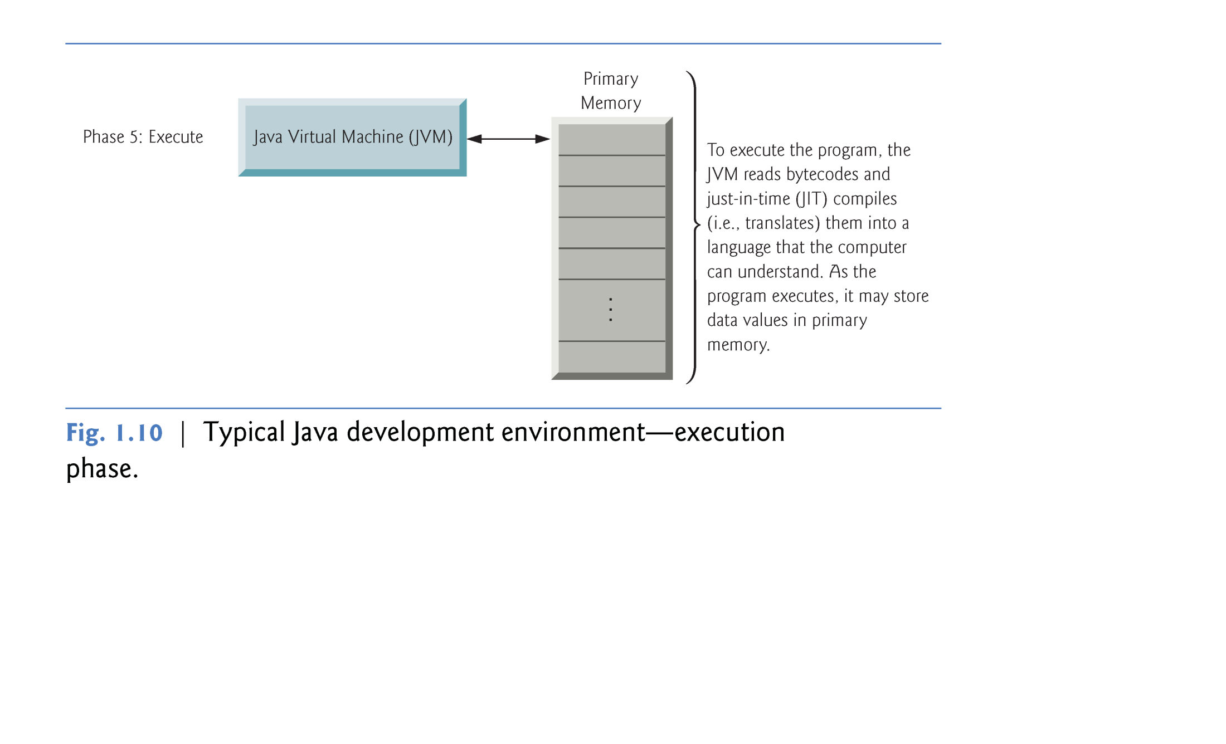

Slide 22
Typical C++ Development Environment

Slide 23
Typical C++ Development Environment
C++ systems generally consist of three parts:
a program development environment
the language
the C++ Standard Library.
C++ programs typically go through six phases:
Edit
Preprocess
Compile
Link
Load
Execute

Slide 24
Typical C++ Development Environment
Phase 1: Editing
consists of editing a file with an editor program, normally known simply as an editor.
Type a C++ program (source code) using the editor.
Make any necessary corrections.
Save the program.
C++ source code filenames often end with the .cpp, .cxx, .cc or .C extensions (note that C is in uppercase) which indicate that a file contains C++ source code.

Slide 25
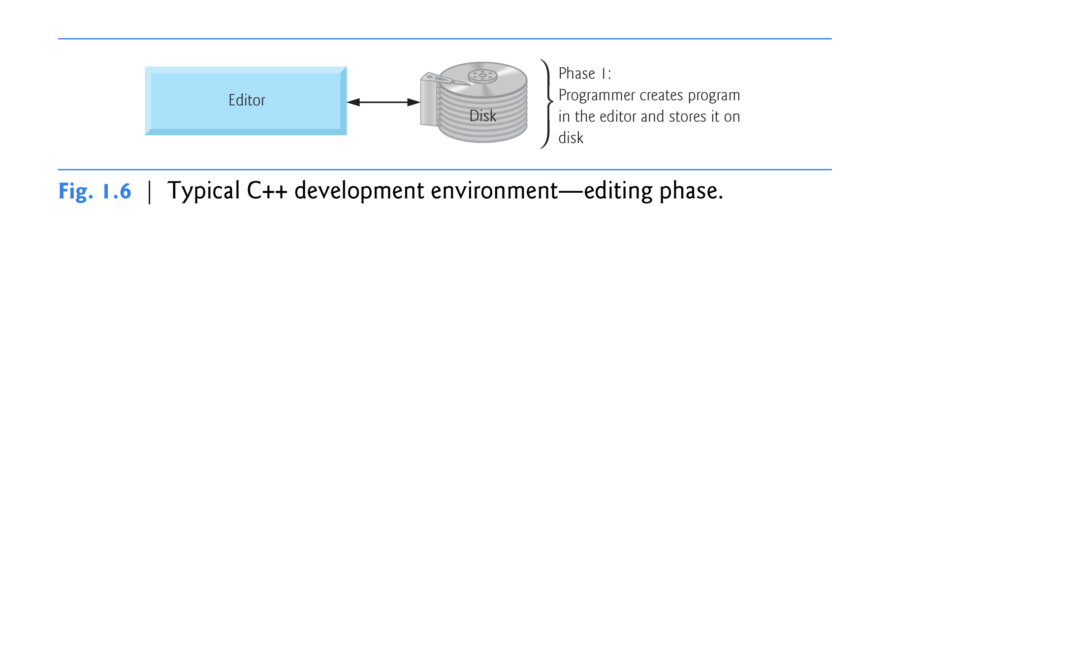

Slide 26
Typical C++ Development Environment
Phase 2: Preprocess the program
A preprocessor program executes automatically before the compiler’s translation phase begins (so we call preprocessing Phase 2 and compiling Phase 3)
typing the compile command kicks off both
preprocessor directives indicate that certain manipulations are to be performed before compilation
Usually to include other text files or perform text replacement

Slide 27
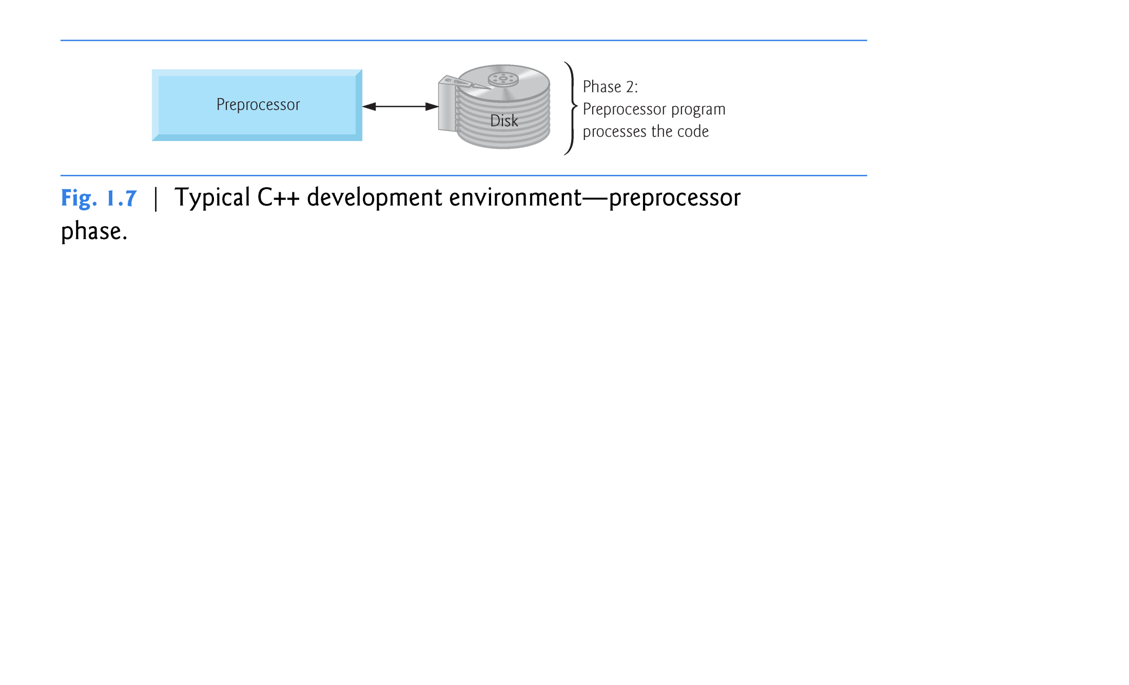

Slide 28
Typical C++ Development Environment
Phase 3 – Compilation
the compiler translates the pre-processed code into machine-language code—also referred to as object code.

Slide 29
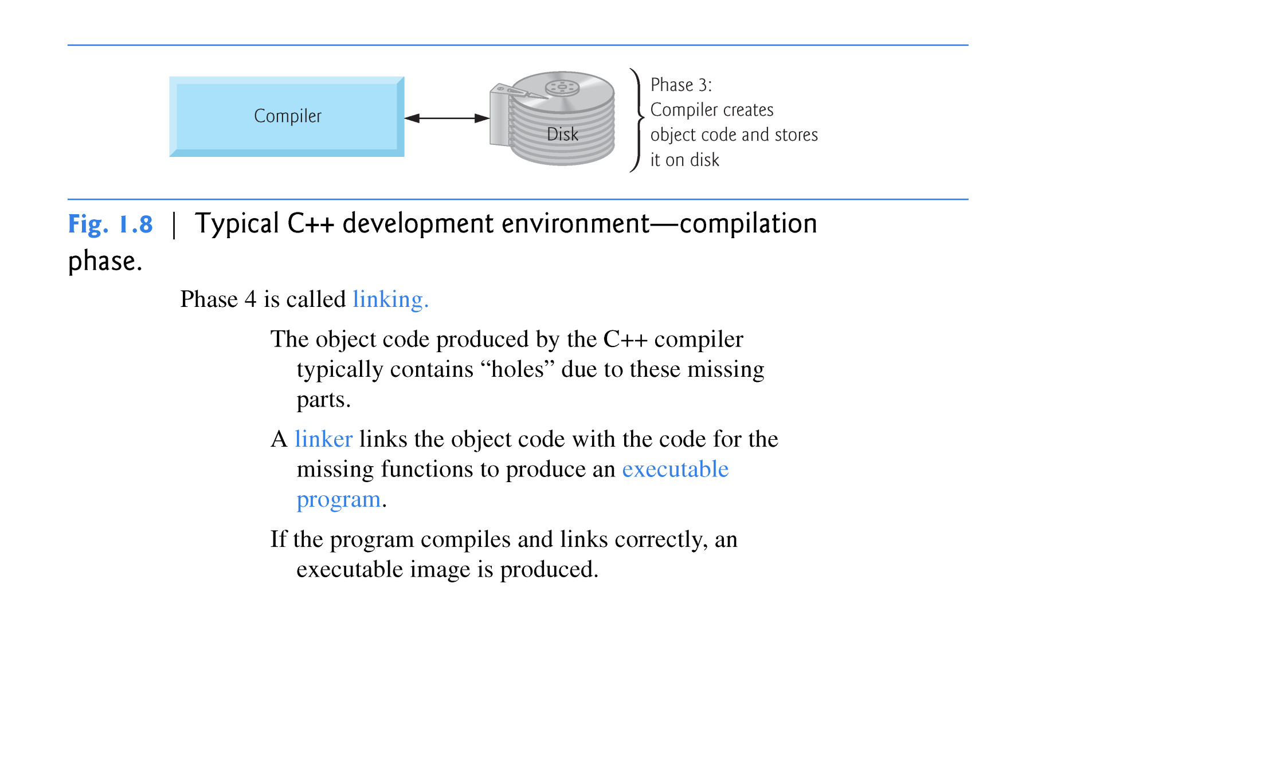

Slide 30
Typical C++ Development Environment
Phase 4: Linking
The object code produced by the C++ compiler typically contains “holes” due to “missing parts” -- code that the the programmer has “promised” the compiler will be available
A linker links the object code with the code for the missing functions to produce an executable program.
If the program compiles and links correctly
an executable image is produced

Slide 31
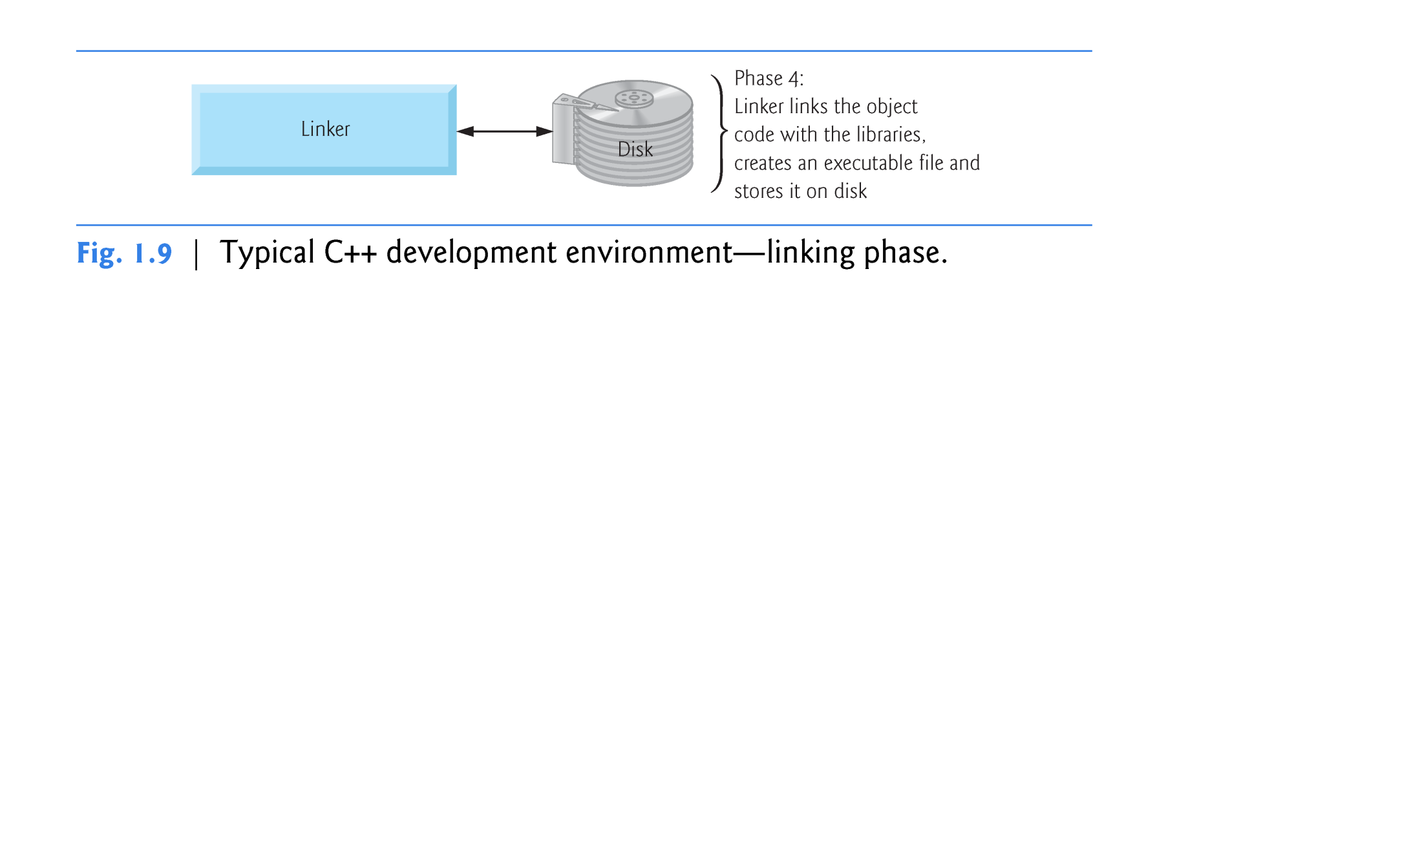

Slide 32
Typical C++ Development Environment
Phase 5: Loading
Before a program can be executed, it must first be placed in memory.
This is done by the loader, which takes the executable image from disk and transfers it to memory.
Additional components from shared libraries that support the program are also loaded.

Slide 33
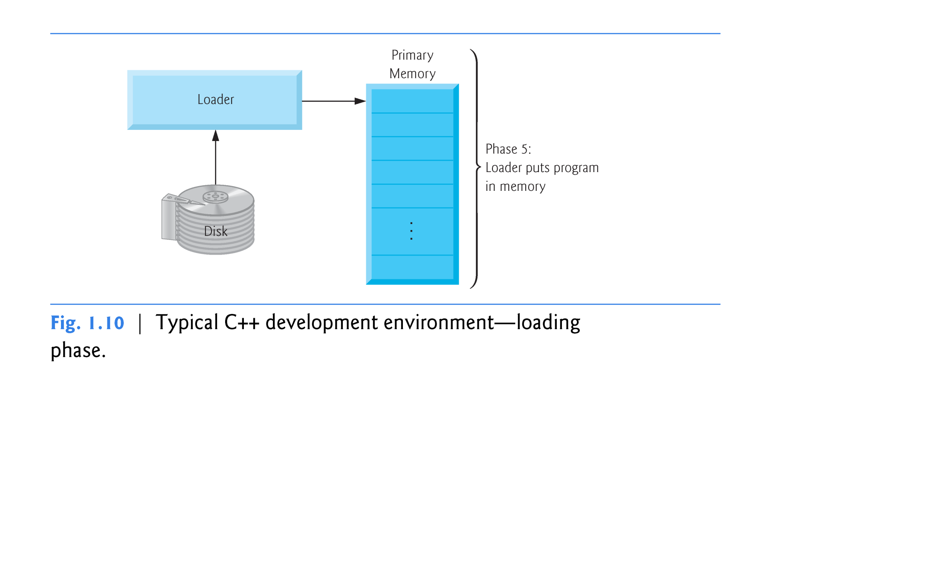

Slide 34
Typical C++ Development Environment
Phase 6: Execution
Finally, the computer, under the control of its CPU, executes the program one instruction at a time.
Some modern computer architectures can execute several instructions in parallel.

Slide 35
