Slide 1

CPSC 371
John D. McGregor
Session 11
Requirements analysis methods, cont’d

Slide 2
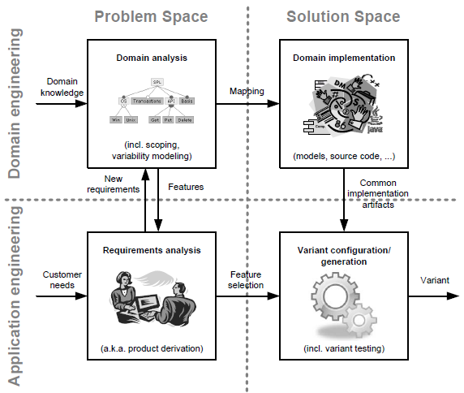
The landscape

Slide 3
Kaos
http://www.objectiver.com/fileadmin/download/documents/KaosTutorial.pdf

Slide 4
Assignment
Read http://www.cs.iastate.edu/~honavar/Papers/SFTA-TD.pdf
Develop a Software Fault Tree Analysis for the OBD2 cloud system.
Due Oct 8 by 11:59 pm.

