Slide 1

CPSC 371
John D. McGregor
Session 10
Requirements analysis methods

Slide 2
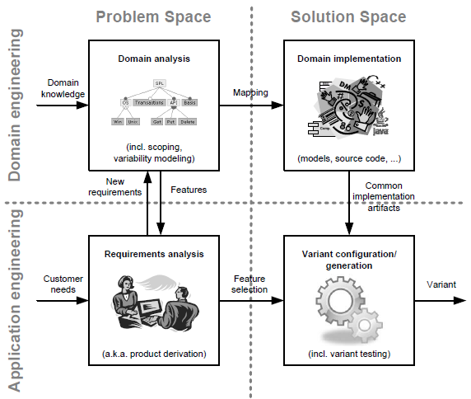
The landscape

Slide 3
Requirements Analysis
User requirements have been identified through elicitation; written in the language of the customer
Product requirements have been identified through domain analysis; written in the language of domain experts
“Derived” requirements are constructed by making these other requirements more explicit; written in the language of the developer

Slide 4
Derived requirements
May be several levels
Customer => Systems engineer => software engineer
DoD usually has 4 levels starting with commanders
Lowest level is sufficient as a contract with developers

Slide 5
Qualities
Correct
  Accurate representation of needed behavior
Complete
  Includes all needed behaviors
Consistent
  No requirement contradicts another

Slide 6
Consistency
    Example:
    R1.2: The speed of the vehicle will never exceed 250 mph.
    R5.4: When the vehicle is cruising at a speed greater than 300 mph, a special “watchdog” safety mechanism will be automatically activated.

Slide 7
Checks
As we move from one level to another need to be certain that:
  All requirements at one level are represented at the next lower level
  The statement of the more specific requirement does not contradict the higher level
  All requirements must be correct – require behaviors that are the ones needed

Slide 8
Traceability
Must be able to show the relationship between a requirement at one level and another
Usually a matrix maps the requirements
Level 1: #5 The OBD reader provides access to values on the CAN bus.
Level 2: #7.5 The OBD reader provides access to the following values that are
available on the CAN Bus:
$01 Rich to Lean sensor threshold voltage, (Constant)
$02 Lean to Rich sensor threshold voltage, (Constant)
$03 Low sensor voltage for switch time calculation, (Constant)
$04 High sensor voltage for switch time calculation, (Constant)
$05 Rich to Lean sensor switch time, (Calculated)
$06 …

Slide 9
System elements
Functions
Objects
Data
Sequential, parallel, interactive

Slide 10
Operations
Abstraction
Partitioning – break system into parts such as ODB, phone, and cloud
Projection – break system into views – such as data flow from car to cloud

Slide 11
hierarchy
There is a system hierarchy
It is a containment hierarchy
Using an o-o approach each top level object decomposes into object that implement those objects

Slide 12
Data flow
This can be an effective analysis technique for a system such as ours that is largely computational.
Trace flows from actor into center if system and on to destination

Slide 13
Kaos
http://www.objectiver.com/fileadmin/download/documents/KaosTutorial.pdf

Slide 14
IEEE 830
http://www.math.uaa.alaska.edu/~afkjm/cs401/IEEE830.pdf
http://www.ieee-stc.org/proceedings/2010/pdfs/jwm2677.pdf
http://www.abelia.com/docs/12207cpt.pdf

