Slide 1

CPSC 872
John D. McGregor
Session 17
More on AADL for Specification

Slide 2
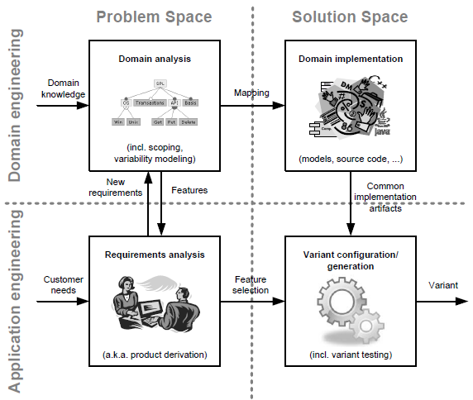
Specification

Slide 3
Specification and design
specification
problem
specification
solution
implementation

Slide 4
Isolette
https://wiki.sei.cmu.edu/aadl/index.php/Isolette_example#Behavior_description
http://www.santoslab.org/pub/high-assurance/module-aadl/slides/AADL-Isolette.pdf
http://dl.acm.org/citation.cfm?id=2527271

Slide 5
System specification
Show what the system can do
  Features
  Properties
Be independent of runtime issues
  No implementation specific definitions

Slide 6
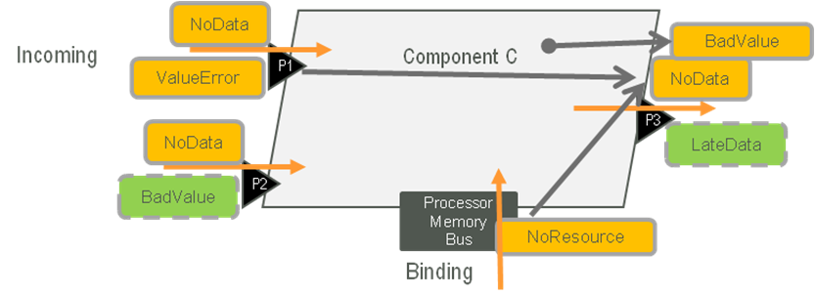
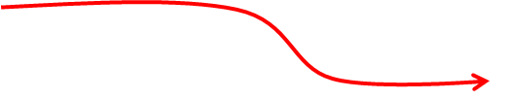
System specification and prototype
AADL uses a wiring approach to connect component

Slide 7
Flows and connections
Flow is internal to a system
Connection is between two systems
Connections between ports are uni-directional and typed
Ports are either for nominal or error flow
Port may be a source or a sink or neither
temp_sensor_source : flow source current_temperature;

Slide 8
Feature group
A set of ports that will be treated as one
“inverse” defines a second set of ports that flow in the reverse direction
feature group Current_Temperature
features
  value : in data port Current_Temp_Value;
  status : in data port Current_Temp_Status;
End Current_Temperature;
current_temperature : feature group inverse of Current_Temperature;

Slide 9
Properties
Isolette_Properties::Temperature_Increase_Rate => 0.5 Fdeg_Minute;
Isolette_Properties::Temperature_Decrease_Rate => 0.5 Fdeg_Minute;
Data_Model::Data_Representation => Enum;
Data_Model::Enumerators => ( "On", "Off" );
Actual_Latency => 750 ms .. 800 ms applies to temp_sensor_to_heat_source_flow;

Slide 10
extends
Inheritance of a specification
system Complete_rt extends Complete
end Complete_rt;
system implementation Complete_rt.PBS_speed_control_ab extends Complete.PBA_speed_control_ab
…
end Complete_rt.PBS_speed_control_ab;

Slide 11
refines to
process control
features
input: in data port signal;
output: feature group output_set;
end control;
process hf_controller extends control
features
input: refined to in data port hf_signal.basic;
output: refined to feature group hf_output.basic;
end hf_controller;

Slide 12
abstract
abstract monitor
end monitor;
system monitorRT extends monitor
End monitor;

Slide 13
virtual
virtual bus secure
end secure;
virtual bus implementation secure.bit_12
end secure.bit_12;

Slide 14
abstract/concrete; type/instantiation; design time/compile time/runtime
Abstract omits specific type information
Concrete refers to actual types
Type – a definition; a spec
Instantiation – a realization of one instance of a type that will be populated with specific instances for each of its data members
Design time – specifies what resources it will need
Runtime – an instance bound to real resources

