Slide 1

CPSC 872
John D. McGregor
Session 18
Evaluating Specification

Slide 2
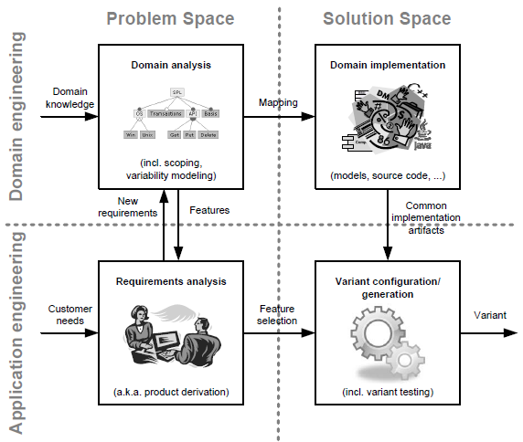

Slide 3
Specification and design
specification
problem
specification
solution
implementation

Slide 4
How do we know its good?
Evaluate the software
Evaluate the process by which the software is built

Slide 5
Evaluate the software
Reviews
requirements
design
code
Testing
simulation
live code tests
unit, integration, and system

Slide 6
Evaluate the process
Capability Maturity Model Integrated (CMMI)
5 levels
http://cmmiinstitute.com/resource/standard-cmmi-appraisal-method-process-improvement-scampi-b-c-version-1-3a-method-definition-document
http://cmmiinstitute.com/wp-content/uploads/2013/10/MDD_IntegratedABC_20131030.pdf
http://www.uccs.edu/Documents/tboult/cmmi-overview05.pdf

Slide 7
Evaluate everything
Certification
FAA/FDA rules and regs
Maybe DoT soon
Safety case
http://www2.warwick.ac.uk/fac/med/staff/sujan/research/safety_case_review/wp3_workshop/kelly_scr.pdf
http://msquair.files.wordpress.com/2012/06/md12_safety_cases_r5.pdf

Slide 8
Quality attribute scenarios
A quality attribute scenario is directly derived from a non-functional requirement and consists of the following parts:
source of stimulus, which is the entity that generated the stimulus;
stimulus, which is the condition that needs to be considered when it arrives at a system;
environment, which determines under which conditions the stimulus occurs;
artifact, is the element that receives the stimulus;
response, which is the activity undertaken after the arrival of the stimulus;
response measure, which represents the way a response is measured when it occurs.

Slide 9
Scenario
Source of stimulus: cell phone
Stimulus: begin reading from bus
Environment: OBD dongle is plugged in
Artifact: data stream
Response: Data begins to be transferred
Response measure: data transferred at a rate equal to the read rate

Slide 10
Source of stimulus:
Stimulus:
Environment:
Artifact:
Response:
Response measure:

Slide 11
Kaos
http://www.objectiver.com/fileadmin/download/documents/KaosTutorial.pdf
http://www.info.ucl.ac.be/~avl/ReqEng.html

Slide 12
Assignment
Sketch a safety case for our system
You will have to refer to non-existent evidence but part of the exercise is to determine what TYPES of evidence will be most convincing
Start with the Kaos approach
Due in pdf via email 11:59 October 15, 2014

Slide 13
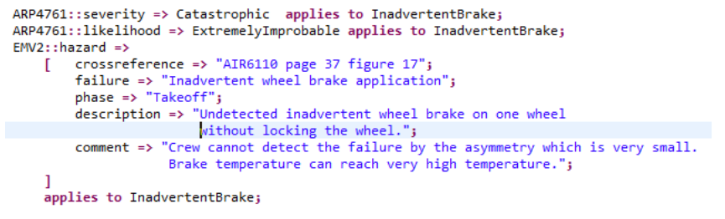
Hazards

