Slide 1

CPSC 872
John D. McGregor
Session 19
Using Scenarios

Slide 2
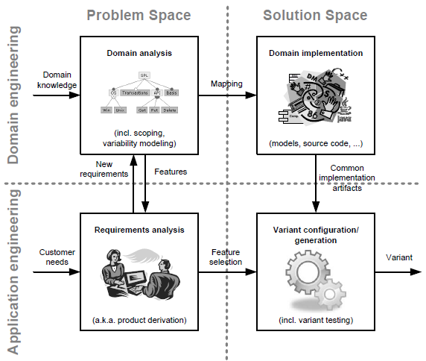

Slide 3
Specification and design
specification
problem
specification
solution
implementation

Slide 4
Scenarios
Software engineering involves a complex interaction of technical and social issues
It is impossible to give a simple list, much less an ordered list of charactertistics without a complete understanding of the context
Short stories are used in many development methods

Slide 5
Use case – one version
Actors. Who's involved?
Purpose. What is to be achieved?
Pre conditions. What conditions need to be in place before the interaction can start?
Post conditions. What conditions indicate successful completion?
Normal course. What is the normal course of the interaction?
Alternative courses. Are there any alternative courses of interaction?
Exception conditions. What could go wrong?
Business rules. Do any business rules apply?
Non-behavioural requirements. Do any non behavioural requirements apply?
Assumptions. Are we assuming anything?

Slide 7
Quality attribute scenarios
A quality attribute scenario is directly derived from a non-functional requirement and consists of the following parts:
source of stimulus, which is the entity that generated the stimulus;
stimulus, which is the condition that needs to be considered when it arrives at a system;
environment, which determines under which conditions the stimulus occurs;
artifact, is the element that receives the stimulus;
response, which is the activity undertaken after the arrival of the stimulus;
response measure, which represents the way a response is measured when it occurs.

Slide 8
Scenario
Source of stimulus: cell phone
Stimulus: begin reading from bus
Environment: OBD dongle is plugged in
Artifact: data stream
Response: Data begins to be transferred
Response measure: data transferred at a rate equal to the read rate

Slide 9
Source of stimulus:
Stimulus:
Environment:
Artifact:
Response:
Response measure:

Slide 10
Usage scenarios
Bridge between use case and sequence diagram
Replaces generic actors with specific names so that data operations are more realistic

Slide 11
Elicitation of requirements at SCALE
http://www.sei.cmu.edu/measurement/research/eliciting-requirements/index.cfm
http://airccse.org/journal/ijsea/papers/3312ijsea05.pdf

Slide 12
Comparison of approaches to elicitation
http://resources.sei.cmu.edu/asset_files/whitepaper/2013_019_001_297234.pdf

Slide 13
Assignment

Slide 14
http://www.slideshare.net/KoenLeekens/iso-26262-introduction

Slide 15
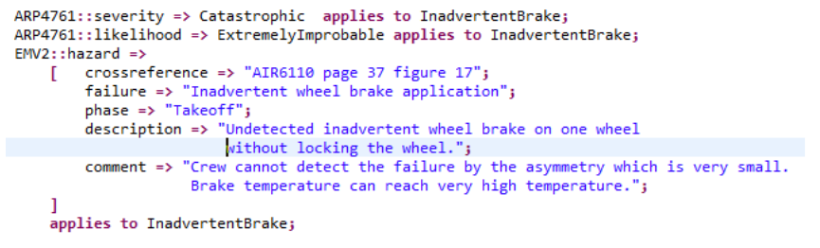
Hazards

