Slide 1

CPSC 371
John D. McGregor
Session 22
Process

Slide 2
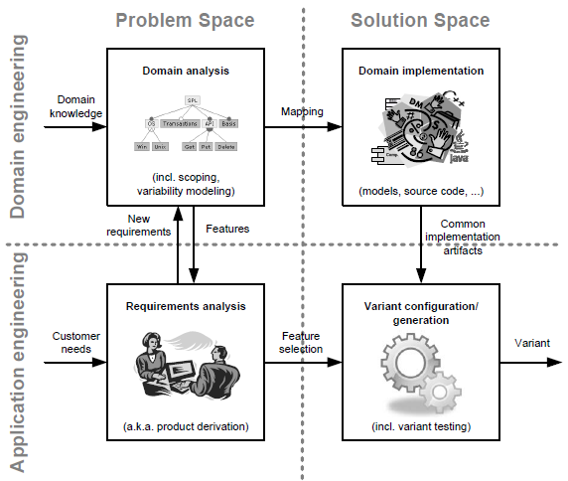

Slide 3
Specification and design
specification
problem
specification
solution
implementation

Slide 4
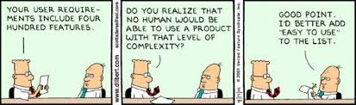

Slide 5
Classes of methods
Plan driven methods
  Waterfall
  Iterative/incremental
Agile methods
Formal methods

Slide 6
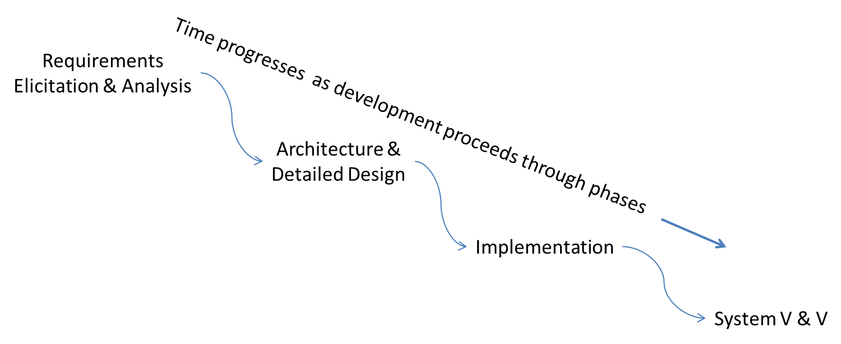
An iteration

Slide 7
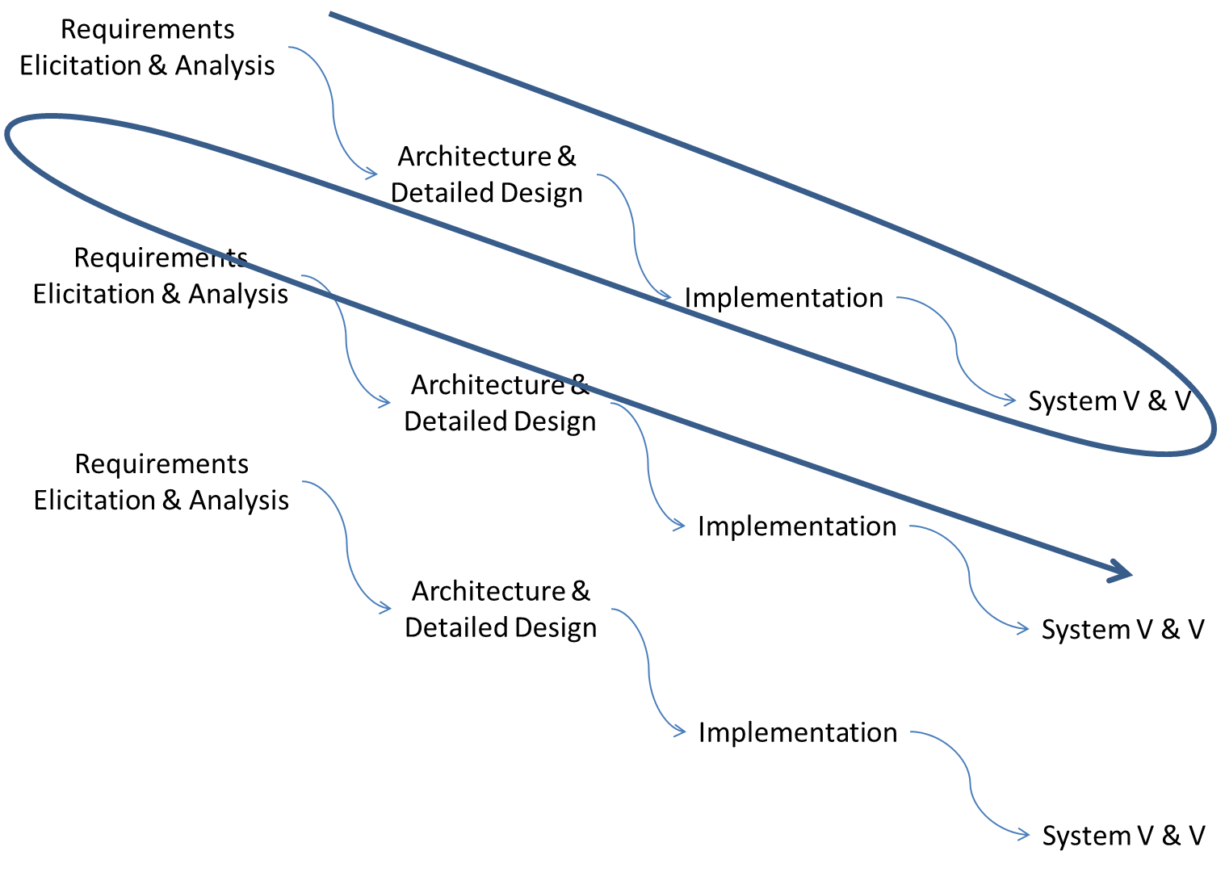
Multiple iterations

Slide 8
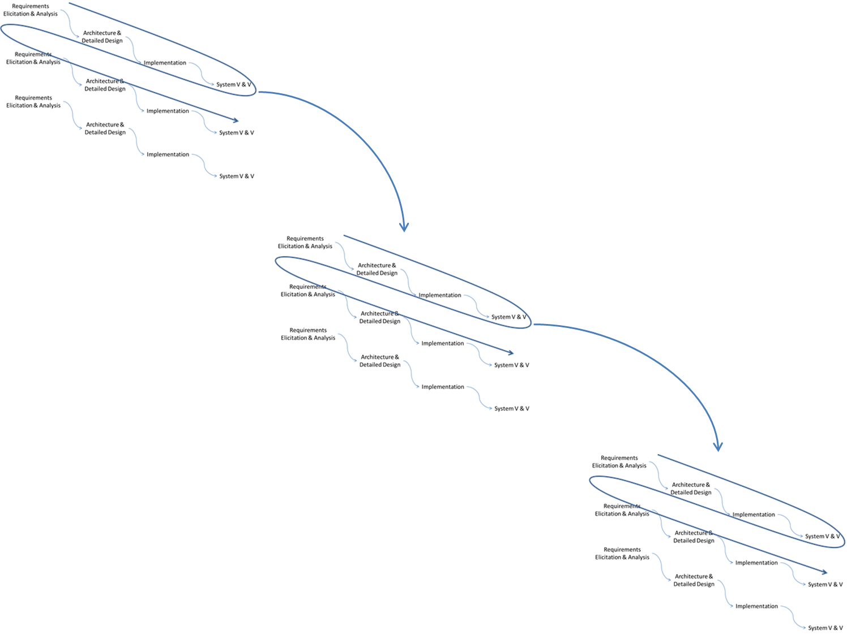
Multiple increments

Slide 9
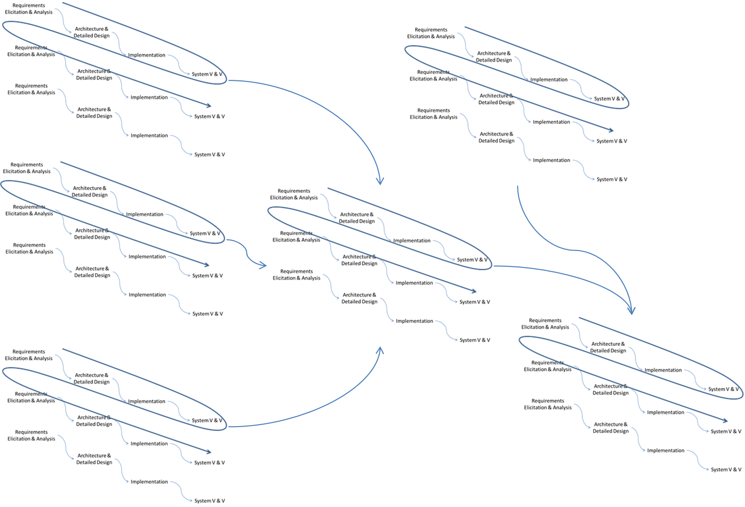
Concurrent increments

Slide 10
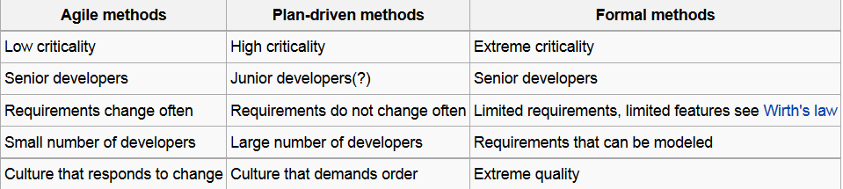
constraints

Slide 11
Agile manifesto
Individuals and interactions over Processes and tools
Working software over Comprehensive documentation
Customer collaboration over Contract negotiation
Responding to change over Following a plan
That is, while there is value in the items on the right, we value the items on the left more.

Slide 12
Agile methods
Adaptive Software Development (ASD)
Agile Modeling
Agile Unified Process (AUP)
Big Agile Toolkit (BAT)
Crystal Clear Methods (Crystal Clear)
Disciplined Agile Delivery
Dynamic Systems Development Method (DSDM)
Extreme Programming (XP)
Feature Driven Development (FDD)
Lean software development
Kanban (development)
Scrum
Scrum-ban

Slide 13
Kanban
It uses a work-in-progress limited pull system as the core mechanism to expose system operation (or process) problems and stimulate collaboration to continuously improve the system. It is rooted in four basic principles:
Start with existing process
Agree to pursue incremental, evolutionary change
Respect the current process, roles, responsibilities and titles
Leadership at all levels

Slide 14
Requirements in Agile
Do just enough
What does it take to get approval?
  2 people, 5 people, a government certifier?
What is at stake?
  Mission critical
  Life critical
Who is going to do the work?
What is the time horizon?

Slide 15
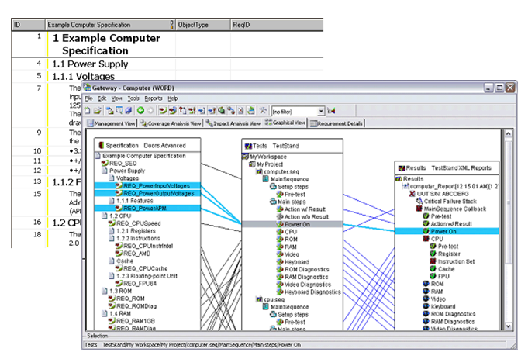
DOORS
http://www.ni.com/white-paper/8751/en/

Slide 16
documentation
“shalls”, “mays”, “mights”
User stories
Use cases

Slide 17
Assignment
Choose your method
Update your EPF model to reflect new methods and actions
Reflect that the requirements activity continues throughout the project’s life time.
Present in class
Due Oct 29th by 11:59PM

