Slide 1

CPSC 371
John D. McGregor
Session 25
Qualities

Slide 2
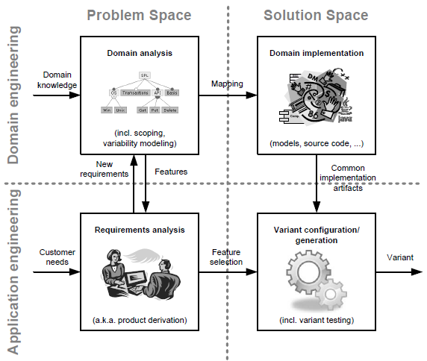

Slide 3
Specification and design
specification
problem
specification
solution
implementation

Slide 4
CAS
http://www.diegm.uniud.it/aiig2003/documents/Materiale%20lezioni/Giannoccaro/Choietal.pdf

Slide 5
Assignment
Think about autonomous vehicles as a complex adaptive system. Map the characteristics of autonomous vehicles onto the characteristics of a CAS. Pay particular attention to the OBD to cloud segment.
What are the potential risks?
What are the key references?
Write a semi-formal paper that summarizes the above.
Due Nov 12th by 11:59PM vi email

