Slide 1

CPSC 371
John D. McGregor
Session 27
State

Slide 2
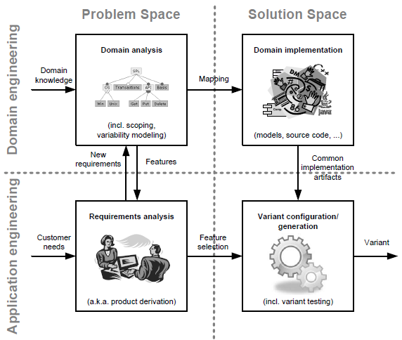

Slide 3
Specification and design
specification
problem
specification
solution
implementation

Slide 4
Driver in or out of the system

Slide 5
CAS
http://sdsi.asu.edu/wp-content/uploads/2013/01/Dahm-AIAA-2013-AIAA-Aerospace-Sciences-Keynote.pdf

Slide 6
http://userpages.umbc.edu/~tarr/dp/lectures/StateStrategy.pdf
http://aadl.sei.cmu.edu/aadl/documents/Behaviour_Annex1.6.pdf

Slide 7
Types of consistency

Slide 8
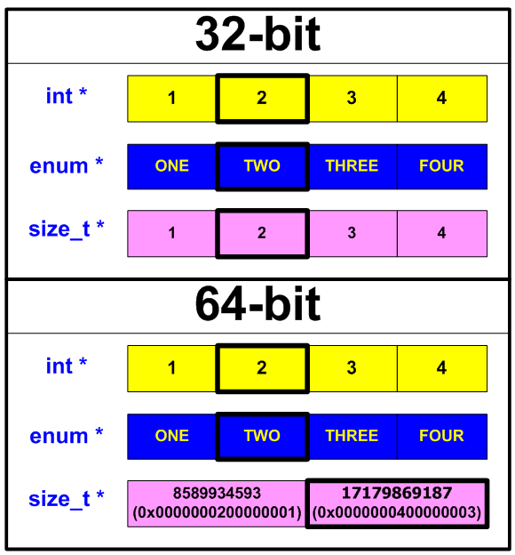
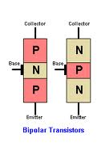


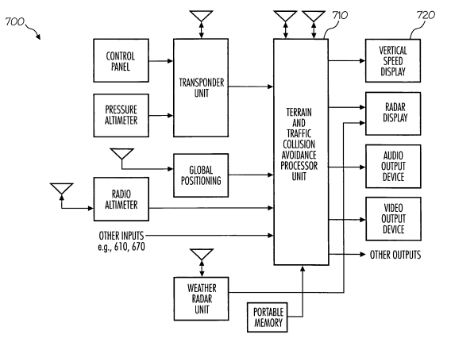

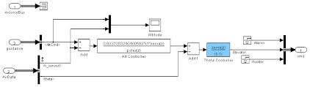
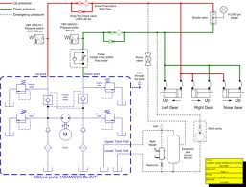
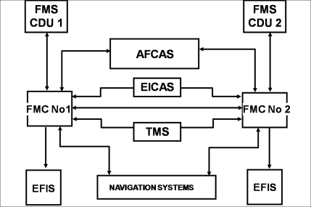


What is SAVI Consistency?
AFE 59S1 – 6 types of consistency
  Interface
  Compositional
  Constraint
  Behavioral
  Version
  Verification
Physical
Geometry
On Ground
Ground Proximity Warning System
Radio Altimeter
Shape
PNP or NPN Junction
Weight on Wheels Switch
Altimeter
Speed Indicator
Landing Gear Model
Engine Indication and Crew Alerting System
Air/Ground Signal
Avionics Model
In Flight
Notes:
What is SAVI Consistency?
SAVI team developers have looked very hard at what “consistency” means within the context of model-based systems engineering. During the last phase of the SAVI Proof of Concept work, they concluded that there are at least six types of consistency (shown on the left side of this chart) essential a SAVI-compliant VIP.
However, simply listing them is usually not quite enough to illustrate what we mean by this phrase. So in this chart and the next one, we have attempted to cite a few examples to help illustrate. [These illustrations are not complete; the interested reader is referred to a presentation assembled by John Chilenski and Mike Kerstetter at: ]
One type of interface consistency is illustrated by the differences in computer words when represented in 32-bit or 64-bit lengths. There are several other examples of interface consistency in the presentation cited above.
Compositional consistency is illustrated in two ways on this chart; one is the simple notion of “square pegs in round holes” cartoon and another with the type of transistor junction in the right-most cartoon.
Constraint consistency is illustrated between a variety of interacting subsystems on an aircraft, which must supply signals to the crew alerting system that recognize when the airplane is on the ground and when it is in flight. If these constraints are not observed, at the very least the crew may see “false alarms” that confuse and obfuscate. More dramatically, they could even lead to a spurious input to the flight control system that leads to a hazardous flight condition.

Slide 9

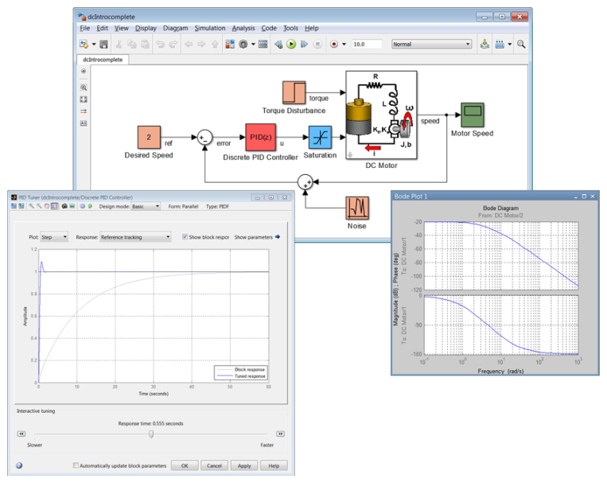
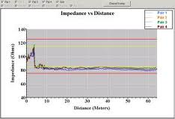
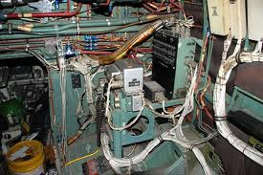
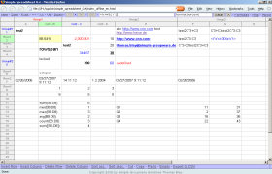
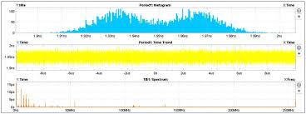
What is SAVI Consistency?
AFE 59S1 – 6 types of consistency
  Interface
  Compositional
  Constraint
  Behavioral
  Version
  Verification
AFE 61 – 8
types of consistency
  Data
    Value
    Type
    Semantics
    Metadata
  Model
    Property
    Semantics
    Metadata
    Behavior
Runtime Consistency: Data Safety, Latencies, Buffer Overflow, Resource Sharing, Data Ordering, etc.
Mathworks
32-bit Windows
Mathworks
64-bit Unix
pi = 3.1415927
pi = 3.14159265358979323846
Signal connectivity analysis doesn’t need wiring length but signal latency and jitter analysis does.
Notes:
What is SAVI Consistency?
Behavioral consistency is another type of consistency that could be illustrated in many ways. We chose run-time behavior to illustrate that category primarily because it is so important systems that depend on embedded software – like a modern aircraft.
Version consistency is illustrated in these example where two different versions of software may utilize different precision in computations on board an aircraft.
Finally, Verification consistency suggests that certain shared properties between subsystems or even types of system analysis carry different levels of importance. Quite clearly such consistency can affect assurance levels for system components – hardware or software.
Note that SAVI continues to study consistency. During this AFE 61 work, Kurt Woodham has reexamined the six types of consistency describe in these charts and proposed a more complete classification that might be even more useful. Examples for this enlarged set of consistencies is being evaluated by the SAVI team.

Slide 10
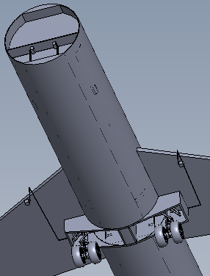
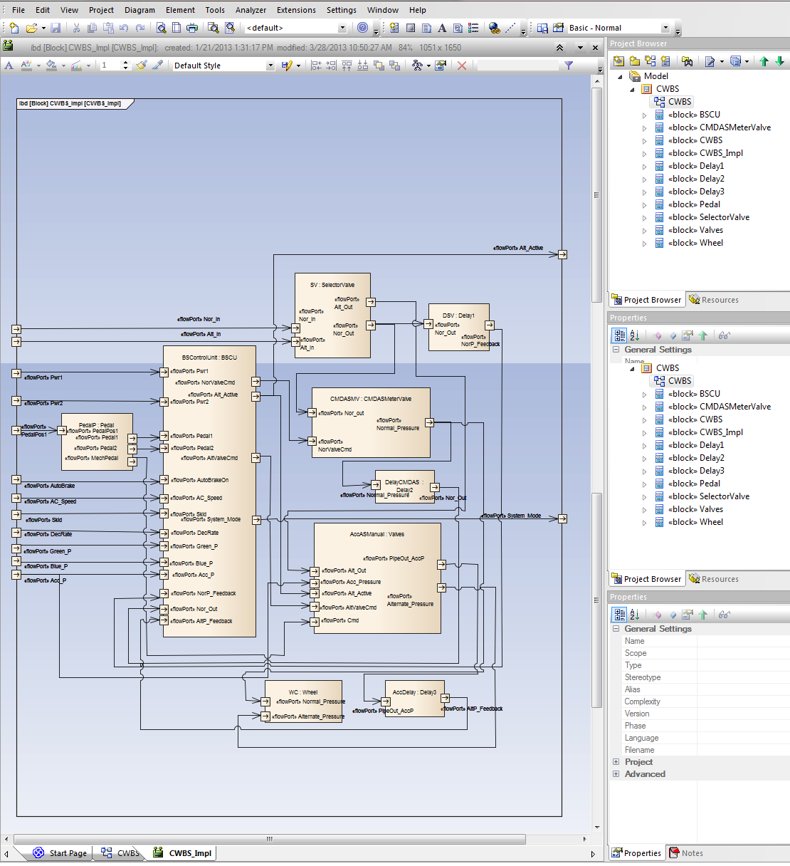
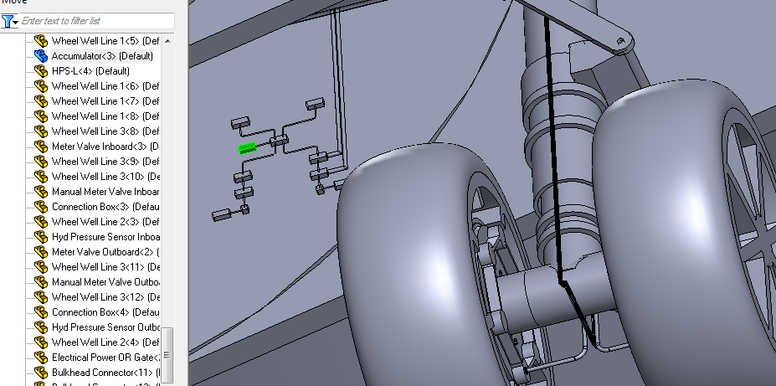
SAVI Consistency Checks
Solid models
BSCU
AADL-SysML models
Hyd power supply
Accumulator
Notes:
SAVI Consistency Checks
This slide illustrates how the two model sets work together and provide a means (within the AADL model) of carrying out consistency checks (SAVI-type extended consistency checks) to uncover system incompatibilities.
The model set consists of an AADL architectural model, a solid geometry model (generated by TAMU students in Solidworks and exported in STEP AP 214 format. The various gold arrows show the linkage between the same components in each model set. Notice also that the right side is a SysML depiction of an AADL model set derived from the AADL model – illustrating that the SysML-AADL translator has done its job for this set of models.
We have shown in our Proof of Concept work that we can handle MATLAB/Simulink files; so we have not readdressed that type of model (short on resources). These models reside in a Model Repository (physically located at TAMU but with folders representing different actors (OEMS, suppliers, and regulators). Intermodel dependencies are being identified and registered at various steps during the consistency checking demonstration.
An example of a consistency check to be demonstrated is rerouting the hydraulic lines (due to repositioning a sensor in the landing gear strut to another location. If the hydraulic lines have too many bends or add too much length, such a modification could cause the pressure to drop below limits specified in the AADL model. Running the analysis tool in AADL should uncover this system deficiency and point back toward this change in hydraulic routing as the base case of this inconsistency.

Slide 11
http://sdsi.asu.edu/wp-content/uploads/2013/01/Dahm-AIAA-2013-AIAA-Aerospace-Sciences-Keynote.pdf

