Slide 1

CPSC 371
John D. McGregor
Session 32
This is it.

Slide 2
The company is ready to begin development of a new product.
We are at ground zero.
How do we begin?
Look to our process for new product development

Slide 3
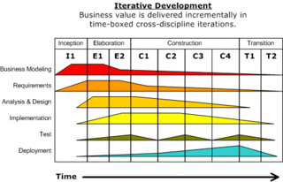
Process

Slide 4
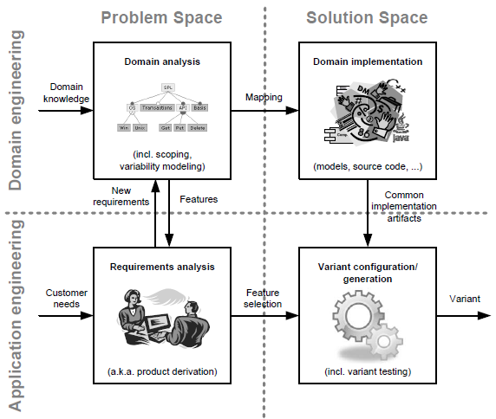

Slide 5
Specification and design
specification
problem
specification
solution
implementation

Slide 6
Analysis
Analysis is an attempt to understand
We try to decipher what an acceptable solution will look like
A team has some prior experiences that provide some starting points

Slide 7
Domain analysis
Domain analysis is an examination of the broader set of ideas within which the problem is framed.
The process by which a software engineer learns enough background information so that he or she can understand the problem and make good decisions during requirements analysis and other stages of the software engineering process

Slide 8
Context diagram
Establishes the scope
OBD I
laptop
OBD II
wireless
wifi
bluetooth
Cell phone
Insurance rating system

Slide 9
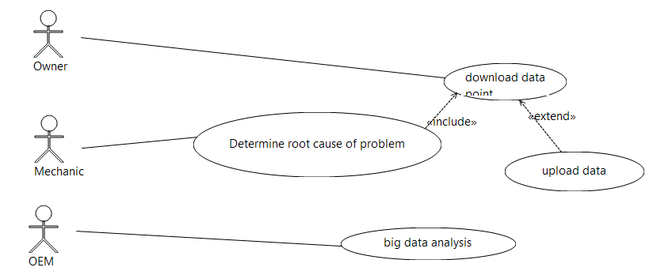
Use cases

Slide 10
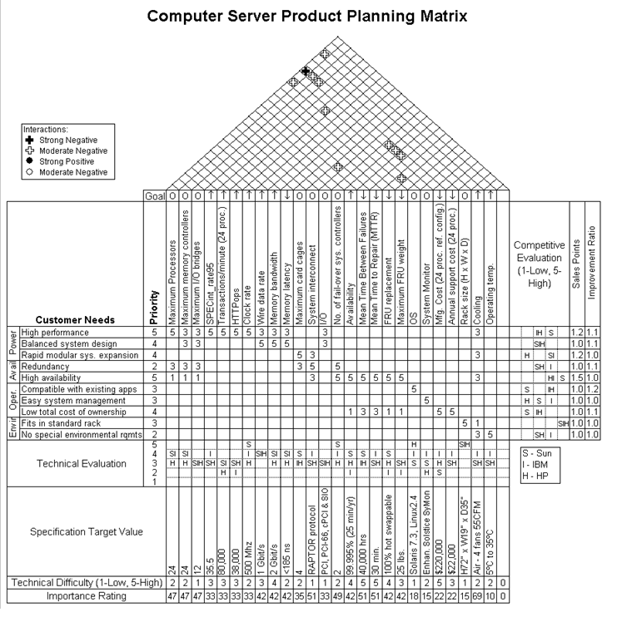
QFD – House of Quality

Slide 11
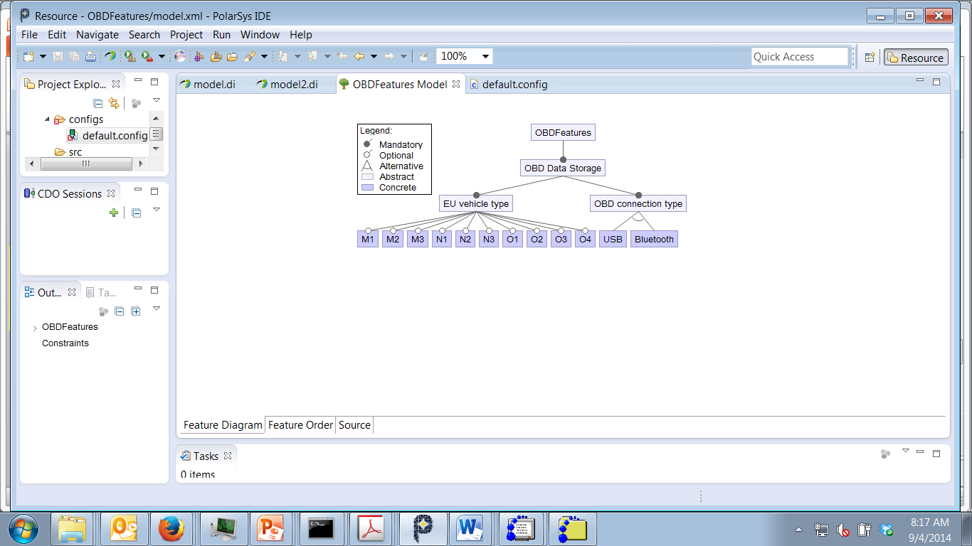
Feature models

Slide 12
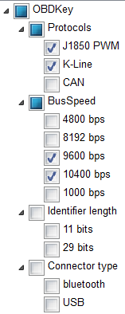
Configurations

Slide 13
Value chains
How will we deliver value to customers?
OBD to cell phone is a local app that uses bluetooth or USB
The cell phone is the driver so the operating company is the principal capturer of value
Cell phone to cloud is wireless/cellular connection so again the operator is in control
Cloud provider captures value in storage fees

Slide 14
Business models
purpose,
business process,
target customers,
offerings,
strategies,
infrastructure,
organizational structures,
trading practices, and
operational processes and policies.

Slide 15
Rationale for business models
Because the business model affects the structure of the system and how we deliver value to customers
A rapidly changing domain that is happy with approximations needs frequent releases
A more slowly changing domain that requires accuracy needs more careful attention before a release.

Slide 16
Requirements
User requirements have been identified through elicitation; written in the language of the customer
Product requirements have been identified through domain analysis; written in the language of domain experts
“Derived” requirements are constructed by making these other requirements more explicit; written in the language of the developer

Slide 17
Requirements
Correct
Accurate representation of needed behavior
Complete
Includes all needed behaviors
Consistent
No requirement contradicts another

Slide 18
Structuring requirements
Abstraction
Partitioning – break system into parts such as ODB, phone, and cloud
Projection – break system into views – such as data flow from car to cloud

Slide 19
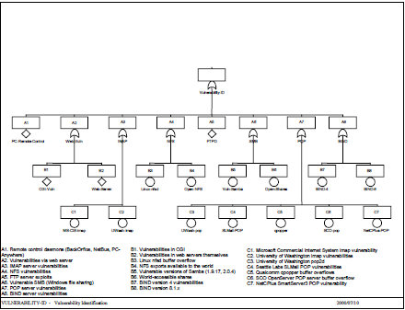
Fault analysis

Slide 20
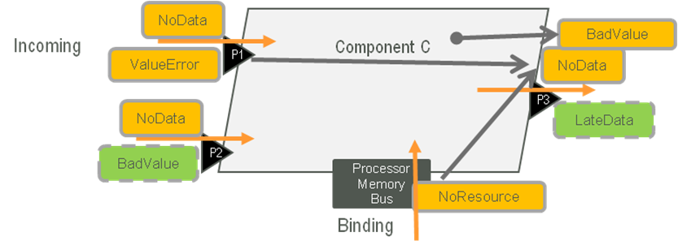

Error models
How are errors to be handled?

Slide 21
Time points
Abstract omits specific type information
Concrete refers to actual types
Type – a definition; a spec
Instantiation – a realization of one instance of a type that will be populated with specific instances for each of its data members
Design time – specifies what resources it will need
Runtime – an instance bound to real resources

Slide 22
Quality attribute scenarios
Source of stimulus: cell phone
Stimulus: begin reading from bus
Environment: OBD dongle is plugged in
Artifact: data stream
Response: Data begins to be transferred
Response measure: data transferred at a rate equal to the read rate

Slide 23
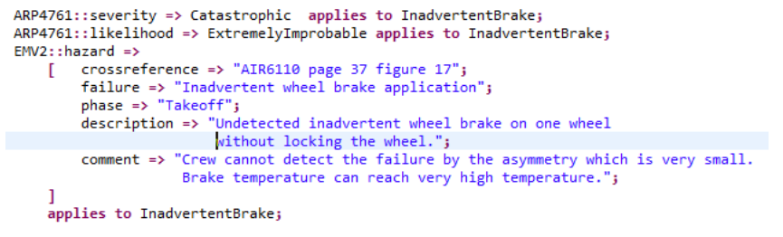
Hazards

Slide 24
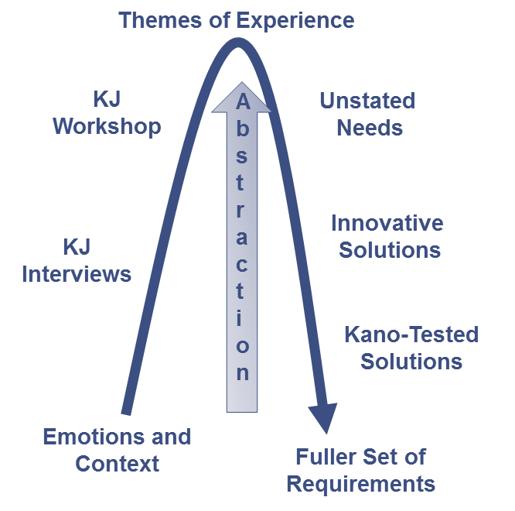
Eliciting requirements at scale – KJ Method
Affinity groups - commonality
must be's, satisfiers, and delighters.

Slide 25
Cyber-physical systems feedback control loop

Slide 26
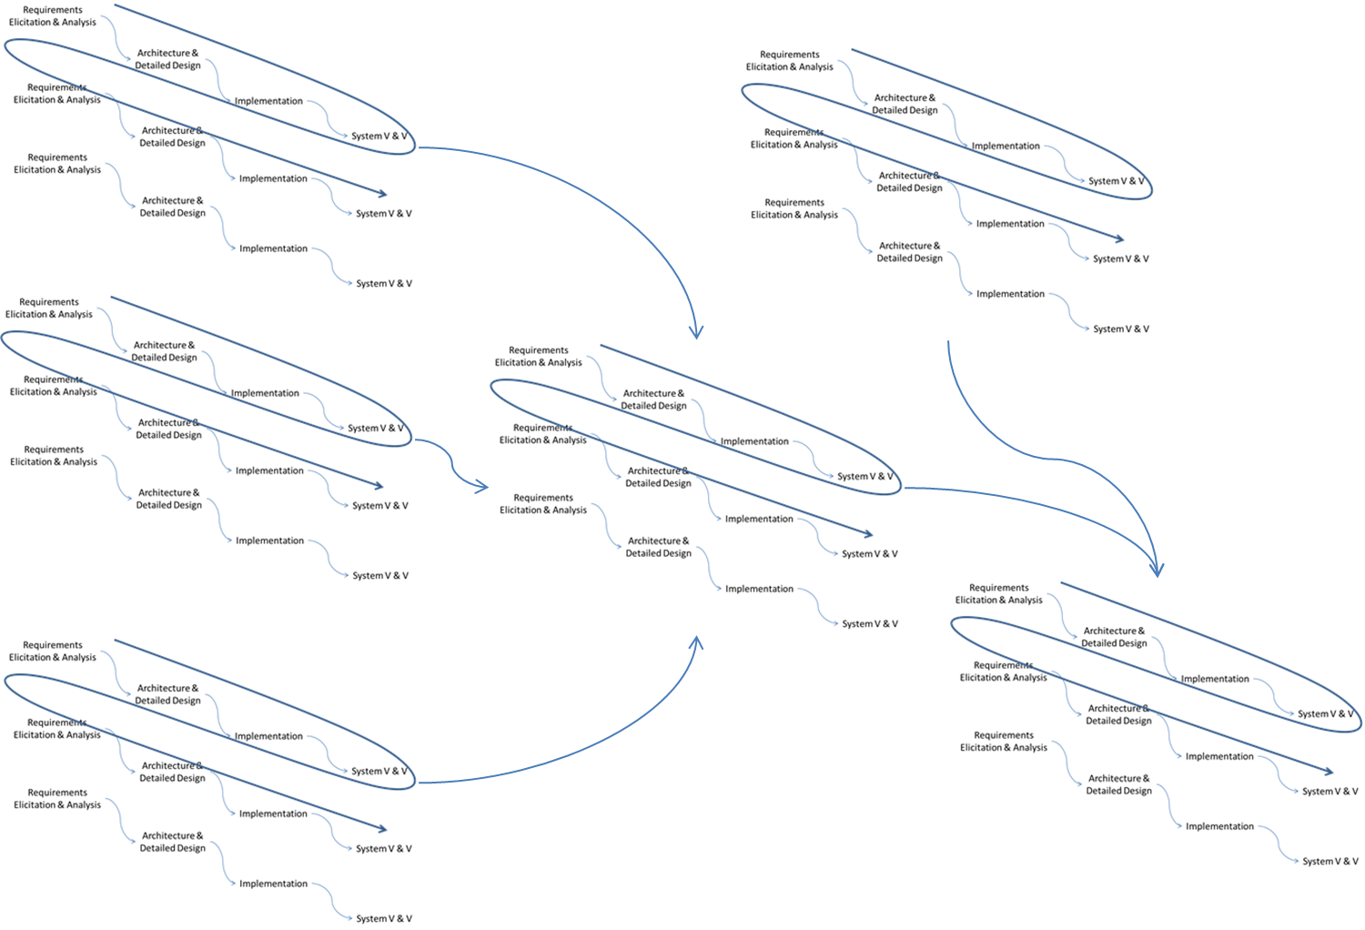
Process

Slide 27
Agile
Individuals and interactions over Processes and tools
Working software over Comprehensive documentation
Customer collaboration over Contract negotiation
Responding to change over Following a plan
That is, while there is value in the items on the right, we value the items on the left more.

Slide 28
Kanban
It uses a work-in-progress limited pull system as the core mechanism to expose system operation (or process) problems and stimulate collaboration to continuously improve the system. It is rooted in four basic principles:
Start with existing process
Agree to pursue incremental, evolutionary change
Respect the current process, roles, responsibilities and titles
Leadership at all levels

Slide 29
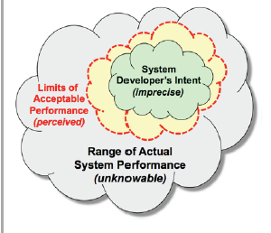
CAS

Slide 30
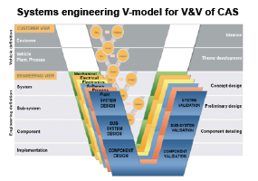
V model

Slide 31
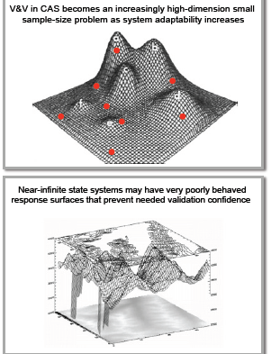
Increasing complexity in V&V

Slide 32
Car
OBD
Phone
Cloud

