Slide 1

CPSC 371
John D. McGregor
Session 4
Domain Analysis

Slide 2


Slide 3


Slide 4
Definition
Domain analysis is an examination of the broader set of ideas within which the problem is framed.
The process by which a software engineer learns enough background information so that he or she can understand the problem and make good decisions during requirements analysis and other stages of the software engineering process

Slide 5
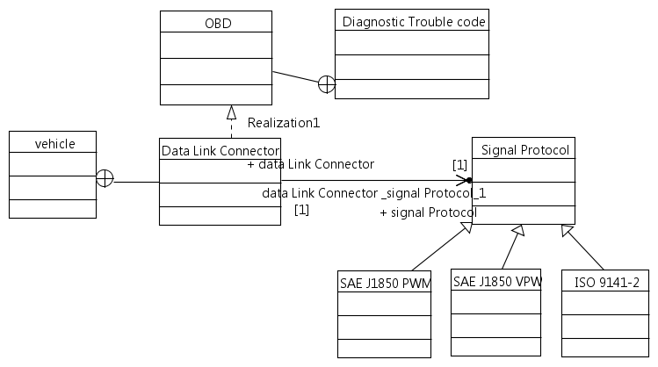
UML/SysML Class Diagram

Slide 6
UML
http://www.sparxsystems.com/resources/uml2_tutorial/index.html
Structural modeling
  Class diagram
Behavioral modeling
  Use cases

Slide 7
UML - relationships
Association – the two elements are related in some way; one person calls another via telephone
Aggregation – a collection of objects; the books in a library
Composition – one element is an assembly of elements; a car has brakes, steering wheel, etc

Slide 8
Context diagram
Scope of the system
In SysML use an inner block diagram
Or just a big circle with items inside the circle and outside
OBD I
laptop
OBD II
wireless
wifi
bluetooth
Cell phone
Insurance rating system

Slide 9
What are the objects in the domain?
Domain is larger than the context
In particular OBDI and OBD II have things in common
But only OBD II is in the product

Slide 10
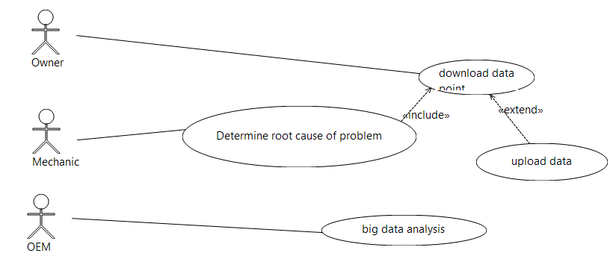
Use cases

Slide 11
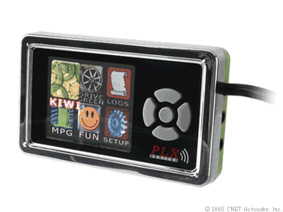
OBD products
http://www.devtoaster.com/products/rev/
http://www.obdkey.com/wifi/index.asp
http://www.cnet.com/products/plx-kiwi-bluetooth/

Slide 12
Rev Features
Vehicle Speed
RPM
Fuel Consumption*
Engine Coolant Temp
Fuel Pressure
Calculated Engine Load
Throttle Position
Intake Manifold Pressure
Air Intake Temp
Timing Advance
Mass Air Flow
Fuel Level
Barometric Pressure
EVAP System Vapor Pressure
Fuel Trim
Boost**

Slide 13
What are the objects in the domain?

Slide 14
featureIDE install
http://wwwiti.cs.uni-magdeburg.de/iti_db/research/featureide/deploy/
Reading assignments:
FODA report on course web page and
http://www.cs.cmu.edu/~ckaestne/pdf/gttse11.pdf

Slide 15
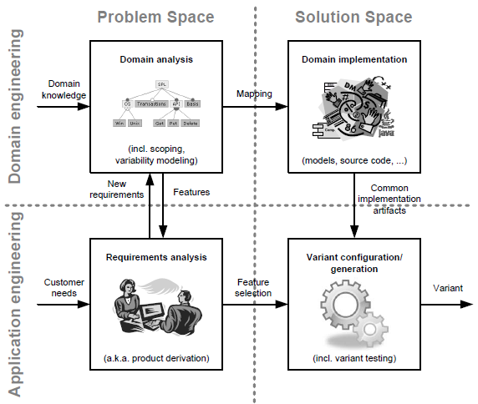
The landscape

Slide 16
Not just “one off”
In today’s markets we plan for multiple products at the same time
Variations such as
  Different OS – windows, linux, android
  Different levels – community, pro, enterprise
  Different capabilities – not allowed to modify,…

Slide 17
Software product line
http://www.pure-systems.com/fileadmin/downloads/pure-variants/tutorials/SPLWithFeatureModelling.pdf

Slide 18
Assignment
Identify features for the product
Use the use cases to identify features
Submit feature model and revised use cases
Submit via email by midnight Sept 8

