Slide 1

CPSC 371
John D. McGregor
Session 5
Domain Analysis, cont’d

Slide 2
featureIDE install
http://wwwiti.cs.uni-magdeburg.de/iti_db/research/featureide/deploy/
Reading assignments:
FODA report on course web page and
http://www.cs.cmu.edu/~ckaestne/pdf/gttse11.pdf

Slide 3
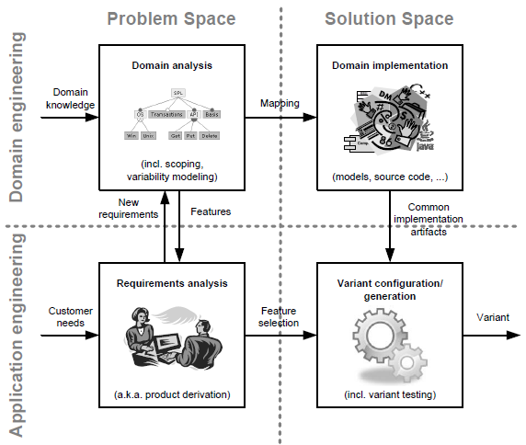
The landscape

Slide 4
Not just “one off”
In today’s markets we plan for multiple products at the same time
Variations such as
Different OS – windows, linux, android
Different levels – community, pro, enterprise
Different capabilities – not allowed to modify,…

Slide 5
Software product line
http://www.pure-systems.com/fileadmin/downloads/pure-variants/tutorials/SPLWithFeatureModelling.pdf

Slide 6
FODA
Context analysis
Look at other systems that are in the same domain?
Domain analysis
What are the concepts in these products
Commonality/variability
Architectural analysis

Slide 7
Domain systems
http://www.devtoaster.com/products/rev/
http://www.obdkey.com/wifi/index.asp
http://www.cnet.com/products/plx-kiwi-bluetooth/

Slide 8
Context diagram

Slide 9
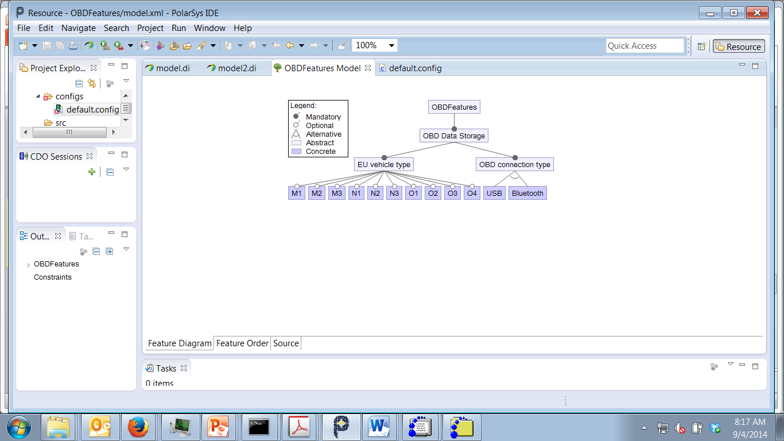
Feature model

Slide 10
Assignment
Identify features for the product
Use the use cases to identify features
Use the similar systems to identify features
Submit feature model and revised use cases
Submit via email by 11:59PM Sept 10

