Slide 1

CPSC 371
John D. McGregor
Session 6
Domain Analysis, cont’d

Slide 2
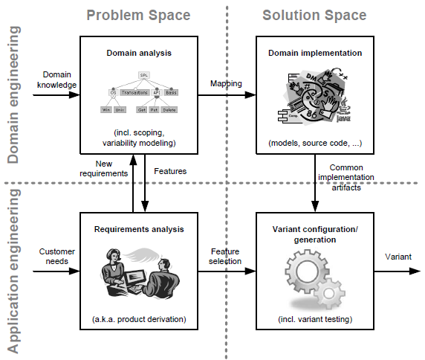
The landscape

Slide 3
Comparable products
http://www.devtoaster.com/products/rev/
http://www.obdkey.com/wifi/index.asp
http://www.cnet.com/products/plx-kiwi-bluetooth/

Slide 4
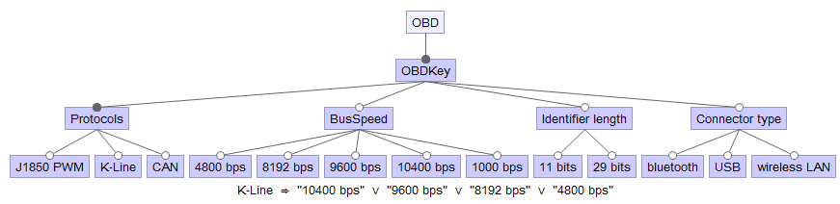

Slide 5
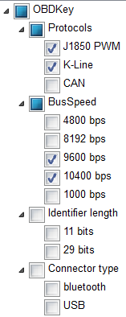

Slide 6
Variation
What
How much when
When (later is better but more expensive)

Slide 7
Assignment
Create feature models for 2 products
Revise your feature model to address any new features you found in the products
Submit via email by 11:59PM Sept 22nd

Slide 8
Process
The set of activities needed to accomplish a task is a “process.”
Sometimes it’s a good process and sometimes not
A good process is
Well-defined
Repeatable
Improvable

Slide 9
Process models
Agile
Iterative, incremental
Waterfall

Slide 10
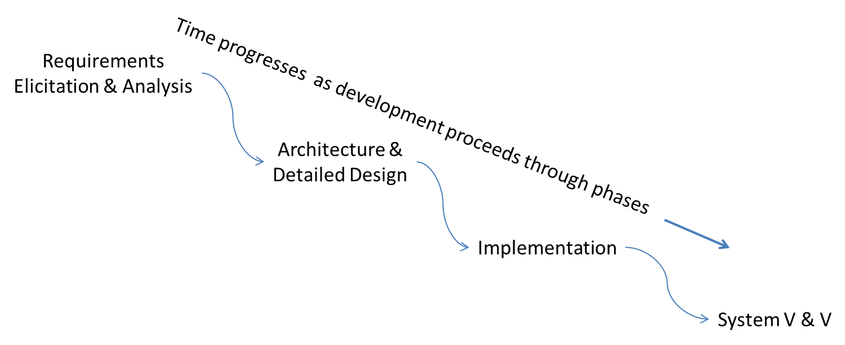
An iteration

Slide 11
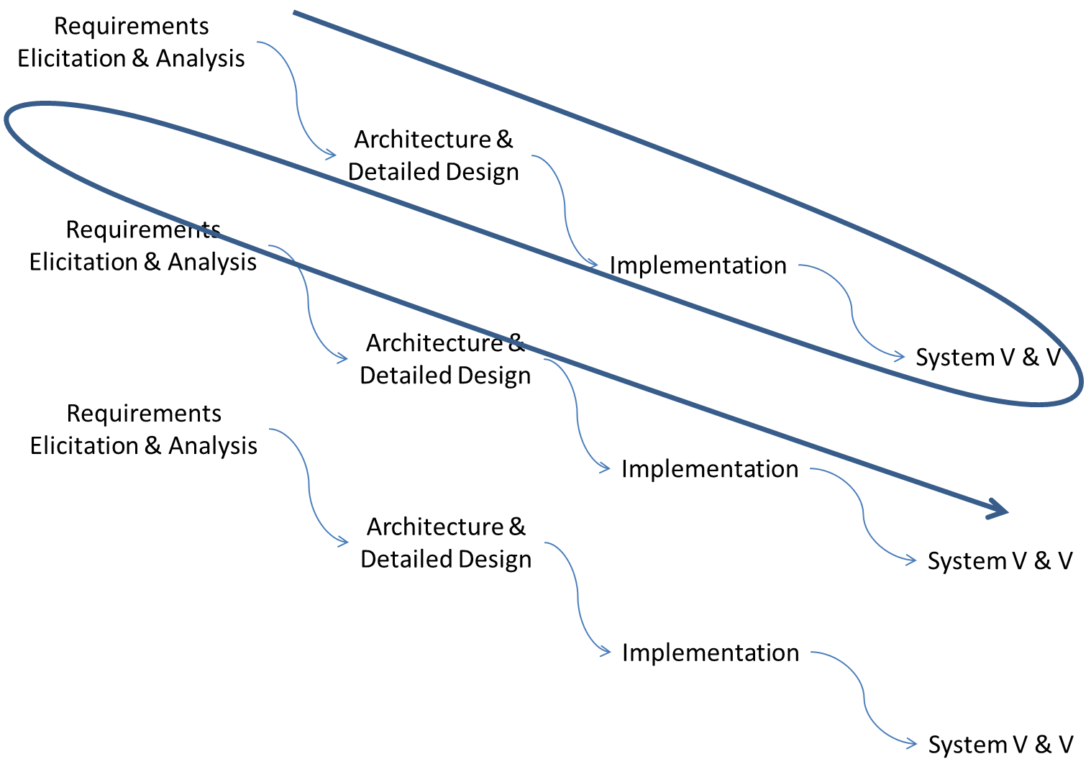
Multiple iterations

Slide 12
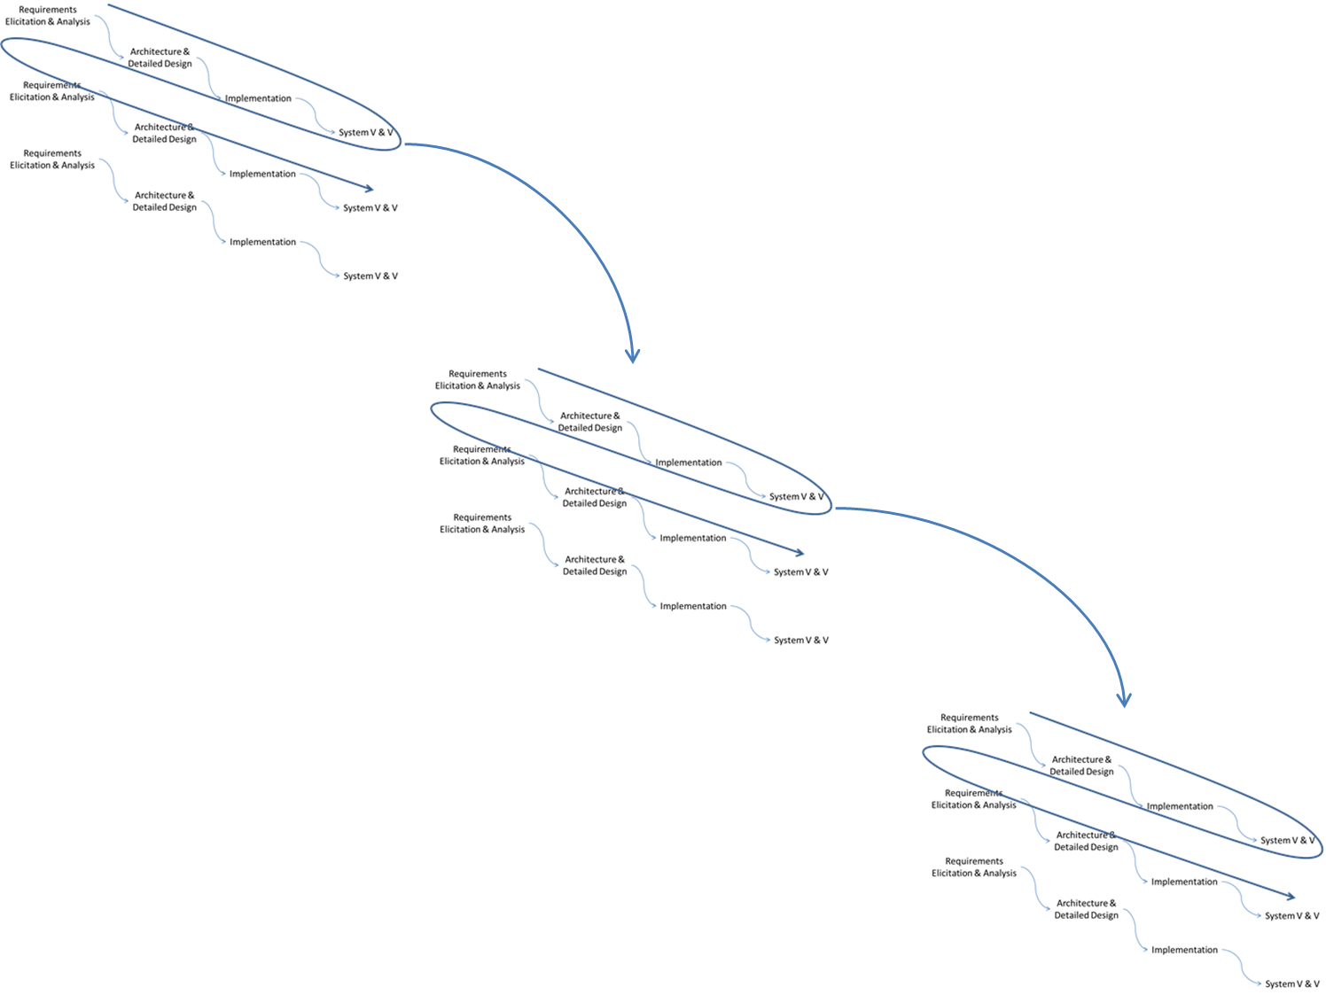
Multiple increments

Slide 13
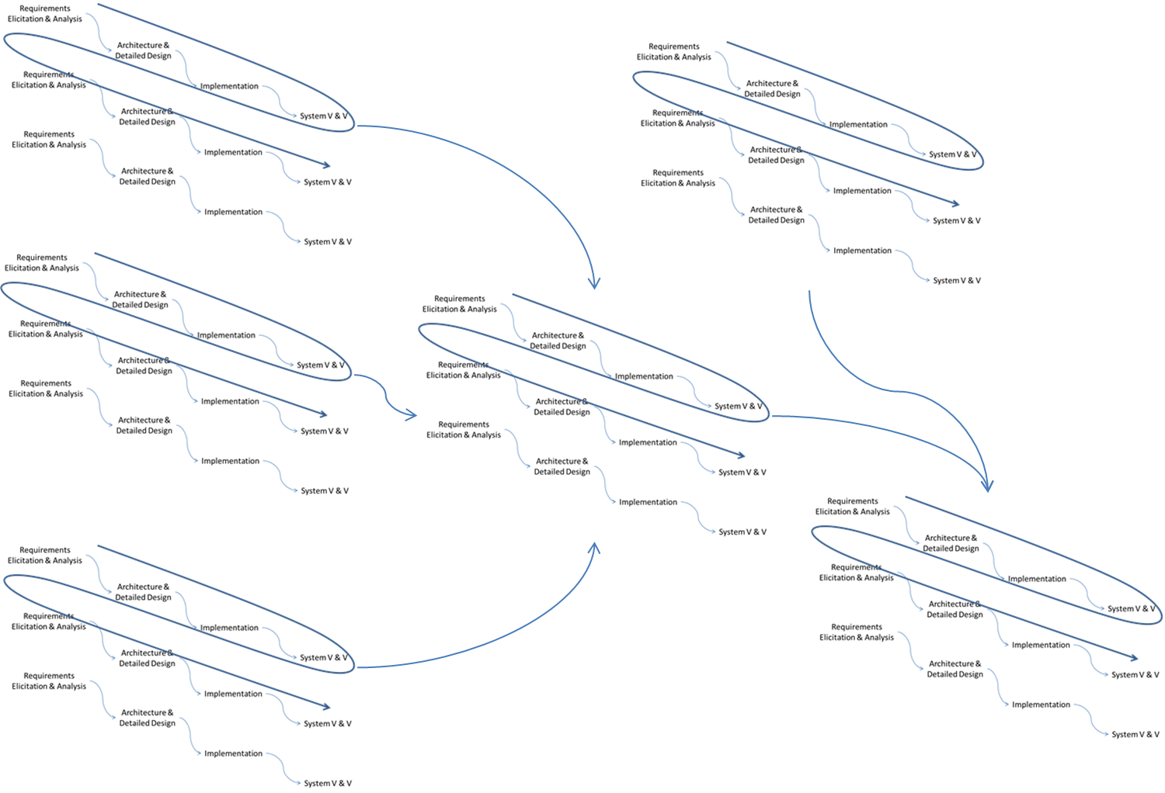
Concurrent increments

Slide 14
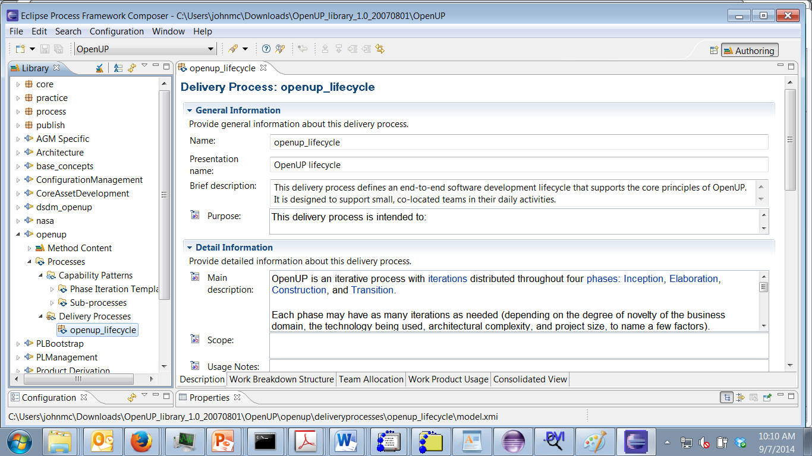
EPF and OpenUp

Slide 15
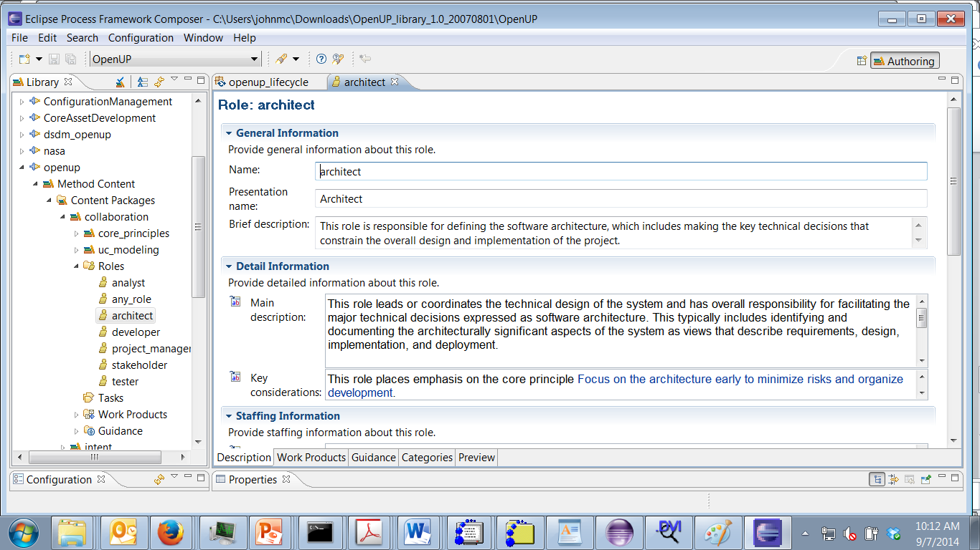
Roles

Slide 16
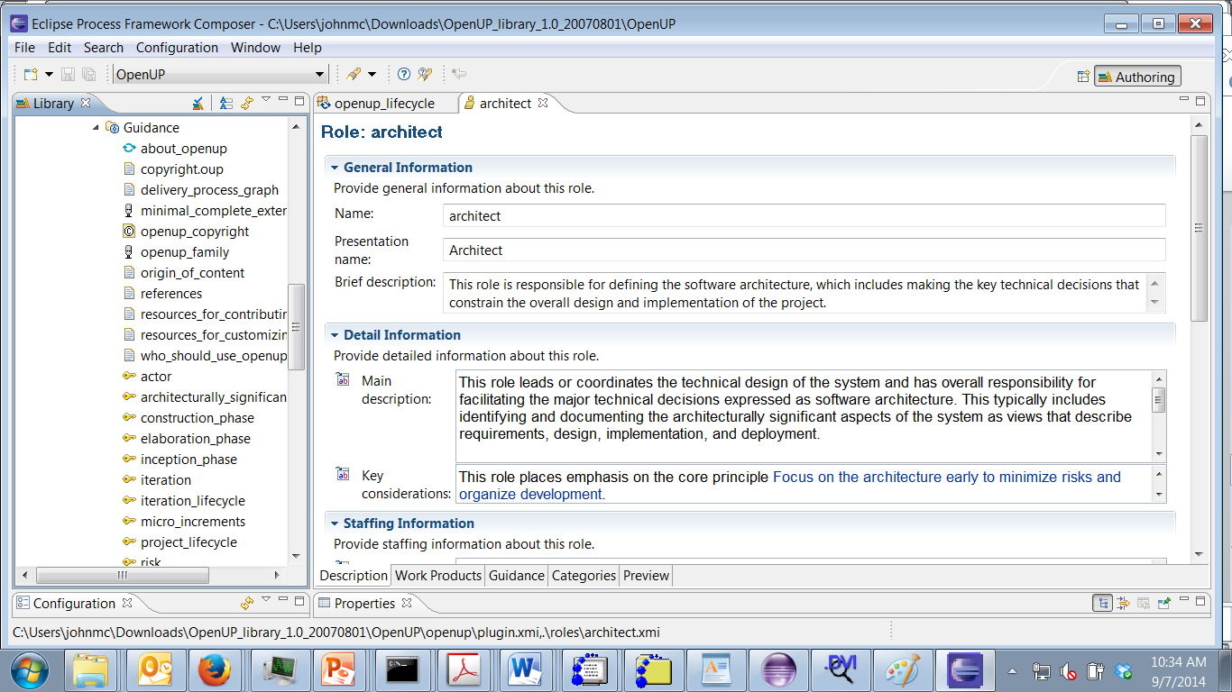
Guidance

Slide 17
Why do we care?
Because the domain affects the process and vice versa
Rapid change in content supports an agile approach
Emerging research ideas support iterative, incremental

Slide 18
Wrapping up domain analysis
Read chapters 2,3,4
http://www.frapu.de/pdf/PESOA_TR_9-2004.pdf

Slide 19
Looking to the product
http://www.infoq.com/articles/ddd-in-practice

Slide 20
Assignment
Capture the domain analysis activities and process in EPF
Be ready to present on Sept 23rd
Export a plugin
Submit via email by 11:59PM Sept 22nd

