Slide 1

CPSC 371
John D. McGregor
Session 7
Business Models

Slide 2
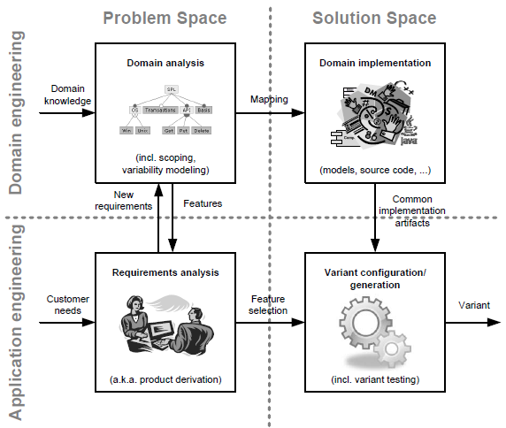
The landscape

Slide 3
Comparable products
http://www.devtoaster.com/products/rev/
http://www.obdkey.com/wifi/index.asp
http://www.cnet.com/products/plx-kiwi-bluetooth/

Slide 4
Value chain
How will we deliver value to customers?
OBD to cell phone is a local app that uses bluetooth or USB
The cell phone is the driver so the operating company is the principal capturer of value
Cell phone to cloud is wireless/cellular connection so again the operator is in control
Cloud provider captures value in storage fees

Slide 5
Value chain
Value to customer
  Reduced insurance rates
  Peace of mind about teenage driver
Value to company
  Sell the OBD module?
  Charge for connection to cloud?
  Charge for storage?
  Charge for computation services?
  Charge for comparative analysis?

Slide 6
Business model
purpose,
business process,
target customers,
offerings,
strategies,
infrastructure,
organizational structures,
trading practices, and
operational processes and policies.

Slide 7
Generic models
Delivery models
  SaaS – software as a service
  PaaS – platform as a service
  IaaS – infrastructure as a service
  Download installer/zip
  Hard media

Slide 8
Generic models - 2
Revenue models
  Subscription
  Lease
  Open source
  Indirect – ads vs content
  Usage based

Slide 9
http://www.slideshare.net/apigee/platform-strategy-ecosystems-31490316?related=1

Slide 10
Why do we care?
Because the business model affects the structure of the system and how we deliver value to customers
A rapidly changing domain that is happy with approximations needs frequent releases
A more slowly changing domain that requires accuracy needs more careful attention before a release.

Slide 11
Read the article
http://www.infoq.com/articles/ddd-in-practice

Slide 12
Assignment
Read the requirements elicitation piece from the course resources page
Read pages 1 – 18; and the section on Elicitation via Interviewing
Develop a draft set of about 10 questions for elicitation for our product. For each question add a sentence about what will be gained from asking that question.
Be ready to interview on Sept 23rd
Submit via email by 11:59PM Sept 22nd

Slide 13
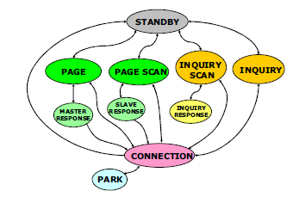
State machines
State machine for the connection manager

Slide 14
Errors
http://www.btnode.ethz.ch/static_docs/doxygen/btnut/group__Bt__Error__Codes.html

Slide 15
Choose one interface and create the state machine and error model for it
Submit pdf file via email by 11:59PM Sept 24

