Slide 1

John D. McGregor
Battery Example

Slide 2
AADL Error Annex
annex error {**
Model => My_Models::Example.Notional;
Model_Hierarchy => Error_Free when 2 ormore (S1[Error_Free],
S2[Error_Free],
S3[Error_Free],
S4[Error_Free])
and 1 orless (S1[Fail_Unknown],
S2[Fail_Unknown],
S3[Fail_Unknown],
S4[Fail_Unknown]),
Fail_Unknown when others;
Fail_1.Vote_Transition =>
S2.A_Failure_Detected[Error_Free,Bad_Data]
and S3.A_Failure_Detected[Error_Free,Bad_Data];
Fail_2.Vote_Transition =>
S1.A_Failure_Detected[Error_Free,Bad_Data]
and S3.B_Failure_Detected[Error_Free,Bad_Data];
Fail_3.Vote_Transition =>
S1.B_Failure_Detected[Error_Free,Bad_Data]
and S2.B_Failure_Detected[Error_Free,Bad_Data];
Report => Error_Free;
**};

Slide 3
Error model syntax
In AADL annexes represent additions to the basic standard
annex error model {** -- this opens use of an annex
error model SensorErrorModel – name of model
initial error state – “error” is a modifier for state
out error propagation – an out port for error returns
{Occurrence => poisson 1E-3} – poisson is a statistical distribution defining frequency of occurrence
Full model starts on next slide=>

Slide 4
Error model
package FireAlarmErrorLib
public
annex error model {**
error model SensorErrorModel
features
error free: initial error state;
unavailable, babbling: error state;
smoke detected omission: out error propagation
{Occurrence => fixed 1};
smoke detected commission: out error propagation
{Occurrence => poisson 1E-3};
fail stop, fail babble: error event;
end SensorErrorModel;

Slide 5
Error model - 2
error model implementation SensorErrorModel.Standard
transitions
error free -[fail stop]-> unavailable;
error free -[fail babble]-> babbling;
unavailable -[out smoke detected omission]->unavailable;
babbling -[out smoke detected commission]-> babbling;
end SensorErrorModel.Standard;
. . .
**};
end FireAlarmErrorLib;

Slide 6
Extended example
http://comjnl.oxfordjournals.org/content/early/2010/03/17/comjnl.bxq024.full.pdf+html

Slide 7
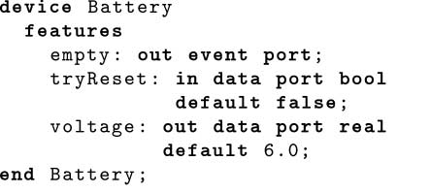
Extended example - 2

Slide 8
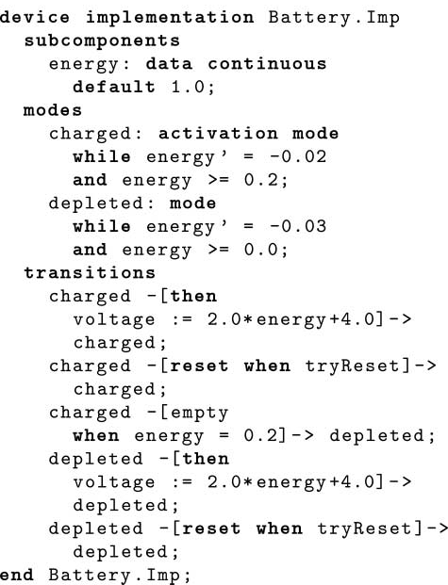
Extended example - 3

Slide 9
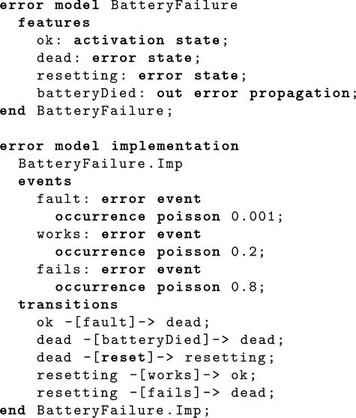
Extended example - 4

