Slide 1
Example diagrams

Slide 2
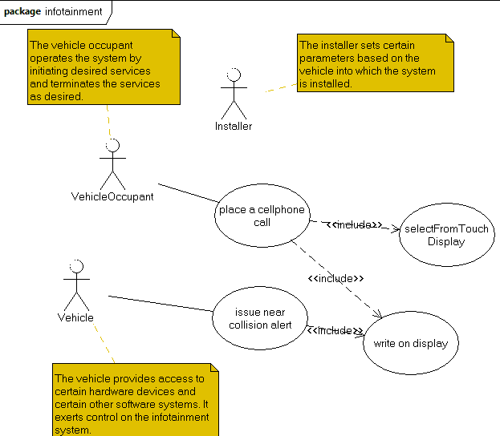

Slide 3
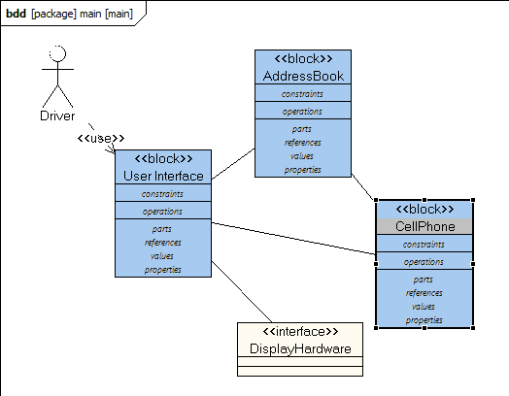

Slide 4
