Slide 1

CPSC 372
John D. McGregor
Module 0 Session 1
Introduction

Slide 2
Course Checklist
Read the syllabus
Visit my website www.cs.clemson.edu/~johnmc and the course’s site under that
Load software – more shortly
Read: http://www.computer.org/portal/web/swebok/html/ch1#Ref1

Slide 3
Introduction
Software engineering - The application of a systematic, disciplined, quantifiable approach to the development, operation, and maintenance of software; that is, the application of engineering to software.

Slide 4
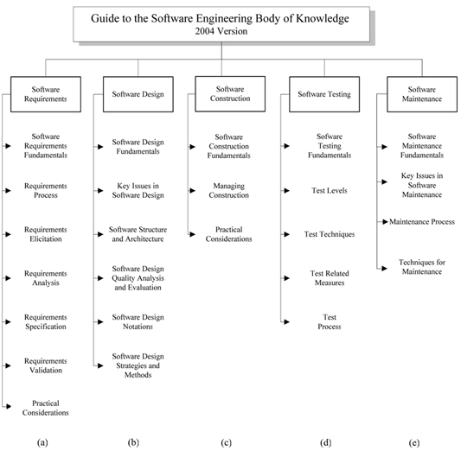
Content of SweBok

Slide 5
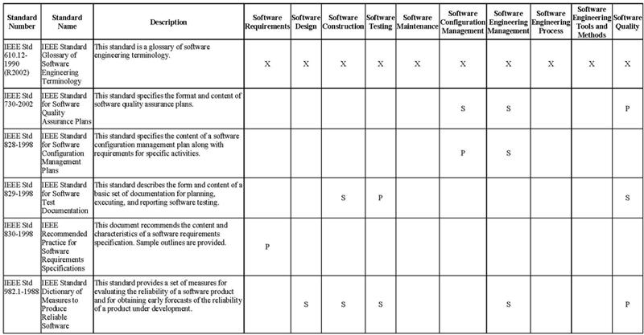
Standards vs Practice areas
SweBok Appendix 3 has complete set

Slide 6
Related disciplines
Computer engineering
Computer science
Management
Mathematics
Project management
Quality management
Software ergonomics
Systems engineering

Slide 7
What’s different

Slide 8
Science and Engineering
Science
Basic knowledge about a domain
Physics
Action/reaction
Engineering
Solving problems by applying basic knowledge
Aeronautical engineering
lift

Slide 9
Software engineering vs computer science
Computer science
Basic knowledge about computation
What can be computed using a Turing machine?
Software engineering
Solving computational problems by applying basic knowledge
Identifying specific needs that can be solved computationally

Slide 10
Software engineers
Apply basic knowledge
  Halstead’s software science
Develop and adhere to standards
  ISO/ANSI/SAE standards
Accept responsibility for their decisions
  Sign off for architectural decisions
Cooperate with others to solve problems
  Work in teams and teams of teams

Slide 11
People in software
Computer scientists
  Relatively small group
Software engineers
  Rapidly growing group
Programmers
  Legacy of code writers
Hackers
  Anyone can buy a compiler
Computer software engineers are
among the occupations projected to
grow the fastest and add the most
new jobs over the 2008-18 decade,
resulting in excellent job prospects.
Employment of computer programmers
is expected to decline by 3 percent
through 2018.

Slide 12
Engineering a product
Solve the problem correctly
Solve it effectively, according to existing standards
Solve it completely, including error conditions.
Solve it efficiently, using smallest amount of resources to achieve maximum in quality

Slide 13
Types of systems
Embedded real-time system
Interactive, GUI-based system
3 to 4 tier ecommerce system
Batch processing system
Service-oriented

Slide 14
Types of systems
Life critical
Mission critical
Strategic
Tactical

Slide 15
If we make a mistake …
June 4, 1996 -- Ariane 5 Flight 501. Working code for the Ariane 4 rocket is reused in the Ariane 5, but the Ariane 5's faster engines trigger a bug in an arithmetic routine inside the rocket's flight computer. The error is in the code that converts a 64-bit floating-point number to a 16-bit signed integer. The faster engines cause the 64-bit numbers to be larger in the Ariane 5 than in the Ariane 4, triggering an overflow condition that results in the flight computer crashing.
First Flight 501's backup computer crashes, followed 0.05 seconds later by a crash of the primary computer. As a result of these crashed computers, the rocket's primary processor overpowers the rocket's engines and causes the rocket to disintegrate 40 seconds after launch.

Slide 16
Software engineering trends
Time to market shortened
Driven by specific qualities
  Usability
  Modifiability
  Reliability
Iterative, incremental process model
Ubiquitous and mission critical

Slide 17
Iterative, incremental process
Process – a defined set of activities that lead from a problem to a working software solution
Iterative – successive passes through a short set of activities
Incremental – a small portion of the system is built at a time. Increments are selected to have always running software.

Slide 18
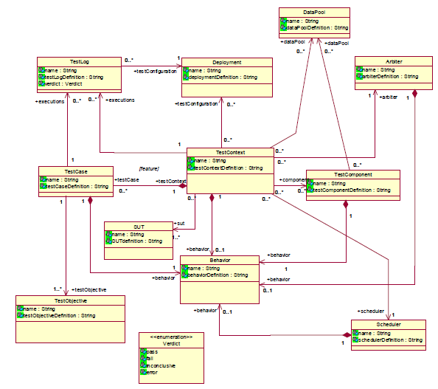
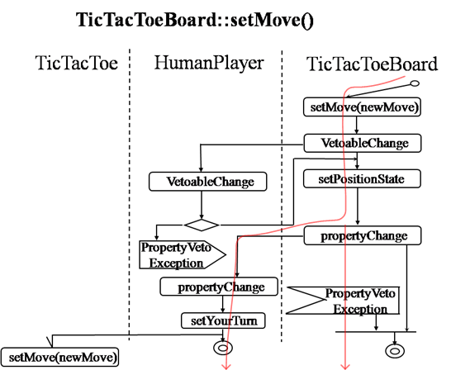
Model-driven
Class diagram – concepts in domain
Activity diagram – detailed algorithms

Slide 19
Use cases
Each “actor” is a user of the system.
Each oval is a use of the system.
These illustrate the behaviors of the system.
Optional AND
.1
real Human Player
Player selects to install the optional scoreboard feature
.2
.7
Player selects the Bowling
feature to play
.1
<<include>>.
<<include>>.
Player plays until all frames
are completed.
Player selects the Brickles
feature to play
<<include>>.
.35
Player selects a next move.
.35
Player plays until all
pucks are used.
.2
<<include>>.
Player plays until all
Bricks are used.
Player selects the Pong feature
to play.
Player checks score periodically
on the scoreboard
Player plays until all pucks are used up.

Slide 20
Summary
This semester we will explore the practices of software engineering.
We will study but we will also practice.
Get ready to “do” software engineering.

Slide 21
Infrastructure
Install Topcased: www.topcased.org
http://www.topcased.org/index.php?documentsSynthesis=y&Itemid=59
Go through the first tutorial under Documents

