Slide 1

CPSC 372
John D. McGregor
Module 1 Session 2
Process Measurement

Slide 2
What do you mean by…
Quality
Productivity
Time to market
Maintainability

Slide 3
What do you mean by…
Quality – number of faults that reach the customer
Productivity – lines of code (KLOC)
Time to market – from first requirements meeting to customer acceptance – calendar days
Maintainability – person days required to make a specified change

Slide 4
What do you mean by…
We don’t know what a term means until we can quantify it.
Most of our measurements are relative to our own previous measurements
Don’t argue about definitions such as how to count lines of code
Just use the same definition consistently

Slide 5
Process improvement
Collect sufficient information
Compare against previous measurements
Identify trends in wrong direction – increased number of faults reaching clients

Slide 6
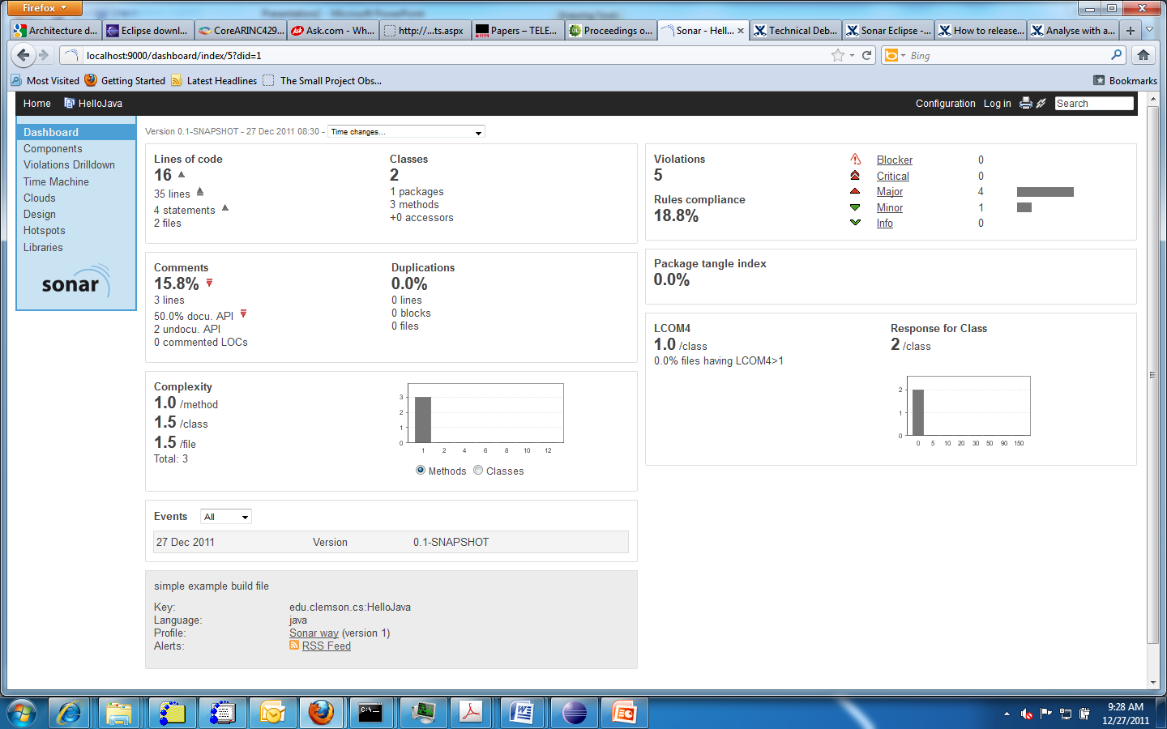
Sonar introduction

Slide 7
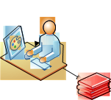
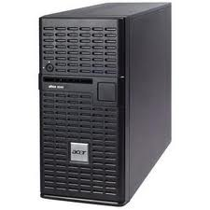
Sonar system architecture
Sonar has a server
that performs the analyses
Sonar client runs in browser
Sonar client runs in Eclipse
Sonar client runs from command line
The server may be for a project or a company.

Slide 8
Installation
Install server on your machine
Install the Eclipse plug-in into your Topcased setup
When a new Eclipse project is created, associate it with Sonar
Create Users in sonar
Assign Users to projects

Slide 9
Downloads
Download sonar from http://www.sonarsource.org/
Download eclipse plugin http://docs.codehaus.org/display/SONAR/Sonar+Eclipse/
Install according to directions

Slide 10
New project
Any new project – add the Sonar nature to the project
Login to Sonar and assign yourself as the User of the project
See “sonar bundle” on the resources page for a tutorial on installing sonar in a new project

Slide 11
Associate an Eclipse project with Sonar

Slide 12
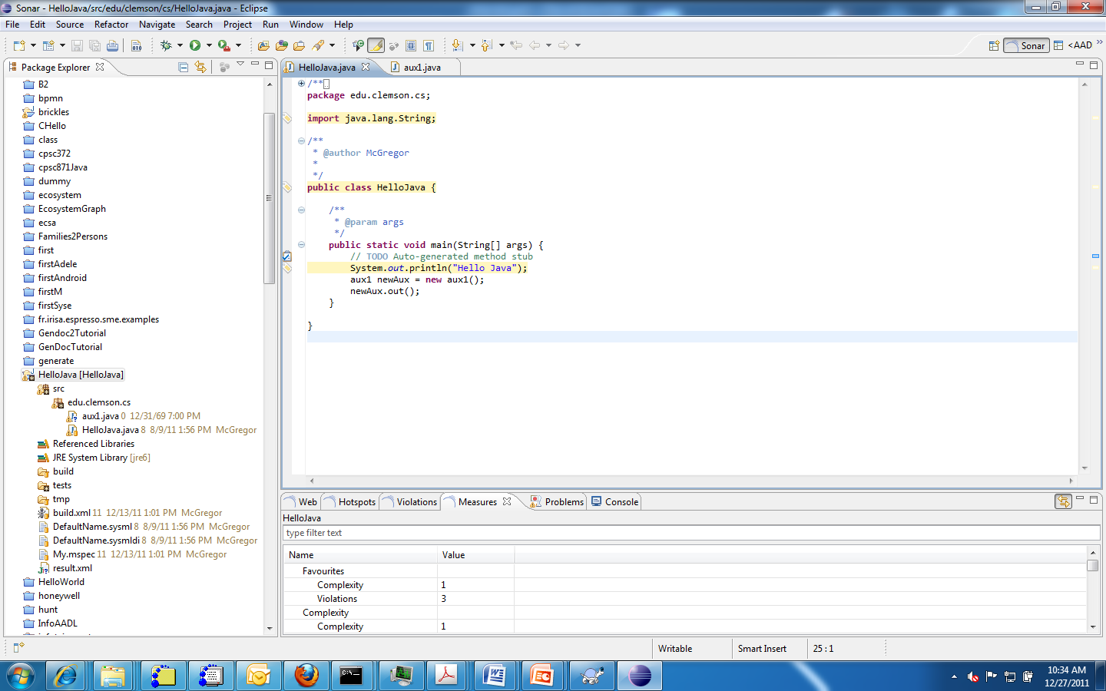
Markers appear in the source editor to indicate Sonar issues

Slide 13
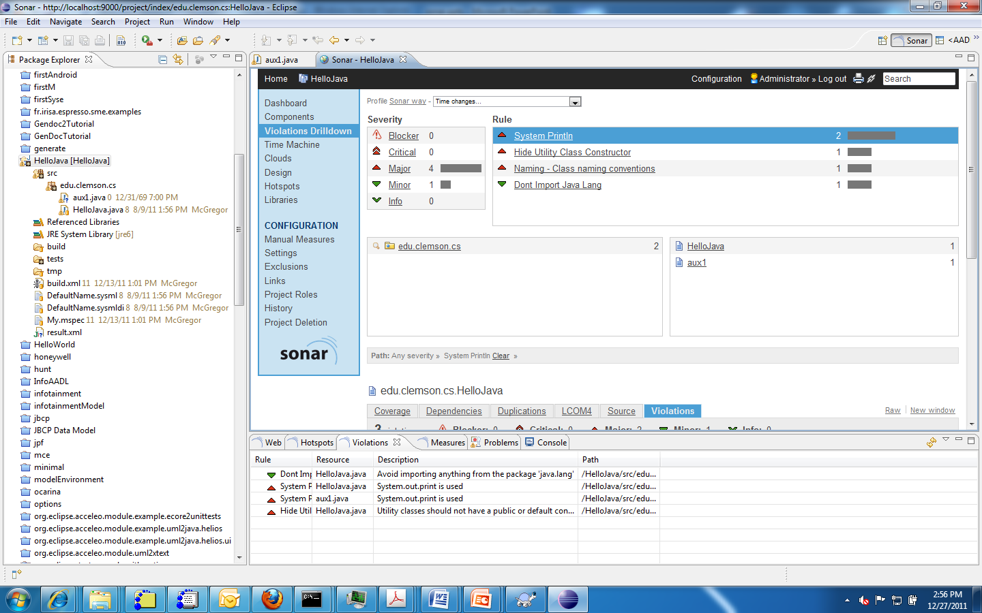
Use violation drill down to locate individual statements

Slide 14
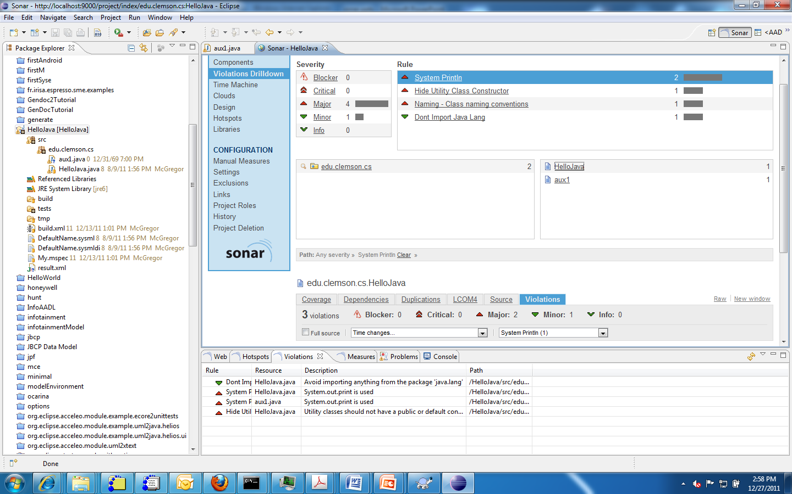
Drill down in unit

Slide 15
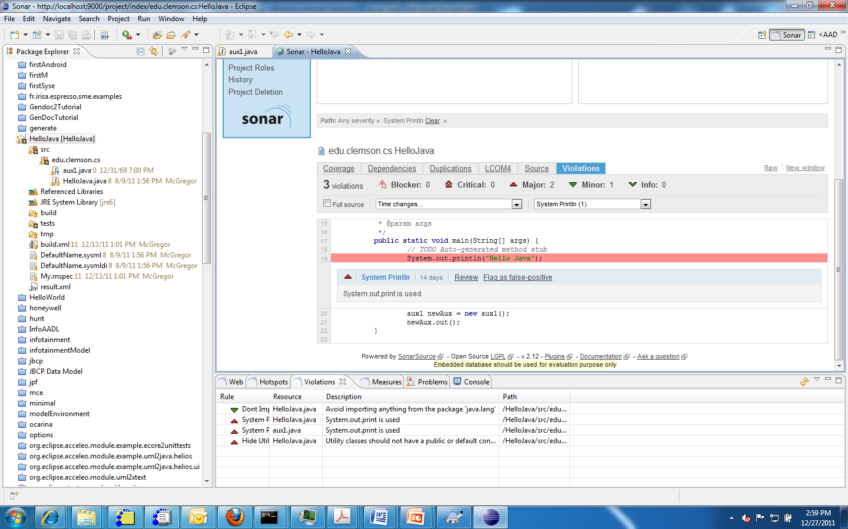
Manual Reviews

Slide 16
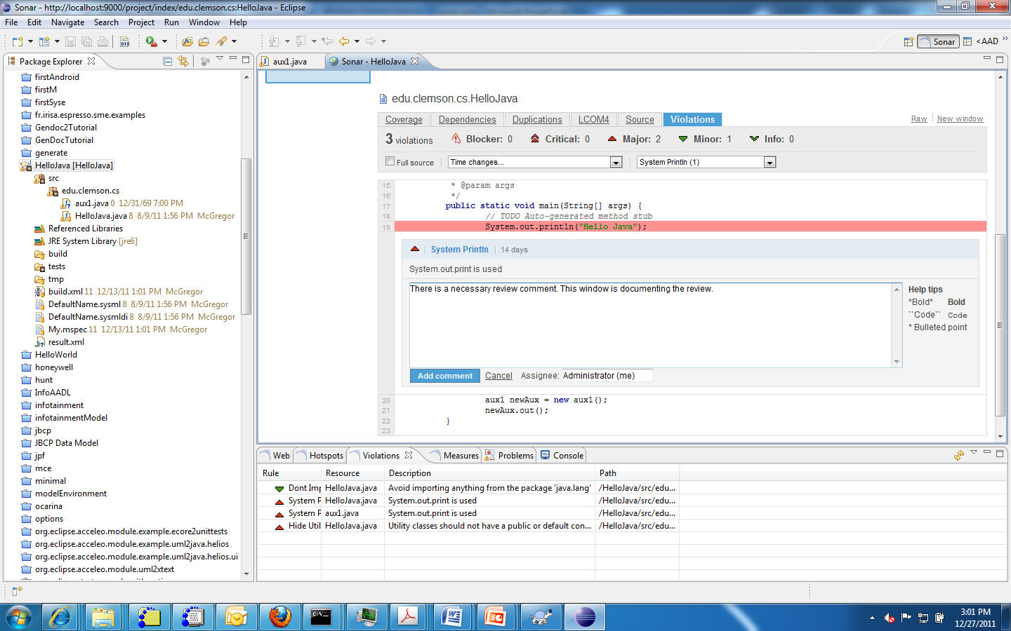
A review begins with the assignment to a reviewer and adding a comment

Slide 17
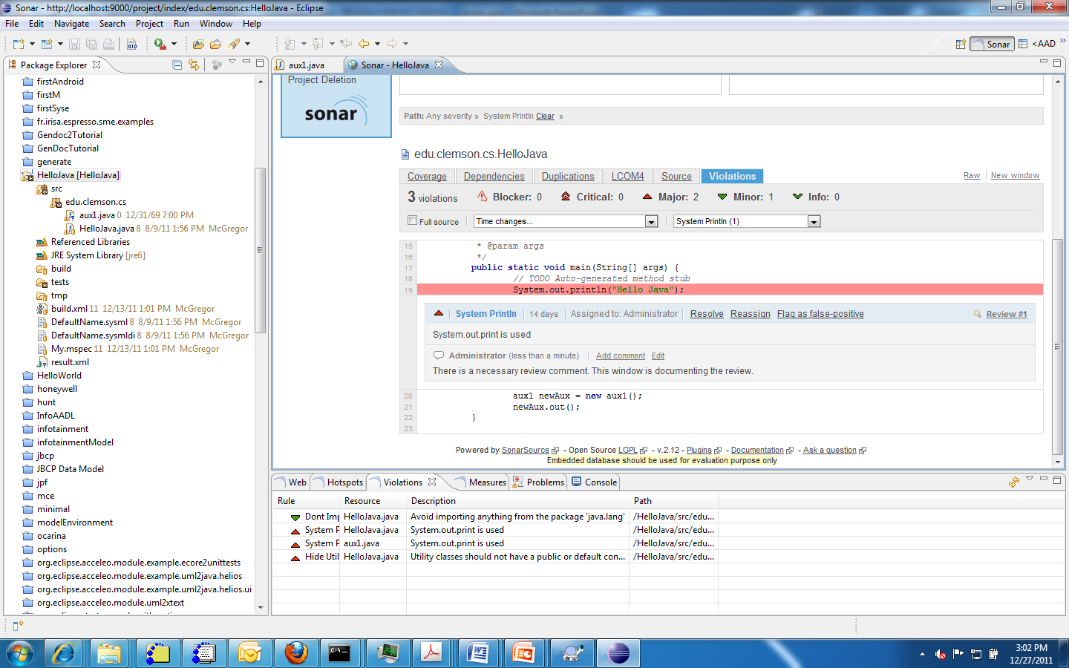
Hovering over violation brings up resolution choices
Pops up

Slide 18
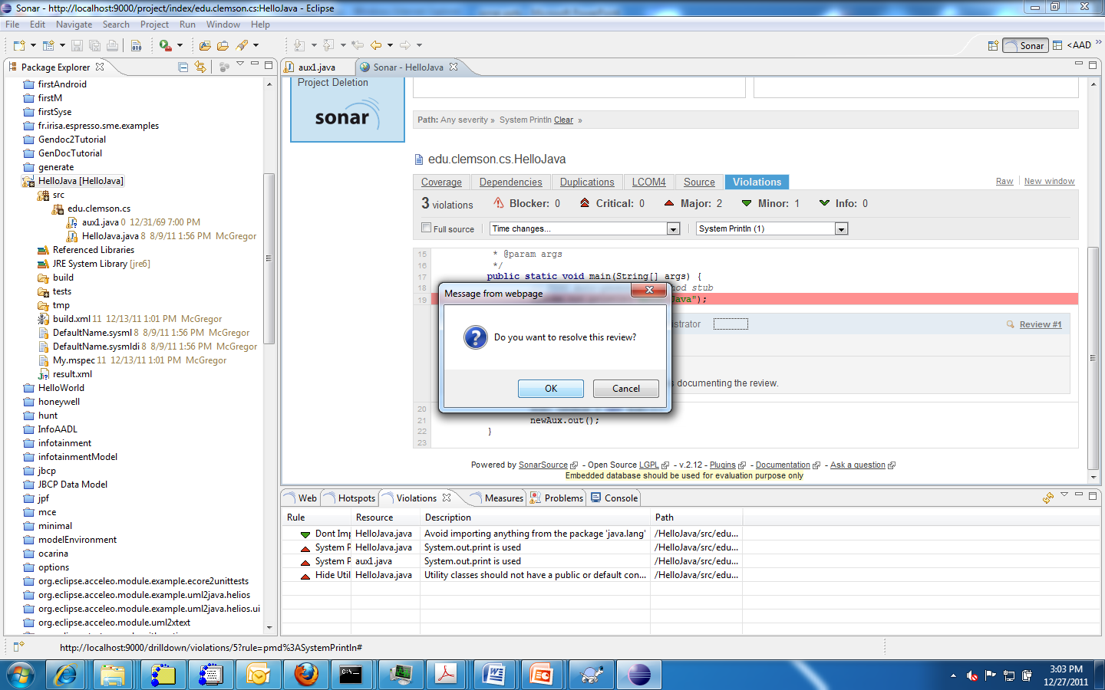
Reviewer has decided on action

Slide 19
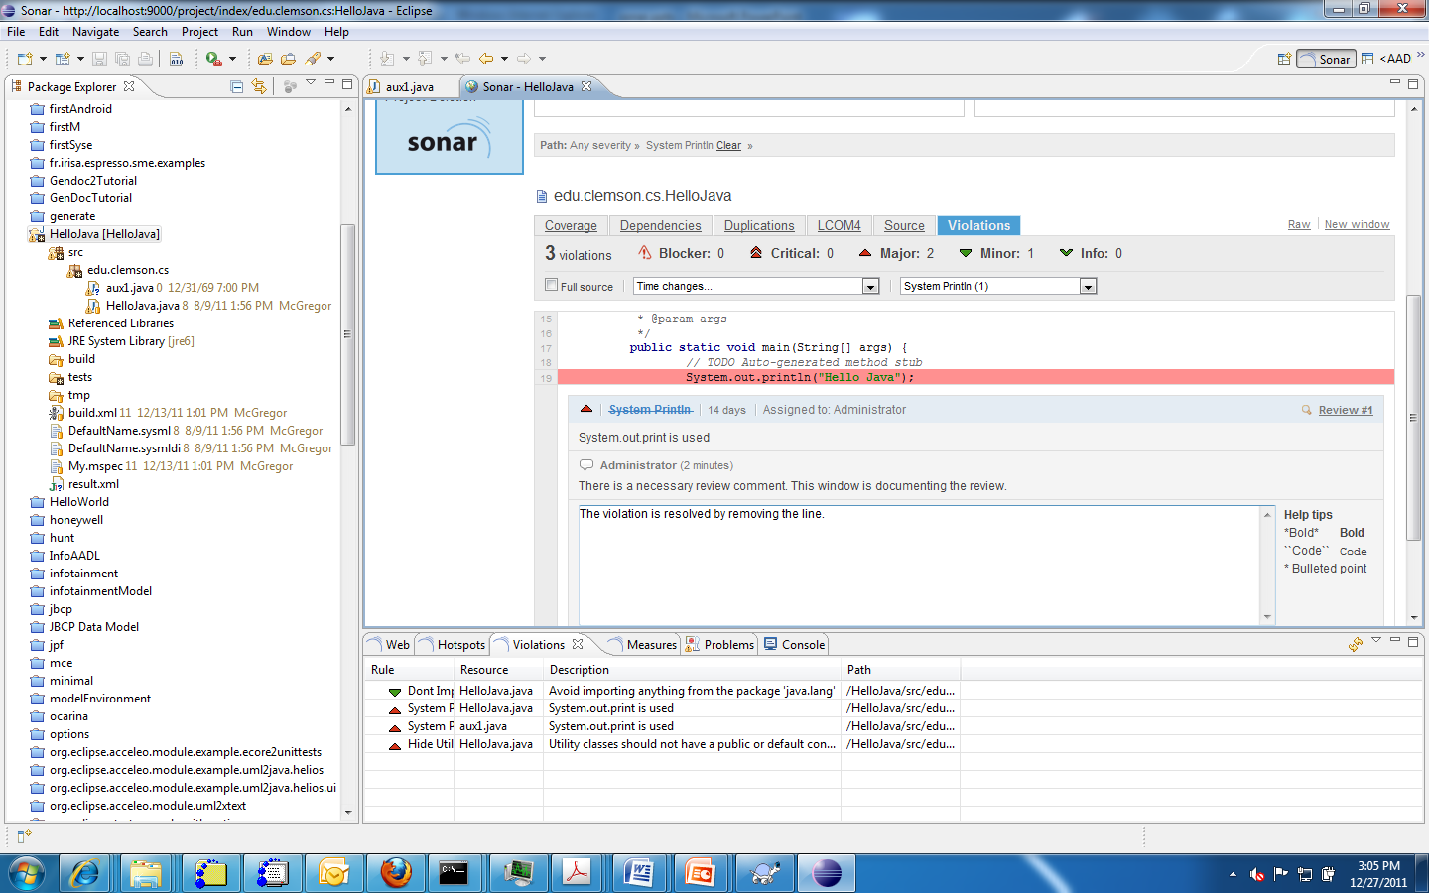
Reviewer fixes violation and adds comment.
Reviewer fixes the violation

Slide 20
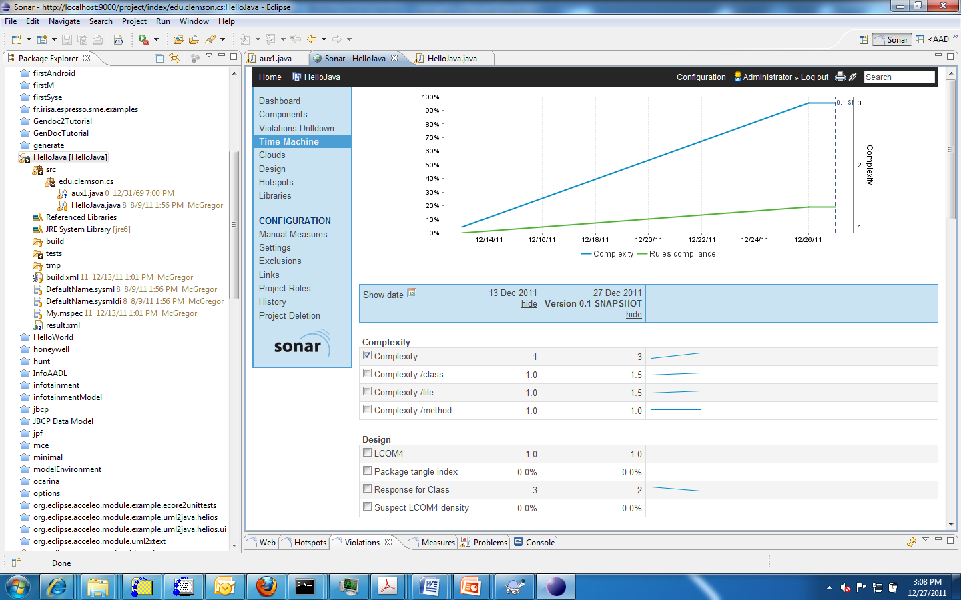
Time machine shows changes across multiple builds

Slide 21
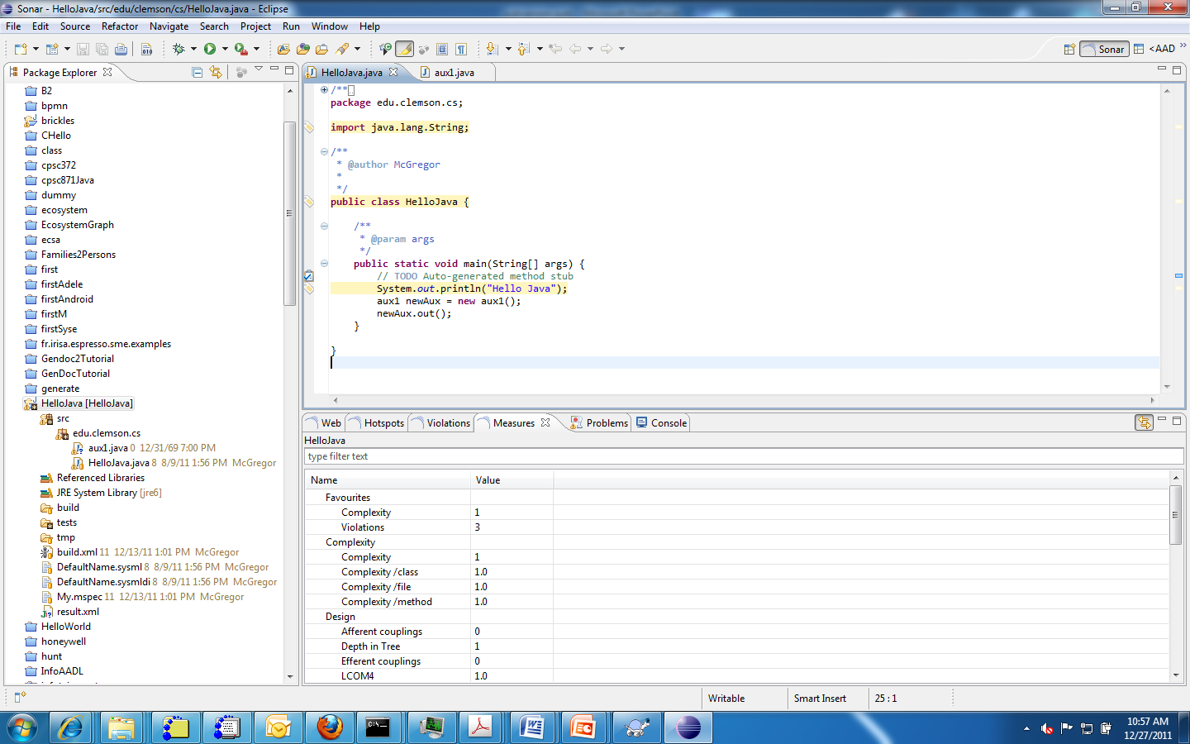
Use the Sonar perspective to open all the windows needed
The same measures as shown
In the web browser are in these
windows

Slide 22
Metrics
Sonar has a number of built-in measures that are applied to every build of the product
There are many plug-ins of additional metrics that can be added to the server.

Slide 23
Here’s what you are going to do
Download the Brickles zip from the resources page
Create a java project in topcased
Import the Brickles code into the project
Use this project with the Sonar discussion
Print a couple of screen shots of Sonar metrics pages.

