Slide 1

CPSC 372
John D. McGregor
Module 2 Session 2
Android SDK

Slide 2
Getting up to speed
In parallel to deciding the requirements for a product the team needs to gather knowledge that will be needed in the later phases of the life cycle.
In our case that means how to implement Android apps.

Slide 3
Setting up
In the first slide set I showed the urls to go to to download the SDK and install it into topcased.
Now we will walk thru some of the steps and some of the tools you will want to use.

Slide 4
Framework
Most SDKs include an Integrated Development Environment (IDE), one or more frameworks, and libraries of assets.
A framework is a partially completed application that provides structure to a standard application that can be added to and modified to produce a product more rapidly.
The libraries include classes as well as images and tools.

Slide 5
Plug-in architecture
The plug-in architecture of Eclipse allows the IDE to be extended in many ways.
The Android plug-in adds menu items, help items, perspectives and views to the standard Eclipse setup.
More about architecture later.

Slide 6
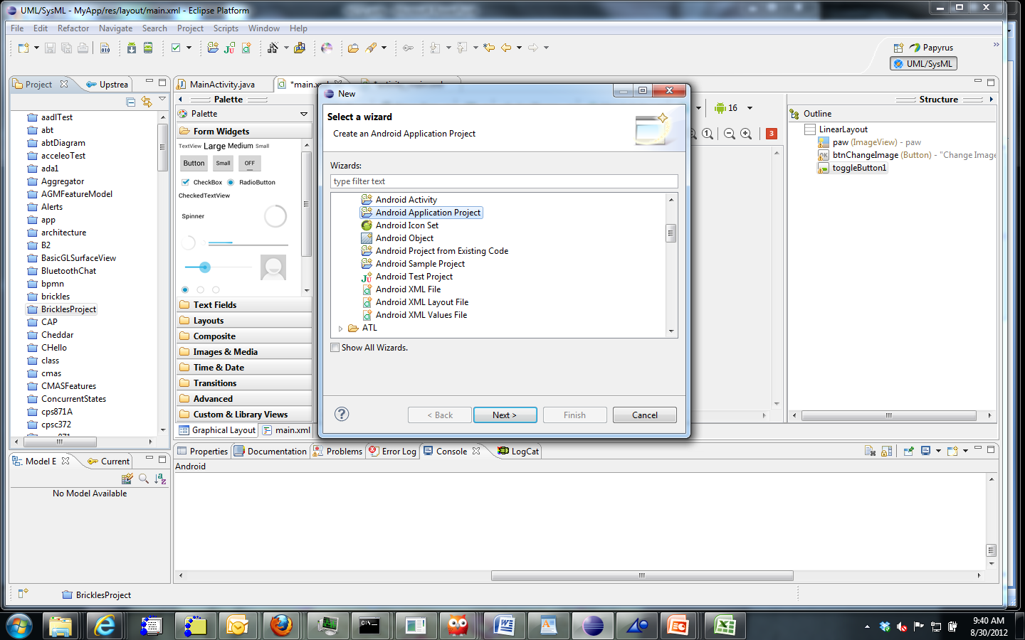
File | New | Android | Android Application Project

Slide 7
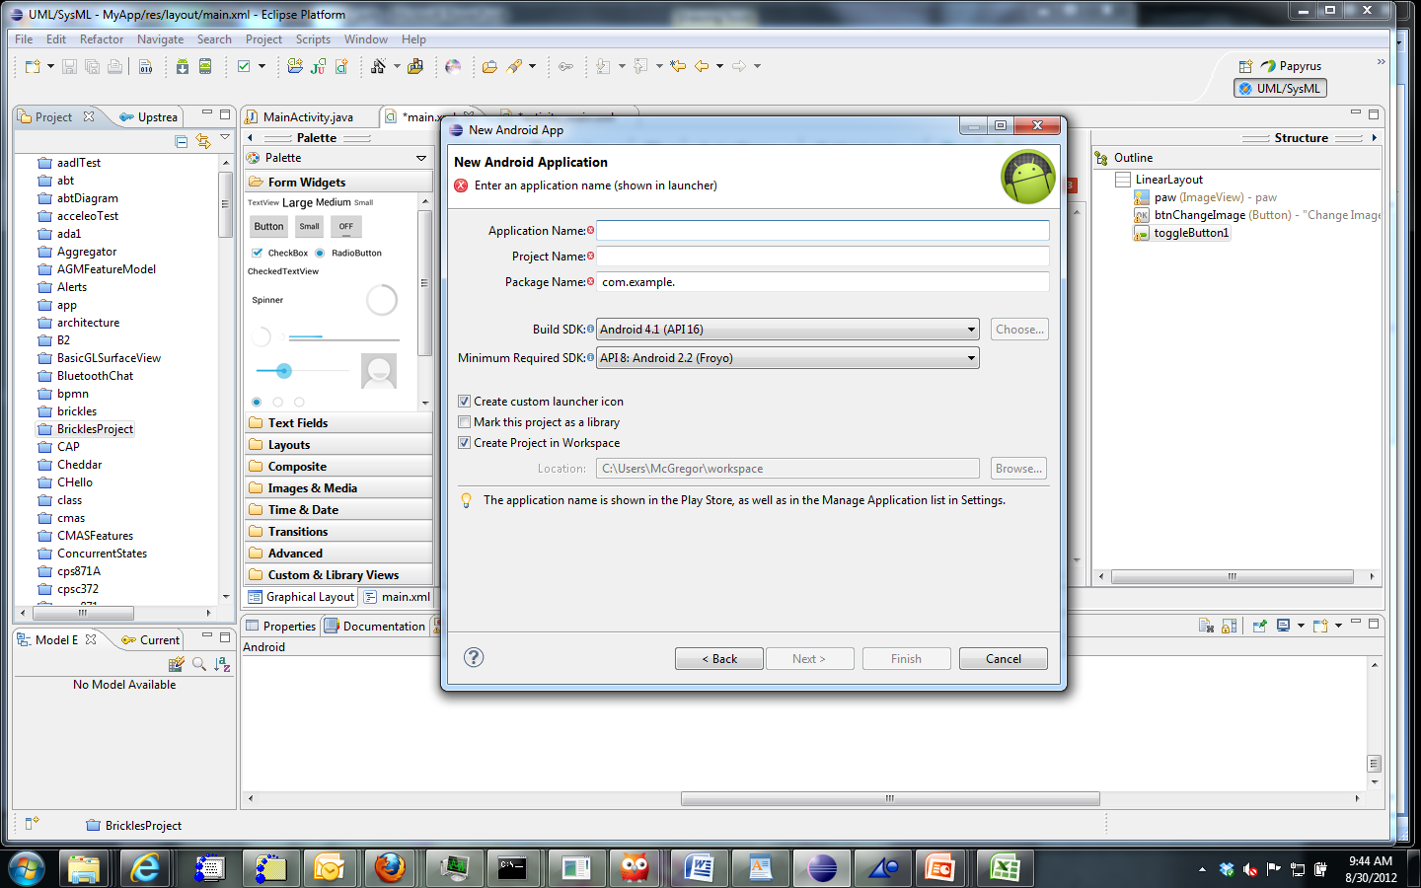

Slide 8
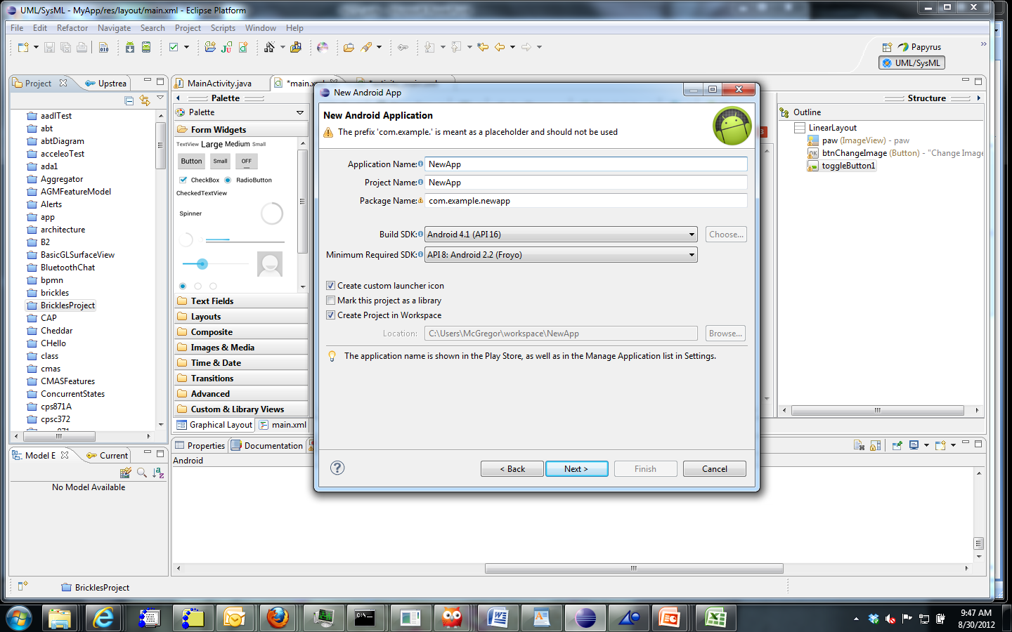

Slide 9
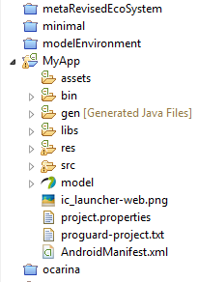
Project structure
When a new Android App project is created these items are created.
The src directory is where we place source code
The bin directory is where compiled code will go
The res directory is for resources such as images

Slide 10
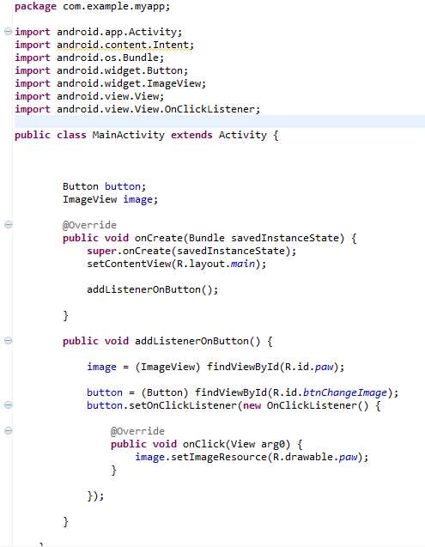
Activity
An app has a main activity which may invoke other activities.
It is a Java class that extends an abstract Activity class that is part of the framework.

Slide 11
Events and event handlers
A function gets called in logical progression in a program and you can trace a flow from input to output.
An event can happen at any time. A human decides to strike a key, for example.
“onCreate” is an event handler that says what to do when an instance is created.

Slide 12
Events and event handlers
“addListenerOnButton” is invoked by the framework when “button” is pressed.
Nested inside that listener is another event handler that defines what to do when the Button being listened to is clicked on.
It will display the image R.drawable.paw
R is an auto-generated object that is part of the framework

Slide 13
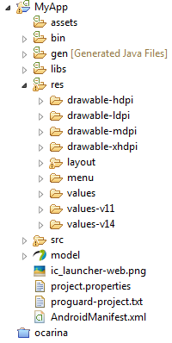
Resources
Apps use lots of “things” images, tones, video, etc.,
These are all fixed resources
Notice the multiple drawable directories
These represent the different resolutions of images for different size devices

Slide 14
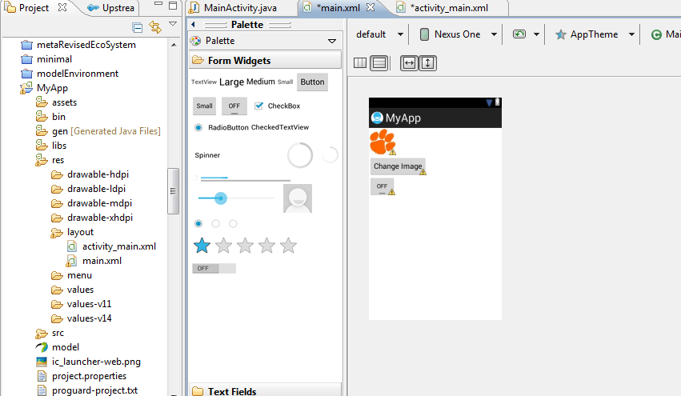
Editors
Editors create an xml file that identifies resources and where they should be placed.

Slide 15
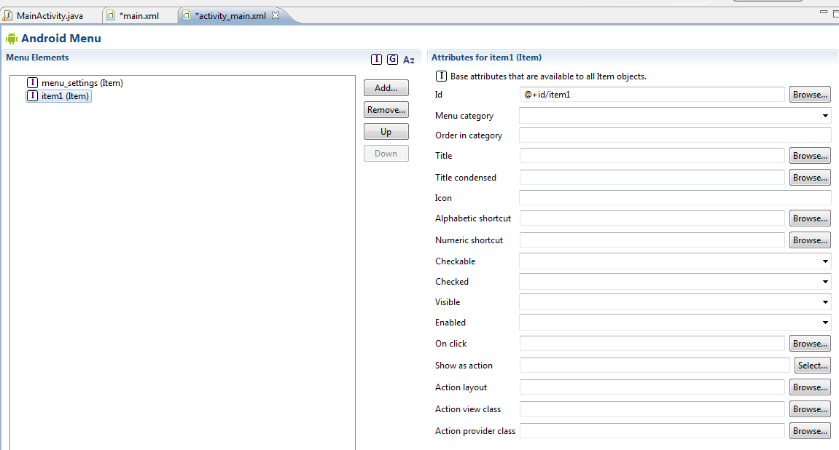
Wizards allow for specification of items such as menus and then the code is automatically generated

Slide 16
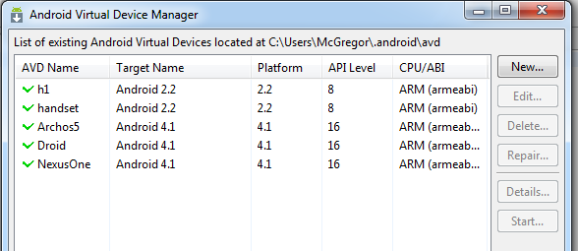
AVD Manager
The SDK provides emulators – virtual devices that mimic real hardware.
The first two come standard. I have added some to mine.

Slide 17
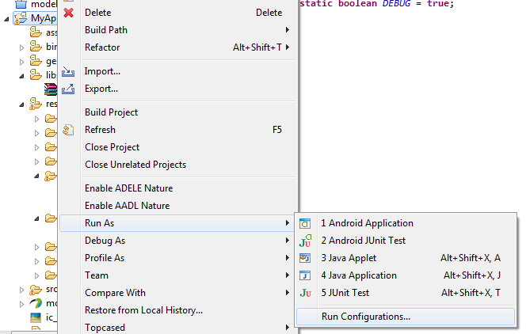
Running the app
To execute we create a run configuration. By going to Run As and then selecting “Run configurations”

Slide 18
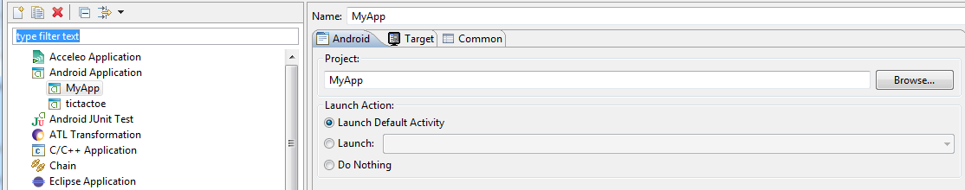
Select Android Application and it there is nothing under that label click on the button under the arrow to create a new one.
Name the run configuration and if you want to start the MainActivity click on “Launch Default Activity”

Slide 19
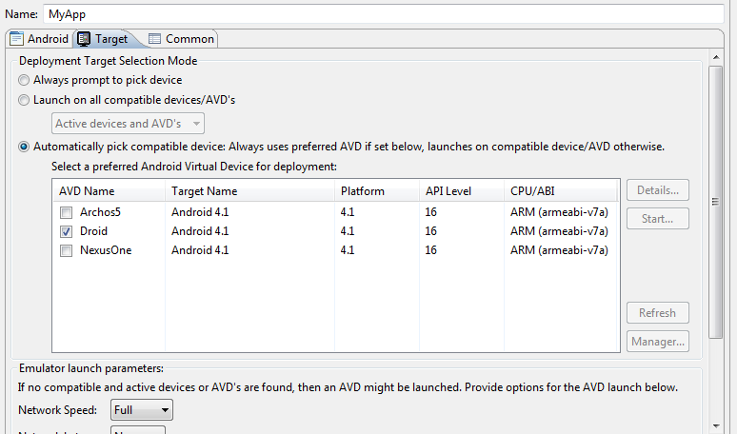
Selecting device
Click on the Target tab and select a device then click on Run

Slide 20
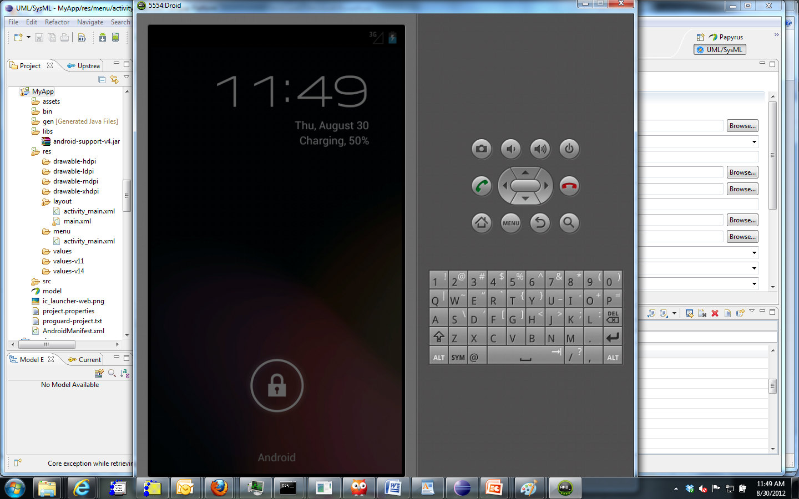

Slide 21
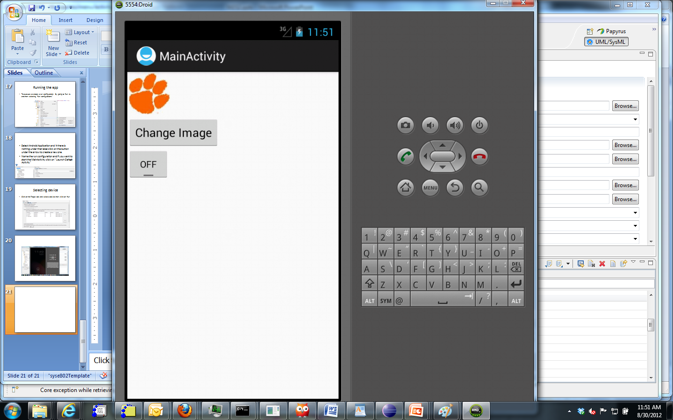

Slide 22
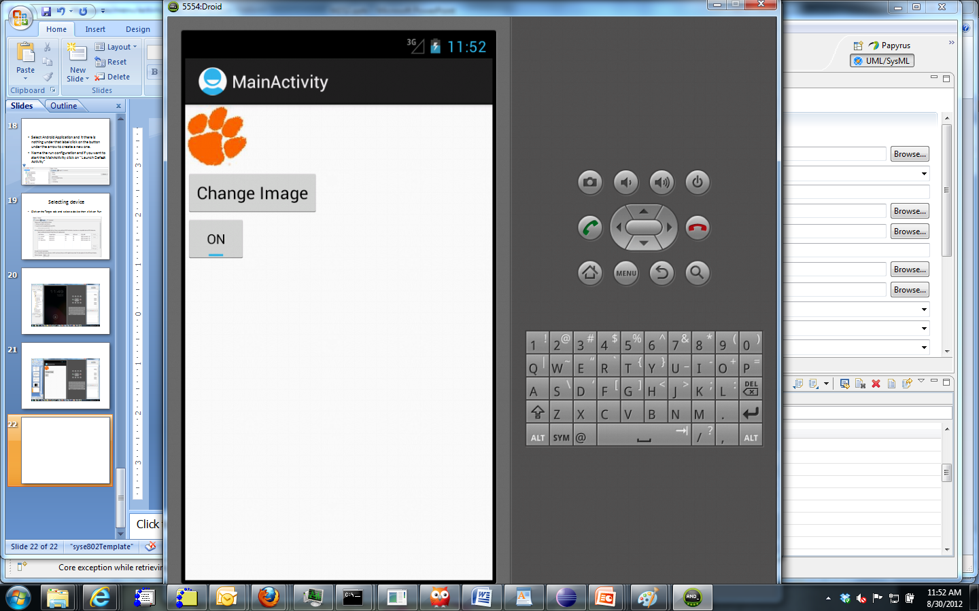
Note the button has been clicked

