Slide 1

CPSC 372
John D. McGregor
Module 0 Session 2
Infrastructure and problem

Slide 2
Android Apps
Software engineering principles apply across the board
We will use Android Apps as our model problem for the semester.
To do that we will use the Android SDK – software development kit
software code
android device emulators
architecture

Slide 3
Installing the Android SDK
http://developer.android.com/sdk/index.html
Follow the instructions – you install to your directory
Use a fast connection – it is large
Be certain to load all the packages it prompts for

Slide 4
Installing the Android plug-in
http://apcmag.com/installing-the-eclipse-android-plugin.htm
You will use the “Install New Software …” entry on the HELP menu of your Topcased installation. Topcased is an extension of Eclipse so they are compatible.
Installing the plug-in adds a set of actions to the “New” menu.

Slide 5
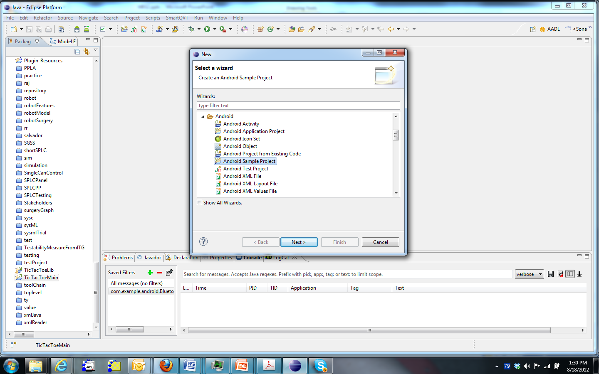
Check it out
Go to New -> Android -> Android Sample Project
This will
create a new
project that
can be
compiled.

Slide 6
Tic Tac Toe
Two projects are created: TicTacToeLib and TicTacToeMain
Use Project ..Build All to build both projects
If they do not build correctly you are missing libraries
Then to run go to the Run menu and to Run Configurations

Slide 7
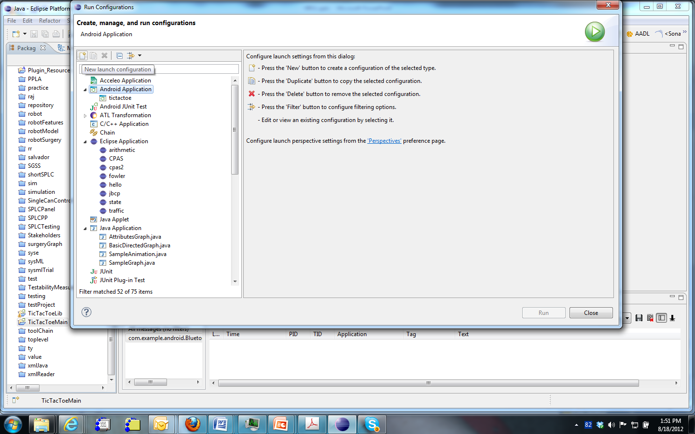
New Run Configuration
(2)
(1)
(1)Select Android Application and then (2) click on the create new configuration icon

Slide 8
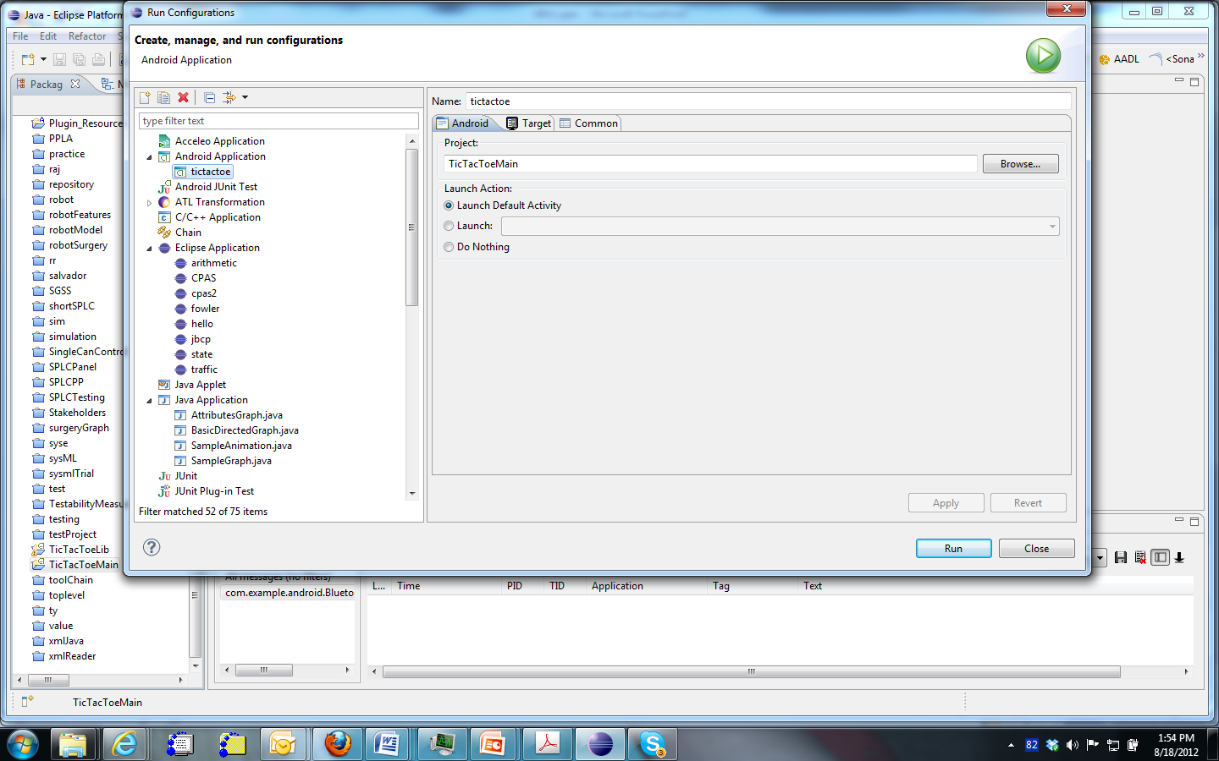
Tic Tac Toe running

Slide 9
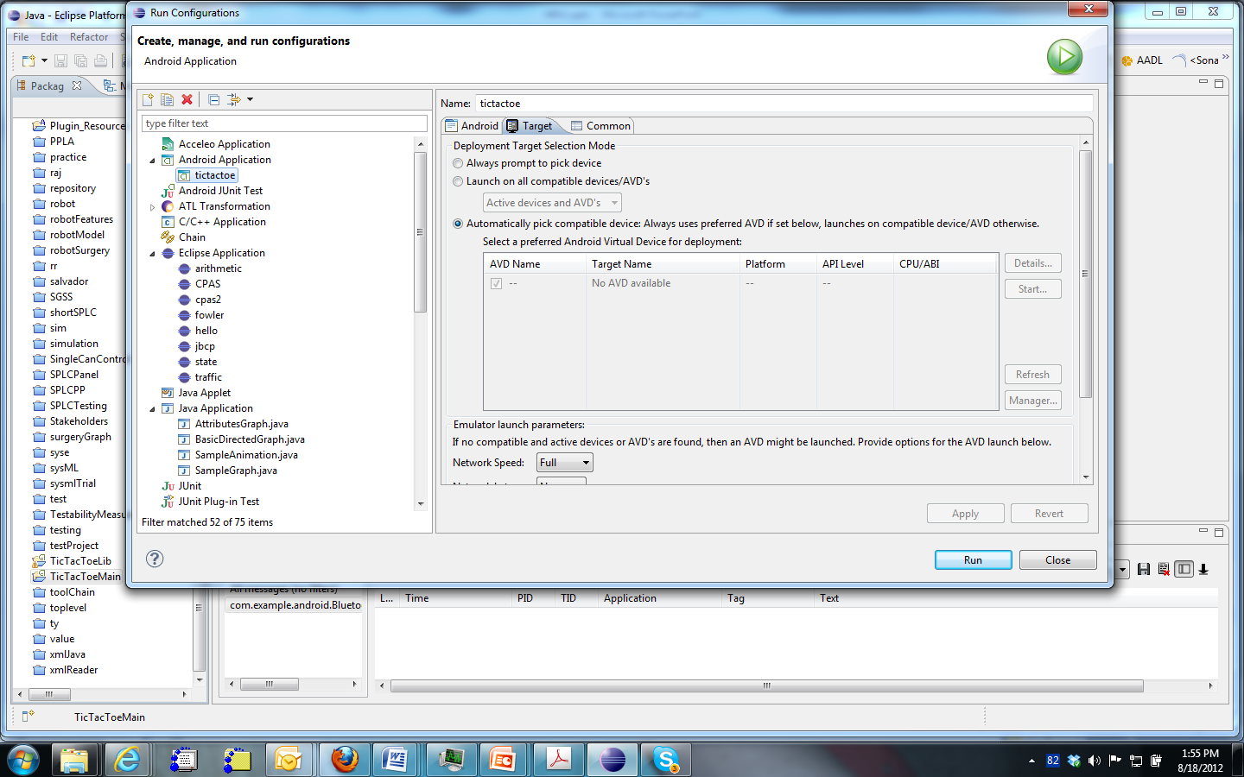
Turn to Target tab and select

Slide 10
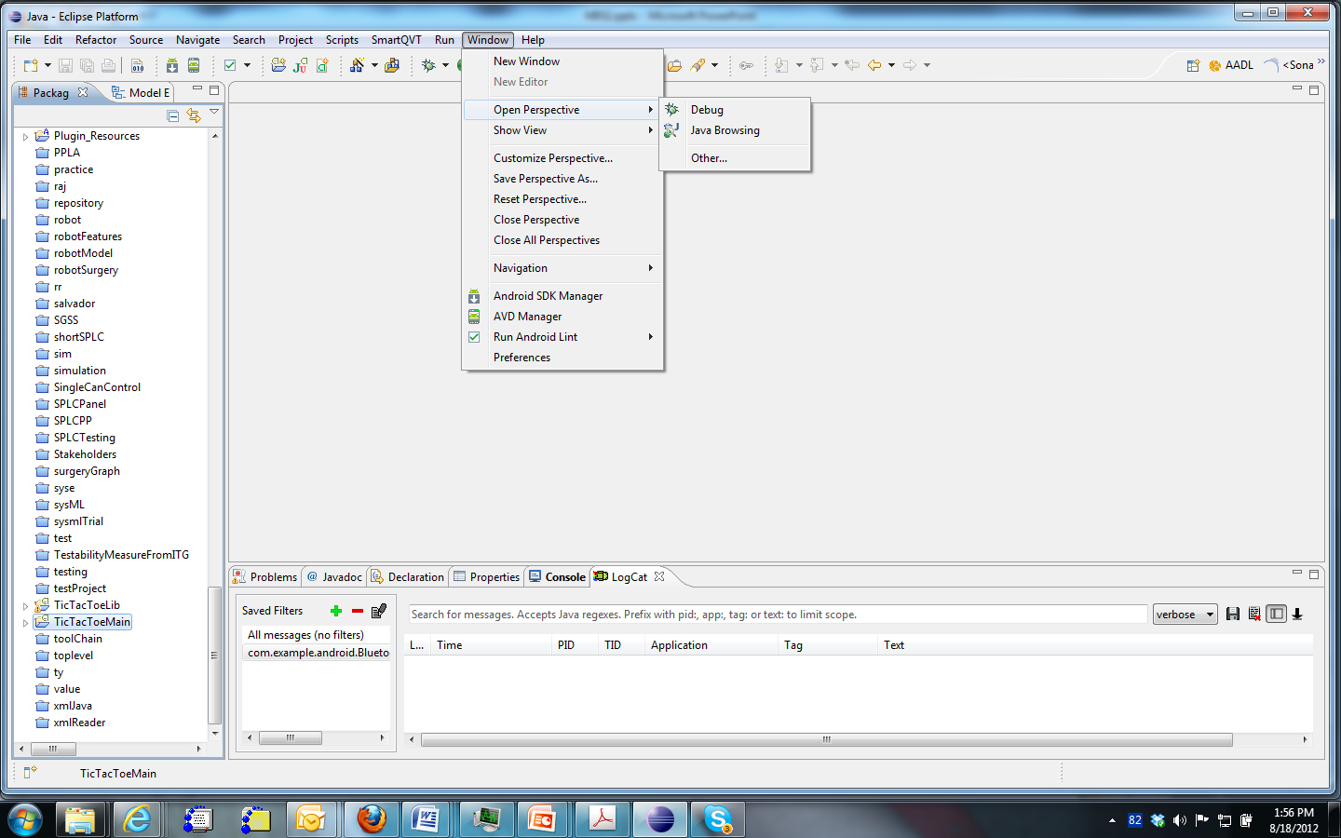
Start the virtual device manager
Select AVD Manager

Slide 11
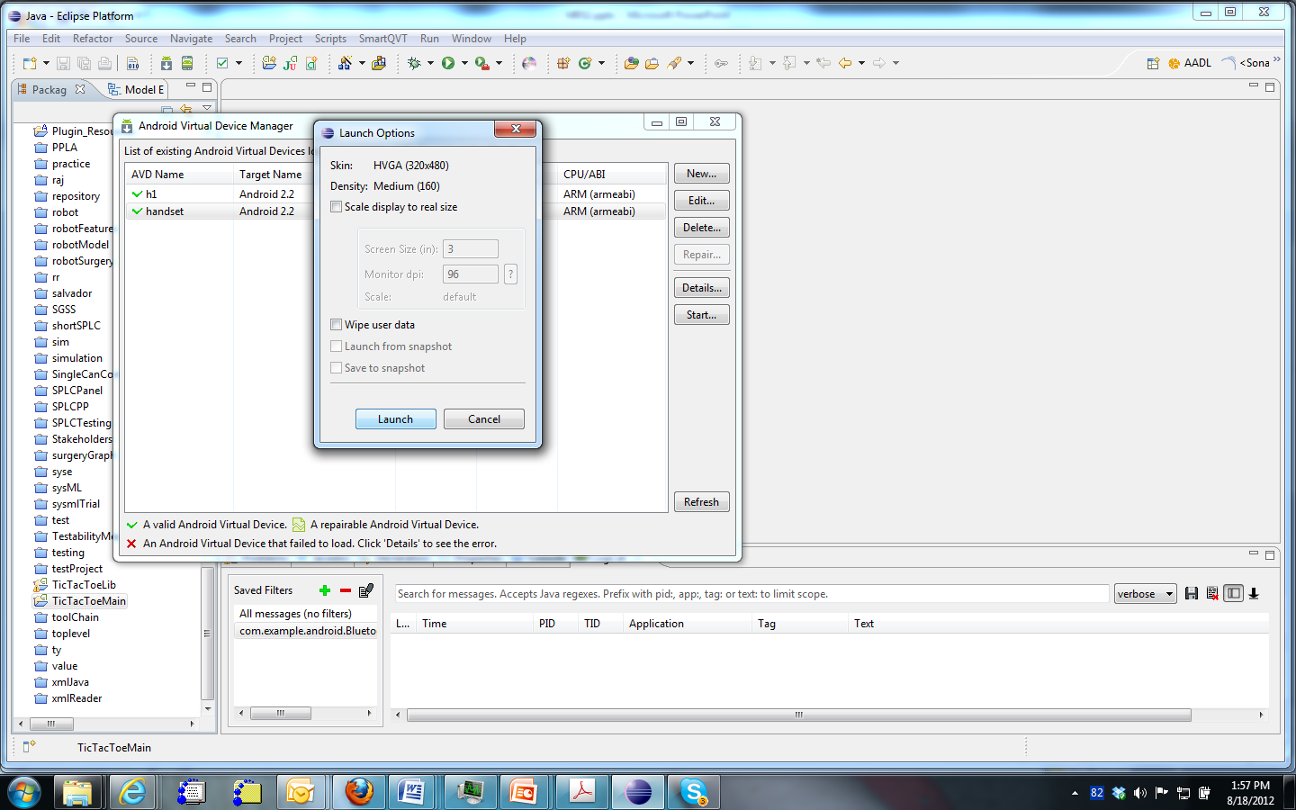
Launching takes a good bit of time
(1) Select handset
(2) Select Start
(3) Select Launch

Slide 12
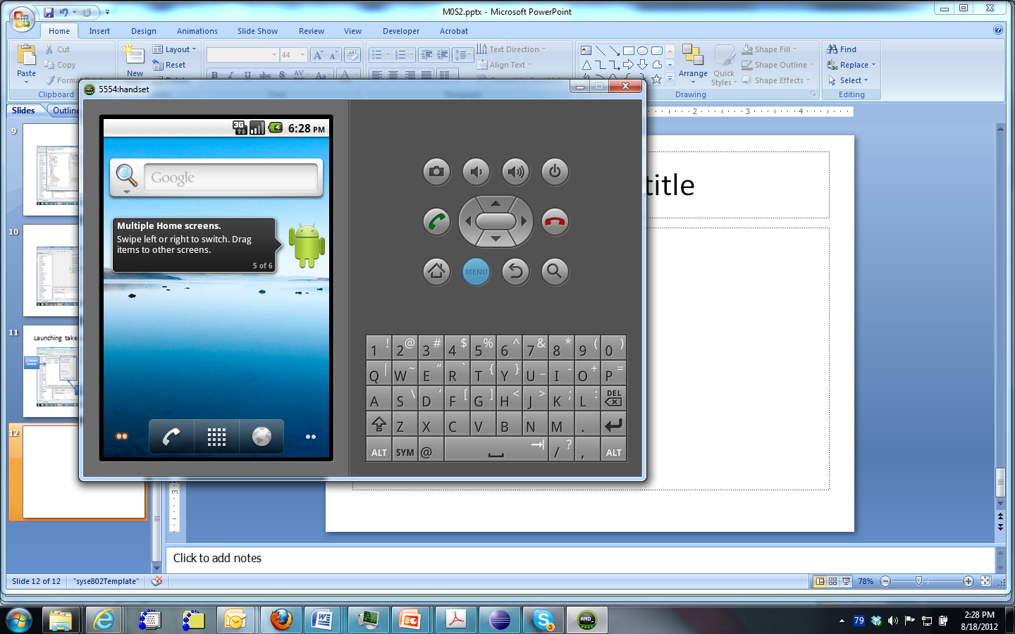
Here is what it looks like

Slide 13
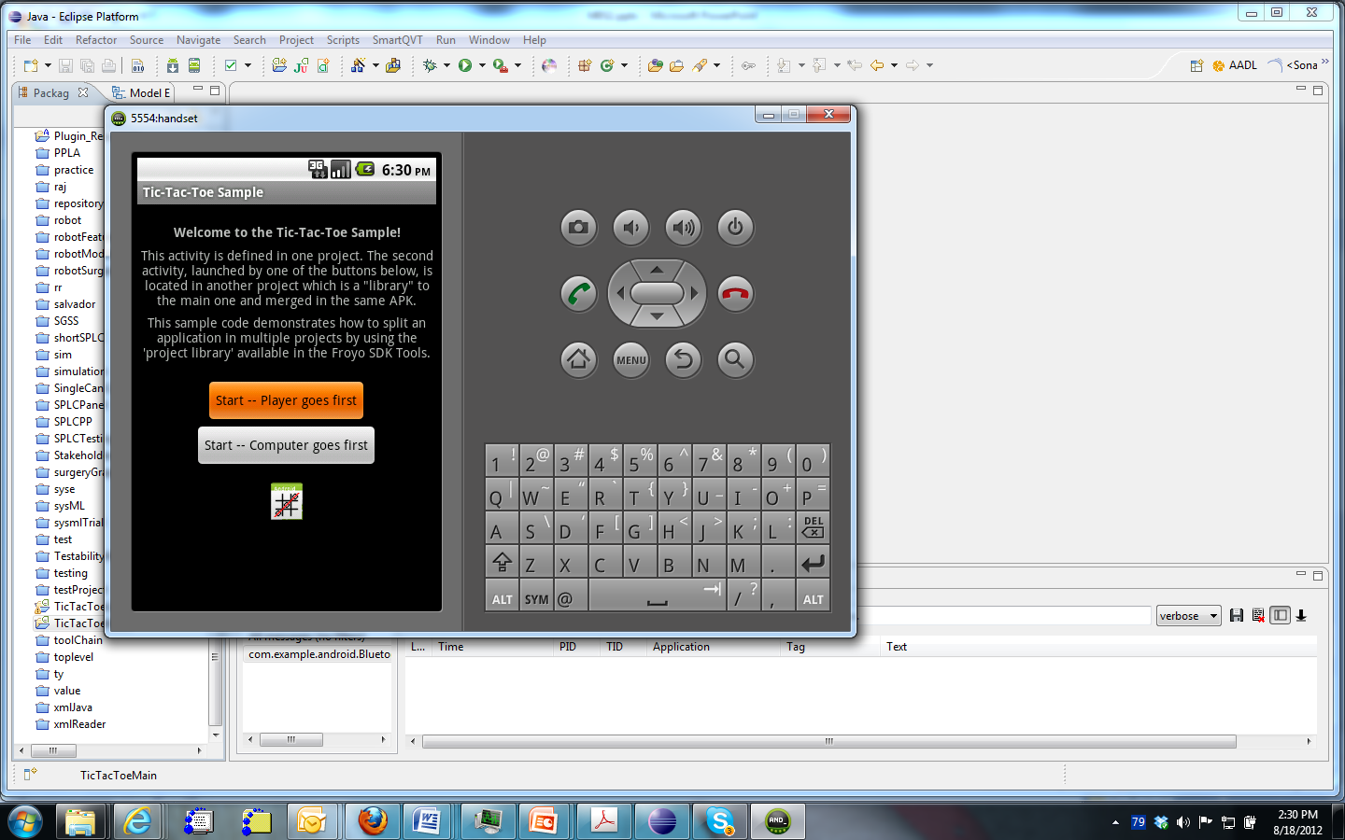
After menu is pressed

Slide 14
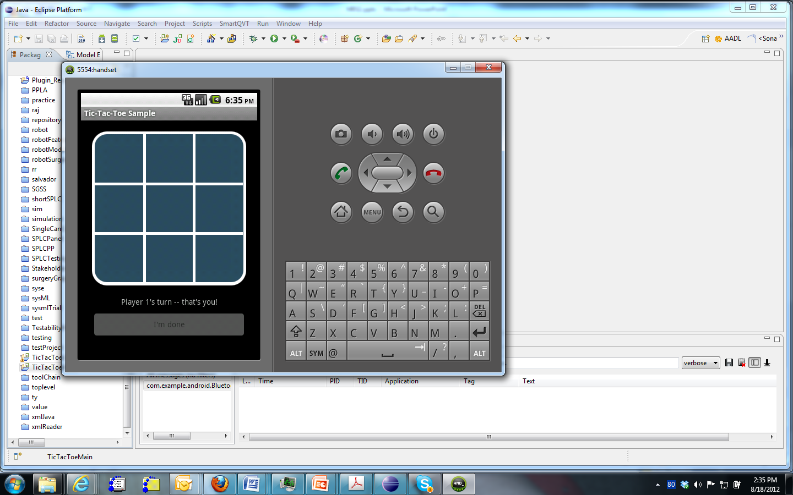
TicTacToe is executing

Slide 15
Design Problems
Take a look at these problems
http://faadesigncompetition.odu.edu/

