Slide 1

CPSC 372
John D. McGregor
M10S1
Documentation/Management/Assignment

Slide 2
Agile
Test driven development
Pair programming
Customer on the floor
A/B testing
Small tasks
Simple architecture
Self organizing teams

Slide 3
Jira
http://www.slideshare.net/jleyser/using-jira-greenhopper-for-agile-development-presentation

Slide 4
Bug report
Product–>Component
Assigned to
Status (New, Assigned, Fixed etc)
Summary
Bug priority
Bug severity (blocker, trivial etc)
Bug reporter

Slide 5
Bug states
unconfirmed
new (this state is acquired once the bug is confirmed)
assigned (once a developer takes possession of the bug)
resolved (when the development with the bug is finished)
reopen (when the solution is not satisfactory)
verified (once the solution is verified and satisfactory)
closed

Slide 6
Bugzilla tutorial
http://divyad.wordpress.com/2007/07/20/quick-bugzilla-tutorial/

Slide 7
Bugs/Issues/Tasks/Backlog
Task list is a job jar from which people can select what they work on next.
Used by self-organizing teams
Backlog is used to refer to the tasks that have been identified but that are not actively being worked

Slide 8
Backlog/Technical Debt
Assume we are working to a release date
We make decisions to delay some error handling or refactoring in order to meet that date
We have incurred “technical debt” – we have traded time for completeness
The technical debt analogy is appropriate because when we return to finish a task it will take longer than it would have – this is the interest on the debt
It takes longer because some other work probably has to be undone.

Slide 9
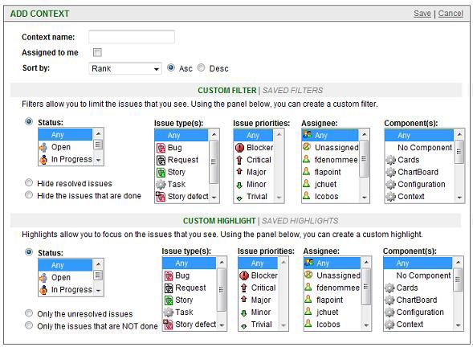
Issues/Greenhopper

Slide 10
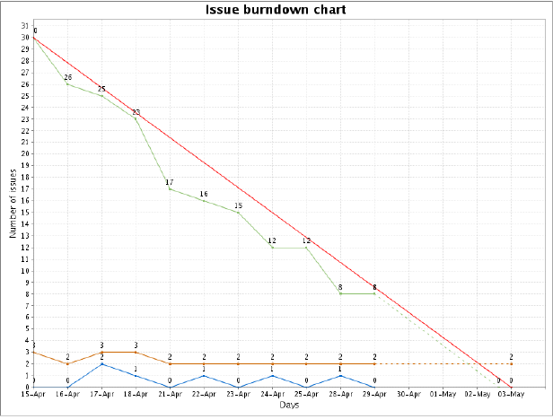
Burn down chart

Slide 11
Documentation
Design – SysML, UML, AADL
Code – JavaDoc, DOxygen
User – user’s manual, tutorials, FAQs, forums

Slide 12
JavaDoc
/** Description of MyClass * *
@author John Doe
@author Jane Doe
@version 6.0z Build 9000 Jan 3, 1970.
/ public class MyClass {
/** Description of myIntField
*/ public int myIntField;
/** Description of MyClass()
* * @throws MyException Description of myException
*/ public MyClass() throws myException { // Blah Blah Blah... }
/** Description of myMethod(int a, String b) *
* @param a Description of a
* @param b Description of b * @return Description of c */ public Object myMethod(int a, String b) { Object c; // Blah Blah Blah... return c; } }

Slide 13
Choices
@author [author name] - identifies author(s) of a class or interface.
@version [version] - version info of a class or interface.
@param [argument name] [argument description] - describes an argument of method or constructor.
@return [description of return] - describes data returned by method (unnecessary for constructors and void methods).
@exception [exception thrown] [exception description] - describes exception thrown by method.
@throws [exception thrown] [exception description] - same as @exception.

Slide 14
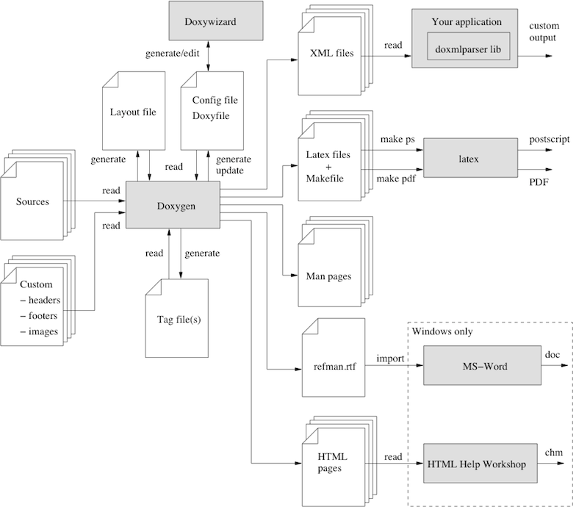
Doxygen - http://www.stack.nl/~dimitri/doxygen/manual.html

Slide 15
Doxygen markup
class Test
{
public:
//! An enum.
/*! More detailed enum description. */
enum TEnum {
TVal1, /*!< Enum value TVal1. */
TVal2, /*!< Enum value TVal2. */
TVal3 /*!< Enum value TVal3. */
}
//! Enum pointer.
/*! Details. */
*enumPtr,
//! Enum variable.
/*! Details. */
enumVar;
//! A constructor.
/*!
A more elaborate description of the constructor.
*/

Slide 16
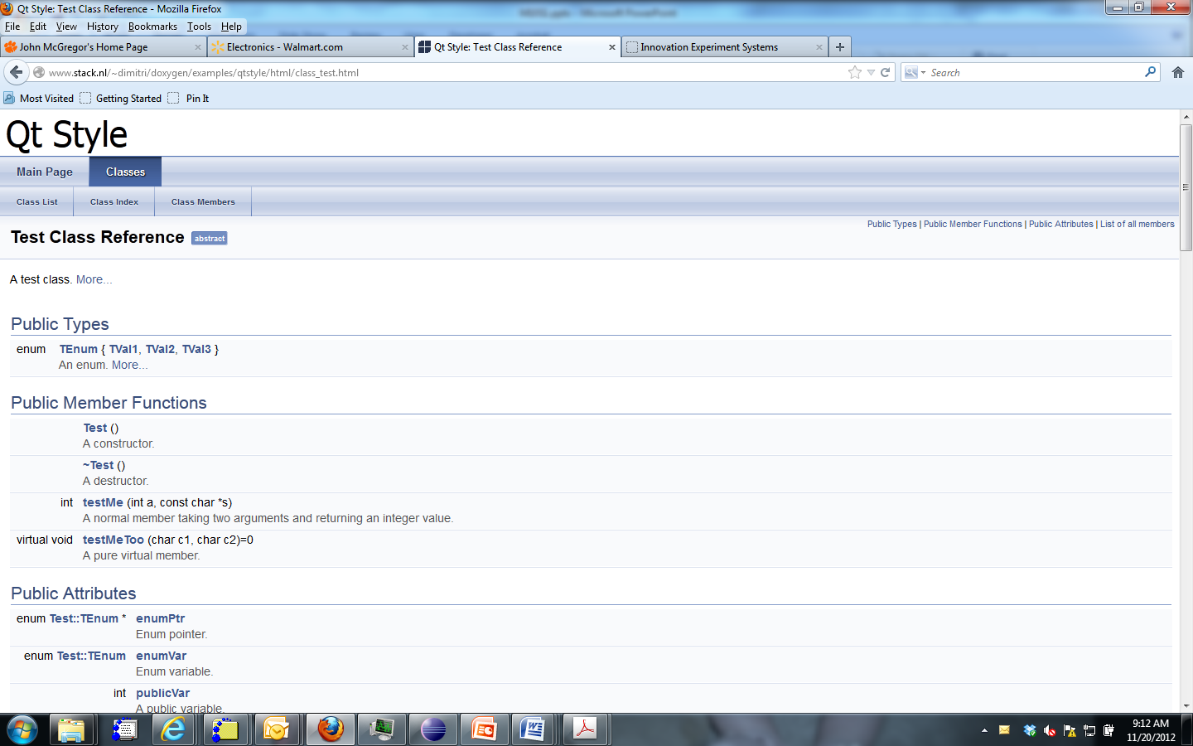
HTML output

Slide 17
GenDoc2
<context model=’${model}’importedBundles=’topcased’/><drop/>
<gendoc><drop/>
<list><drop/>
[for (p:Package|self.getSortedContent()->filter(Package))]<drop/
[p.name.clean()/]
Documentation : <dropEmpty>[self.getDocumentation().clean()/]</dropEmpty>
[if (not(self.getDiagram().oclIsUndefined() or self.getFirstDiagram().isDiagramEmpty()))]<drop/>
<image object=’[self.getDiagram()/]’ keepW=’true’><drop/>
</image><drop/>
[/if]<drop/>

Slide 18
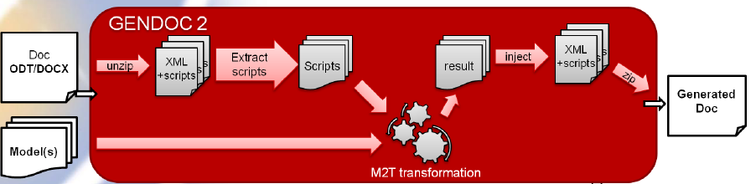
GenDoc2

Slide 19
Assignment
Develop comprehensive (design, code, user) documentation for your project.
Blend the models using English text and cut/paste the diagrams into the text.
Create JavaDocs for all classes you created.
Due Dec 4 as usual
Final delivery which will be a brief presentation at one of two classes – Dec 4 or 6

