Slide 1

CPSC 372
John D. McGregor
M12S1
WrapUp

Slide 2
To do
Go to this site and answer the questions. http://www.cs.clemson.edu/group/resolve/teaching/surveys/surveys.html
You can not take the final exam if this has not been completed by Monday morning 8am.
You will have 75 minutes for the exam; not the full exam session

Slide 3
Two elements of software engineering
Process
Product

Slide 4
Process
Who does what and when do they do it?
Iterative, incremental
Agile
Tools
  EPF
Fundamental steps
  Requirements – Understand the problem
  Design – Design a solution to the problem
  Construct – construct that solution
  Test – test to ensure it is a solution

Slide 5
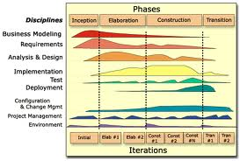
Life Cycle

Slide 6
Product
The output of the process is something of value to someone
Stakeholders – different views on value
Value is often related to how a product does something as much as what it does
  Reliability
  Availability
  …
The tools of our trade help build products
  Modeling/Design tools
  Language tools
  Test tools

Slide 7
Good design characteristics
Low coupling
High cohesion
Hierarchy
Symmetry
Designed to purpose
Simple
Clear specifications

Slide 8
Clear specifications
Invariants
Pre-conditions
Post-conditions
Where placed
How stated
How tested

Slide 9
Meta-models,languages, models
Meta-model
Meta-model
Meta-model
SysML
UML
AADL
A specific model written in SysML
A specific model written in UML
A specific model written in AADL

