Slide 1

Domain Specific Models
John D. McGregor
M13S1

Slide 2
Tool development
Eclipse is an environment intended as a basis for building software engineering tools
It provides a basis for construction and testing of these tools
Testing requires executing the tool in the “context” of the tool editor
Eclipse allows one instance of the workbench to start another and to have special hooks into the child instance

Slide 3
Transformations
A transformation is a function that maps one set of symbols to another
It can be 1-1 or M-1
It can map text to model (T2M) or model to text (M2T) or M2M or T2T
For example, in the AADL tools set we used a text grammar and OSATE generated an IMV (T2M)and an .aaxl2 (xml file) (T2T)

Slide 4
Transformations - 2
Transformations make it easier to work in a mode that is best for you. Text is better for humans; xml is better for computation.
To be most useful a transformation should map every symbol in the domain to a symbol in the range so that no information is lost.
A chain of transformations can be used. For example I might write a program in Java that is translated into the language of the JVM which in turn translates to the machine code of the target platform.

Slide 5
Coils.aadl

Slide 6
.AAXL2

Slide 7
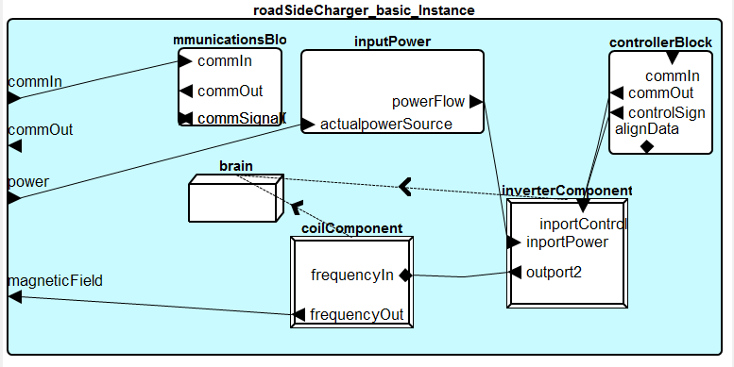
Covers a larger area than coils

Slide 8
Domain model
Defines a vocabulary
Use UML/SySML class diagrams (or an AADL model)to start
Nouns are entities
Verbs are behaviors related to an entity
Variants are often subclasses of an abstract entity

Slide 9
Portion of a model

Slide 10

Domain specific language
A language that is limited to a smaller set of concepts than a general purpose language
AADL vs Java
User is more guided but also more constrained
UML and SysML are DSLs
If I have a hammer every problem
looks like a nail.

Slide 11
UML is intended for the types of models used for object-oriented

Slide 12
AADL model
Defines components and relationships among them
Systems are entities
Features are either methods or data
Ports are entry/exit points

Slide 13
Requirements
Use domain vocabulary to be more precise than general English
Write sentences using that vocabulary
“The gap between the pads shall be no greater than 5 inches and no less than 3 inches.”

Slide 14
Product line requirements
Variants are represented at variation points
“The gap between the pads shall be no greater than <<x>> <<LinearMeasurementUnits>> and no less than <<y>> <<LinearMeasurementUnits>>.”
“This model of vehicle requires a <<coil>> .”

Slide 15
Tool support for a DSL
Needs a grammar
Needs an editor
Needs a code generator
Debuggers and other items would be nice but DSL programs are usually simpler than general purpose programs

Slide 16
xText
xText is a DSL generator
It takes a grammar as input and outputs the infrastructure needed for a basic editing environment for a language
The current version of editors in OSATE are generated using xText

Slide 17
xText in Eclipse
grammar org.xtext.example.mydsl.MyDsl with org.eclipse.xtext.common.Terminals
generate myDsl "http://www.xtext.org/example/mydsl/MyDsl"
Model:
greetings+=Greeting*;
Greeting:
'Hello' name=ID '!';

Slide 18
Wireless power transfer dsl – just a small example
grammar org.xtext.wpt.wptdsl.MyDsl with org.eclipse.xtext.common.Terminals
generate myDsl "http://www.xtext.org/wpt/wptdsl/MyDsl"
Model:
requirements+='The type of coil required is '+Coil*;
Coil:
'LowCapacityCoil' | 'HighCapacityCoil';

Slide 19
Results
Editor gives error if I deviate from the grammar

Slide 20
Installing xText
There are two update sites needed to install xText
http://download.eclipse.org/modeling/tmf/xtext/updates/composite/releases/
http://download.itemis.de/updates/
The first gets the body of xText
The second gets antlr which is a parser generator
Licensing issues require the separation

Slide 21
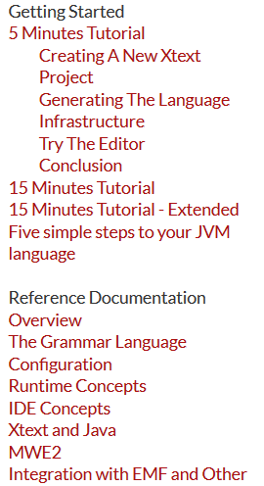


http://www.eclipse.org/Xtext/documentation.html#FirstFiveMinutes
Work through
}
Read through all of this

Slide 22
Here’s what you are going to do
Submit 2 or 3 screen shots of the Eclipse environment showing your work at the end of the last tutorial
Submit by 11:59PM Oct 23rd

