Slide 1

CPSC 372
John D. McGregor
Process
Module 1 Session 1

Slide 2
Building a product
The first engineering step in building a software-intensive product is to organize the resources needed to solve the problem.
We need people assigned to roles and we need a schedule and sequence of events
There are many “process models” which we can use as a guide as we create a detailed schedule.

Slide 3
Disciplines/Practices
There are many different roles that are involved in building a software-intensive product.
These roles are experienced in specific disciplines such as requirements analysis and architecture.
Each process model defines a set of disciplines but not all of the models have the same scope so often there are necessary roles that are “hidden” because they are outside the scope of the process model.
For example, most process models do not have a role of deployment package creator but it is very necessary. The process model describes software development not the use of that software in a real business.

Slide 4
Fundamental activities
Understand the problem
  Understand the domain – maybe it really is rocket science
  Understand what the customer wants
    requirements
Solve the problem
  High-level design – the software architecture
  Detailed design
  Implement the designed solution

Slide 5
Fundamental activities - 2
Development
Testing
Understand the problem
  Understand the domain
  Understand what the customer wants
Solve the problem
  High-level design
  Detailed design
  Implement the designed solution
Review of requirements
Design reviews
Executable tests

Slide 6
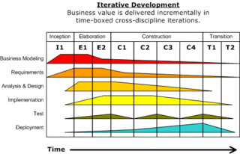
Rational Unified Process
Several process models were brought together hence the “unified” in unified process
This view emphasizes that each discipline is related to others

Slide 7
Iterative, incremental
Iterative – a series of tasks are repeated til an acceptable level of quality is achieved.
Incremental – a big task is broken down into smaller, simpler tasks.
An iterative, incremental approach is useful when the product will change as the project progresses or it is a new concept with which there is some learning.

Slide 8
Time-boxed vs function-based
Time-boxed – means we will work for only a fixed amount of time and then stop rather than continue until a specific task is finished.
  Every two weeks we will deliver what we have developed and tested so far.
Function-based – we will deliver a function when it has been developed and tested
  Deliveries happen at irregular time intervals since different functions take different amounts of time to develop and test

Slide 9
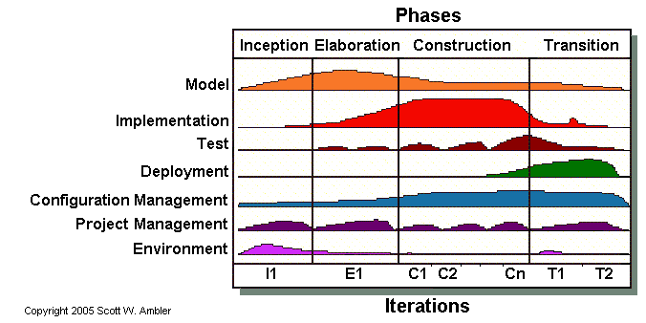
Agile Unified Process
The agile approach to building software de-emphasizes documentation and planning.
It is not by itself model-driven but it does share some elements.

Slide 10
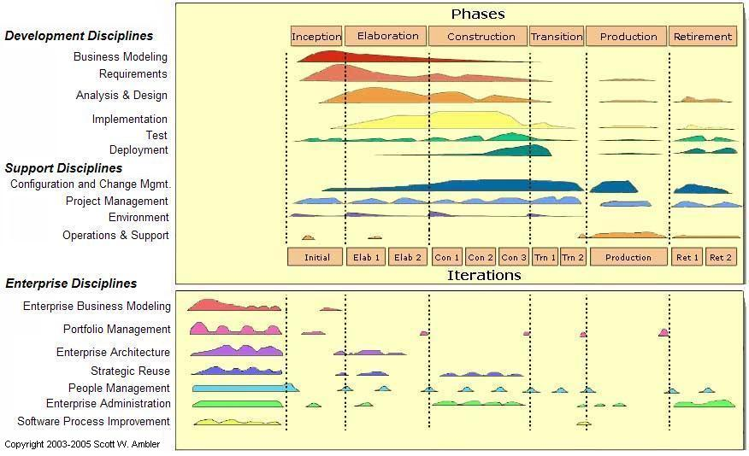
Enterprise UP

Slide 11
Work breakdown structure (WBS)
Although each process model has a set of disciplines and a set of phases, each team may tailor the process steps to fit the specific project.
A work breakdown structure is a hierarchical structure in which a general task is broken down into smaller, more specific tasks.

Slide 12
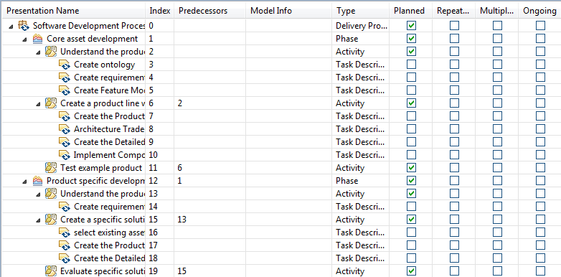
Example
Here is a WBS done in the EPF tool
Two main phases are decomposed in this example
There is a hierarchy of Phase, Activity, and Task. Each is a subset of the previous.

Slide 13
Defining a process
Engineers use standard, well-defined notations
The Software Process Engineering Meta-model (SPEM) recognizes 4 types of process elements
Basic elements
  Role - defines a set of related skills, competencies, and responsibilities
  Task - defines work being performed by Roles Definition instances
  Work product - used, modified, and produced by Task Definitions
  Guidance - information related to Describable Elements

Slide 14
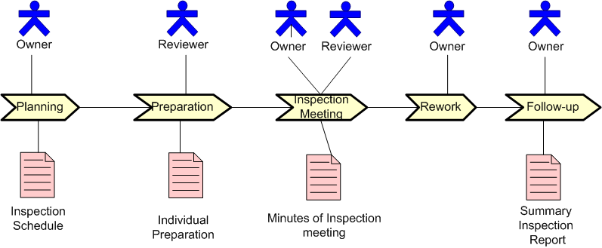
Notations
Many engineering notations have multiple syntax – English, XML, graphical
role
task
work product

Slide 15
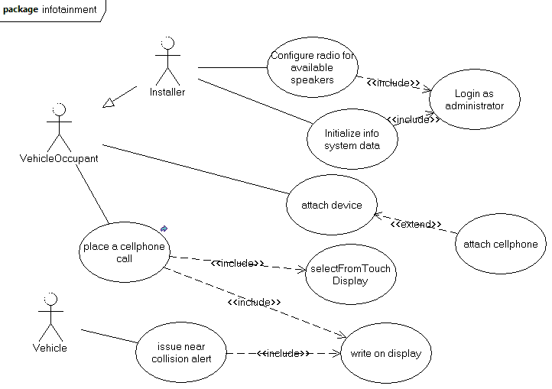
Notation

Slide 16
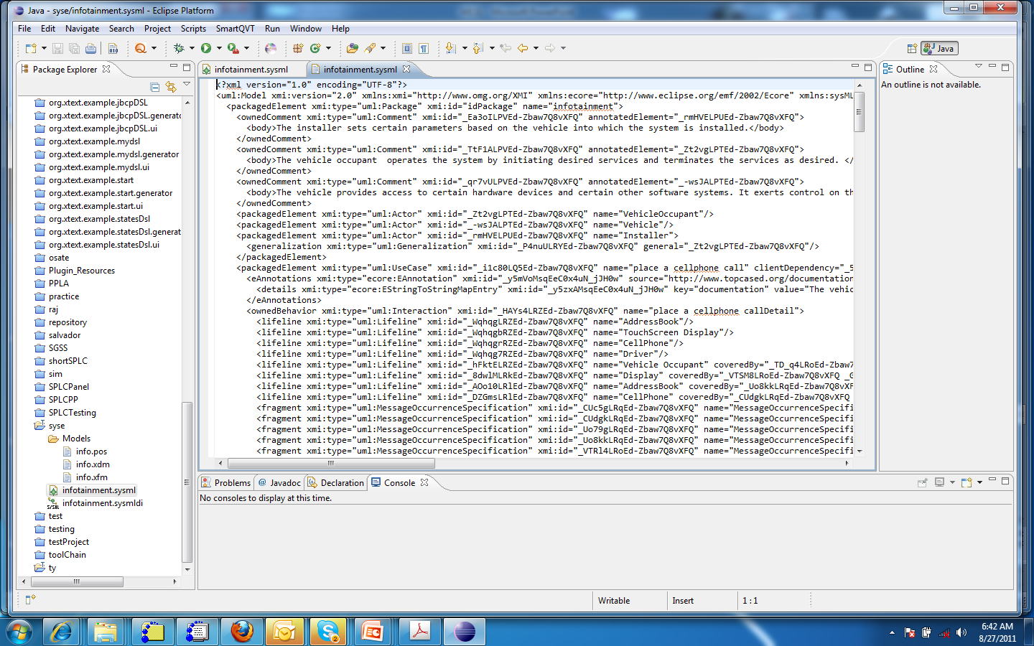
EPF

Slide 17
Rhythm
A steady rhythm allows for anticipation and good planning
Time-boxing allows a steady rhythm while function-based does not
Establishing a rhythm with a client, schedule a teleconference every Monday, makes it more likely they will make time for you.

Slide 18
Allow for differences
Embedded, real time products are different from business products
How they are developed is different
Performance is a very high priority for embedded systems while security is lower.
For a Business system security is the high priority and performance is lower.
Different processes are needed
Different processes and different emphasis on things.

Slide 19
Pressures
Customers want us to have a faster and faster clockspeed so that products are delivered more rapidly
Software is becoming more integral to everyday life – reliability is a big issue
Processes are tailored to meet specific goals

Slide 20
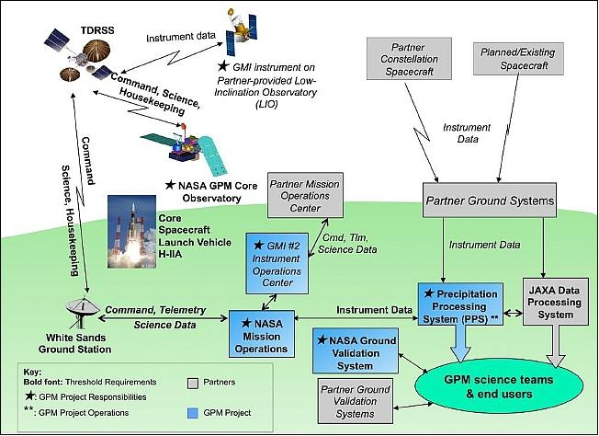
A system with differing qualities

Slide 21
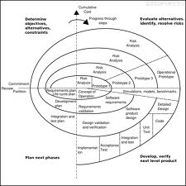
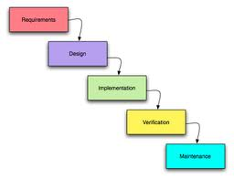
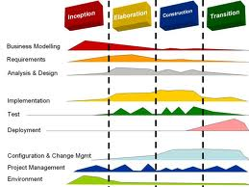
Process styles
Waterfall
Iterative, incremental
Agile
Spiral

Slide 22
Agile development
Integrate customer into the development process
Short “sprints” with specific, small goals
In some cases, doing test-first development
Basic assumption: requirements change so frequently that making long-term plans is a waste
Others feel that a long-term plan re-calibrated frequently is a better approach

Slide 23
Agile manifesto
We are uncovering better ways of developing
software by doing it and helping others do it.
Through this work we have come to value:
Individuals and interactions over processes and tools
Working software over comprehensive documentation
Customer collaboration over contract negotiation
Responding to change over following a plan
That is, while there is value in the items on
the right, we value the items on the left more.

Slide 24
The danger
The danger of agile is that companies use it as a means of explaining away poor practices.
They overlook the part of the manifesto that says there is good on both sides of each statement

Slide 25
Ultimately
The evaluation of a process or a process style is whether it achieves the objectives which justified its use.
Agile organizations want to be quick
But in some domains quick may not be the most important attribute
Certification can also be important

Slide 26
Certification
Software must be fit for its purpose
If the software is used in control of flight it must be certified as air-worthy by the FAA
If it is used in medical devices it must be certified by the FDA
If it is to be used on the public telephony network it must be certified by an industry led laboratory
And the list goes on

Slide 27
Certification - 2
These types of certifications consider the end quality of the product mainly by analyzing the process that went into making the software.
A chain of evidence is constructed as the product is built from requirements to code.
The chain shows what was done at each step to build a quality product.
More on this as we go on.

Slide 28
Improving processes
A process can be measured, modified, and then used again to determine whether the process is “better.”
To accurately describe and measure a process an exact description is needed.
The OMG has defined the Software Process Engineering Meta-model (SPEM).
The Eclipse Process Foundation (EPF) is an Eclipse-based tool.

Slide 29
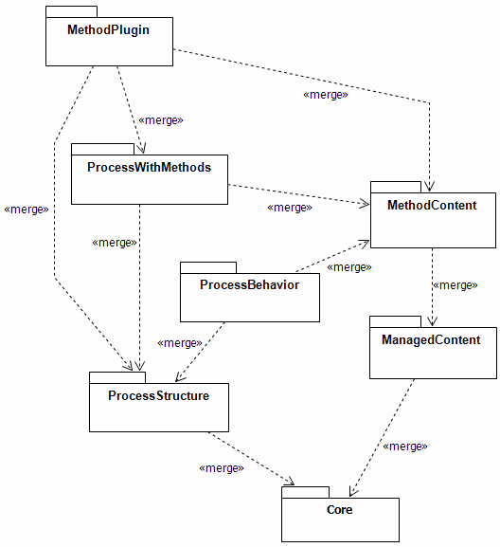
Meta-model structure
The SPEM is divided into packages.
We will look at these in more detail through out the course. For now just look at the top level.
The meta-model includes the plugin concept as a way of extending incrementally.

Slide 30
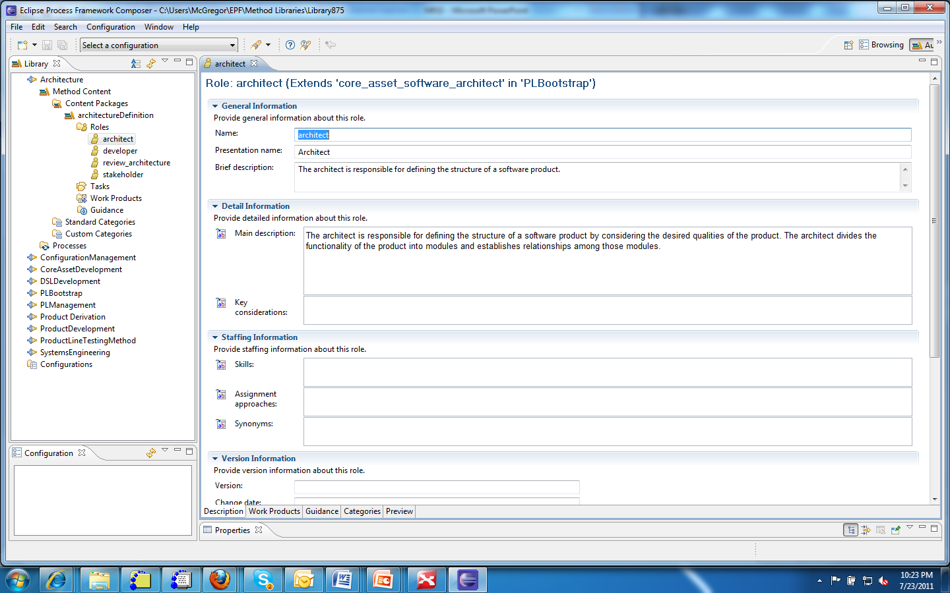
EPF
2
1
3

Slide 31
EPF - 2
1 – The EPF workspace is structured following the SPEM.
2 – Each page has numerous fields which must be filled in to give a complete view.
3 – The tabs at the bottom give access to differ methods of extending each page definition.

