Slide 1

CPSC 372
John D. McGregor
Module 1 Session 3
Requirements & Assignment

Slide 2
Product Requirements
There are two phases to defining the requirements for a product
Requirements elicitation – get information from sources such as people, documents, regulations, etc
Requirements analysis – derive explicit measurable statements from the information gathered

Slide 3
Concept Elaboration
In the earliest stage of system development, actions are less structured and less rigorous than in the later stages.
A feasibility study may have been executed or marketing information gathered to identify the need or opportunity that the system is intended to address.
A business case may be constructed at this time to determine go/no go for building a production product or this effort may be chartered as an investigation.

Slide 4
jet
helicopter

Slide 5
Early steps
Early in the product’s life cycle the system engineer gathers information about the problem/need.
The system engineer may create domain models or at least a domain dictionary that capture relevant concepts in the domain of the system and their meaning.
The system engineer will definitely create a requirements model.

Slide 6
Early steps - 2
Stakeholder requirements give the stakeholders’ view of what the product should do and properties the system should possess.
These will be translated by the SEs into system (derived) requirements.
The stakeholder requirements are stated in terms of their interest in the product. The SEs translate these into more specific, more objective, more modular, and less ambiguous statements.

Slide 7
For example,
For example consider a system that allows the user to use a radio, a video system, and other devices.
The system must use a reasonable amount of power of the type found in a vehicle.
A requirement might read:”The system shall support the user tuning the radio to any station on the standard AM broadcast band.”

Slide 8
Stakeholders
Initially each stakeholder has their own objectives.
Each stakeholder must advocate for their view of the need and show how it is of more importance than the views of others.
Ultimately a common mission is established.

Slide 9
Domain models
A domain model can be thought of as a structured glossary.
The boxes in the diagram on the following slide represent concepts in the domain.
The lines between boxes represent relationships among concepts.
This diagram uses the block diagram notation of SysML.
The words enclosed in «» are called stereotypes. Like a type they define what properties the concept may have.

Slide 10
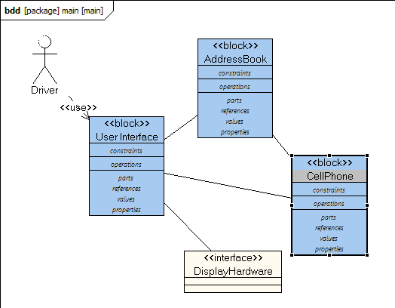
Domain models - 2
Blocks, in a SysML block diagram can be used for concepts.

Slide 11
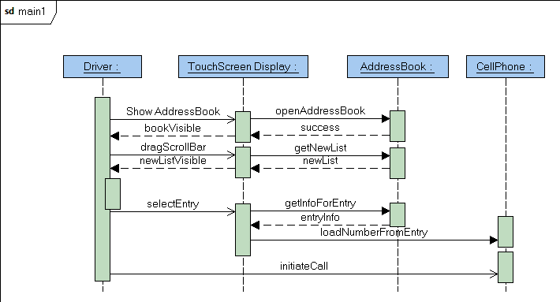
Domain models - 3
A domain model also captures standard interactions, which are characteristic
of the problem not the solution, using SysML sequence diagrams.

Slide 12
Domain models - 4
The purpose of a domain model is to establish a common vocabulary among members of a project team.
This is particularly important if several specialties are being integrated to solve a problem or if several organizations are collaborating.
Even a term like “project” can have different meanings if the solution is distributed over several countries.

Slide 13
Domain model - 5
Professional societies and governmental organizations are good starting points for these models. They produce general models that represent the thinking of large numbers of people.
These domain models will also serve as the basis for domain specific languages (DSLs) for later stages of model-driven development

Slide 14
Features
For many efforts the size and complexity of the product is too much to think of as a single list of requirements statements. 10,000 items is too many.
One way of dividing the problem into manageable pieces is to use a high level unit termed a “feature”. By high-level I mean broadly encompassing. Vehicle is more encompassing than automobile.
A feature can represent any aspect of a system. A very vague definition I know but a very flexible one.
Having a GPS device is a feature of our system.

Slide 15
New Feature modeling tool
We have been using the feature modeling tool described in the next slides but I found a better tool at http://wwwiti.cs.uni-magdeburg.de/iti_db/research/featureide/
It is a plug-in so near the bottom of their web page they give step-by-step instructions for loading the plug-in into Eclipse.
Please do that. I have left the next few slides as a good overview of features.

Slide 16
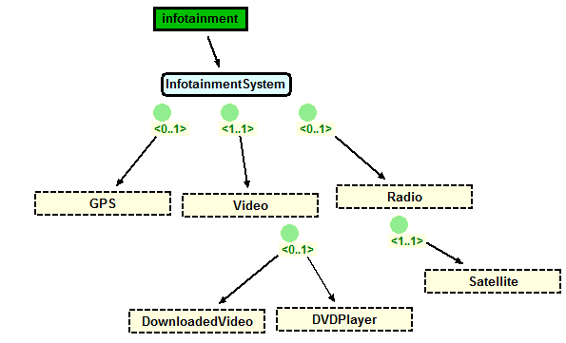
Features - 2
The <0..1> cardinality means the feature is either part of the system or not.
The <1..1> cardinality means the feature must be part of the system.
Notice that many of these features are directly from the mind map.
http://www.pnp-software.com/XFeature/

Slide 17
Features - 3
Satellite radio is a mandatory feature if we have a radio.
A product we build may have a GPS component or not (indicated by 0..1). This is an optional feature.
There is a video feature in every product and there is a choice of two players.

Slide 18
Features - 4
These statements are very high level requirements but each one represents many of the individual requirements statements. The features are sufficiently different that building a detailed requirements model for each feature will minimize the amount of interactions between requirements in one feature and those in another.
Non-functional aspects may be addressed as well with features such as security or performance levels.

Slide 19
Features - 5
Notice that a feature model gives more than just the requirements for A product.
It gives requirements for a family of products.
More about this later in the course.

Slide 20
Features - 5
Notice that a feature model gives more than just the requirements for A product.
It gives requirements for a family of products.
More about this later in the course.

Slide 21
Functional vs Non-functional requirements
Functional requirements describe WHAT a product must do
  The system shall be able to receive SMS (short message service) messages.
Non-functional describe HOW the product will do it
  The system shall be able to receive at a rate of 100 messages per minute.
Both are essential to building an acceptable product.

Slide 22
A good requirement is
Correct
Unambiguous
Complete
Consistent
Prioritized
Verifiable
Modifiable
Traceable

Slide 23
Two operations
The systems engineer
  elicits requirements from many sources, and
  analyzes the compete set of requirements
In order to elicit, the systems engineer identifies those who have an interest in the product - the stakeholders
Not all stakeholders have the same priority. Some are clients while some are the people creating the product.

Slide 24
Implicit and Explicit
Standards documents and spec sheets for former products are examples of explicit knowledge which is the easiest to convert into requirements
Implicit knowledge such as the experience of a 20 year veteran in a company is harder to capture completely and correctly
Just recently a doctor tried uploading data for a medical research project and we found that he had forgotten to tell me that each MRI scan was 120 separate files.

Slide 25
Many techniques
There are many different techniques for eliciting requirements
  Interviews – structured and non-structured
  Story boards
  …
We will focus on use cases. A use case is a description of a use of the system by some external entity termed an actor.

Slide 26
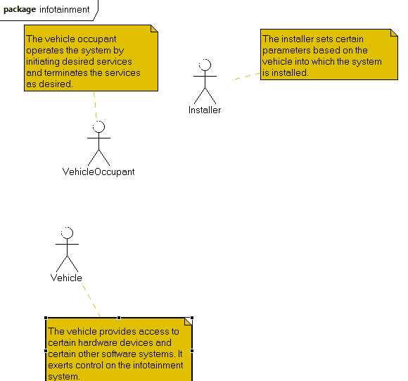
Elicitation
The stakeholders can be represented as “actor”s in a SysML/UML Use Case model. The figure below is an early version of the model for our continuing example. The actors may be people or other systems. What outside forces act on the system?

Slide 27
Scenarios
A scenario is a very short story.
A use case is a set of scenarios that all describe related uses of the system being developed.
A number of software development methods use scenarios for a variety of models.
Some methods just use simple story boards while others are structured by fill-in the blanks style statements.

Slide 28
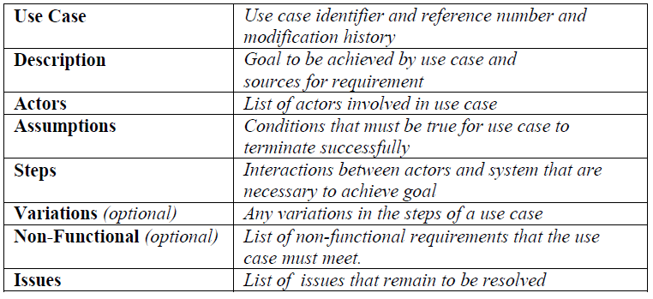
Use case template
If you are not using a tool such as Papyrus this is a nice outline to follow.

Slide 29
Use case structure
Typically there may be several variations on a use and so multiple scenarios are grouped together under a single use case. There are types of scenarios that routinely are used:
  Sunny day (everything goes well)
  Rainy day (something does not work)
  Exceptional (rare situations that require specific handling)

Slide 30
Use case model structure
The use case model is not just a list of uses
The model has structure resulting from relationships between uses
  Extends – The use is written so that new uses can be incrementally defined by adding to an existing use; the original use case must indicate what can be extended
  Generalizes – Similar to inheritance
  Includes – Similar to composition

Slide 31
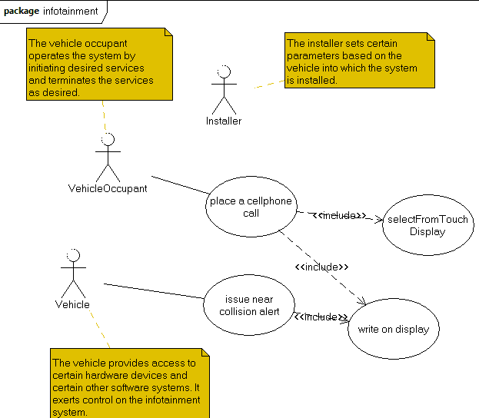
Use cases
Use cases give a means of decomposing actors’ actions.

Slide 32
Here is what you are going to do:
Form a team of three people. Remember that it might be nice to work with a friend, but look for persons who have specific skills that you need.
Choose a name for the team. Submit the team name and the three people’s names as part of this week’s package.

Slide 33
Here is what you are going to do:
Create context diagram, feature diagram and use cases for a proposed app using Papyrus and featureIDE
Export the diagrams
Bundle the screen shot and exported diagrams in a zip
Use your team name as the name of the zip and email to johnmc@cs.clemson.edu. One copy only per team. Due September 5th by 11:59pm.
Also don’t forget the membership list for your team.

