Slide 1

CPSC 372
John D. McGregor
Module 2 Session 1
More on requirements and the Investment Decision

Slide 2
Requirements problems
Customers don’t know what they want
Requirements change during the course of the project
Customers have unreasonable timelines
Communication gaps exist between customers, engineers and project managers
The development team doesn't understand the politics of the customer's organization

Slide 3
Statement of requirements
Not ambiguous or vague.
Clearly worded.
Sufficiently detailed so that everything is known. (Project over-runs and problems usually come from unknowns that were not identified, or sufficiently well-analyzed.)
Related to the business needs.
Listed in sufficient detail to create a working system or product design.

Slide 4
Prioritize requirements
Not time to give everything all the attention you would like
Different circumstances result in different criteria for prioritizing
Risk
Which customer wants it
More about risk later
Follow a process that is repeatable and justifiable

Slide 5
Analyze the impact of change
If a requirement is changed what will it take to adjust other requirements?
What will this do to time to market
Is the change important enough to make the effort to make the other changes
Prioritize stakeholders as well as requirements

Slide 6
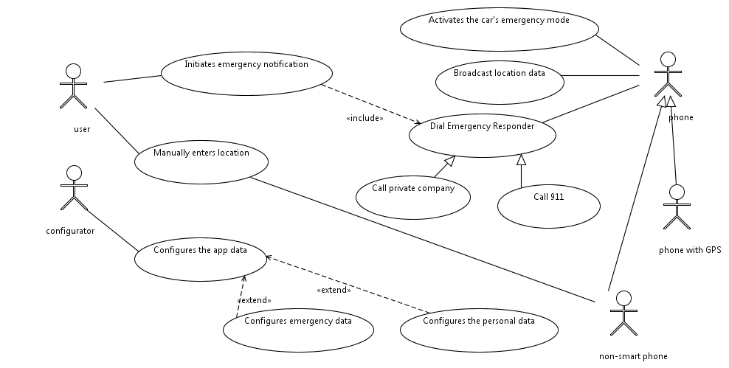

Slide 7
Operations on Models
Partitioning – break the model elements into parts
Abstraction – eliminate details to find commonality
Projection – define a view on a portion of the model

Slide 8
Partitioning
A use case may be long and complicated or you may recognize that part of one use case is also part of another use case.
Modularity is a fundamental software engineering construct.
A design that is modular is less complex than one that is not.

Slide 9
Abstraction
An actor is a specific role
By abstracting we can define an abstract actor for a broad role and then more concrete actors under that
Abstraction is a fundamental software engineering construct.
Abstraction enhances reuse and reduces complexity.

Slide 10
Projection
A stakeholder may only be interested in those uses in his/her department and would like not to be distracted by other uses.
In a use case diagram we can hide those use cases that a viewer should not have to try to understand.
Projection is a fundamental modeling operation.
It reduces the cognitive load on the viewer.

Slide 11
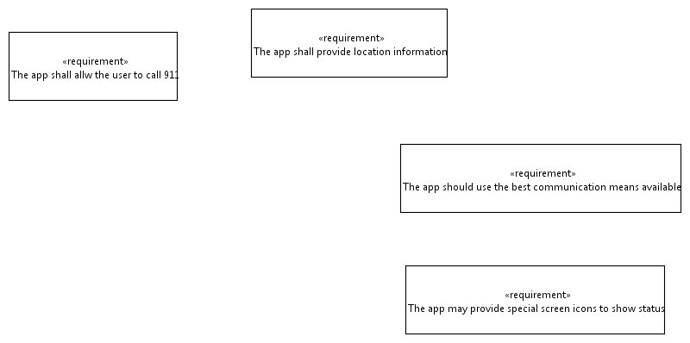

Slide 12
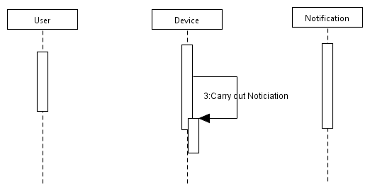
1:Initiate notification
2: Create notification

Slide 13
Requirements review/inspection
The terms review and inspection are often used interchangeably but there are some differences.
A review is usually a less formal read through by individuals while an inspection is usually a team process done together.
Either may result in a formal report.
What criteria are used for the inspection? How do you get those criteria?

Slide 14
Review of use cases
http://www.interface.ru/rational/rup51/process/activity/ac_rvbuc.htm

Slide 15
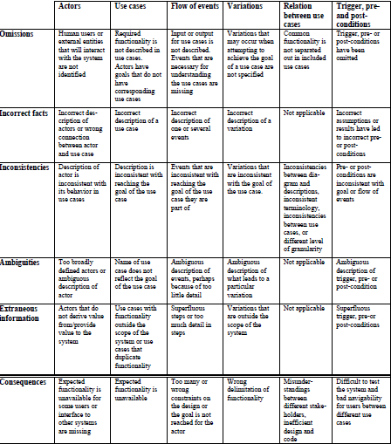

Slide 16
1. Actors
1.1. Are there any actors that are not defined in the use case model, that is, will the system communicate with any other systems, hardware or human users that have not been described?
1.2. Are there any superfluous actors in the use case model, that is, human users or other systems that will not provide input to or receive output from the system?
1.3. Are all the actors clearly described, and do you agree with the descriptions?
1.4. Is it clear which actors are involved in which use cases, and can this be clearly seen from the use case diagram and textual descriptions? Are all the actors connected to the right use cases?
2. The use cases
2.1. Is there any missing functionality, that is, do the actors have goals that must be fulfilled, but that have not been described in use cases?
2.2. Are there any superfluous use cases, that is, use cases that are outside the boundary of the system, do not lead to the fulfilment of a goal for an actor or duplicate functionality described in other use cases?
2.3. Do all the use cases lead to the fulfilment of exactly one goal for an actor, and is it clear from the use case name what is the goal?
2.4. Are the descriptions of how the actor interacts with the system in the use cases consistent with the description of the actor?
2.5. Is it clear from the descriptions of the use cases how the goals are reached and do you agree with the descriptions?

Slide 17
3. The description of each use case
3.1. Is expected input and output correctly defined in each use case; is the output from the system defined for every input from the actor, both for normal flow of events and variations?
3.2. Does each event in the normal flow of events relate to the goal of its use case?
3.3. Is the flow of events described with concrete terms and measurable concepts and is it described at a suitable level of detail without details that restrict the user interface or the design of the system?
3.4. Are there any variants to the normal flow of events that have not been identified in the use cases, that is, are there any missing variations?
3.5. Are the triggers, starting conditions, for each use case described at the correct level of detail?
3.6. Are the pre- and post-conditions correctly described for all use cases, that is, are they described with the correct level of detail, do the pre- and post conditions match for each of the use cases and are they testable?
4. Relation between the use cases:
4.1. Do the use case diagram and the textual descriptions match?
4.2. Has the include-relation been used to factor out common behavior?
4.3. Does the behavior of a use case conflict with the behavior of other use cases?
4.4. Are all the use cases described at the same level of detail?

Slide 18
Inspection criteria
Complete – nothing can be added that changes the model
Correct – what is present is accurate
Consistent – any contradictions between model elements are accompanied by appropriate constraints

Slide 19
Inspection
Understand the problem being solved
How complete is the set of actors?
Does each use accurately reflect how the problem should be handled?
Is each top level use really a use someone would make of the system?

Slide 20
Inspection

Slide 21
Investment decision
The software engineer is responsible for presenting sufficient data that the responsible parties can make a thoughtful decision.
The extent of this data will vary widely from organization to organization.
But it will usually include a very high level statement of requirements. The most significant, highest priority and those that clearly relate to the business goals.

Slide 22
Decision - 1
At the very least there is an estimate of the cost of the project.
At the best there is also an estimate of the value of the project.
Just as when you are designing software, decomposing the project into parts makes it easier to estimate cost and value.

Slide 23
Decision - 2
The investment decision is based on the amount that must be expended/invested before revenue streams produce cash flow.

Slide 24
Hazard/Safety Analysis
http://santoslab.org/pub/mdcf-architect/HazardAnalysis.html

