Slide 1

CPSC 372
John D. McGregor
Module 3 Session 2
Architecture Analysis/Design

Slide 2
New exam date
Sept 29th
Sept 27th question day

Slide 3
Design
Architecting is design
It is very high-level design, but the rules of design apply
But the decisions that are made vary depending upon the system context
The structures include bundles of functionality (classes, packages) but also control flow and data flow
There are also static vs dynamic perspectives

Slide 4
Basic design principles
http://learndesignprinciples.com/
UML tutorial
http://edn.embarcadero.com/article/31863

Slide 5
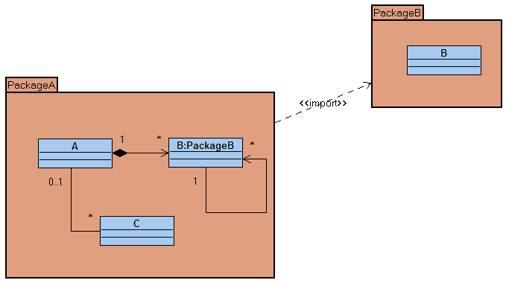
Static

Slide 6
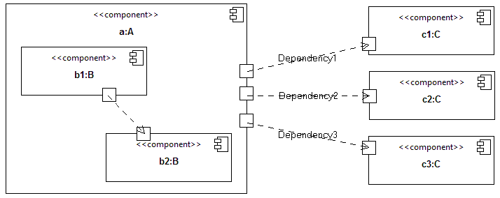
Dynamic

Slide 7
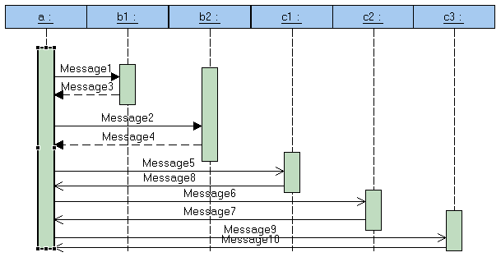
Dynamic, more detail

Slide 8
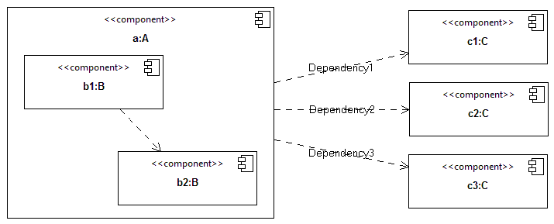
Different perspectives and levels

Slide 9
Design Principles
Abstraction
Coupling and cohesion
Decomposition and modularization
Encapsulation/information hiding
Separation of specification from implementation
Sufficiency, completeness and primitiveness

Slide 10

Abstraction
Removal of detail to focus on essentials
Sometimes handled by folding
Representing a real world object such as a house as a graphic is abstraction
Representing any real world object in software is an abstraction
Downsides: loss of accuracy; reduced testability

Slide 11
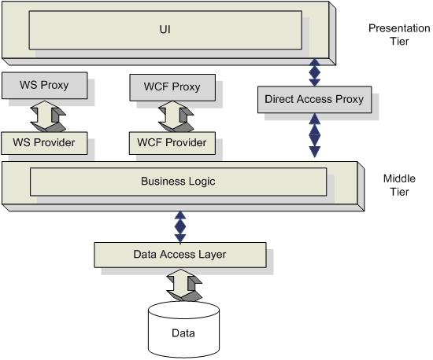
Layers
Layering abstracts away details.
The “hardware abstraction layer” is the layer between the hardware and your application.
Enhances portability.
Separates concerns

Slide 12
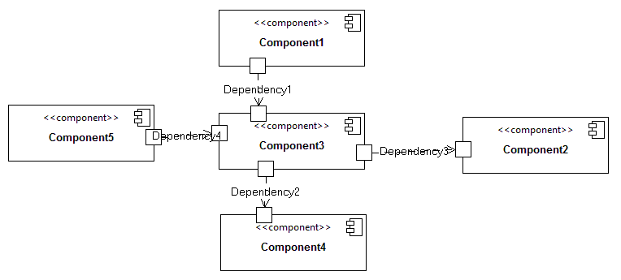
Interfaces in layering
An component “provides” services/capabilities through an interface
A component “requires” services/capabilities from other components

Slide 13
Coupling and Cohesion
Two objects are tightly coupled when almost every time one object is changed, the other must be changed as well.
Coupling refers to a relationship BETWEEN two entities.
If there are few relationships between two modules then coupling is low.
If coupling is high the architect may decide to encapsulate the two entities into one.

Slide 14
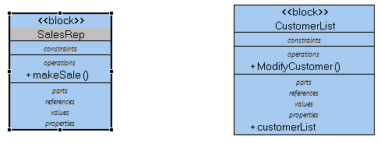
Coupling
modifyCustomer
Return Customer
SalesRep writes a string to the name field of the customer record
OR
SalesRep uses methods on the Customer object to change the name
Affects maintainability and extensibility

Slide 15
Coupling and Cohesion
An object is cohesive if the properties and the functions can’t be divided into subsets that have no overlap.
Cohesion refers to a relationship WITHIN an entity.
If the features within a module are strongly related then cohesion is high.
If cohesion is low the architect may want to divide the module into two or more modules.

Slide 16
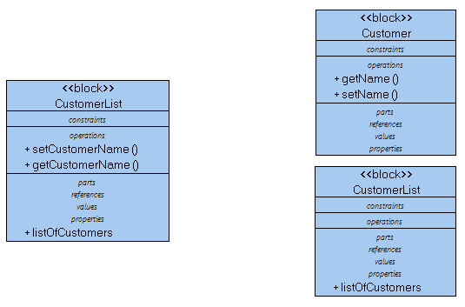
Cohesion
Methods access list
data structure and
members of the list
Methods access list
data structure OR
members of the list

Slide 17
Decomposition and modularization
By decomposing we have 2 modules instead of one. Each is more
Isolated from the other. One can be changed without affecting the other.

Slide 18
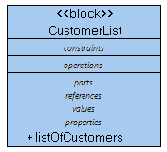
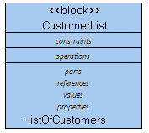
Encapsulation/information hiding
I distinguish between these two where other people often do not.
Encapsulation is packaging that allows movement or copying from one place to another. A class encapsulates the operations and properties defined within so that it is easy to use this definition in another program. Java makes it even easier by encapsulating a class in a file.
Marking a definition in a class as private prevents elements outside the class from manipulating it directly.
Public, encapsulated definitions can be accessed from anywhere.

Slide 19
Separation of specification from implementation
Information hiding is used to enforce the separation of the specification from the implementation. Users are forced to use the interface methods in the specification.
System message
sendMessage();
End message;
System implementation message.plainText
End message;
System implementation message.encrypted
End message;

Slide 20
Sufficiency, completeness and primitiveness
Start with smallest pieces
Build up through aggregation/composition
Encapsulate each new concept and protect using information hiding
Stop when it is complete
Don’t elaborate just to be elaborating; add when it adds value

Slide 21
2 perspectives
Static, definition time architecture
Dynamic, runtime architecture
Must visualize the runtime for many of the design issues

Slide 22
Design Issues
Concurrency
Control and Handling of Events
Distribution of Components
Error and Exception Handling and Fault Tolerance
Data Persistence
Interaction and Presentation

Slide 23
Concurrency
Two issues – time and order
Timing
  Two things can not physically happen at the same time in a concurrent program but they can logically
  Two things can physically happen at the same time in a parallel program
Process/thread
  Processes are heavy weight; clear all data registers when switching from one to another
  Threads are light weight; only clears instruction pointer
Concurrency is used when it makes the control flow simpler

Slide 24
Concurrency - 2
Break the solution into blocks that can be worked on independently
As long as there are no shared (process level) variables, threading is easy
When two threads will access the same data in write-mode there must be some level of synchronization
  May be logical – the developer is “certain”
  May be code-based – structures “lock” the location
Many schemes for locking

Slide 25
Control and Handling of Events
An event is an object created in response to some outside stimulus
This allows the action to be passed around the system.
A registry allows “handlers” to register their interest in certain events.
When an event is created the registry sends the event out to all handlers (broadcast) or to only those registered for the type of event (point-to-point)

Slide 26
Architecture Pattern
Event
2
Event generator
4
generate
3
notify
Event Handler
Registry
register
1
Event handling is so routine that we have standard patterns and
some languages, like Java, have implementations that are reusable.

Slide 27
Distribution of Components
A type of computing in which different components and objects comprising an application can be located on different computers connected to a network.
What is “different computer”?
  Processes
  Cores
  Physical boxes
Multi-core, many-core, dual core all have more than one CPU co-located in the same box
A single application can have multiple operations at the same time.

Slide 28
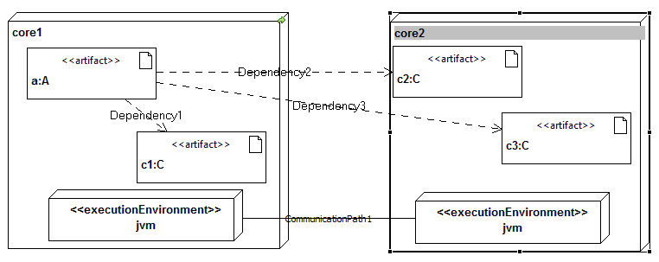
Distribution of Components - 2

Slide 29
Error and Exception Handling and Fault Tolerance
When a location having a fault is executed that result is propagated along the data flow of the program
That faulty execution may cause other executions to be in error even though there is no fault at that location.
If the result propagates that will lead to a failure to satisfy the specification.
Detecting the error as soon as possible requires program logic to perform checks of type and magnitude
Then when it is detected where do we want flow of data/control to go?

Slide 30
Error and Exception Handling and Fault Tolerance - 2
Exception handling provides a means to interrupt normal flow and give it to an exception handler.
The handler may correct the data locally and resume normal flow or
The handler may decide it can not correct and hand control to the next handler in a hierarchy of handlers

Slide 31
Error and Exception Handling and Fault Tolerance - 3
Try/catch in Java and C++ are implementations of this pattern
The details of what the exception handler does is component design
But the overall flow is architectural because it cuts across modules

Slide 32
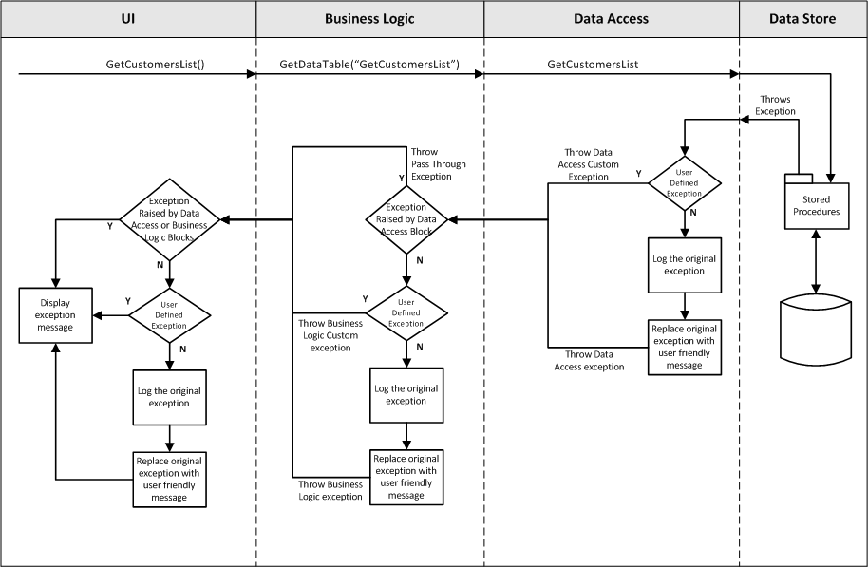
From:http://www.codeproject.com/KB/exception/expceptionhandling-3-tier.aspx

Slide 33
Fault tolerance
Some errors can’t be avoided but we can tolerate them. After an exception is caught…
Cancel an operation
Reset to default values
…
Even rerunning the same algorithm again might work due to “context”

Slide 34
Data Persistence
Local variables, return values, parameters, class variables, global variables
Configuration files, data files, caches, database tables
Persistent – data is available after its scope is exited
Becomes architectural when it persists across module boundaries

Slide 35
Data Persistence - 2
Data flow is a fundamental “structure” of a system
Every piece of data has a lifetime and it should happen by design not by accident
Choice of storage is due to type of data and performance requirements

Slide 36
Interaction and Presentation
Response to a user should be fast
Data from a user should be validated as close to the user as possible
Interaction should eliminate as many mistakes as possible – a spinner widget with the names of states so spelling errors are eliminated
Usability – choice of colors, localization

Slide 37
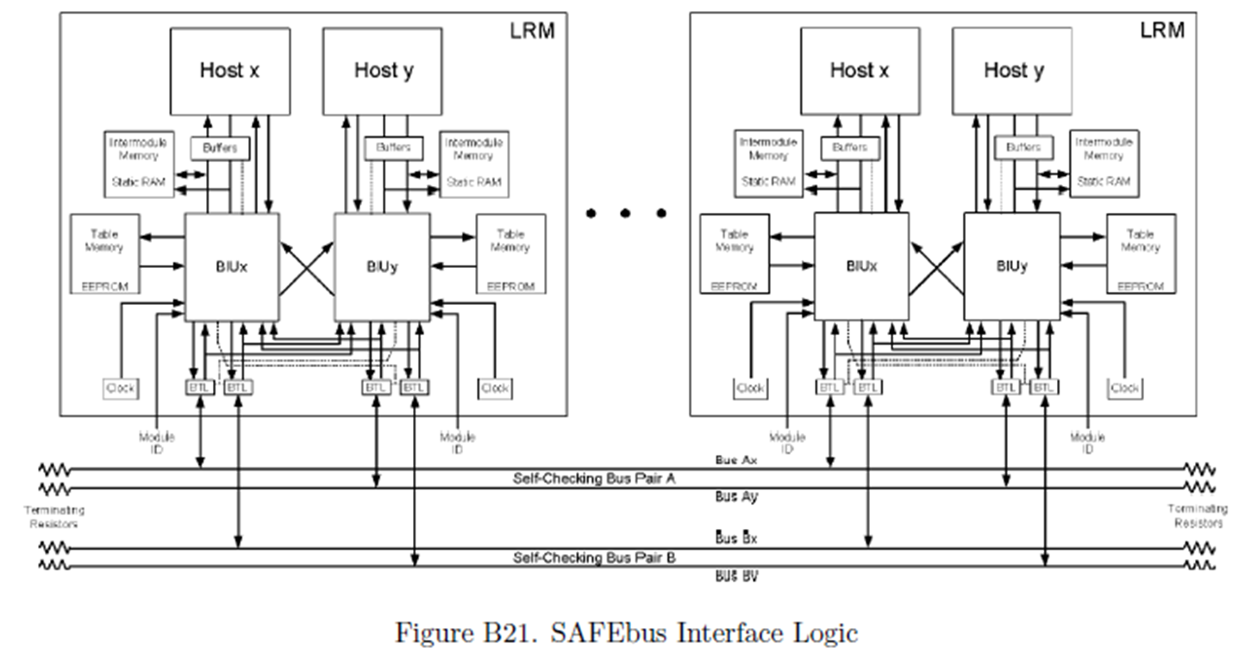
Symmetry

