Slide 1

CPSC 372
John D. McGregor
Module 3 Session 7
Process Assignment

Slide 2
Architecture drivers
What needs to change the fastest? What will change the slowest?
Who needs to know about whom?

Slide 3
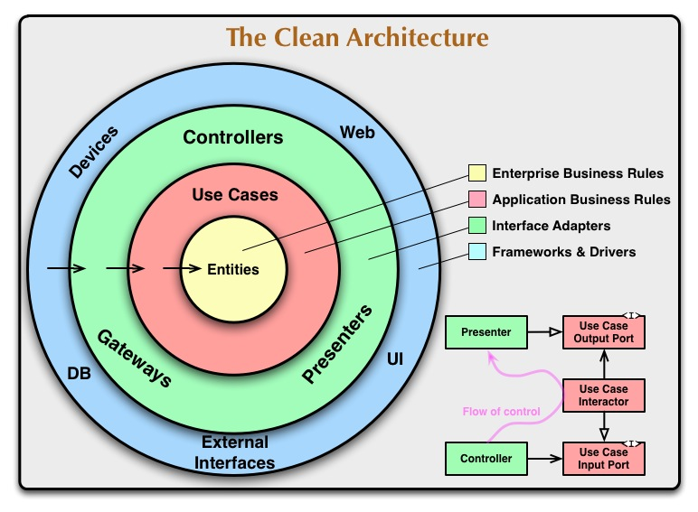
What goes where?

Slide 4
For Thursday: Be able to view these pages in class
http://developer.android.com/design/patterns/new.html
http://www.cs.gordon.edu/courses/cs211/AddressBookExample/index.html
http://www.cs.gordon.edu/courses/cs211/ATMExample/index.html

Slide 5
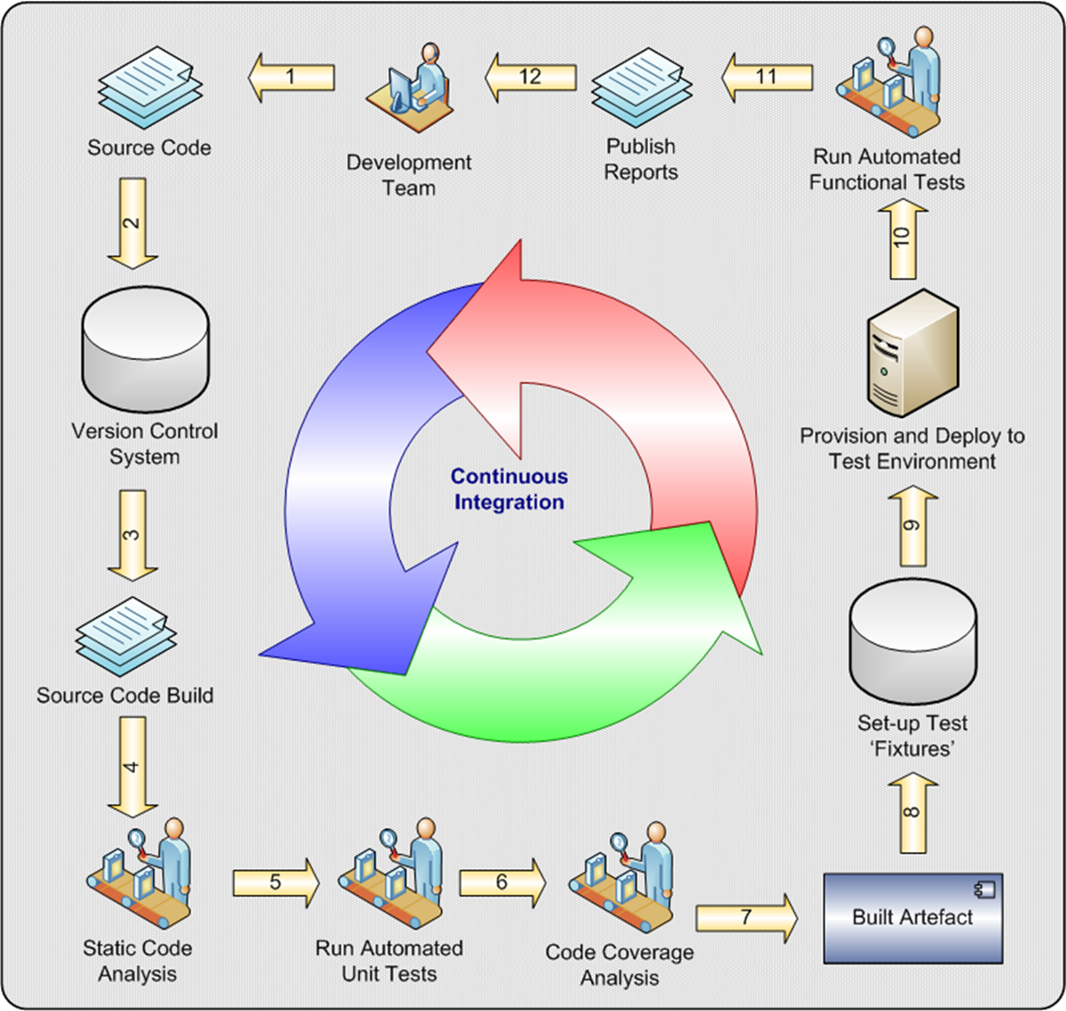

Slide 6
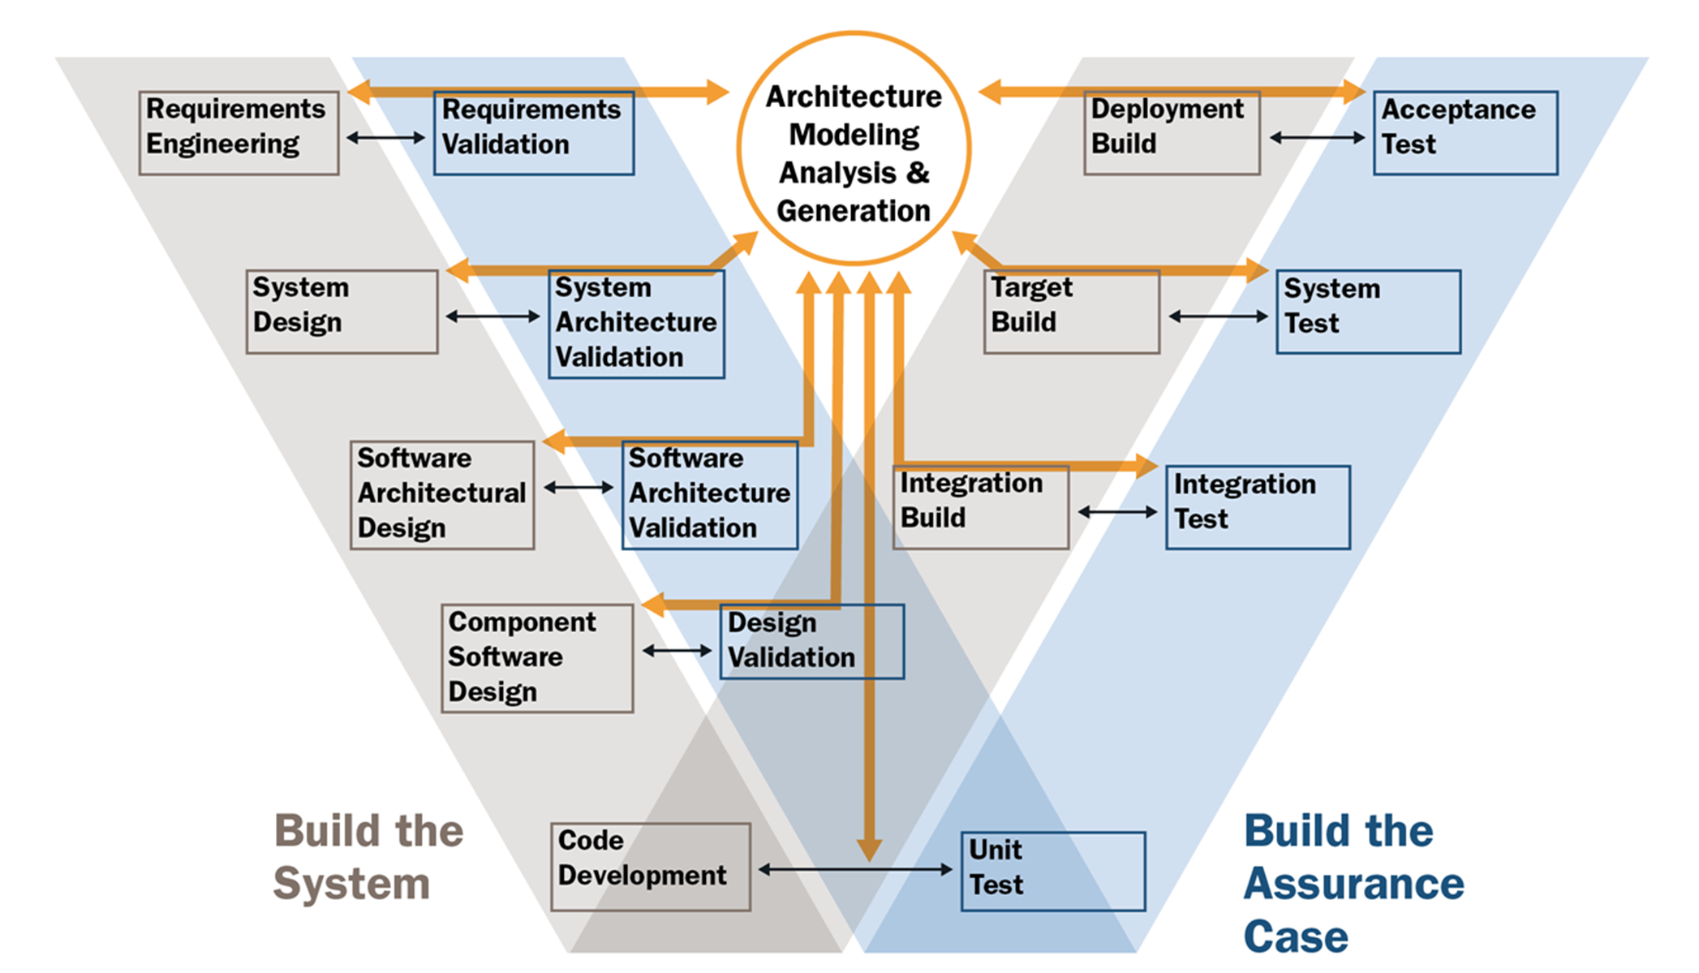

Slide 7
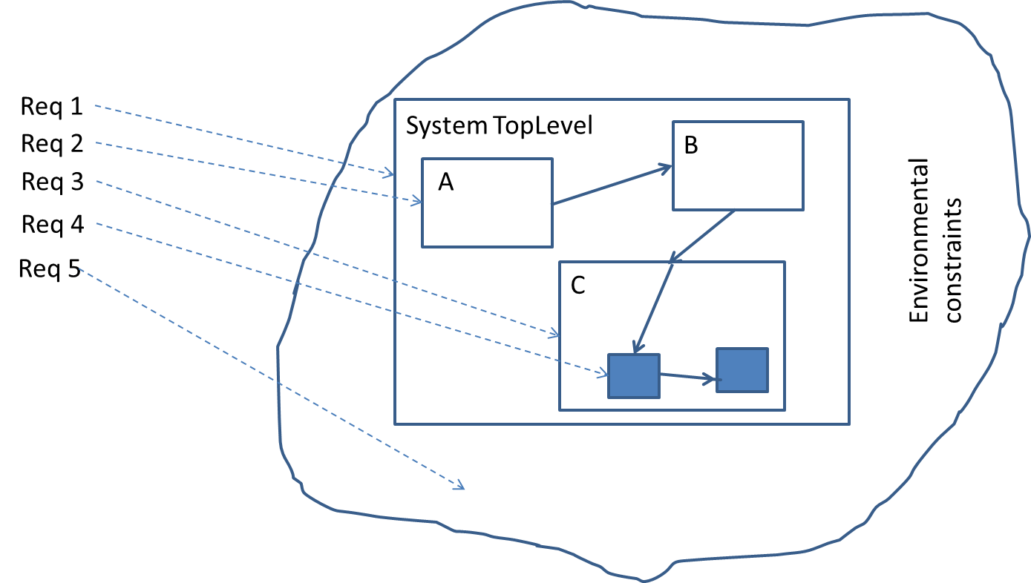
Requirements hierarchy

Slide 8
Here’s what you are going to do
Using English text describe the CLEAN Architecture for your app.
Using EPF and the Bootstrap process description describe in more detail a requirements process and architecture definition process that could be used. Write a separate one page description of what you added to Bootstrap.
Commit all to Bitbucket by 11:59 PM Sept 19th

