Slide 1

CPSC 372
John D. McGregor
Module 4 Session 3
Static analysis

Slide 2
OSATE
Download the lastest stable release of OSATE
http://osate.github.io/
Install and get familiar with it

Slide 3
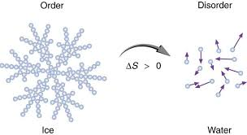
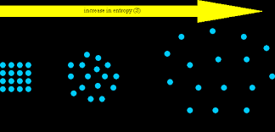
Entropy
lack of order or predictability; gradual decline into disorder

Slide 4
Using design patterns
This url starts a series of blogs that explain parts of the implementation:
http://www.therealjoshua.com/2012/09/android-architecture-structuring-network-calls/
http://www.therealjoshua.com/2012/09/android-architecture-structuring-network-calls-part-2/
http://www.therealjoshua.com/2012/10/android-architecture-structuring-network-calls-part-3/

Slide 5
Assignment: Understand the design and implementation of a program
Do a diagram that shows dependencies among the files in the project.
Use: http://www.agilej.com/ or some other program
Follow their page to get started
Identify patterns used in the code.
Identify language idioms used in the code.
Submit the diagrams and a brief description of the patterns/idioms
Submit by Oct 10th 11:59PM

Slide 6
Understand Java
https://scitools.com/download/?gclid=CJmsvP-9v88CFdRyfgodBdsGmQ
Use Brickles program from resource page
Analyze
Create a report
Submit by Oct 10th 11:59PM

Slide 7
Resources
https://www.google.com/search?q=static+analysis+ppt&ie=utf-8&oe=utf-8
https://www.google.com/search?q=static+analysis+ppt&ie=utf-8&oe=utf-8

