Slide 1

CPSC 372
John D. McGregor
Module 6 Session 4
Sonar

Slide 2
BricklesProject
Download and unzip the BricklesProject zip
Import the BricklesProject into your Topcased
The project can be executed by right clicking on the BricklesView.java file. Select Java Applet and it should execute.

Slide 3
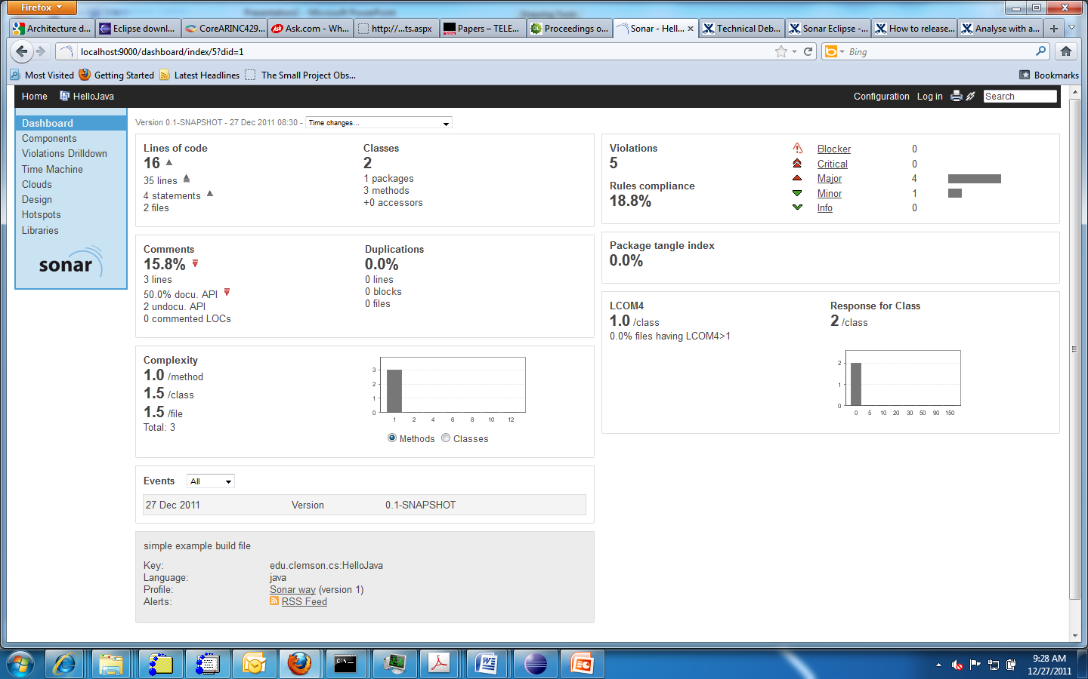
Sonar introduction

Slide 4
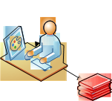
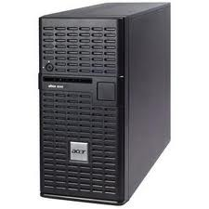
Sonar system architecture
Sonar has a server
that performs the analyses
Sonar client runs in browser
Sonar client runs in Eclipse
Sonar client runs from command line
The server may be for a project or a company.

Slide 5
Installation
Install server on your machine
Install the Eclipse plug-in into your Topcased setup
When a new Eclipse project is created, associate it with Sonar
Create Users in sonar
Assign Users to projects

Slide 6
Sonar startup
Sonar is a static analysis tool for code
Download from:
http://www.sonarsource.org/downloads/
Unzip
from the bin/win32-x86 click on StartSonar for a windows system
this will start the Sonar server
It will listen on localhost:9000

Slide 7
Eclipse sonar
Download the plug-in
http://docs.codehaus.org/display/SONAR/Sonar+Eclipse
Follow the installation instructions to add it into your Topcased installation

Slide 8
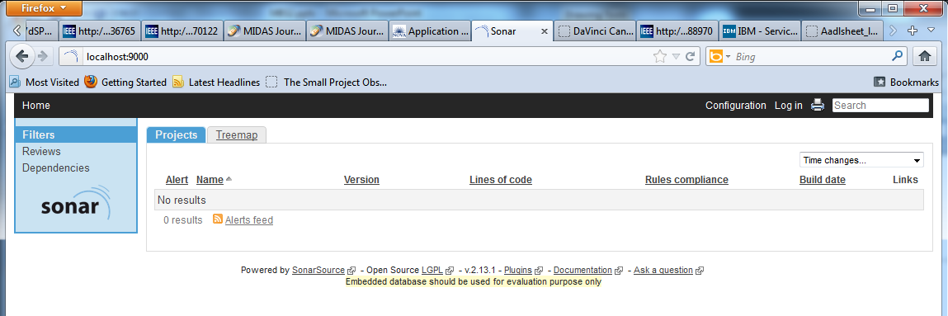
Sonar initial screen
Browse to localhost:9000 using any browser

Slide 9
Sonar startup
There is a wink tutorial on getting a program up and running with Sonar.

Slide 10
New project
Any new project – add the Sonar nature to the project
Login to Sonar and assign yourself as the User of the project

Slide 11
Associate an Eclipse project with Sonar

Slide 12
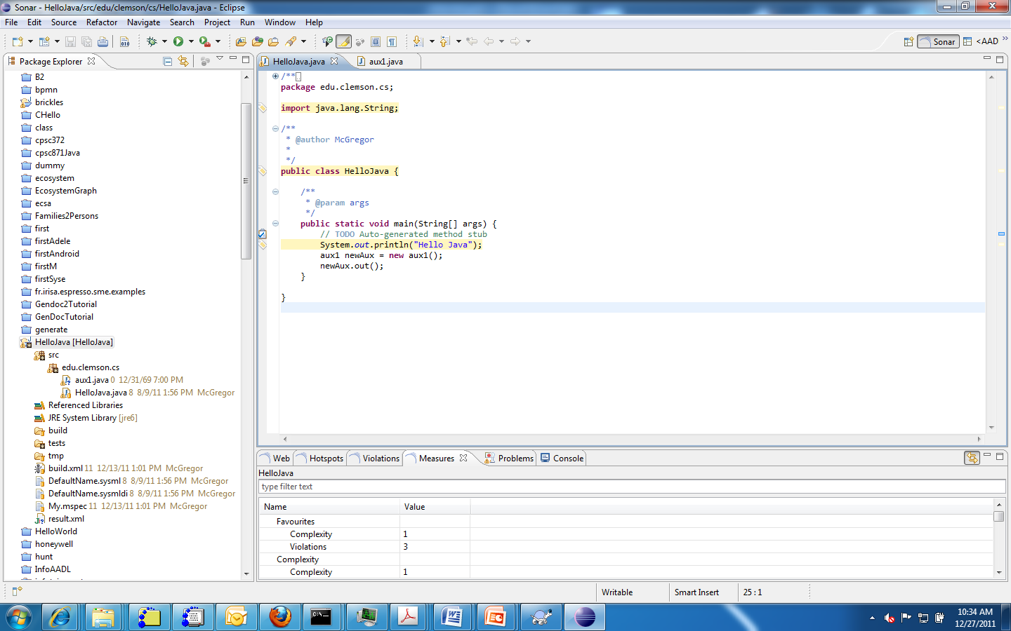
Markers appear in the source editor to indicate Sonar issues

Slide 13
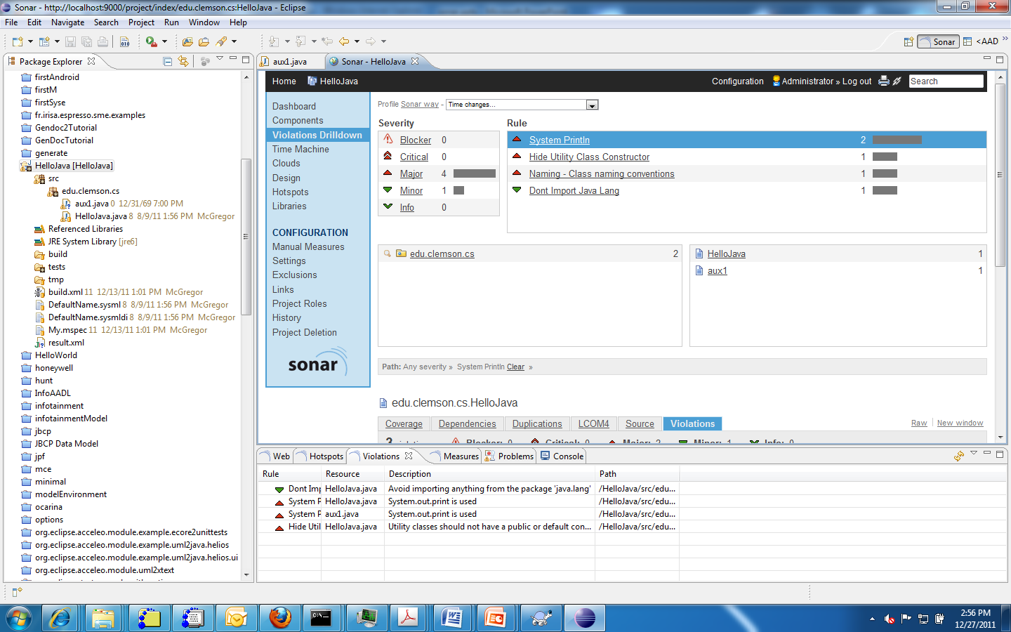
Use violation drill down to locate individual statements

Slide 14
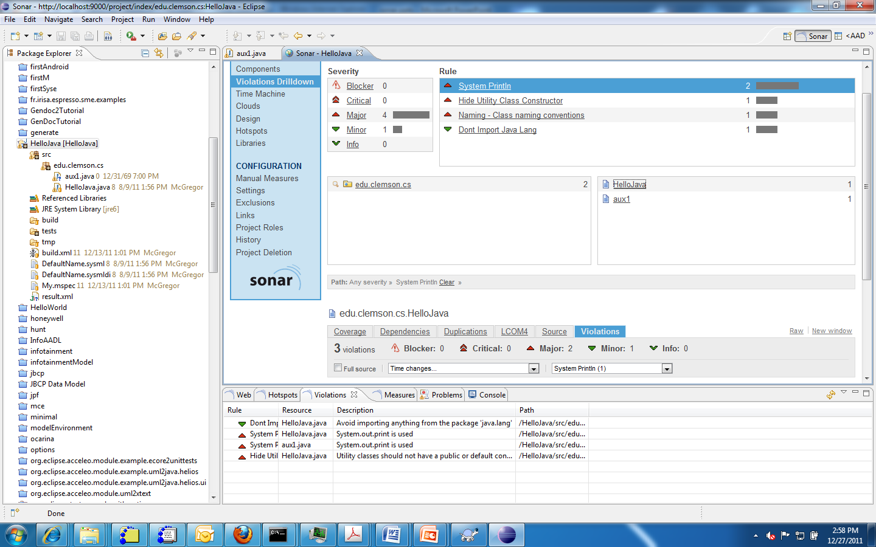
Drill down in unit

Slide 15
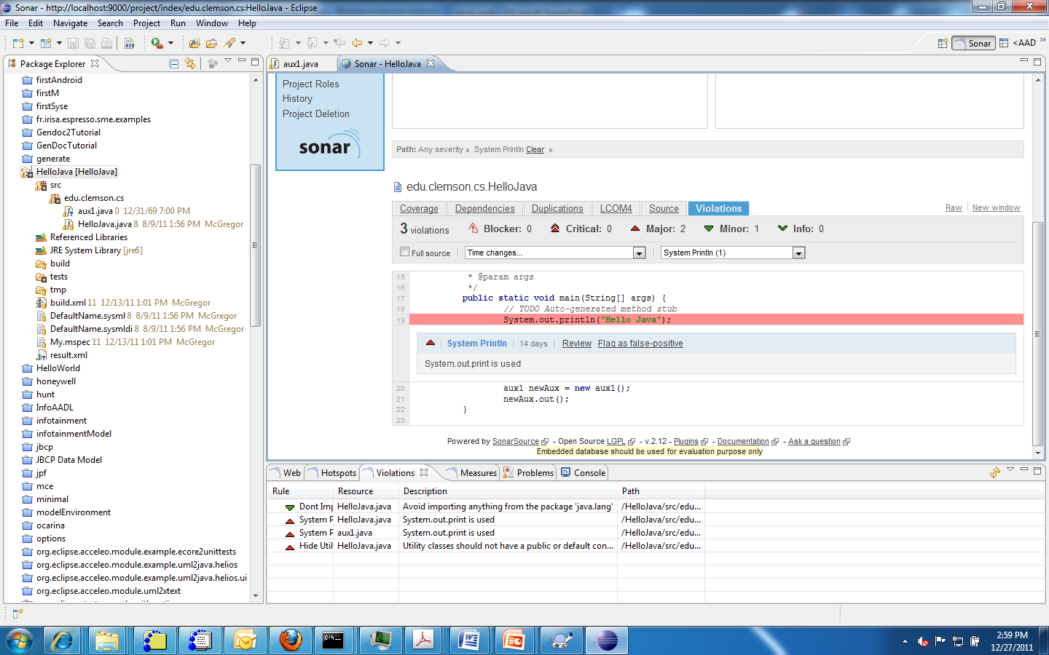
Manual Reviews

Slide 16
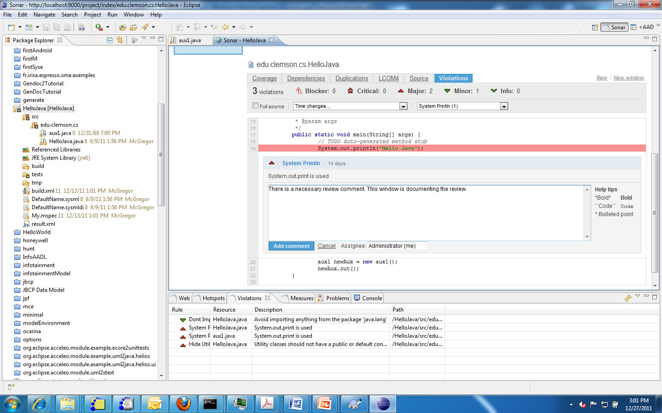
A review begins with the assignment to a reviewer and adding a comment

Slide 17
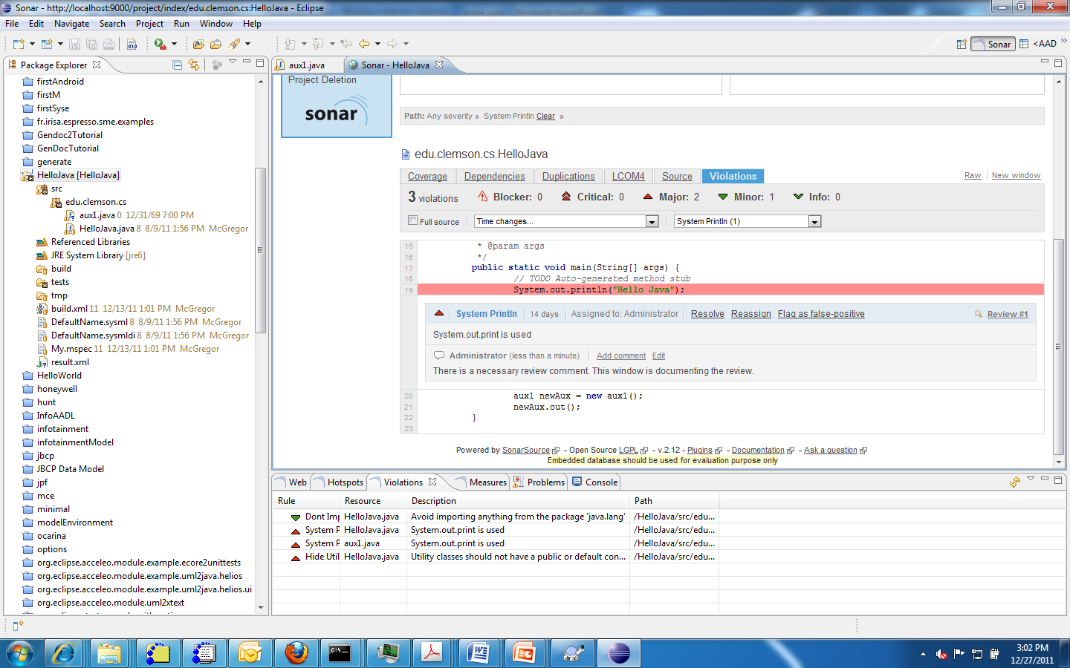
Hovering over violation brings up resolution choices
Pops up

Slide 18
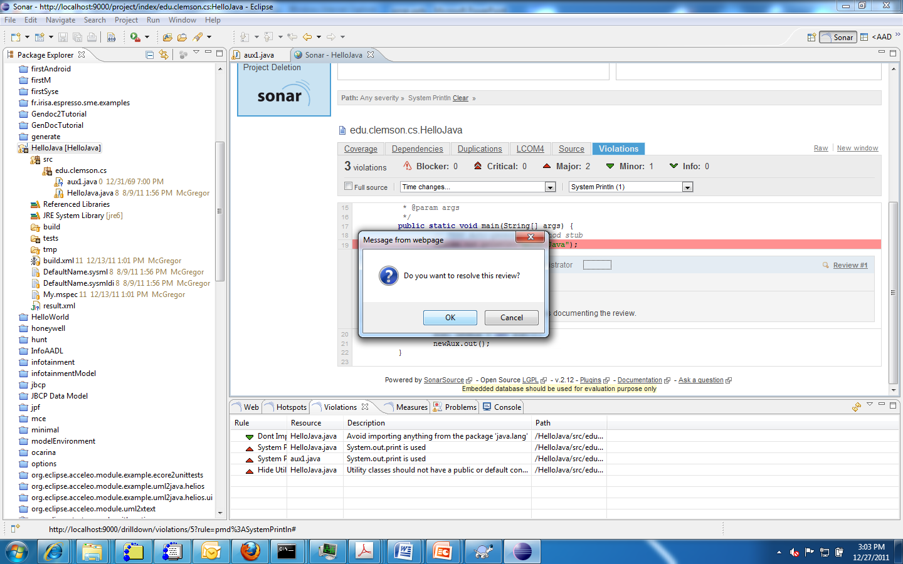
Reviewer has decided on action

Slide 19
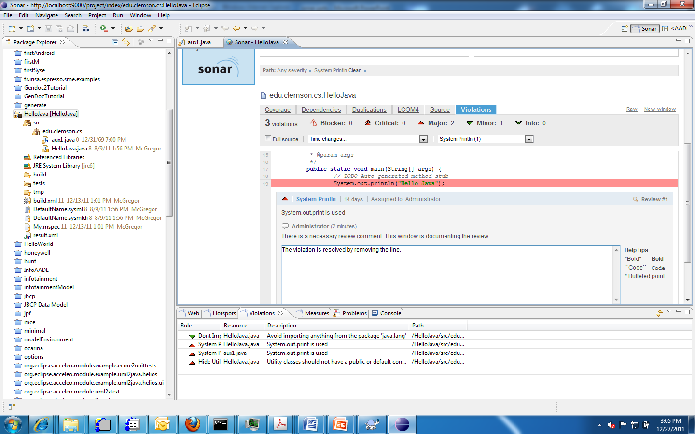
Reviewer fixes violation and adds comment.
Reviewer fixes the violation

Slide 20
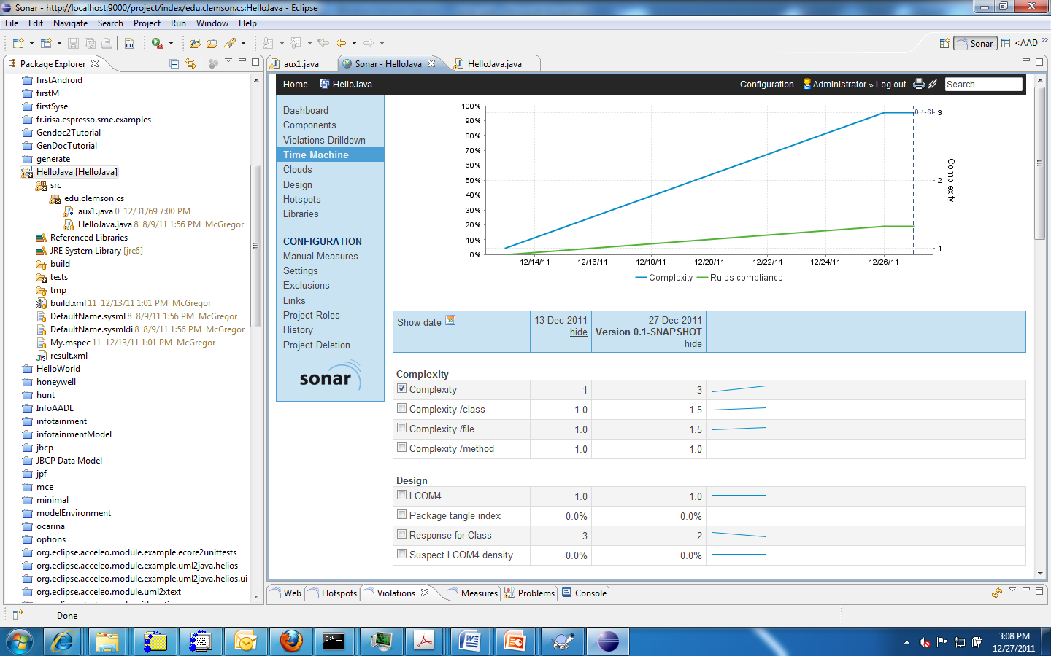
Time machine shows changes across multiple builds

Slide 21
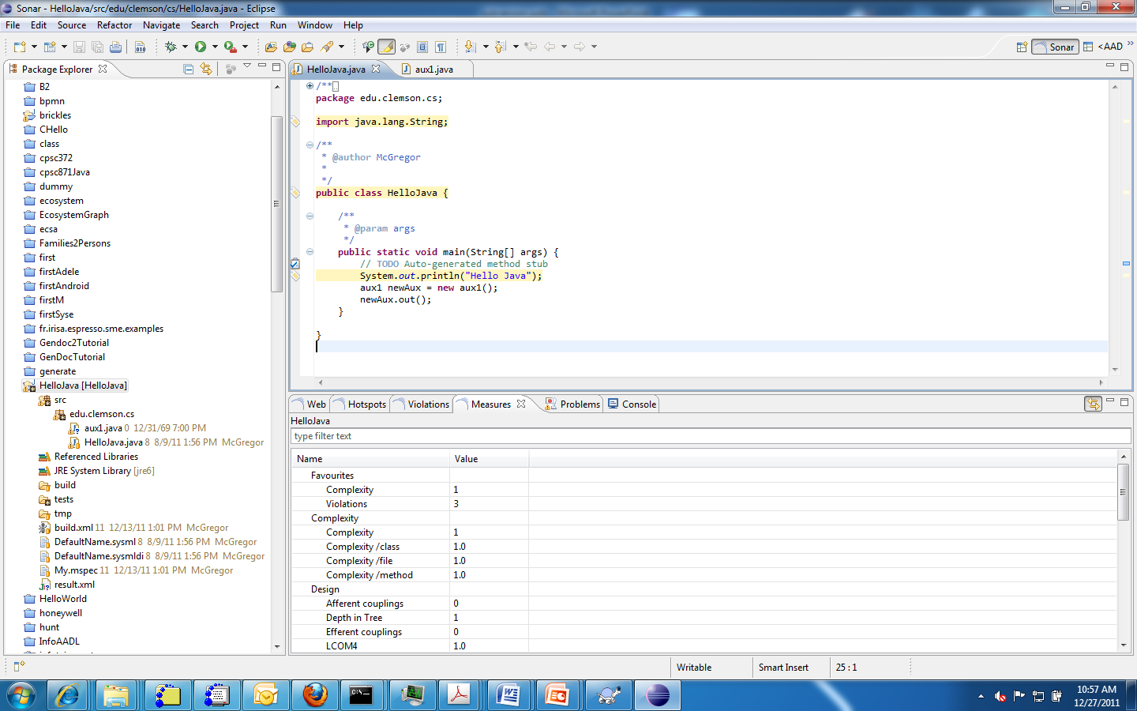
Use the Sonar perspective to open all the windows needed
The same measures as shown
In the web browser are in these
windows

Slide 22
Metrics
Sonar has a number of built-in measures that are applied to every build of the product
There are many plug-ins of additional metrics that can be added to the server.

Slide 23
Here’s what you are going to do
Install Sonar
Import the Brickles project into Topcased
Build the project
Look at the Sonar DashBoard
Explore how to conduct a design review using Sonar
Submit a screen shot of your code dashBoard for Brickles
Follow the review process to generate a review report

