Slide 1

CPSC 372
John D. McGregor
More on Design

Slide 2
Early life cycle
We start with requirements. Functional/No-functional
These drive the architecture. We look for patterns, styles, qualities, but must also accommodate frameworks and existing components.
We use tutorials, blogs, forums, and documentation about the existing pieces.
Now we go inside the modules. How will each module manipulate its inputs to produce the expected outputs?

Slide 3
MVC
How do we design the controller?
The major element type is an “event”
The explicit logic for events is not sequential
What patterns do we have that handle this?
“Event handler” is a pattern for asynchronous communication.
So break down the controller into some event handlers. One per event type that it must be able to receive.

Slide 4
MVC - 2
The controller now has a set of event handlers
Each handler invokes a specific method in either M, V, or C
So the outputs of the controller design are messages to M and V, which were already recognized at a high level in the pattern.
The controller talks to M and V but they do not talk to C.
Then we move on to M or V and decompose each of those.

Slide 5
MVC-3
At the same time that we are dividing up behavior, we should be dividing up data.
One drives the other.
MVC has two main groups of data: events and the content being managed by the program.
The controller is the source of events and the data associated with them (where was the mouse when it was clicked…)
The model consumes the event data but stores content data such as software metrics that have been calculated.
All of the data makes up the state of the model but much of the data may not be represented as stateful.

Slide 6
MVC - 4
A view retrieves some data from the model
But this data usually will just be displayed as retrieved
The model may munch the data and produce new data, like summaries
The design of the model will be the most complex
The model has algorithms for modifying data

Slide 7
MVC-5
Consider the state of the entire phone
Many concurrent things happening
Many interactions that must be controlled
Relate data to all workflows that will use it
Synchronize at data writes

Slide 8
All Together
Behavior and data
What behavior creates, modifies, moves, uses, deletes each data element?
Use sequence diagrams and state machines.
The transitions in the state machines are behaviors shown in the sequence diagrams

Slide 9
Now lets step back and look at design principles
You need to have certain general design goals as background when you design a piece

Slide 10
Previously
We have talked about
Separation of concerns
Information hiding
Encapsulation
Minimize coupling/Maximize cohesion
Attribute driven design (quality attributes)

Slide 11
Good design
"You know you've achieved perfection in design, not when you have nothing more to add, but when you have nothing more to take away" - Antoine de Saint-Exupery
10. Considers the Sophistication of the Team that Will Implement It
9. Uniformly Distributes Responsibility and Intelligence
8. Is Expressed in a Precise Design Language
7. Selects Appropriate Implementation Mechanisms
6. Is Robustly Documented
5. Eliminates Duplication
4. Is Internally Consistent and Unsurprising
3. Exhibits Maximum Cohesion and Minimum Coupling
2. Is as Simple as Current and Foreseeable Constraints will Allow
1. Provides the Necessary Functionality
http://www.theserverside.com/news/thread.tss?thread_id=26021

Slide 12
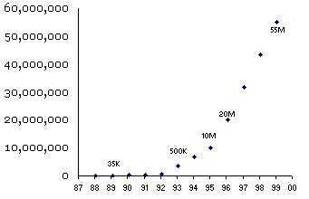
Good software takes 10 years, get used to it.
This is a chart showing the number of installed seats of the Lotus Notes workgroup software, from the time it was introduced in 1989 through 2000. In fact when Notes 1.0 finally shipped it had been under development for five years. Notice just how dang long it took before Notes was really good enough that people started buying it. Indeed, from the first line of code written in 1984 until the hockey-stick part of the curve where things really started to turn up, about 11 years passed. During this time Ray Ozzie and his crew weren't drinking piña coladas in St Barts. They were writing code.
http://www.joelonsoftware.com/articles/fog0000000017.html

Slide 13
R. Buckminster Fuller:
“When I am working on a problem I never think about beauty. I think only how to solve the problem. But when I have finished, if the solution is not beautiful, I know it is wrong.”

Slide 14
Design guidelines
https://www-01.ibm.com/software/ucd/designconcepts/designbasics.html

Slide 15
Quality with a Name.
http://www.jamesshore.com/Articles/Quality-With-a-Name.html
http://blog.extremeplanner.com/2006/04/what-is-good-software-design.html
Every design decision is made in the context of the whole design. The problem being solved; the other design decisions that have been made; the time schedule; the available pool of programming talent; etc., etc.
Context makes every piece of specific design advice suspect. I'm not saying that you shouldn't listen to it... you should! But at every moment, you should ask yourself: "When is this not true? What is the author assuming?"

Slide 16
What is design? ... It’s where you stand with a foot in two worlds—the world of technology and the world of people and human purposes—and you try to bring the two together. – Mitch Kapor
http://hci.stanford.edu/publications/bds/1-kapor.html

Slide 17
http://www.stsc.hill.af.mil/resources/tech_docs/gsam4/chap15.pdf

Slide 18
Design methods
Structured Design
Hierarchical decomposition
Object Oriented Design
Models domain objects

Slide 19
Structured design
Take an algorithm and break it into parts and then break each of those parts into parts and then break each one of those …
Algorithm
Piece
Piece
Piece
Piece
Piece
Piece
Piece
Piece
Piece

Slide 20
Object-oriented design
Objects correspond to “real world” entities. Classes of objects are defined. Some relationships between classes result in messages between objects from the classes.
Customer
Account
Deposit
PayBill
Withdraw

Slide 21
Android framework
Activity is a central concept in the framework
MainActivity is a subclass and is the starting point for an app.
Put in here the initial things to do and the overall outline of logic.
Sets user interface buttons and connects them to methods in objects

Slide 22
Android framework - 2
MainActivity creates and wires together objects by passing them as parameters.
soundPool = new SoundPool(4, AudioManager.STREAM_MUSIC, 100);
soundPoolMap = new HashMap<Integer, Integer>();
soundPoolMap.put(soundID, soundPool.load(this, R.raw.siren, 1));
Button buttonPlay = (Button)findViewById(R.id.playSound);
buttonPlay.setOnClickListener(buttonPlayOnClickListener);
MainActivity
SoundPool
HashMap
Button

Slide 23
AndroidManifest.xml
When you look at MainActivity there is no sequential logic above Activity
There are additional files of instructions generated by the framework tools.
<application
android:icon="@drawable/ic_launcher"
android:label="@string/app_name"
android:theme="@style/AppTheme" >
<activity
android:name=".MainActivity"
android:label="@string/title_activity_main" >
<intent-filter>
<action android:name="android.intent.action.MAIN" />
<category android:name="android.intent.category.LAUNCHER" />
</intent-filter>
</activity>
</application>

Slide 24
Changing an application
Compiled vs interpreted
Instructions vs data
Static/design time
Modify code files
Create manifest entries
Static/ deployment time
Change manifest rather than the logic
Dynamic/run time
Change data files
Command line parameters

Slide 25
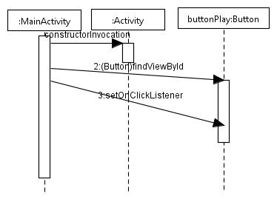
Tools to help visualize design
Modeling and storyboarding are two tools

Slide 26
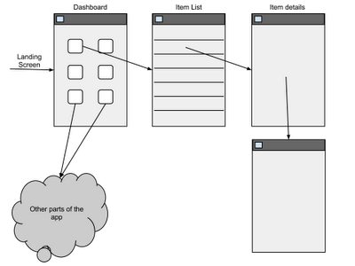
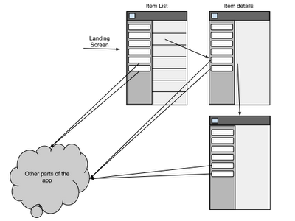
Storyboarding
http://www.androiduipatterns.com/2012/06/emerging-ui-pattern-side-navigation.html
http://android.cyrilmottier.com/?p=658
OR

Slide 27
Facebook
Open Graph – a basic architectural element for Facebook data
Fragment – a particular construct for defining a partial method
https://developers.facebook.com/docs/getting-started/facebook-sdk-for-android/3.0/

Slide 28
RescueMe
One button operation to ensure speed
No data entry – can’t think in an emergency
Config file – holds logins for broadcasting messages; Facebook login, etc
Alert both local and distributed

Slide 29
Implementation
Which language?
Java
PHP
C++
What are the characteristics that are important?
Are the qualities difficult to achieve?
If you have an SDK then you must be compatible.

Slide 30
http://arxiv.org/ftp/arxiv/papers/1008/1008.3434.pdf

Slide 31
Language
Who will be doing the programming?
What is the execution environment?
Strong typing vs weak typing
Deployment approach – classes, jars, executables, etc
Expressiveness

Slide 32
Assignment
Polish the design
Begin a systematic implementation.
Create a repository for the team’s code using SVN. Submit screen shots. Subversion.apache.org
Identify language idioms used in the Android SDK and other Android applications.
Document these idioms and explain what design elements each idiom corresponds to. Submit a word docx.

