Slide 1

CPSC 372
John D. McGregor
Module 8 Session 2
JUnit

Slide 2
Test First Programming
Look at the spec for a method
Write tests for it
Run the tests – they will fail because there is no implementation
Implement the method
Rerun the tests
Check results and correct method if there are failures

Slide 3
Test mechanism
Due to its dynamic nature Java provides powerful facilities for examining code.
JUnit was developed in the 1990’s as a reusable test framework that took advantage of that dynamic aspect to automatically assemble a set of test cases from a set of methods. Any method name that includes “test” is assumed to be a test case and is run by the framework.
This has been sufficiently successful that there are now other _Unit implementations for other languages.

Slide 4
Test code
In the next few slides we look at the PuckSupplyTest.java file from the BricklesProject.
The @Before before the method definition insures that the method is run just before each method.
Notice that several classes have to be instantiated in-order to test this one class. This is one of those situations in which writing the test cases early can inform about bad designs.
@Before
public void setUp() throws Exception {
System.out.println("In test setup");
bv = new BricklesView();
ag = new BricklesGame(bv);
pf = new PlayingField(ag);
}

Slide 5
Test code - 2
The annotation before this method signals that the method is a test case.
In this test case an instance of the PuckSupply class is created from scratch and then in the last line is queried to see if it contains the specified number of pucks.
The assertTrue method at the end of the test case is part of the Junit test framework. It returns true/false depending on whether the “numberLeft” method returns 3.
@Test
public void testNumberLeft() {
PuckSupply ps = new PuckSupply(pf);
assertTrue(ps.numberLeft()==3);
}

Slide 6
Test code - 3
From the AllTests.java class here is a way to create a single class that will execute a number test classes each with an arbitrary number of test cases.
package bricklesPackage;
import org.junit.runner.RunWith;
import org.junit.runners.Suite;
import org.junit.runners.Suite.SuiteClasses;
@RunWith(Suite.class) --- Suite.class is from the Junit framework
@SuiteClasses({ PuckSupplyTest.class }) --- all test classes are listed here
public class AllTests { --- No need for any implementation
}

Slide 7
Ant JUnit Task
<target name="runTests" depends="compile">
<junit printsummary="yes" haltonfailure="no">
<test name="bricklesPackage.AllTests" haltonfailure="no" outfile="result">
<formatter type="xml"/>
</test>
<classpath refid="junitclasspath" />
</junit>
</target>

Slide 8
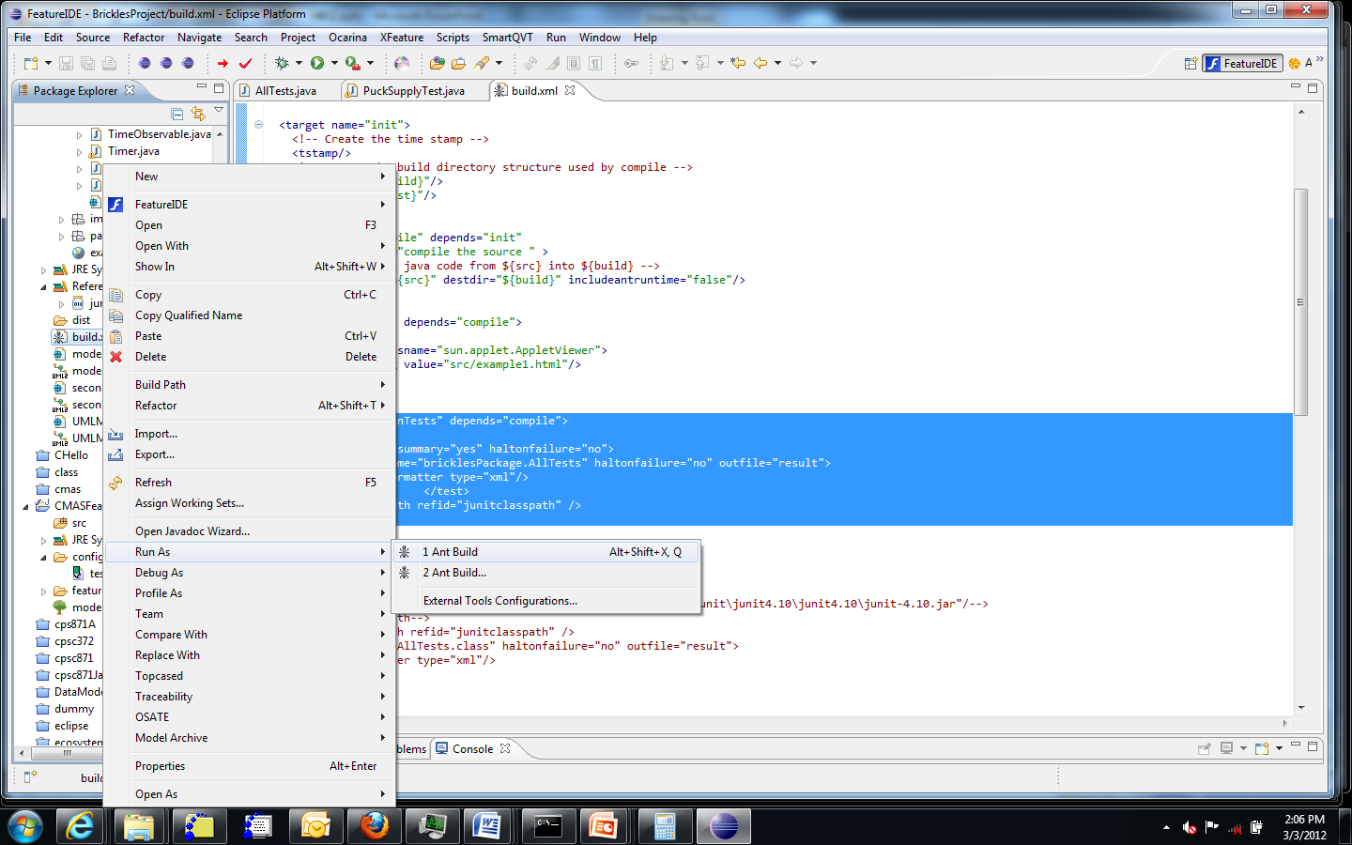
Setup targets in Ant Build

Slide 9
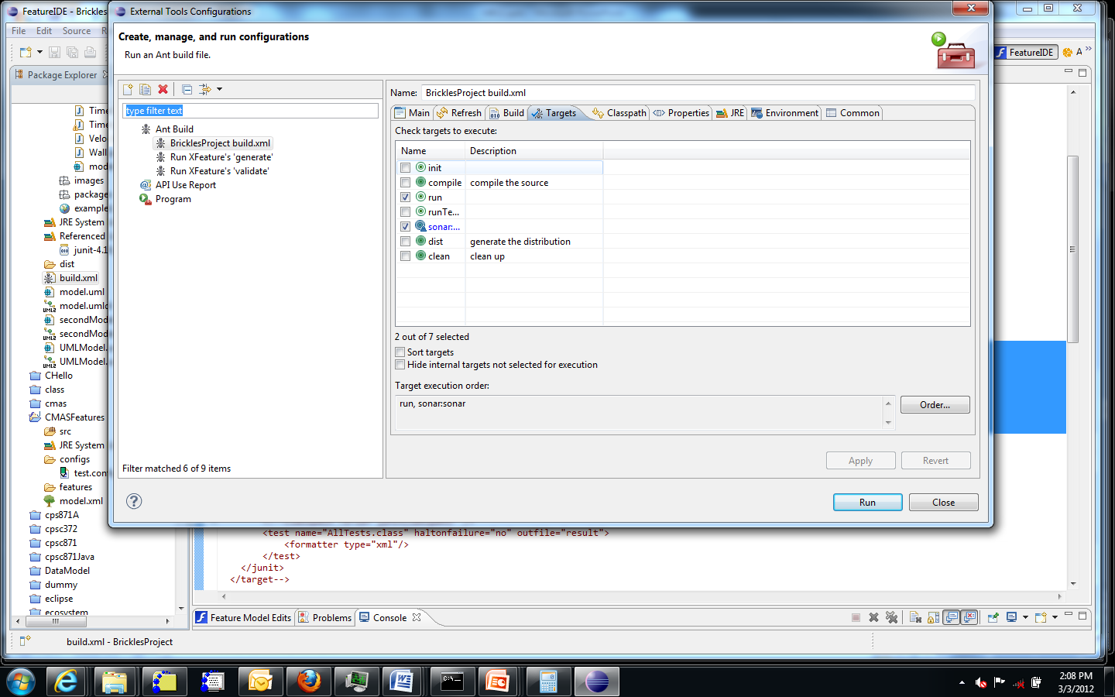
Select targets

Slide 10
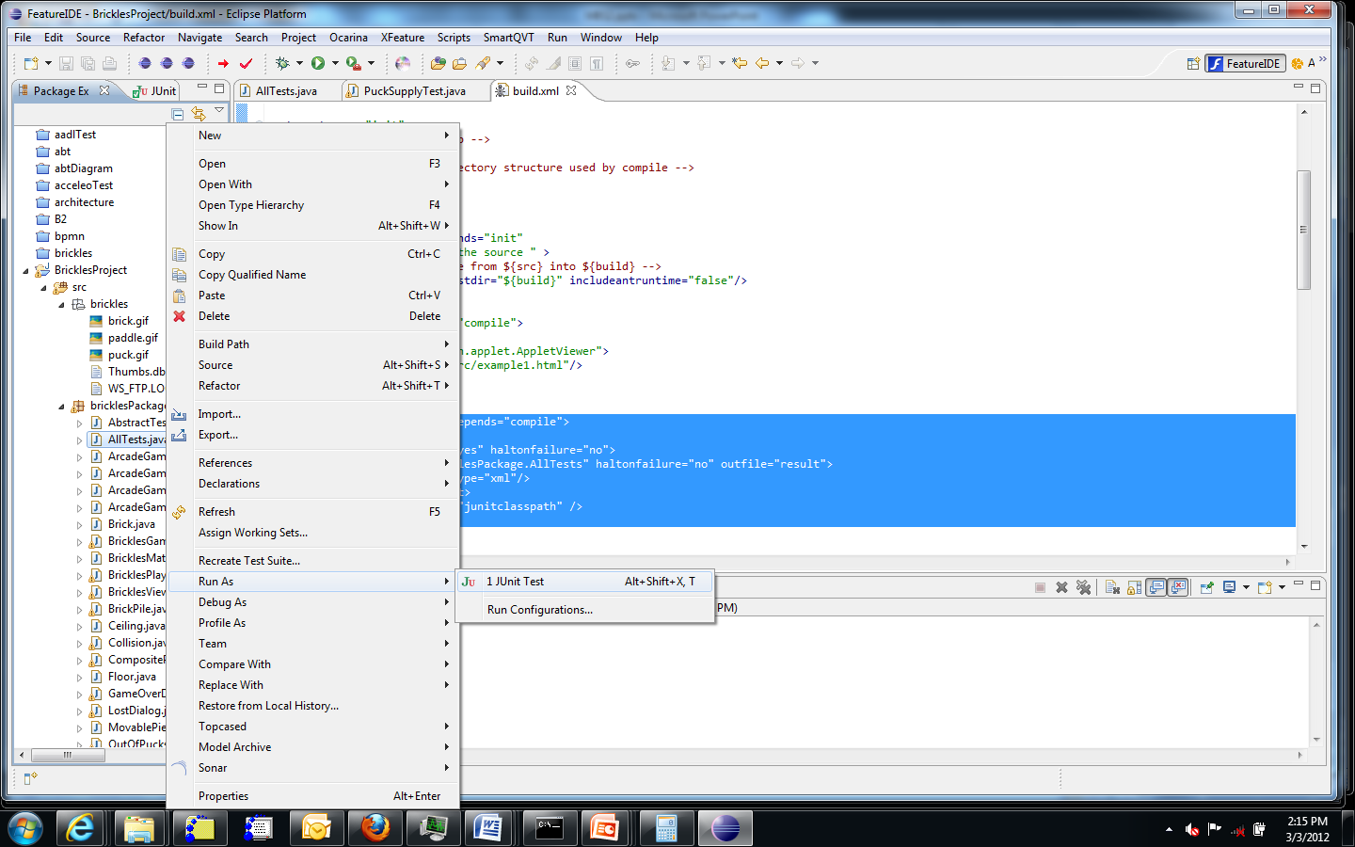
Run as a Junit configuration

Slide 11
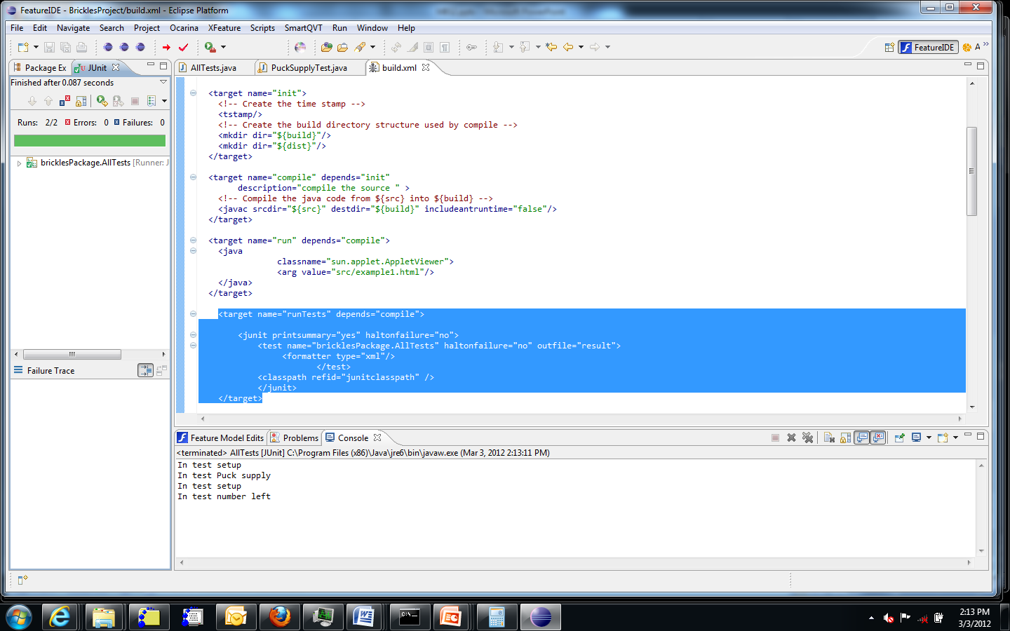
Resulting display

Slide 12
JUnit tutorial
http://www.vogella.de/articles/JUnit/article.html

