Slide 1

CPSC 372
John D. McGregor
MSemat

Slide 2
These next slides use images taken from https://www.ivarjacobson.com/services/essential-unified-process

Slide 3
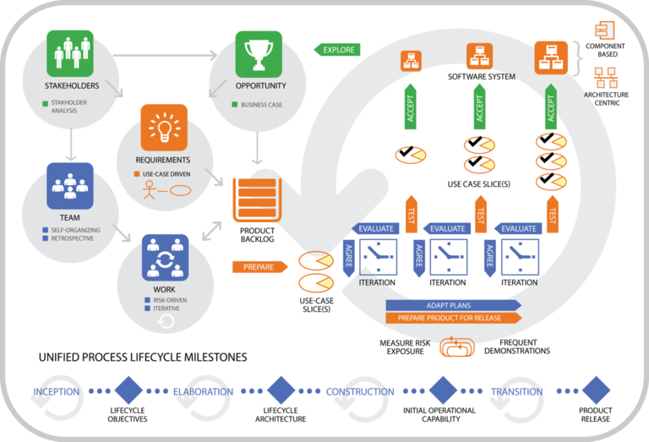
Essentials Unified Process

Slide 4
Essential Practices

Slide 5
Architecture Essentials

Slide 6
Architecture Essentials-2

Slide 7
Iteration Essentials

Slide 8
Iteration Essentials - 2

Slide 9
Use Case Essentials

Slide 10
Use Case Essentials - 2

Slide 11
Testing Essentials

Slide 12
Testing Essentials - 2

Slide 13
SEMAT
http://www.slideshare.net/fdgiraldo/semat
https://www.google.com/url?sa=t&rct=j&q=&esrc=s&source=web&cd=1&ved=0ahUKEwjmkdz00KnQAhUqxYMKHb5VA6sQFggdMAA&url=http%3A%2F%2Fold.semat.org%2Fwp-content%2Fuploads%2F2013%2F07%2FIntro-to-EssenceBerlin-Ivar.pptm&usg=AFQjCNHn54dWZ3DO5My4KJ72kJSaHb4a2Q&cad=rja

Slide 14
Calculate grade
25*(grade exam1)/100 + 25*(grade exam2)/100 + 25*(grade exam3)/100 + 20*(homework points)/12 + class participation score(0-5)

Slide 15
Here’s what you are going to do
Submit a new more complete version of your app
Also submit our use cases showing which ones have been implemented in the current version
Compress your workspace and submit along with the use cases by Nov 21, 11:59pm

