Slide 1

CPSC 372
John D. McGregor
MSumS1
Summary – the business of software engineering

Slide 2
These next slides use images taken from https://www.ivarjacobson.com/services/essential-unified-process

Slide 3
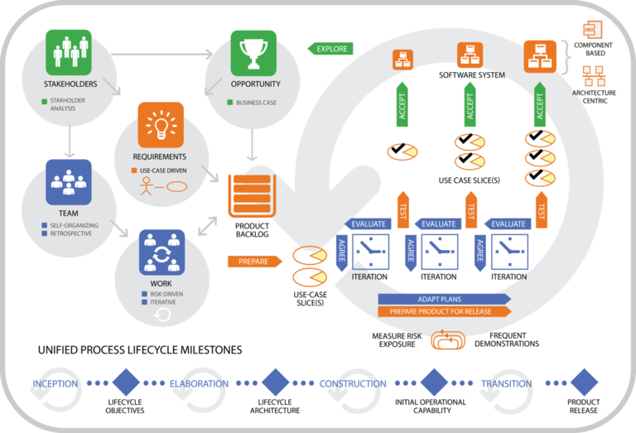
Essentials Unified Process

Slide 4
Essential Practices

Slide 5
Architecture Essentials

Slide 6
Architecture Essentials-2

Slide 7
Iteration Essentials

Slide 8
Iteration Essentials - 2

Slide 9
Use Case Essentials

Slide 10
Use Case Essentials - 2

Slide 11
Testing Essentials

Slide 12
Testing Essentials - 2

Slide 19
SEMAT
http://www.slideshare.net/fdgiraldo/semat
https://www.google.com/url?sa=t&rct=j&q=&esrc=s&source=web&cd=1&ved=0ahUKEwjmkdz00KnQAhUqxYMKHb5VA6sQFggdMAA&url=http%3A%2F%2Fold.semat.org%2Fwp-content%2Fuploads%2F2013%2F07%2FIntro-to-EssenceBerlin-Ivar.pptm&usg=AFQjCNHn54dWZ3DO5My4KJ72kJSaHb4a2Q&cad=rja

Slide 20
A Third Iteration
First iteration
  Went through process in detail
  Setup and worked through an example app
Second iteration
  Looked at special topics
  Implementation of app
Third Iteration
  Consolidation
  A detailed summary and case studies

Slide 21
Outline of summary
The big, high-level picture
Contexts, business models and domains
Types of applications
Types of development processes
An example
Practice by practice

Slide 22
Your scenario
The third iteration will dig into your scenario
Take a minute and write a couple of sentences about your app. Who is the target audience? What are they like?
For wireless charging, right now, we are targeting
people who are pioneers. They are less interested
in a smooth interface and more on control and
access to the internals.

Slide 23
Ecosystem
Business
  Friend and foe interact directly or indirectly
  Supply chains intersect
  Prices and new features are indirect interactions
Technical
  Domain sets certain constraints on process
  Life critical, mission critical, …

Slide 24
Ecosystem - 2
The canonical ecosystem scenario is a large organization (keystone) in discussions with other members of their ecosystem (niche players) decides to contribute a significant amount of code to the public domain.
They establish a foundation that will own the IP of any contributed code and any code created as part of the foundation activity.

Slide 25
Ecosystems overlap and get fuzzy at the edges
Consumer electronics
Automotive
The overlap is where culture clashes happen. The
fast paced consumer electronics market and the
slower, more conservative automotive market. This
affects the qualities that are valued.

Slide 26
Ecosystem - 3
Whether there is a foundation, there are collaborative ventures among organizations
An ecosystem will encompass a market
Indirect influence will happen between organizations with the customer as the connection.
Requirements volatility will depend upon the market and the domain.

Slide 27
Ecosystem - 4
Business models
  Software to order
  Bid on jobs
  Software for market
  In-house development staff
Business strategy
  One product at a time
  Roadmap
  Software product line

Slide 28
Case study - Hadoop
Originated at Google
Transferred to Apache Foundation
In an area of intense research and development interest
Since joining the Apache Foundation
  Sub-projects of Hadoop have been promoted to independent top level projects
  The ecosystem has exploded

Slide 29
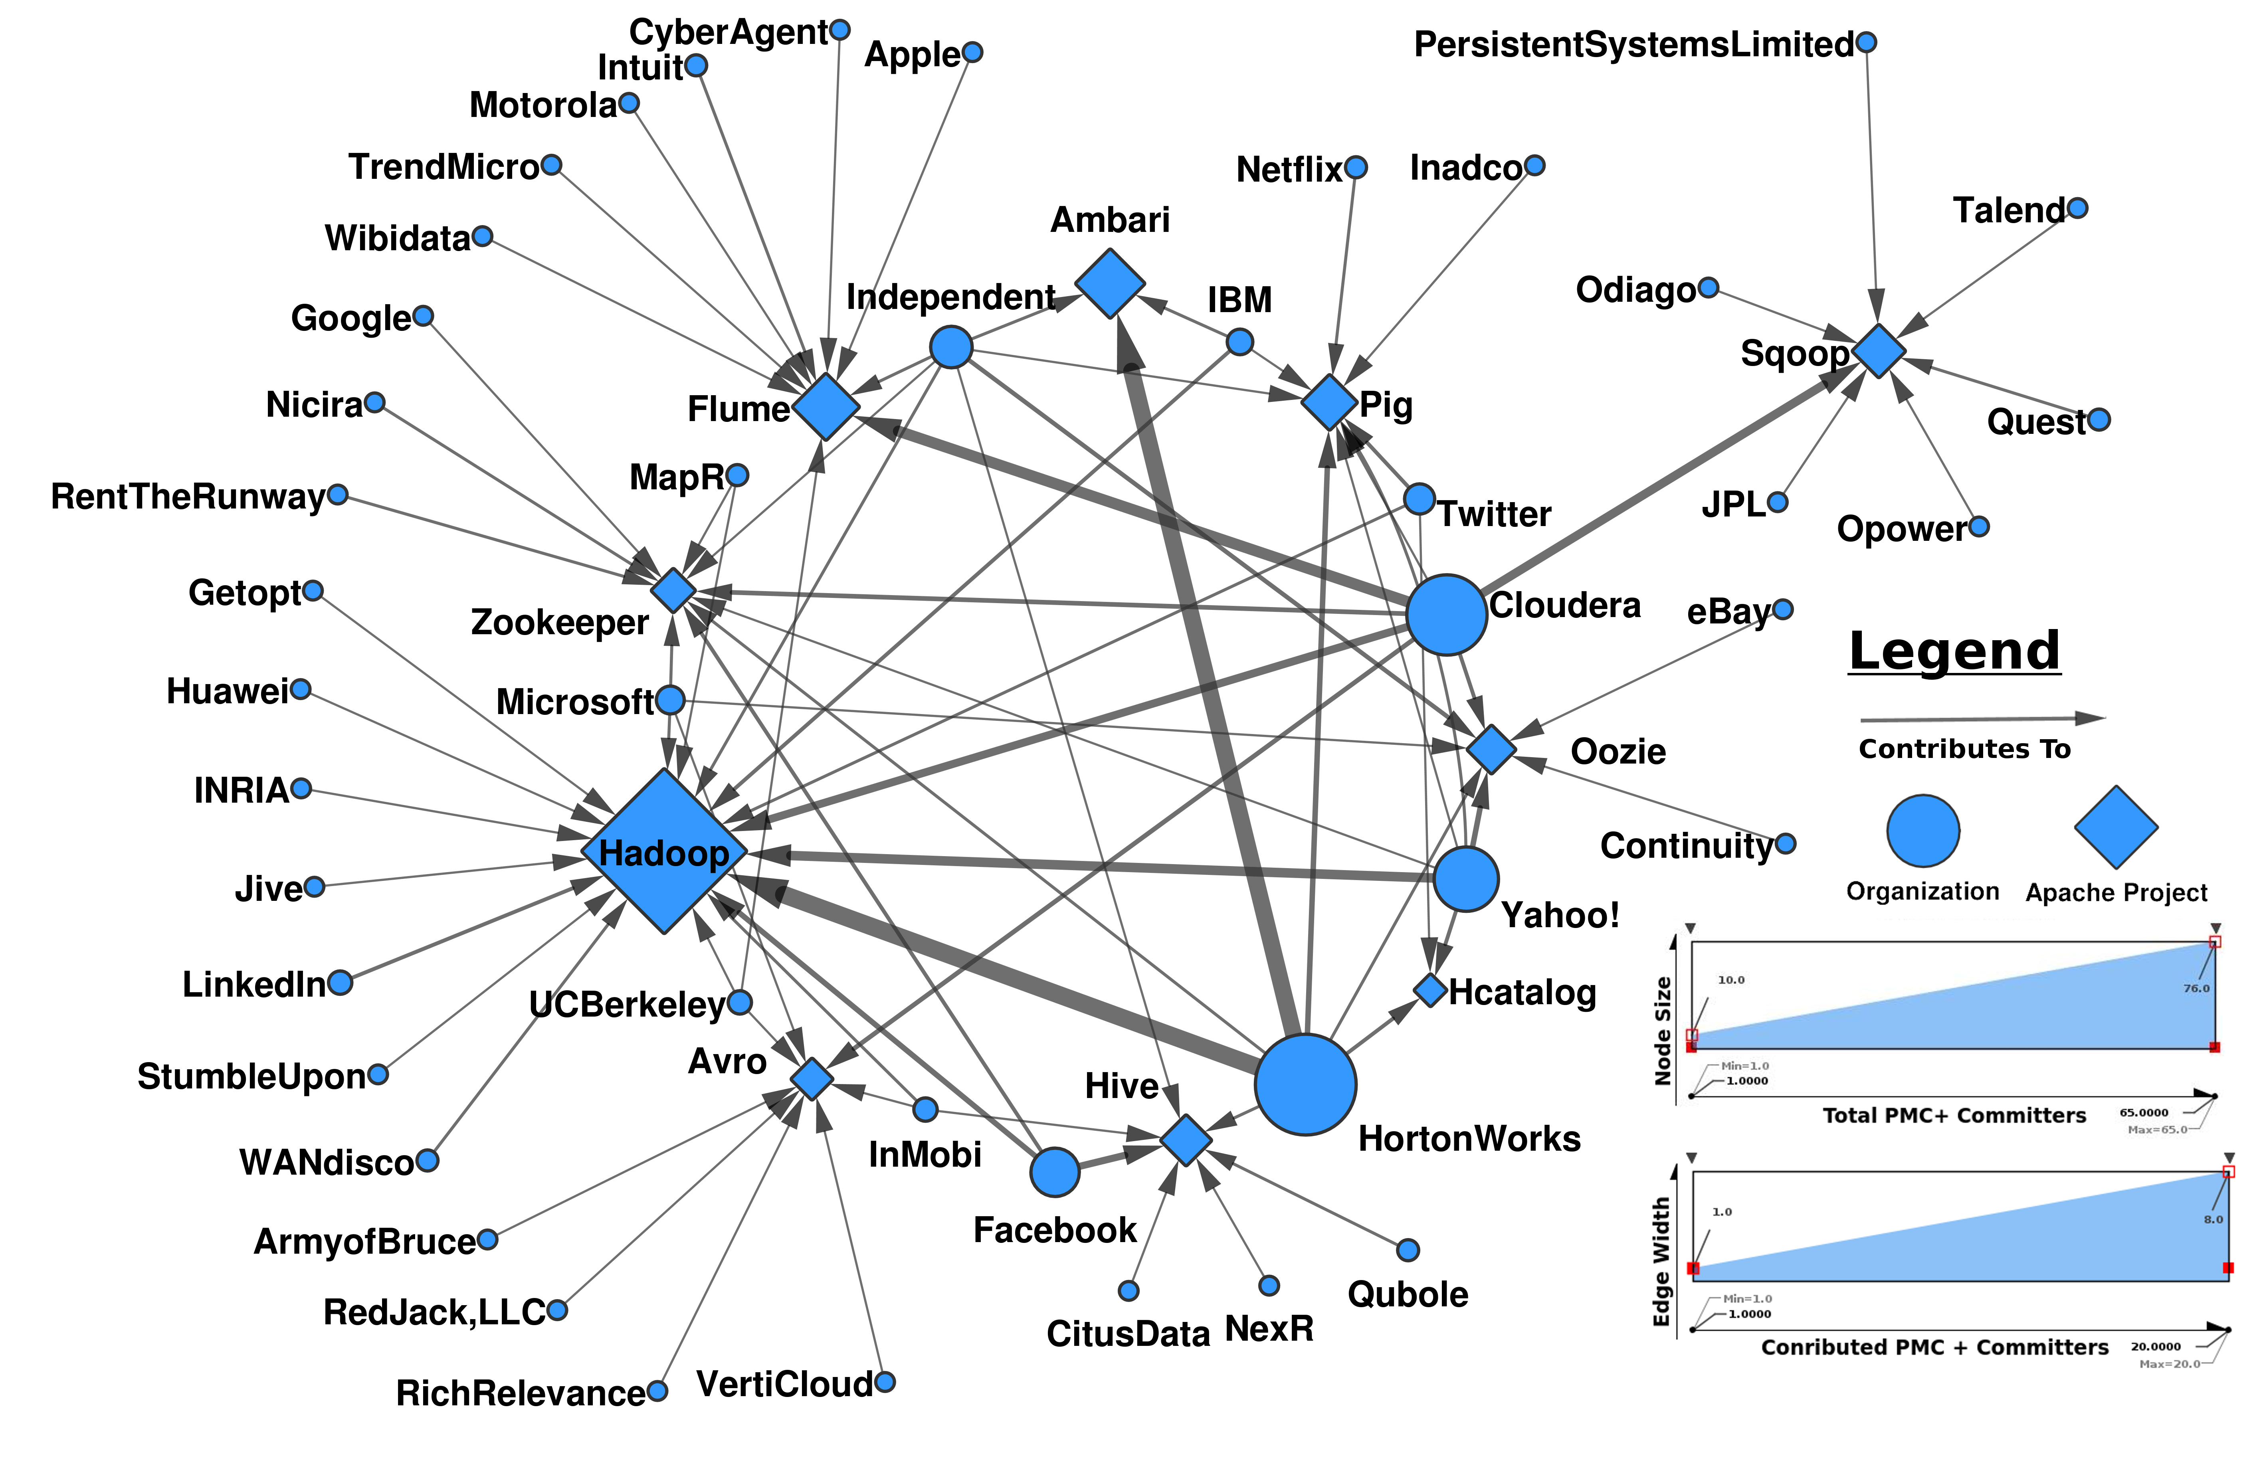
Hadoop Supply Chain

Slide 30
Hadoop - 3
Hadoop is the infrastructure for Big Data analysis techniques
Central architecture is Map/Reduce where algorithms are mapped to nodes that contain data, the algorithm massages the data and sends the result to an aggregator who aggregates results from several nodes and then sends the aggregated results to the next level of aggregation.

Slide 31
Software Product Line
Management
  Identifies a set of similar products
  Or determines a line of business
  Organizes the work force
Organization
  Core asset/product teams
  Each person does some of both
  Rotation between types of teams

Slide 32
Software Product Line - 2
Core asset team
  Broad product line-wide view
  Creates a product line architecture
  Creates configurable assets to fit in the product line architecture
  Accepts requests for new features/defect repairs
  Maintains a set of priorities for quality attributes
  Maintains a set of priorities for products

Slide 33
Software Product Line - 3
Product development teams
  Focus on one product
  One set of quality attribute priorities
  A small set of product-specific requirements
  Possibly multiple ways of satisfying a given product line requirement

Slide 34
Software Product Line - 4
A software product line might be the development strategy for a member of an ecosystem.
If the member has responsibility for a particular kind of asset there might be a product line that produces variants on that asset.
The ecosystem may define a product line.

Slide 35
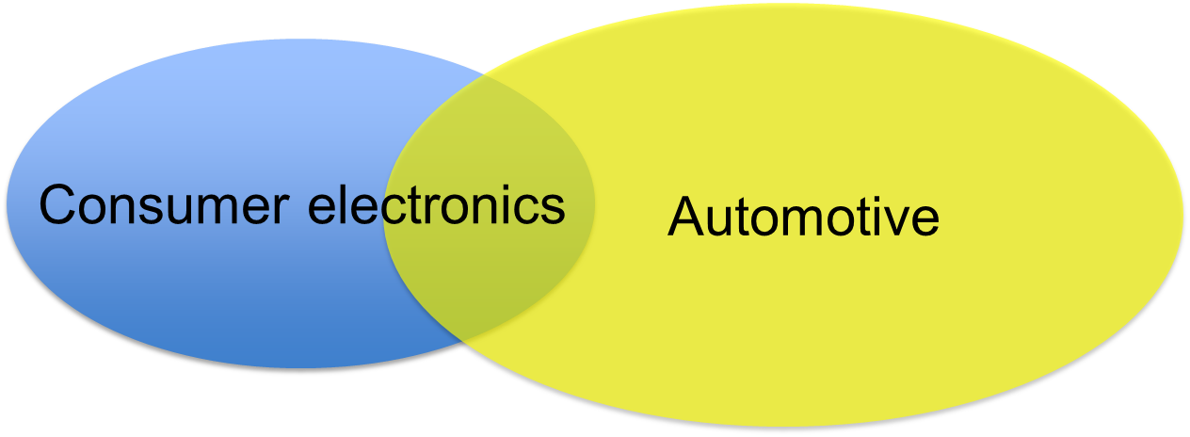
Software product line
If we are the in-house development team there will be
multiple models of vehicles to address. If we are in
the after-market there will be all the models of all of
the manufacturers.

Slide 36
Software Product Line Case Study – Cummins Engines
http://resources.sei.cmu.edu/asset_files/Presentation/2008_017_001_24246.pdf

Slide 37
A single product
Most fundamental unit
Organization must have a strategy by which this is profitable
In some cases only way to profit is through product line
Product is built through a combination of assembly and construction

Slide 38
Assembly
Size of the pieces
  May be a data structure from C++ Template Library
  May be a browser component
  May be an sdk
Purchase commodity items
Create unique, product-specific assets

Slide 39
Construction
Use languages, tools to build pieces
  Craftsman approach
  “normal” approach
  Hacking approach
Choose appropriate levels of quality
  What are the risks?
  What are the costs?

Slide 40
Tracking assets
Versions, releases, builds
  Build – a single pass through compilation, binding and provisioning; happens many times a day
  Release – a published build, e.g. nightly build for an open source project; happens at most n times a day; automated test suite is passed
  Version – a polished release that has significant new functionality from previous version; test suite passed
  Product – a set of envisioned features delivered incrementally over several releases

Slide 41
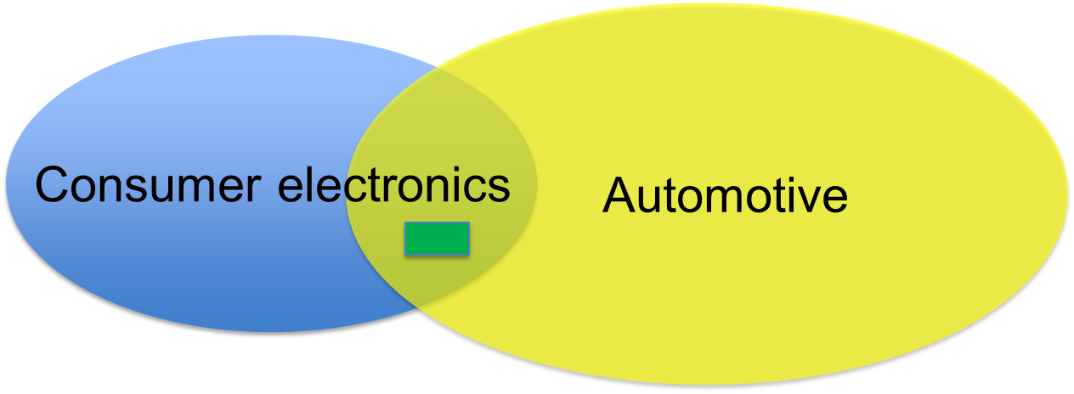
A single release
Each product goes through an evolution of multiple versions, releases, and builds.

Slide 42
Components
How can we manage all of these changing artifacts and create them by assembling components?

Slide 43
Certification - Personal
IEEE – software engineering certification
Oracle, Microsoft, etc
Certificates in specific areas such as systems engineering

Slide 44
Certification - Organization
Capability Maturity Model, Integrated
5 levels: initial, managed, defined, quantitatively managed, optimizing
Independent “registrars” are licensed to evaluate and rate an organization
Measuring conformance to the standard for each level
Only of value to get a contract

Slide 45
Certification - Product
Conformance to rules/regulations
FAA, FDA, etc
For wireless charging maybe the Good Housekeeping Seal of Approval
Usually focus on the process rather than doing testing on their own
Independent testing labs for product features such as Bluetooth compatibility

Slide 46
Summary
The wireless charging app needs to be engineered to meet the rigorous standards of the automotive industry but should have the bells and whistles of a consumer product.
A product line approach will help handle the many models of cars available.

