Slide 1
JPF for Beginners
David Bushnell
david.h.bushnell@nasa.gov
JPF Workshop 2008

Slide 2
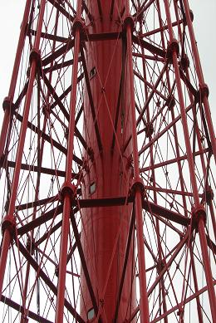
What is JPF?
An explicit state model checker
  Focus is on finding bugs in Java programs
A framework for runtime Java verification
  Model checking
  Symbolic execution
  UML state chart modeling
  Numeric Verification (int overflow, fp over/underflow, …)
  ... ad infinitum

Slide 3
What is Model Checking?
Systematically verifying that a model satisfies a set of properties
  Formal Model: UML state charts, Java programs, Promela models, …
  Properties: Temporal Logic (xTL), code assertions, …
In JPF:
  The models are Java programs
  The properties can be assertions, gov.nasa.jpf.Property objects, or JPF listener objects

Slide 4
Model Checking vs Testing
A test will explore a single execution path
  You must identify each important execution path
  You must find the inputs that will execute those paths.
OK
Code
Testing
error

Slide 5
Model Checking vs Testing
A model checker can explore every execution path
  Including scheduler decisions for concurrent models
A model checker can identify both errors and the execution paths leading to those errors
Code
OK
Model Checking
error trace
properties
Line 5: …
Line 12: …
…
Line 41:…
Line 47:…

Slide 6

What Can JPF Handle?
Pure Java up to ??-KLOC
  Depends on logical complexity and state size, not KLOC.
  Programs with 100K+ lines have been analyzed
Multi-threaded code (Of Course!)
Can find: deadlocks, race conditions, unhandled exceptions, application-specific assertions, ...

Slide 7
What Can’t JPF Handle?
Unsupported native calls (JNI)
  Can simulate/support native calls with MJI
Hence: No libraries with unsupported native calls
  Much or all of java.io, java.net, AWT, Swing, …
Really complex programs
  But: it is often enough to apply JPF to a simplified version, AKA a model.
  Example: apply JPF to a communications protocol used in your program

Slide 8
Using JPF
Installing JPF
Using JPF in an Eclipse project
Configuring JPF
Common Config Options
  Example: Running JPF, detecting race conditions
Controlling JPF Execution
  Example: Detecting deadlock
Extensions
Listeners
  Example: OpCodePrinter
Overriding Bytecodes
  Example: Numerics

Slide 9
Installing JPF for Eclipse
Not covered: using JPF with other IDEs or from the command line
  See documentation at SourceForge
Prerequisites:
  JDK 1.5+
  Eclipse 3.2+ (www.eclipse.org)
  Subclipse plugin (subclipse.tigris.org)

Slide 10
Installing JPF for Eclipse (2)
Downloading JPF in Eclipse:
  Create a new project (not a Java project)
  Use the SVN → “Checkout Projects from SVN” wizard
  Repository URL: https://javapathfinder.svn.sourceforge.net/svnroot/javapathfinder
  Select “trunk” as your folder, not “tags” or “branches”
  Anything for project name
  Use defaults for everything else
  Can have many copies of JPF, each as a different Eclipse project

Slide 11

Configuring JPF
Bad News: JPF has lots of config options
Good News: The defaults are mostly ok. You seldom need to set more than 4 or 5.

Slide 12



Configuring JPF
Config hierarchy:
  Command line args
  (written as +vm.classpath=.)
  take precedence over
  jpf.properties values
  (written as vm.classpath=.) take precedence over
  default.properties values
Command line trick: comment out config options with +_some.config.option=...

Slide 13
Configuring JPF
(2)
Rules:
  Never change default.properties
  jpf.properties is for values common to a project. Copy it to your project’s top-level directory and change your copy
  (do not change the jpf.properties file in your JPF project)
  Set the command line args for values specific to a single run
In practice, in Eclipse:
  Ignore jpf.properties.
  Set everything with the command line using Eclipse’s launch configurations
For details on most core config properties, look in default.properties and jpf.properties

Slide 14
Configuring JPF
(3)
Common config properties
  jpf.basedir
    Where JPF is located
  vm.classpath
    Where your compiled code is located, a classpath.
    Usually set to “.”, i.e. vm.classpath=.
  vm.sourcepath
    Where your source code is located.
    Defaults to vm.classpath, so you don’t usually need to set it
  search.class
    The search strategy to use (a class).
    Defaults to gov.nasa.jpf.search.DFSearch
    Look in src/gov/nasa/jpf/search for others

Slide 15
Configuring JPF
(4)
Some other common config properties
  vm.storage.class
    Class used to hash/store states (if not set, states are not matched)
    For small problems, can set to empty,
    vm.storage.class=
  search.multiple_errors
    true/false: Quit after the first error or keep going?
  jpf.report.xxx
    Lots of options to configure the reporting subsystem
    See default.properties
    jpf.report.console.finished
      What to report when JPF exits. Defaults to some statistics.
    jpf.report.console.show_code
      true/false: Show the bytecode in error traces?
  jpf.listener
    A “:” separated list of Listener classes

Slide 16
Using JPF in Eclipse
Create an Eclipse Java project
Write your Java code
Create an Eclipse run configuration that:
  Has gov.nasa.jpf.JPF as its “Main class”
  Has the right JPF config args
  Has your JPF project in its classpath

Slide 17
Running JPF
Race Detection
  DEMO
  MyRaceCondition

Slide 18
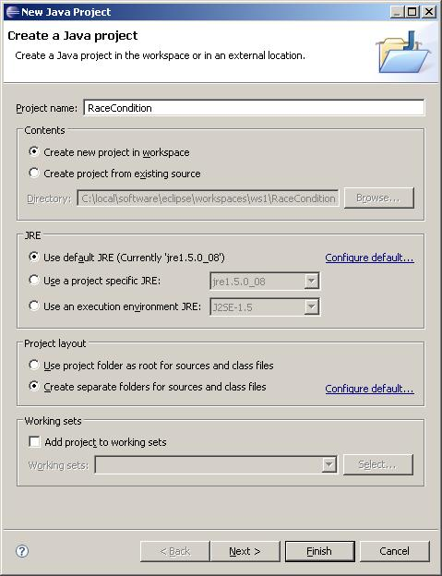
Create an Eclipse Project
(1)
Create a Java Eclipse project

Slide 19
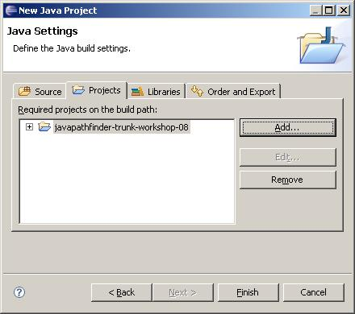
Create an Eclipse Project
(2)
Add your JPF project to the Java build settings

Slide 20
Write Your Java Code
public class MyRaceCondition {
private static class Pair {
String x = "x";
String y = "y";
public void update() {
x = x + y + x;
}
}
private static class RC extends Thread {
Pair p;
public void run() {
p.update();
}
}
public static void main(String[] args) {
Pair p = new Pair();
RC rc1 = new RC();
RC rc2 = new RC();
rc1.p = p;
rc2.p = p;
rc1.start();
rc2.start();
rc1.join();
rc2.join();
System.out.println("x: " + p.x);
}
}

Slide 21
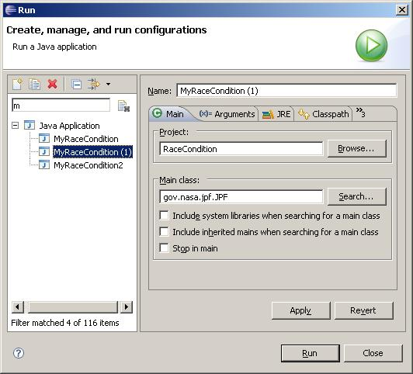
Create Eclipse Run Config
(1)
gov.nasa.jpf.JPF is the Main class

Slide 22
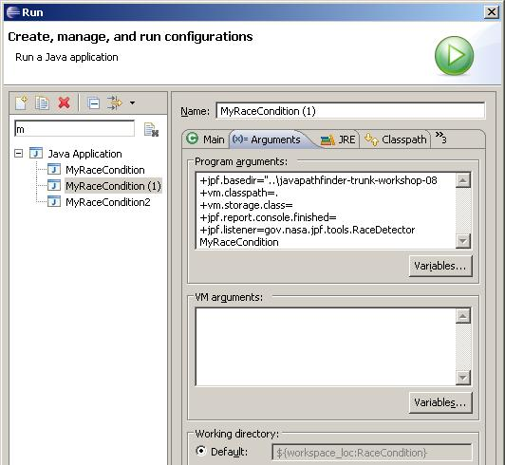
Create Eclipse Run Config
(2)
Set your arguments
For race conditions: jpf.listener=...RaceDetector
Last arg should be the class you are checking

Slide 23
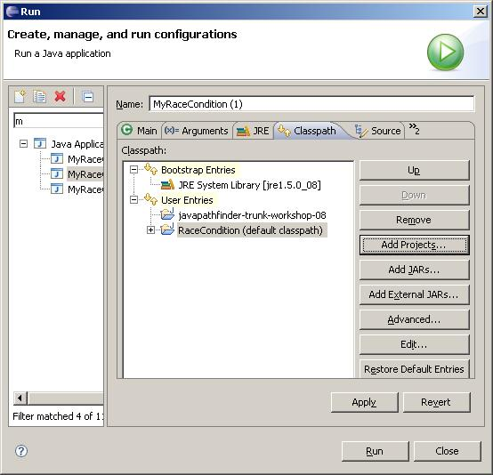
Create Eclipse Run Config
(3)
Add your JPF project in the Classpath tab
Run

Slide 24
Race Detection Results
Results:
potential race detected: MyRaceCondition$Pair@216.x
read from thread: "Thread-1", holding locks {} in MyRaceCondition$Pair.update(MyRaceCondition.java:7)
write from thread: "Thread-0", holding locks {} in MyRaceCondition$Pair.update(MyRaceCondition.java:7)
====================================================== error #1
gov.nasa.jpf.tools.RaceDetector
potential field race: MyRaceCondition$Pair@216.x
... etc ...
------------------------------------------------------ transition #9 thread: 1
gov.nasa.jpf.jvm.choice.ThreadChoiceFromSet {>Thread-0,Thread-1}
MyRaceCondition.java:7 : x = x + y + x;
MyRaceCondition.java:8 : }
MyRaceCondition.java:16 : }
... etc ...
------------------------------------------------------ transition #11 thread: 2
gov.nasa.jpf.jvm.choice.ThreadChoiceFromSet {main,>Thread-1}
MyRaceCondition.java:15 : p.update();
------------------------------------------------------ transition #12 thread: 2
gov.nasa.jpf.jvm.choice.ThreadChoiceFromSet {main,>Thread-1}
MyRaceCondition.java:15 : p.update();
MyRaceCondition.java:7 : x = x + y + x;

Slide 25
Detecting Deadlock
  DEMO
  MyRaceCondition2

Slide 26
Detecting Deadlock
(1)
public class MyRaceCondition2 {
private static class Pair {
String x = "x";
String y = "y";
String z = "";
public void update() {
x = x + y + x;
}}
private static class RC1 extends Thread {
Pair p;
public void run() {
synchronized (p.x) {
synchronized (p.y) {
p.update();
}}}}
private static class RC2 extends Thread {
Pair p;
public void run() {
synchronized (p.y) {
synchronized (p.x) {
p.update();
}}}}
public static void main(String[] args) throws Exception
{
Pair p = new Pair();
RC1 rc1 = new RC1();
RC2 rc2 = new RC2();
rc1.p = p;
rc2.p = p;
rc1.start();
rc2.start();
rc1.join();
rc2.join();
System.out.println("x: " + p.x);
}}

Slide 27
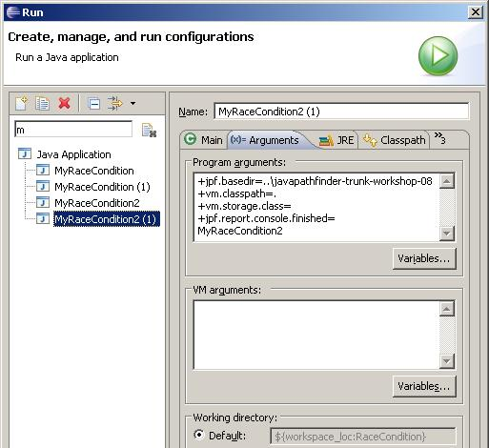
Detecting Deadlock
(2)
Run changes:
  no jpf.listener needed
  test class: MyRaceCondition2

Slide 28
Detecting Deadlock
(3)
Results:
====================================================== error #1
gov.nasa.jpf.jvm.NotDeadlockedProperty
deadlock encountered:
thread index=0,name=main,status=WAITING,this=java.lang.Thread@0,target=null,priority=5,lockCount=1
thread index=1,name=Thread-0,status=BLOCKED,this=MyRaceCondition2$RC1@226,priority=5,lockCount=0
thread index=2,name=Thread-1,status=BLOCKED,this=MyRaceCondition2$RC2@247,priority=5,lockCount=0
... etc ...
====================================================== snapshot #1
thread index=0,name=main,status=WAITING,this=java.lang.Thread@0,target=null,priority=5,lockCount=1
waiting on: MyRaceCondition2$RC1@226
call stack:
at java.lang.Thread.join(Thread.java:197)
at MyRaceCondition2.main(MyRaceCondition2.java:47)
thread index=1,name=Thread-0,status=BLOCKED,this=MyRaceCondition2$RC1@226,priority=5,lockCount=0
owned locks:java.lang.String@217
blocked on: java.lang.String@219
call stack:
at MyRaceCondition2$RC1.run(MyRaceCondition2.java:18)
thread index=2,name=Thread-1,status=BLOCKED,this=MyRaceCondition2$RC2@247,priority=5,lockCount=0
owned locks:java.lang.String@219
blocked on: java.lang.String@217
call stack:
at MyRaceCondition2$RC2.run(MyRaceCondition2.java:30)
====================================================== search finished: 4/29/08 10:38 AM

Slide 29
Verify: Controlling JPF
The class gov.nasa.jpf.jvm.Verify lets you control simple aspects of JPF
  Calls to Verify methods are specially recognized and handled by JPF
  Search and backtracking
  Counters
  Logging
  Attributes

Slide 30
Verify: Search
(1)
Choice Generators
  When you need JPF to try alternatives:
  Verify.getInt, getDouble, getBoolean,...
  When JPF hits Verify.getXxx()it branches the execution tree and executes one branch for each value
int x = Verify.getInt(-1,1);
System.out.println(x);
[x == 0]
System.out.println(x);
[x == -1]
System.out.println(x);
[x == 1]
System.out.println(x);

Slide 31
Verify: Search
(2)
Choice Generator Variations
  Your code:
  double y = Verify.getDouble(“Tag”);
  Your run config:
  +Tag.class=gov.nasa.jpf.jvm.choice.DoubleChoiceFromSet
  +Tag.values=-1.0:0.0:123.0
  Result: your code runs with y==-1.0, y==0.0, and y==123.0
  Other choice generators: see gov.nasa.jpf.jvm.choice

Slide 32

Verify: Search
(3)
Verify.ignoreIf():
Search Pruning
  Forces JPF to abandon the current execution path and backtrack to the previous choice point
  Useful when you know which parts of the execution search tree are irrelevant to you
  Can speed up search dramatically (by ignoring parts of the search tree)

Slide 33
Verify: Search
(4)
Example: your method is not designed to handle cyclic graphs, but your test driver produces them
public void print(Graph g) {
Verify.ignoreIf(g.isCyclic());
...
}

Slide 34
Verify: Search
  DEMO
  ShowVerify
  ShowVerify2

Slide 35
Advanced Topic:
Extending JPF
JPF is extremely flexible: many ways to extend
  Listeners and properties (example follows)
  Model Java Interface (MJI): Library abstractions & adding code to the core
  Redefining bytecodes (see Symbolic Execution and Numerics extensions on SourceForge)
  Serializer/restorer (Saving and restoring states)
  Publisher (Collecting and printing statistics and results in different formats)

Slide 36

Advanced Topic: Listeners
(1)
Listeners are the preferred way of extending JPF
You must know a bit about JPF internals to use them
They give you access to JPF’s internal execution

Slide 37
Advanced Topic: Listeners
(2)
Two flavors: gov.nasa.jpf.search.SearchListener gov.nasa.jpf.jvm.VMListener
Interface SearchListener: observe search (backtracking, states’ processing, property violation, ...)
Interface VMListener: observe the VM’s execution (bytecode execution, exceptions, thread starts, ...)

Slide 38
Advanced Topic: Listeners
(3)
Useful adapter class: gov.nasa.jpf.ListenerAdapter implements all the methods in SearchListener and VMListener.
See JPF documentation (javapathfinder.sourceforge.net) and code for more details

Slide 39
VMListener Example
  DEMO
  OpCodePrinter

Slide 40
VMListener Example
public class OpCodePrinter extends ListenerAdapter {
String lastLoc = "";
public void executeInstruction(JVM vm) {
Instruction instr = vm.getNextInstruction();
if (instr != null) {
String loc = instr.getFileLocation();
if (loc != null && ! loc.startsWith("java")) {
if (! lastLoc.equals(loc)) {
System.out.println(loc);
lastLoc = loc;
}
System.out.println(" " + instr.getMnemonic().toUpperCase());
}}}}

Slide 41
JPF Extensions
Extensions found under extensions/ in the JPF distribution
Developed independently of JPF core
  JPF core code should never refer to extension code
  vice versa ok (of course!)
Symbolic Execution (extensions/symbc)
UML StateCharts (extensions/statechart)
UI Model Checking (extensions/ui)
Compositional Verification (extensions/cv)
Numeric Properties (extensions/numeric)

Slide 42
Extension Example
Numerics Extension
  Finds “bad” numerical behavior
    integer and long overflow
    floating point compares (NaN, infinity)
    floating point inexact propagation (NaN, infinity)
    floating point cancellation (lost precision)
  How?
    Write new bytecode implementations
    Write bytecode factory

Slide 43
Numerics Extension
Write InstructionFactory:
  Tells JPF which bytecodes are being overridden and which classes to use for them
Override numeric bytecodes:
  Floating point comparisons: DCMPG, DCMPL, FCMPG, FCMPL
  Floating point arithmetic: DADD, DSUB, DMUL, DDIV, FADD, FSUB, FMUL, FDIV
  Int/long arithmetic: IADD, ISUB, IMUL, IDIV, IINC, LADD, LSUB, LMUL, LDIV
Set config options

Slide 44
Numerics Extension
(InstructionFactory)
public class NumericInstructionFactory extends GenericInstructionFactory {
// which bytecodes do we replace
static final String[] BC_NAMES = {
"DCMPG", "DCMPL", "DADD", "DSUB", "DMUL", "DDIV",
"FCMPG", "FCMPL", "FADD", "FSUB", "FMUL", "FDIV",
"IADD", "ISUB", "IMUL", "IDIV", "IINC",
"LADD", "LSUB", "LMUL", "LDIV"};
// where do they reside
protected static final String BC_PREFIX = "gov.nasa.jpf.numeric.bytecode.";
// what classes should use them
protected static final String[] DEFAULT_EXCLUDES = { "java.*", "javax.*" };
public NumericInstructionFactory (Config conf){
super(BC_PREFIX, BC_NAMES, null, DEFAULT_EXCLUDES);
NumericUtils.init(conf);
}}

Slide 45
Numerics Extension
(Original IMUL)
public class IMUL extends Instruction {
public void setPeer (org.apache.bcel.generic.Instruction i,
ConstantPool cp) {
}
public Instruction execute (SystemState ss, KernelState ks,
ThreadInfo th) {
int v1 = th.pop();
int v2 = th.pop();
th.push(v1 * v2, false);
return getNext(th);
}
public int getByteCode () {
return 0x68;
}
}

Slide 46
Numerics Extension
(Overridden IMUL)
public class IMUL extends gov.nasa.jpf.jvm.bytecode.IMUL {
@Override
public Instruction execute (SystemState ss, KernelState ks, ThreadInfo th) {
int v1 = th.pop();
int v2 = th.pop();
// check for overflow
if ((long)v1 * (long)v2 != v1 * v2){
return th.createAndThrowException("java.lang.ArithmeticException",
"integer overflow: " + v2 + "*" +
v1 + "=" + v1*v2);
}
th.push(v1 * v2, false);
return getNext(th);
}
}

Slide 47
Numerics Extension
  DEMO
  NumericsExample

Slide 48
Numerics Extension
(Config Options/Running)
Recall:
  Main class: gov.nasa.jpf.JPF
  Classpath: include your JPF project
Config Program Arguments:
+jpf.basedir=..\javapathfinder-trunk-workshop-08
+vm.classpath=.
+vm.storage.class=
+jpf.report.console.finished=
+vm.insn_factory.class=gov.nasa.jpf.numeric.NumericInstructionFactory
NumericsExample

Slide 49
Numerics Extension
(Output)
====================================================== error #1
gov.nasa.jpf.jvm.NoUncaughtExceptionsProperty
java.lang.ArithmeticException: integer overflow: 43046721*43046721=-501334399
at NumericsExample.main(NumericsExample.java:6)
====================================================== trace #1
------------------------------------------------------ transition #0 thread: 0
gov.nasa.jpf.jvm.choice.ThreadChoiceFromSet {>main}
[1864 insn w/o sources]
NumericsExample.java:4 : int i = 3;
NumericsExample.java:5 : for (int j=0; j<10; j++) {
NumericsExample.java:6 : i = i * i;
... etc...
NumericsExample.java:6 : i = i * i;
NumericsExample.java:5 : for (int j=0; j<10; j++) {
NumericsExample.java:6 : i = i * i;
====================================================== snapshot #1

Slide 50
References
JPF: http://javapathfinder.sourceforge.net
Eclipse: http://www.eclipse.org
Subversion Plugin: http://subclipse.tigris.org
Older but more advanced tutorial: http://www.visserhome.com/willem/presentations/ase06jpftut.ppt
Survey of recent additions: http://dsrg.mff.cuni.cz/teaching/seminars/2007-06-26-Parizek-JPF4.pdf
NASA Ames RSE group publications (including JPF): http://ti.arc.nasa.gov/tech/rse/publications/vandvpub.php#model
Book on Model Checking theory (not JPF):
Systems and Software Verification, by B. Berard, M. Bidoit, et. al.
Model checking tutorials:
Google for “model checking tutorial”

