Slide 1

CPSC 871
John D. McGregor
Process – an introduction
Module 0 Session 3

Slide 2
Eclipse Process Framework
www.eclispe.org/epf
Download and install

Slide 3
How to solve a problem
Like most engineers, software engineers are problem solvers.
We solve problems that require some form of computer-based software to solve.
Most professional programs are of sufficient complexity to require several people to solve.
We need a “process,” a roadmap of activities needed to coordinate the work of many people.

Slide 4
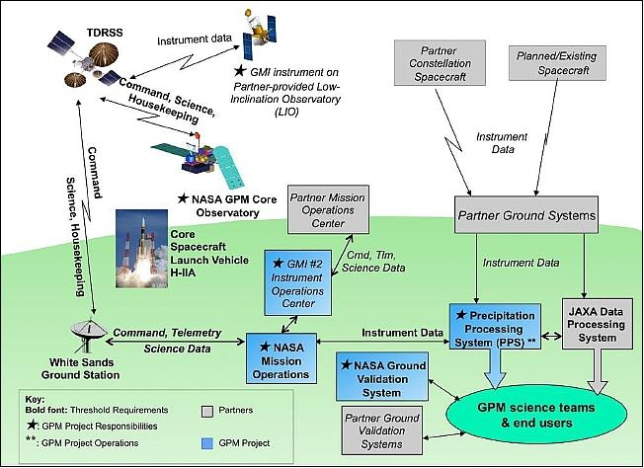
System

Slide 5
Improving processes
A process can be measured, modified, and then used again to determine whether the process is “better.”
To accurately describe and measure a process an exact description is needed.
The OMG has defined the Software Process Engineering Meta-model (SPEM).
The Eclipse Process Foundation (EPF) is an Eclipse-based tool.

Slide 6
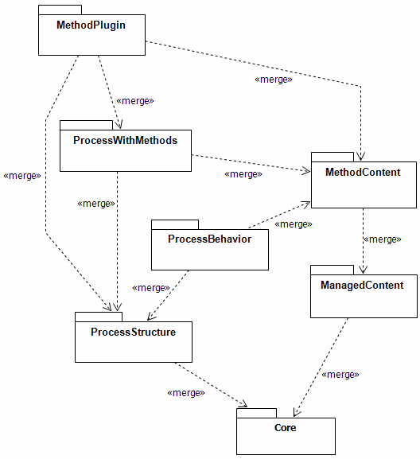
Meta-model structure
The SPEM is divided into packages.
We will look at these in more detail through out the course. For now just look at the top level.
The meta-model includes the plug-in concept as a way of extending incrementally.

Slide 7
Organizing
Software engineers structure their activities around processes.
The SPEM gives a vocabulary for describing these processes.
EPF provides 4 major categories:
  Roles
  Tasks
  Work products
  Guidance

Slide 8
Roles
A description of a collection of related tasks taken on by a person
Architect is a role performing a set of related tasks.
A person may take on multiple roles

Slide 9
Tasks
A task is a piece of work
It is assigned to a person who has assumed the appropriate role.
Creating the software architecture is a task for the architects.

Slide 10
Work products
This is the output of some task.
It is produced by a person who has assumed the appropriate role.
It is the result of following a process.
The architecture is a work product produced by architects.

Slide 11
Guidance
These are descriptions of how to do something.
How do you create an architecture?
How do you write code?
Tutorials, white papers, …

Slide 12
EPF
The EPF tool defines a number of pages that represent different types of information.
There is one for each type of element and there are many types of guidance.
The ultimate goal is to define processes so on the next slide is an example of a delivery process definition.
Each page has multiple tabs. Two slides forward is an example of one tab from the delivery process.

Slide 13
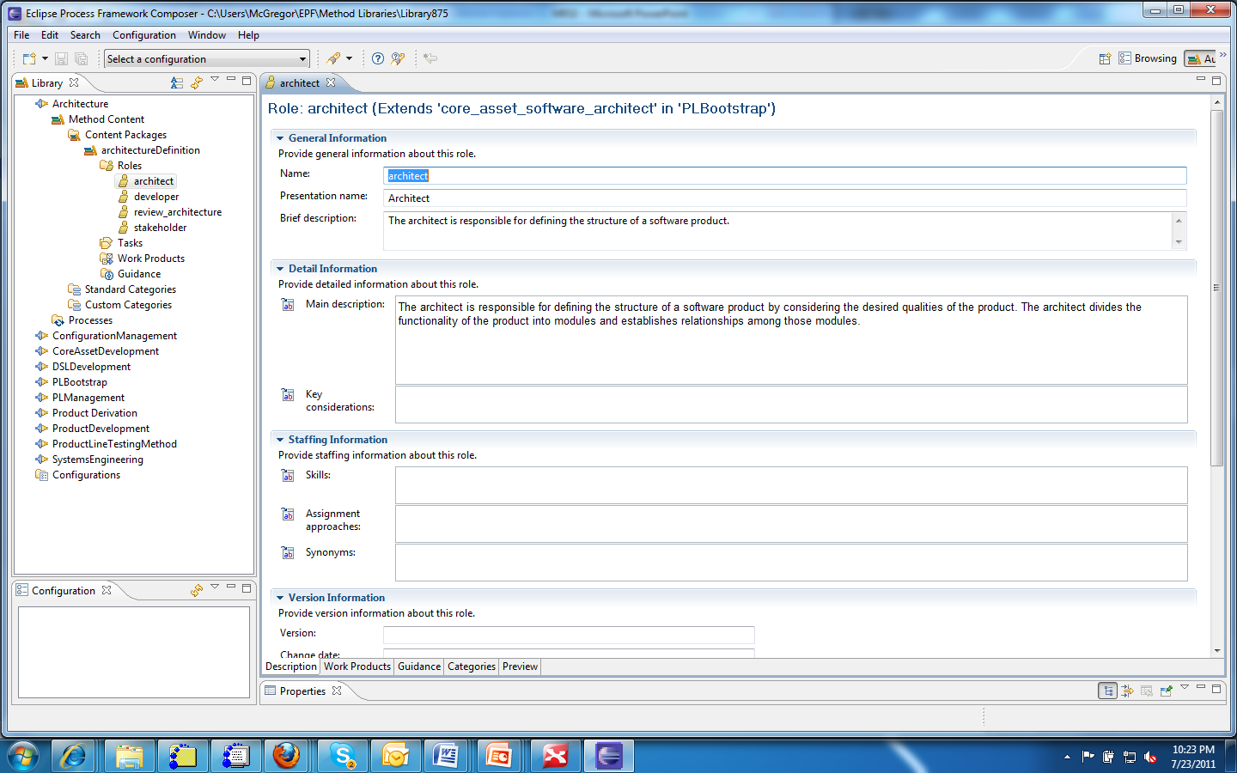
EPF
2
1
3

Slide 14
EPF - 2
1 – The EPF workspace is structured following the SPEM.
2 – Each page has numerous fields which must be fill in to give a complete view.
3 – The tabs at the bottom give access to differ methods of extending each page definition.

Slide 15
3 steps
Click on the “PLBootstrap” library and it will show:
  Method content
  Processes
The method content has:
  Content package
  Standard categories
  Custom categories

Slide 16
Content package
This contains the four basic pieces
  Role
  Task
  Work product
  Guidance
Take a look at each type of page to see what you can specify
The PLBootstrap package has several examples of each.

Slide 17
Custom categories
A custom category allows the user to combine other elements like roles and work products.
This will be used to form combinations later.
For example I could define an architecture team and aggregate several role descriptions for slightly different roles on the team.

Slide 18
Processes
Capability Patterns
  Define a reusable pattern of process definition
Delivery Processes
  Combine capability patterns and basic content to form a process that works
Again look at examples in PLBootstrap

Slide 19
Configurations
The final assembly is termed a configuration
The configuration allows you to attach “views” which are the custom category pages mentioned earlier.
A configuration can be “published” which actually creates a web site.
This is the method for showing others our model.

Slide 20
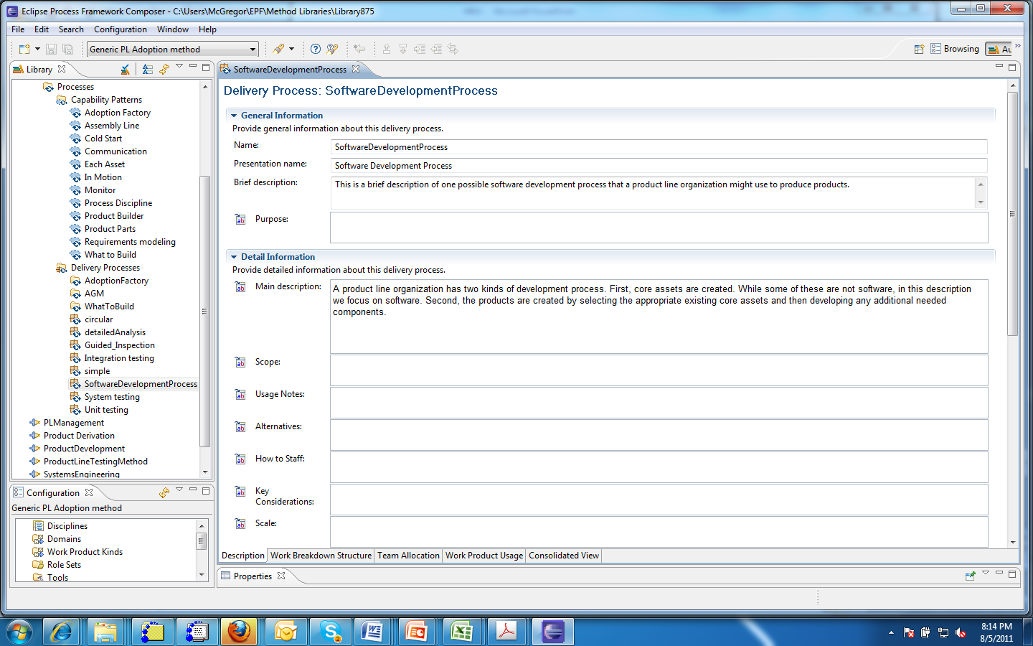
A Delivery Process

Slide 21
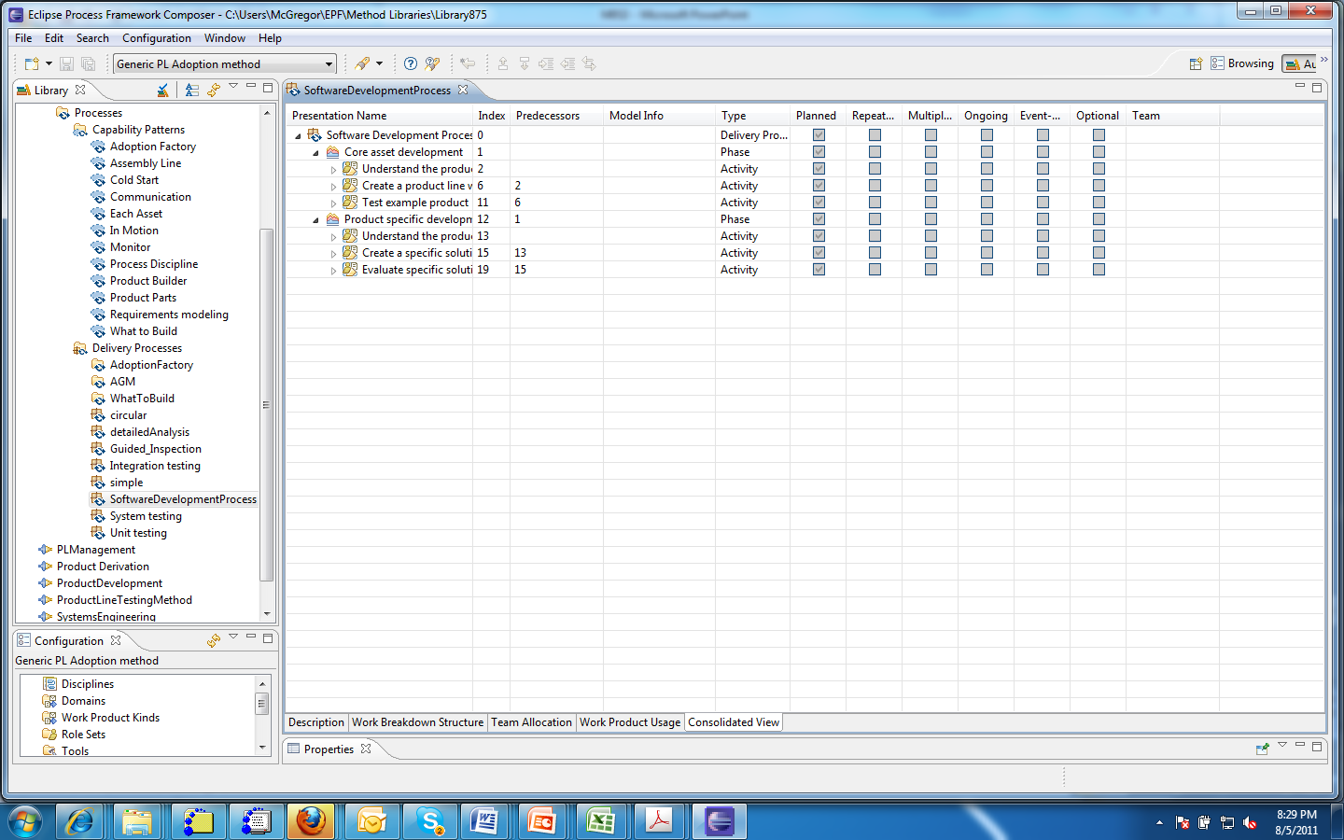
Consolidated View

Slide 22
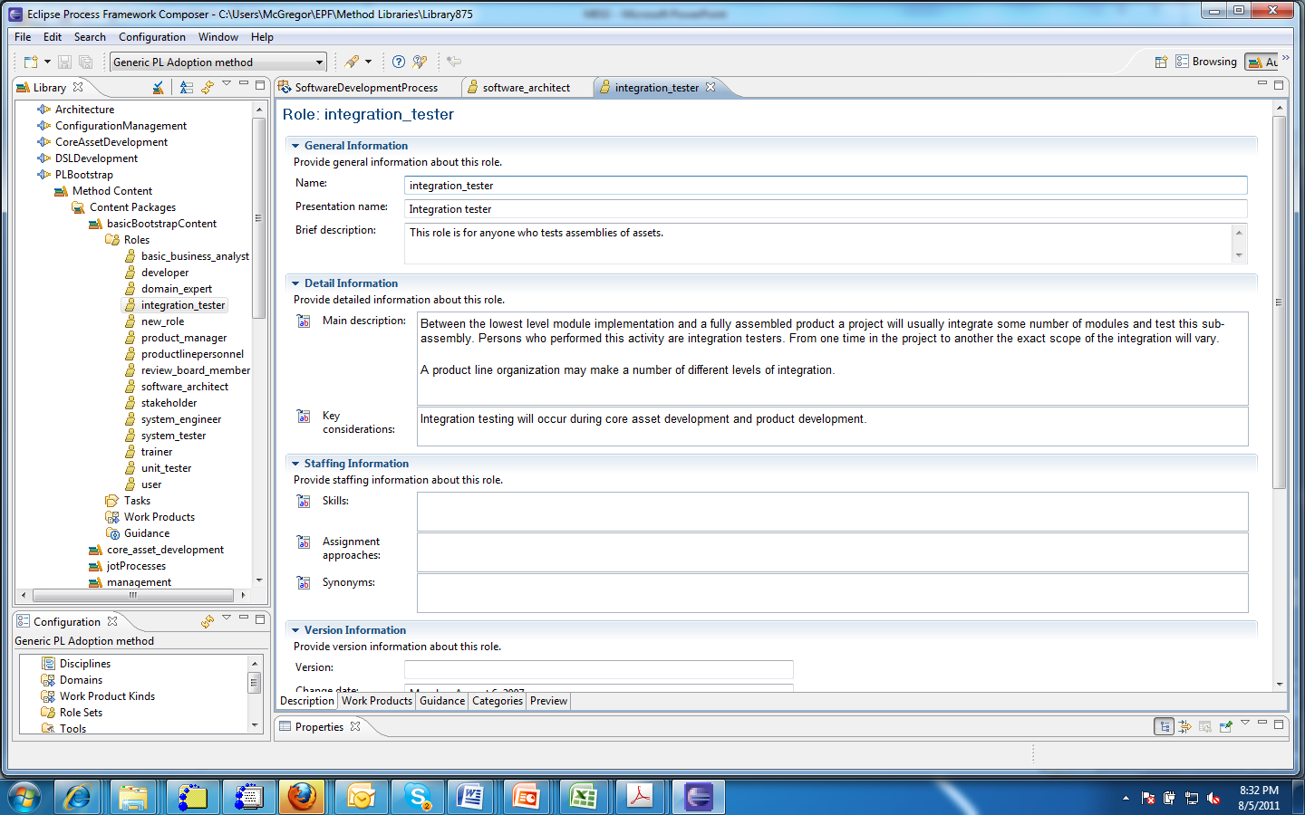
Role definition page

Slide 23
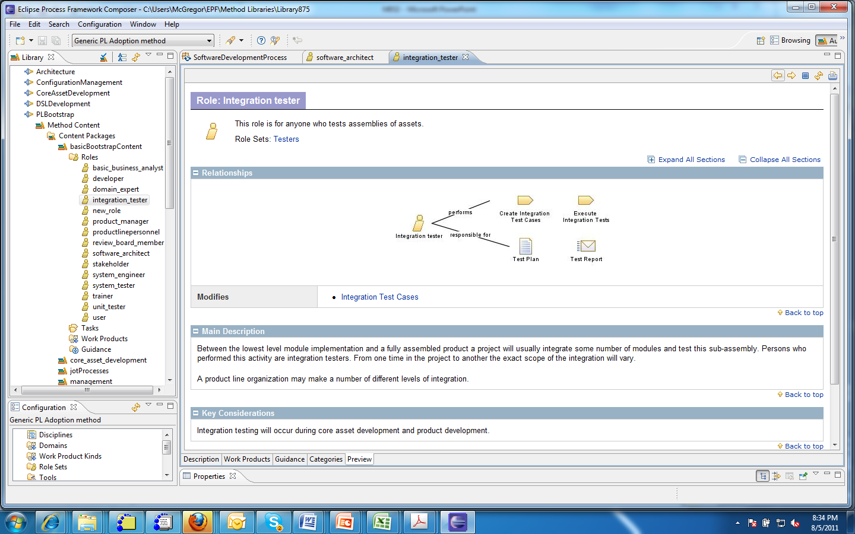
Role definition web page

Slide 24
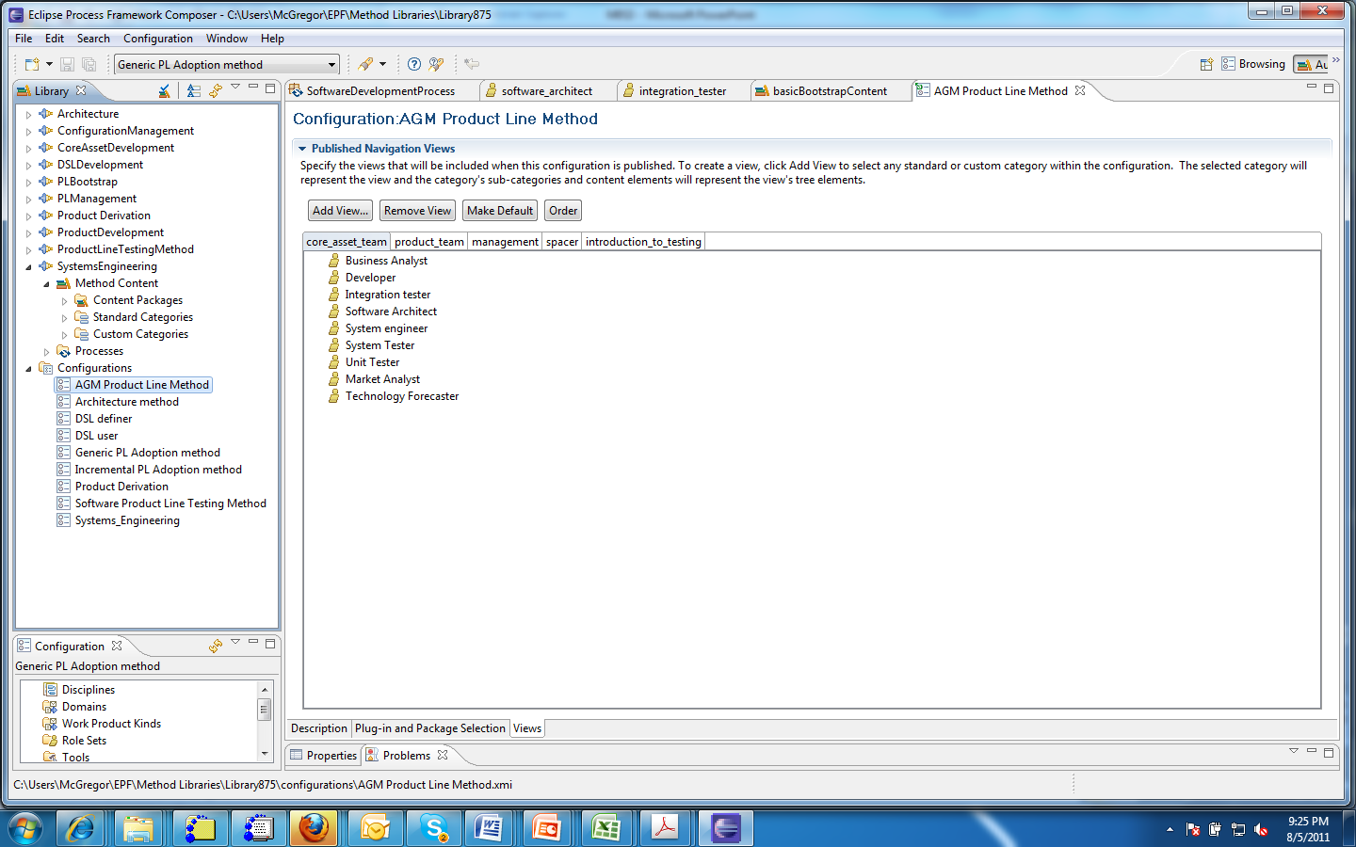
Configuration

Slide 25
Organizing information
Much of the information in this course can be organized according to the SPEM.
Begin now to capture information using EPF.
Unfortunately there is still no Mac version of EPF, just Windows and Linux.
There is a 2 part tutorial at www.eclipse.org/epf

