Slide 1
Issue Tracking and Risk Management
John D. McGregor
Module 10 Session 1
Issue Tracking and Risk

Slide 2
Risk
Every engineering discipline has techniques for managing risk.
The Capability Maturity Model of the SEI provides a CMMI practice area on risk
http://www.sei.cmu.edu/cmmi/casestudies/mappings/pdfs/upload/RSKMv1-3.pdf

Slide 3
Risk-2
Risk is about uncertainty
If we are certain about something
And we are correct – great
And we are incorrect – that is a problem not a risk
Otherwise we are uncertain about something
There is a probability of a situation occurring
If it does happen there are consequences
There are things we can do to either
Reduce the possibility
Reduce the impact

Slide 4
Risk-3
Risk is affected by many factors
Time – the further in the future an event is the less certain we can be about the outcome
Velocity – the faster the knowledge in an area is changing the less certain we can be
Importance – the more important a function is the greater the consequences of failure

Slide 5
Uncertainty in reqspec
uncertainty [ volatility <number> costImpact <number> scheduleImpact <number> familiarity <number> riskIndex <number> proportionalRiskIndex <number> maturityIndex <number> ]

Slide 6
Uncertainty in assurance case
<Claim> ::= claim claimID ( : "Descriptive title" )? ( '(' <claimweight> ')' )? for <requirement reference> [ ( assert <ArgumentExpression> ( argument <String> <Uncertainty> )? ( rationale <String> )? ( <Claim> )* ( issues ("explanation")+ )? ]

Slide 7
Specific Goal/Specific Practices
SG 1 Prepare for Risk Management
SP 1.1 Determine Risk Sources and Categories
SP 1.2 Define Risk Parameters
SP 1.3 Establish a Risk Management Strategy
SG 2 Identify and Analyze Risks
SP 2.1 Identify Risks
SP 2.2 Evaluate, Categorize, and Prioritize Risks
SG 3 Mitigate Risks
SP 3.1 Develop Risk Mitigation Plans
SP 3.2 Implement Risk Mitigation Plans

Slide 8
Prepare for Risk Management
Determine Risk Sources and Categories
• Uncertain requirements
Unprecedented efforts (i.e., estimates unavailable)
• Infeasible design
• Competing quality attribute requirements that affect solution selection and design
• Unavailable technology
• Unrealistic schedule estimates or allocation
• Inadequate staffing and skills
• Cost or funding issues
• Uncertain or inadequate subcontractor capability
• Uncertain or inadequate supplier capability
• Inadequate communication with actual or potential customers or with their
representatives
• Disruptions to the continuity of operations
• Regulatory constraints (e.g. security, safety, environment)

Slide 9
Prepare for Risk Management
Define Risk Categories
The following factors can be considered when determining risk categories:
• Phases of the project’s lifecycle model (e.g., requirements, design, manufacturing, test and evaluation, delivery, disposal)
• Types of processes used
• Types of products used
• Project management risks (e.g., contract risks, budget risks, schedule risks, resource risks)
• Technical performance risks (e.g., quality attribute related risks, supportability risks)

Slide 10
Prepare for Risk Management
Define Risk Parameters
Risk likelihood (i.e., probability of risk occurrence)
• Risk consequence (i.e., impact and severity of risk occurrence)
• Thresholds to trigger management activities

Slide 11
Prepare for Risk Management
Establish a Risk Management Strategy
The scope of the risk management effort
• Methods and tools to be used for risk identification, risk analysis, risk
mitigation, risk monitoring, and communication
• Project specific sources of risks
• How risks are to be organized, categorized, compared, and
consolidated
• Parameters used for taking action on identified risks, including
likelihood, consequence, and thresholds
• Risk mitigation techniques to be used, such as prototyping, piloting,
simulation, alternative designs, or evolutionary development
• The definition of risk measures used to monitor the status of risks

Slide 12
Identify and Analyze Risks
Identify Risks
Examine each element of the project work breakdown structure.
• Conduct a risk assessment using a risk taxonomy.
• Interview subject matter experts.
• Review risk management efforts from similar products.
• Examine lessons learned documents or databases.
• Examine design specifications and agreement requirements.

Slide 13
Identify and Analyze Risks
Evaluate, Categorize, and Prioritize Risks
Each risk is evaluated and assigned values according to defined risk parameters,
which can include likelihood, consequence (i.e., severity, impact), and thresholds. The
assigned risk parameter values can be integrated to produce additional measures,
such as risk exposure (i.e., the combination of likelihood and consequence), which can
be used to prioritize risks for handling.

Slide 14
Identify and Analyze Risks
Evaluate, Categorize, and Prioritize Risks
• Low
Medium
• High
• Negligible
• Marginal
• Significant
• Critical
• Catastrophic

Slide 15
Identify and Analyze Risks
Evaluate, Categorize, and Prioritize Risks
A relative priority is determined for each risk based on assigned risk parameters. Clear criteria should be used to determine risk priority. Risk prioritization helps to determine the most effective areas to which resources for risks mitigation can be applied with the greatest positive impact on the project.

Slide 16
Mitigate Risks
Develop Risk Mitigation Plans
A critical component of risk mitigation planning is developing alternative
courses of action, workarounds, and fallback positions, and a
recommended course of action for each critical risk. The risk mitigation plan
for a given risk includes techniques and methods used to avoid, reduce,
and control the probability of risk occurrence; the extent of damage incurred
should the risk occur (sometimes called a “contingency plan”); or both.
Risks are monitored and when they exceed established thresholds, risk
mitigation plans are deployed to return the affected effort to an acceptable
risk level. If the risk cannot be mitigated, a contingency plan can be
invoked.

Slide 17
Mitigate Risks
Implement Risk Mitigation Plans
Risk avoidance: changing or lowering requirements while still meeting end user needs
• Risk control: taking active steps to minimize risks
• Risk transfer: reallocating requirements to lower risks
• Risk monitoring: watching and periodically reevaluating the risk for changes in assigned
risk parameters
• Risk acceptance: acknowledging risk but not taking action

Slide 18
Risk tracking
Monitor the status of each risk periodically and implement the risk mitigation plan as appropriate.

Slide 20
Issue Tracking

Slide 21
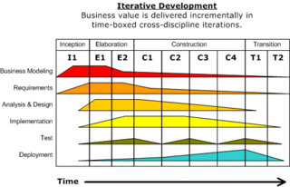
scenario
The system test team files a formal test report which is sent to the requirements team. There are several defects in different requirements. These are broken into issues and tracked.

Slide 22
Agile development
Issue tracking can be very useful fo rqucik moving, self-organizing teams
http://agilesoftwaredevelopment.com/blog/pbielicki/issue-tracking-fits-agile

Slide 23
Issue Tracking
A project has many questions, pending decisions, and assigned actions from meetings.
These items fall through the cracks of most process definitions.
Using a tool makes it less likely something will be forgotten until it causes a major delay.

Slide 24
Regular committees
The Change Control Board meets periodically.
Change requests should have been entered into some system such as this before the meeting and members should have read them.
During the meeting brief results can be entered directly; more extensive notes later
They have their own section in the tracker.
They may assign an issue to any team for further study.

Slide 25
Access
Using a web-based interface allows a widely distributed community to use the information and contribute as well.

Slide 26
Ad hoc meetings
Issues should be collected from these meetings but often they are not.

Slide 27
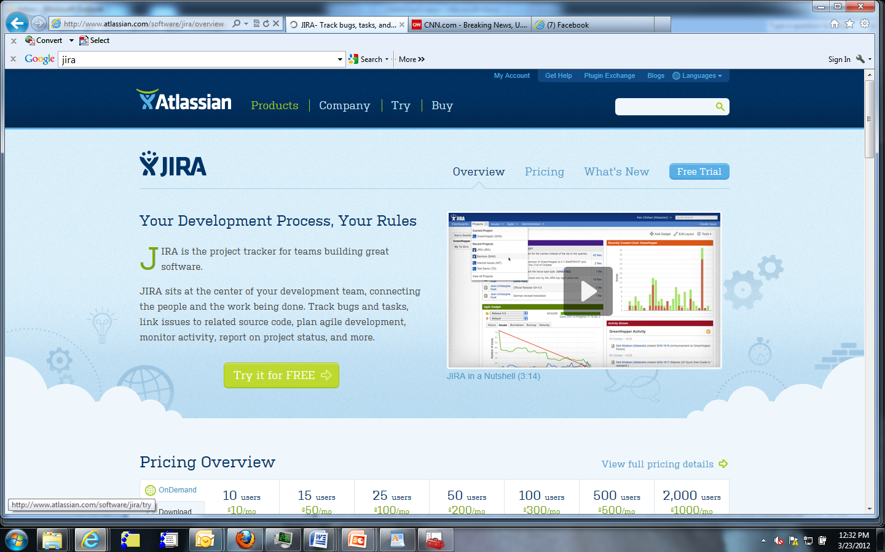

Slide 28
Trac
This is a
http://trac.edgewall.org/wiki/TracOnWindowsStandalone

Slide 29
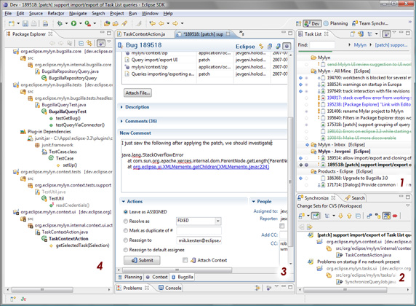
Mylyn

Slide 30
Bugzilla
http://landfill.bugzilla.org/win32installer/

Slide 31
Integrated development environment
IDE – you see it all the time but in the last few modules we have looked at pieces of it in detail
Various of the issue tracking systems fit better or worse with the other tools we have already identified.
The issue tracker’s ability to play nicely with the other tools is an important criteria in selecting a tool.

Slide 32
Example evaluation form
Look at a couple of evaluation matrices
http://it.toolbox.com/blogs/enterprise-solutions/alternatives-evaluation-matrix-13138

Slide 33
Jira
http://www.softwaretestinghelp.com/atlassian-jira-tutorial-1/

