Slide 1

CPSC 871
John D. McGregor
M11S1
Value-driven Software Engineering – part 1

Slide 2
Value
As we get toward the end of the semester we have looked at most techniques but only covered 20% of development time. 80% is ahead of us.
The CVRIA example system we have used off and on during the semester can be viewed from a value perspective.
In this unit I want us to do a deep dive into Value and Value-driven methods.

Slide 3
X-driven
In software engineering there have been several initiatives such as model-driven or specification-based in which a specific technology is the driving force for making decisions.
Value-driven or value-based is different only in that it is at a more abstract level.
What is value and how do we use it?

Slide 4
Value
The worth of all the benefits and rights arising from ownership. Two types of economic value are (1) the utility of a good or service, and (2) power of a good or service to command other goods, services, or money, in voluntary exchange.
The extent to which a good or service is perceived by its customer to meet his or her needs or wants, measured by customer's willingness to pay for it. It commonly depends more on the customer's perception of the worth of the product than on its intrinsic value.
Value changes over time.

Slide 5
Change vs revenue
The manager balances revenue stream against pace of change
Emerging markets have sufficient potential to absorb new products and produce sufficient revenue at a rate that engineers can afford to stay current with changes in the domain
As the market matures and revenue growth slows, the rate of change in features must slow due to a smaller revenue stream.
SPLE allows the rate of change to stay higher longer because an asset is dependent on multiple revenue streams.

Slide 6
Value
Strategic – Use careful investment decisions to build value; use uncertainty principles to compute value
Tactical – Use organizational structure to isolate differences in styles; use technology decisions to reduce costs.

Slide 7
Based on Boehm
Key elements
  1. Benefits Realization Analysis
  2. Stakeholder Value Proposition Elicitation and Reconciliation
  3. Business Case Analysis
  4. Continuous Risk and Opportunity Management
  5. Concurrent System and Software Engineering
  6. Value-Based Monitoring and Control
  7. Change as Opportunity

Slide 8
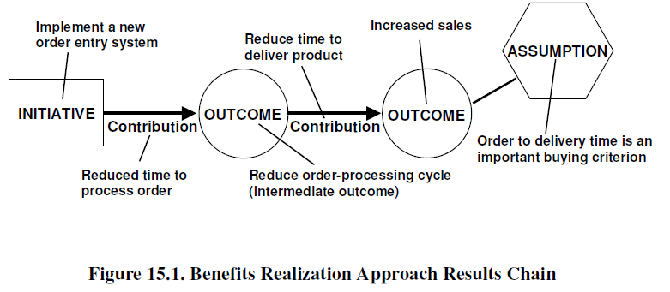
Benefits Realization Analysis

Slide 9
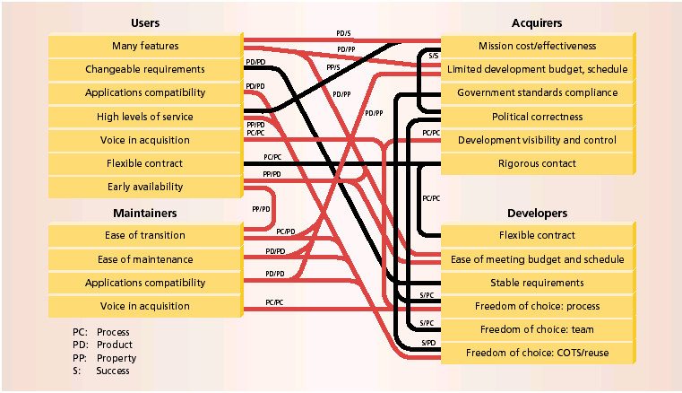
Stakeholder Value Proposition Elicitation and Reconciliation

Slide 10

Business Case Analysis
The business case compares costs to benefits.
Some of those benefits are implicit in that they relate to unquantifiable benefits such as stakeholder good will.
Some of this can be quantified via marketing surveys

Slide 11
Continuous Risk and Opportunity Management
We have already considered continuous risk management
A utility function is a way of computing what a person values
For example, one reason a programmer would rather develop from scratch than explore a reusable component that has a chance of saving a lot of time

Slide 12
Concurrent System and Software Engineering
System Engineering defines requirements usually for a technical system with strict non-functional requirements.
Often a process defines a sequence where requirements are finished before design begins

Slide 13
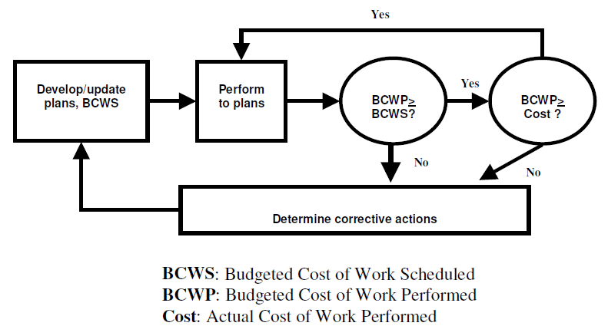
Value-Based Monitoring and Control
Earned Value – total budget is allocated across milestones

Slide 14
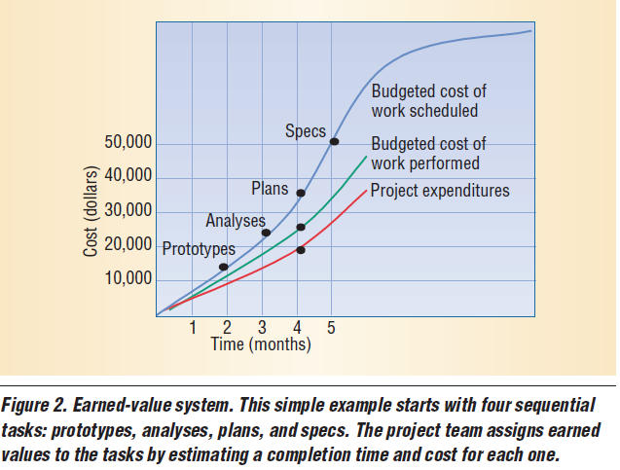
Earned Value Example
Barry Boehm, Li Guo Huang; Value-Based Software Engineering: A Case Study; IEEE Software, March 2003

Slide 15
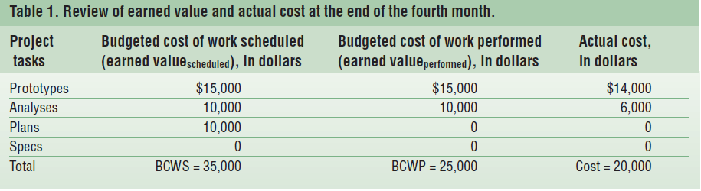
Earned Value Example - 2

Slide 16
Change as Opportunity
Marginal costs
Developing a change-anticipatory modular design can be considered as an investment in real options

