Slide 1

CPSC 871
John D. McGregor
M12S1
Putting it all together

Slide 2
SWEBOK
COPYRIGHT
FOREWORD
ASSOCIATE EDITORS
INDUSTRIAL ADVISORY BOARD
PANEL OF EXPERTS
REVIEW TEAM
PREFACE
CHAPTER 1: INTRODUCTION TO THE GUIDE
CHAPTER 2: SOFTWARE REQUIREMENTS
CHAPTER 3: SOFTWARE DESIGN
CHAPTER 4: SOFTWARE CONSTRUCTION
CHAPTER 5: SOFTWARE TESTING
CHAPTER 6: SOFTWARE MAINTENANCE
CHAPTER 7: SOFTWARE CONFIGURATION MANAGEMENT
CHAPTER 8: SOFTWARE ENGINEERING MANAGEMENT
CHAPTER 9: SOFTWARE ENGINEERING PROCESS
CHAPTER 10: SOFTWARE ENGINEERING TOOLS AND METHODS
CHAPTER 11: SOFTWARE QUALITY
CHAPTER 12: RELATED DISCIPLINES OF SOFTWARE ENGINEERING
APPENDIX A: KNOWLEDGE AREA DESCRIPTION SPECIFICATIONS FOR THE IRONMAN VERSION OF THE GUIDE TO THE SOFTWARE ENGINEERING BODY OF KNOWLEDGE
APPENDIX B: EVOLUTION OF THE GUIDE TO THE SOFTWARE ENGINEERING BODY OF KNOWLEDGE
APPENDIX C: ALLOCATION OF IEEE AND ISO SOFTWARE ENGINEERING STANDARDS TO SWEBOK KNOWLEDGE AREAS
APPENDIX D: CLASSIFICATION OF TOPICS ACCORDING TO BLOOM’S TAXONOMY

Slide 3
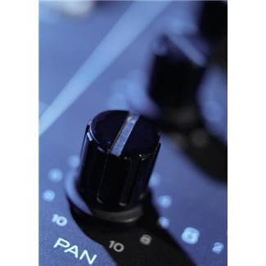
One size does not fit all
As we recap much of what we have studied this semester we will also think about tailoring what we know to the project at hand. It depends on the context.
Team
size
>100
>15
1-2
Criticality
No issue
Mission Critical
Safety Critical

Slide 4
A second perspective
Your business unit’s work
ecosystem
Your division’s work
Scope of responsibility
iterative
Your team’s work
agile
Your own work
Strategic
Tactical
Concrete

Slide 5

Context
The ecosystem in which an organization resides affects what techniques and tools are appropriate.
An ecosystem has diversity and competition.
What degree of precision do we need?

Slide 6
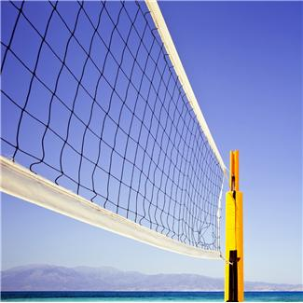
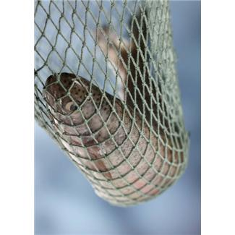
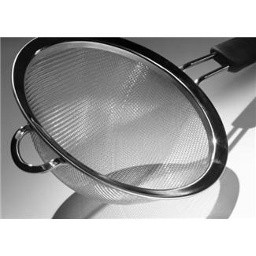
Granularity of coverage
Team
size
As criticality increases, the granularity of coverage has to become finer.
How much is enough?
>100
>15
1-2
Criticality
No issue
Mission Critical
Safety Critical

Slide 7
System
A system is the complete solution to a problem
It usually requires the integration of hardware and software, even if the hardware is not installed or sold with the software.
Systems are hard to build well.
They are hard to build well because it involves communication among people with diverse backgrounds.
Uncertain communication introduces risk.
One of the ways we handle risk is standards.

Slide 8
Coordination
Large projects that combine software and hardware to create a system are usually managed technically by systems engineers.
Systems engineers are trained to analyze problems and create solutions as mixes of hardware and software.
The systems engineer allocates project requirements to hardware and software engineers.
This is referred to as “requirements flow down”
Each group needs to understand how the others function and what their constraints are.

Slide 9
Coordination - 2
The hardware engineer usually can only manage to assemble from existing parts.
They don’t have time or money to fabricate new hardware.
The software engineer has more flexibility but that can be a temptation to always build from language rather than use existing components.
System engineer
Software engineer
Hardware engineer

Slide 10
Communication
Languages are used for communicating between same type of engineer and between different types of engineers.
There are several types of communication in a project. Actual code, models, documentation, meetings…
SysML
System engineer
Software engineer
Hardware engineer
SysML/UML
SysML/HDL

Slide 11
Communication - 2
Code and models are the preferred means of communication because they eliminate the ambiguities of human language.
But, models are abstractions and eliminate some details.
Code is truth,
But complex.
We have focused on models this semester because it is the best communication tradeoff between code and human language.

Slide 12
Communication - 3
We begin with models of the problem domain
Use cases and/or
Scenarios
These support creation of models of solutions
Architecture
This supports creation of the code.
Along the way we communicate with domain experts, systems engineers, managers, software engineers, and hardware engineers.

Slide 13
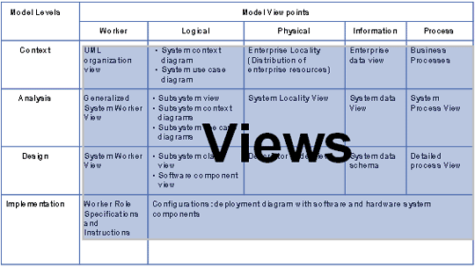
Model feeds to the next model
We build a chain of models built from multiple viewpoints.
Models from several perspectives
http://www.ibm.com/developerworks/rational/library/content/RationalEdge/sep03/m_systemarch_mc.pdf

Slide 14
In lieu of communication
Process
We don’t have to talk if everyone knows what they are suppose to do
Written processes
Continuous improvement
Goal –defined by maturity model

Slide 15
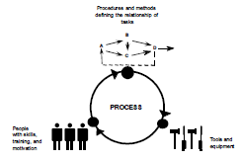
Capability Maturity Model - Integrated
People, procedures and tools
Does not mandate a specific process
Strike a balance between formal and informal introductions of CMMI

Slide 16
Introducing CMMI
http://www.powershow.com/view/12138-ODVmM/Extending_CMMI_to_Hardware_Engineering_Disciplines_flash_ppt_presentation
Engineering Process
Council (EPC)
Engineering Process
Group (EPG)
Discipline
Teams (8)
Action
Teams
Tools, Methods, and
Technology (TMTs)
Short-Term Tasks
Long-Term, Persistent

Slide 17
CMMI
Integrated hardware and software
Start a CMMI improvement project with a baseline assessment
Understand the model
Identify gaps
Implement the actions
Ensure representation across projects and disciplines
Metrics help define, characterize, and improve processes
Identify the prioritized areas for improvement
Start small, look for value
Use available data first before creating something new
http://www.powershow.com/view/12138-ODVmM/Extending_CMMI_to_Hardware_Engineering_Disciplines_flash_ppt_presentation

Slide 18
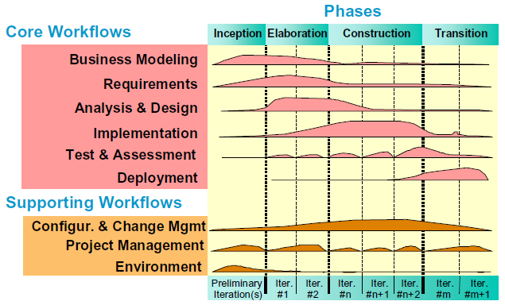
Rational Unified Process
iterative & incremental
architecture
risk
use case/scenario

Slide 19
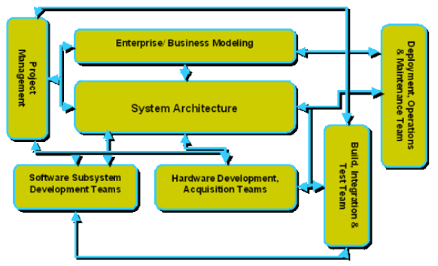
Overall relationships among tasks
http://www.ibm.com/developerworks/rational/library/content/RationalEdge/oct03/m_rupse_mc.pdf

Slide 20
Process definition and method tailoring
We used EPF as a tool that allows us to write customized methods.
Each project will want to use the “extend” facility in EPF to create specialized definitions.
Method engineering defines rules for systematically tailoring processes.
http://doc.utwente.nl/18012/1/Brinkkemper96method.pdf

Slide 21
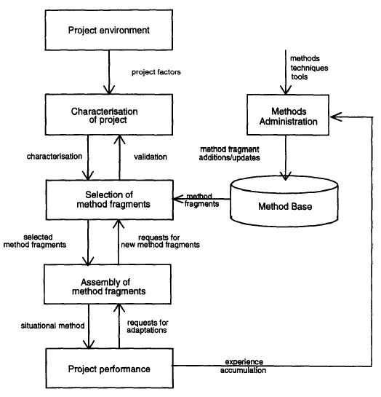
Method engineering

Slide 22

Risk
Problem/probability/consequences
Mitigation
The more critical the project the more costly are the consequences
Team
size
>100
>15
1-2
Criticality
No issue
Mission Critical
Safety Critical

Slide 23
Risk - 2
Engineering is about reducing risk
The number one way to reduce risk is to reduce complexity.
Reduce complexity by
Decomposing/increasing modularity
Documentation

Slide 24
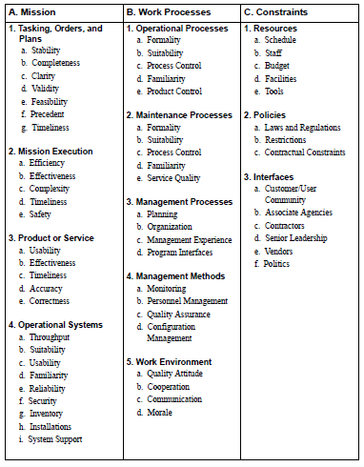
Operational Risk Taxonomy

Slide 25


Standards - Process
UML – design language standard
AADL – architecture description language standard
Interface definitions are standards within some scope.

Slide 26
Standards - Products
Specific to the domain
Autosar is a standard architecture for automotive domain

Slide 27
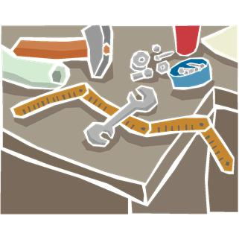
Software engineering workbench
Programming tools - eclipse
Code management tools - subversion
Requirements management tools - SysML
Risk and issue management tools - Trac

Slide 28
workbench
The workbench supports many different processes
That is why the RUP figure uses parallel lines for processes, there are many processes running in parallel

Slide 29
Mapping
Your business unit’s work
ecosystem
Your division’s work
Scope of responsibility
iterative
Your team’s work
agile
Your own work
Strategic
Tactical
Concrete

