Slide 1

CPSC 871
John D. McGregor
M13S1
More on certification

Slide 2
Reference
An Iterative Approach for Development of Safety-Critical Software and Safety Arguments
Xiaocheng Ge, Richard F. Paige and John A. McDermid
2010 Agile Conference

Slide 3
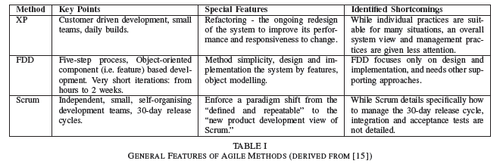
Agile methods

Slide 5
Comparison of plan vs agile

Slide 7
Model with a purpose
“with respect to modeling, perhaps you need to understand an aspect of your software better, perhaps you need to communicate your approach to senior management to justify your project, or perhaps you need to create documentation that describes your system to the people who will be operating and/or maintaining/evolving it over time. If you cannot identify why and for whom you are creating a model then why are you bothering to work on it all?”

Slide 8
Upfront design
for safety-critical projects, the up-front design/plan needs to be sufficiently detailed to serve as input to hazard analysis, which in turn informs the safety analysis and certification processes later. Checklists in some domains or systematic techniques such as Functional Failure Analysis (FFA), are carried out at the start of the development. As design progresses, more detailed analyses are carried out using techniques such as Fault tree analysis (FTA), Hazards and operability analysis (HAZOP), or Failure modes and effects analysis (FMEA); there is usually iteration between the design and analysis processes

Slide 9
Defeasible reasoning
The conclusion may be modified based on new evidence
We are never 100% doubt free
So we have doubts and we want to remove as much doubt as possible
The more doubts that are removed the more confidence in the final product

Slide 10
How is Confidence in a Hypothesis Increased?
A classic philosophical problem:
Determining the basis for belief in a hypothesis when it is impossible to examine every possible circumstance covered by the hypothesis
Use Induction
Enumerative: number of confirming instances (Pascalian)
Eliminative: variety of reasons for doubt (Baconian)
Measuring support for a hypothesis/claim
Enumerative: support increases with number of confirmations
Eliminative: support increases with the number of excluded alternative explanations, i.e., by eliminating reasons for doubting the claim
Defeaters: reasons for doubting a claim

Slide 11



A Baconian Theory of AC Confidence
Confidence is the degree of belief
We grade “degree of belief” in terms of the number of eliminated defeaters (reasons for doubt)
i out of n reasons for doubt (i/n)
0/n – no confidence
n/n – no remaining reasons for doubt
8/10 – residual doubt
Fundamental principle: Build confidence by eliminating reasons to doubt the validity of:
Claims (look for counter-examples and why they can’t occur)
Evidence (look for reasons the evidence might be invalid and show those conditions do not hold)
Inference rules (look for conditions under which the rule is not valid and why those conditions do not hold)
As reasons for doubt are eliminated, confidence grows (eliminative induction)

Slide 12
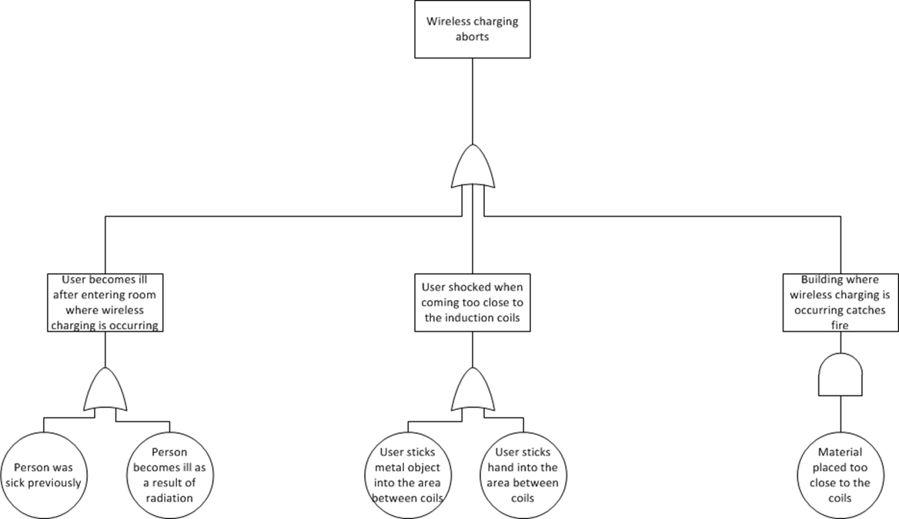
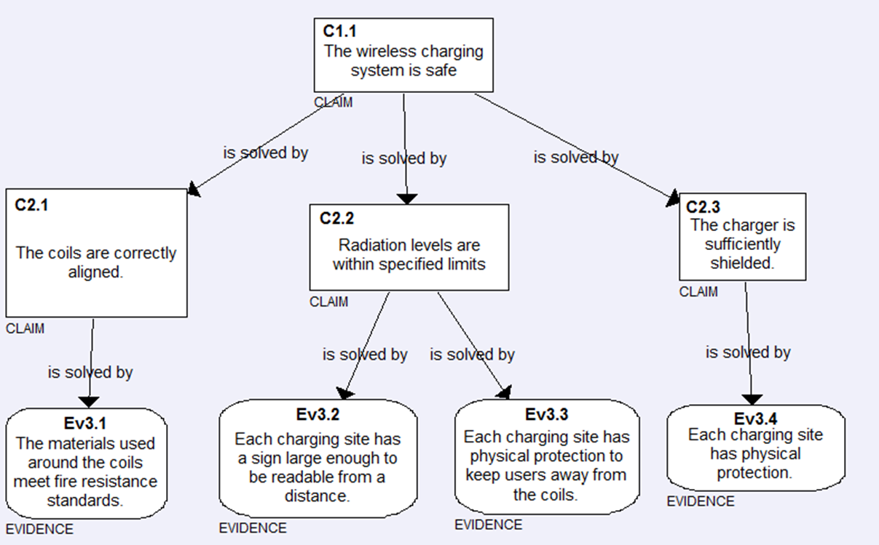

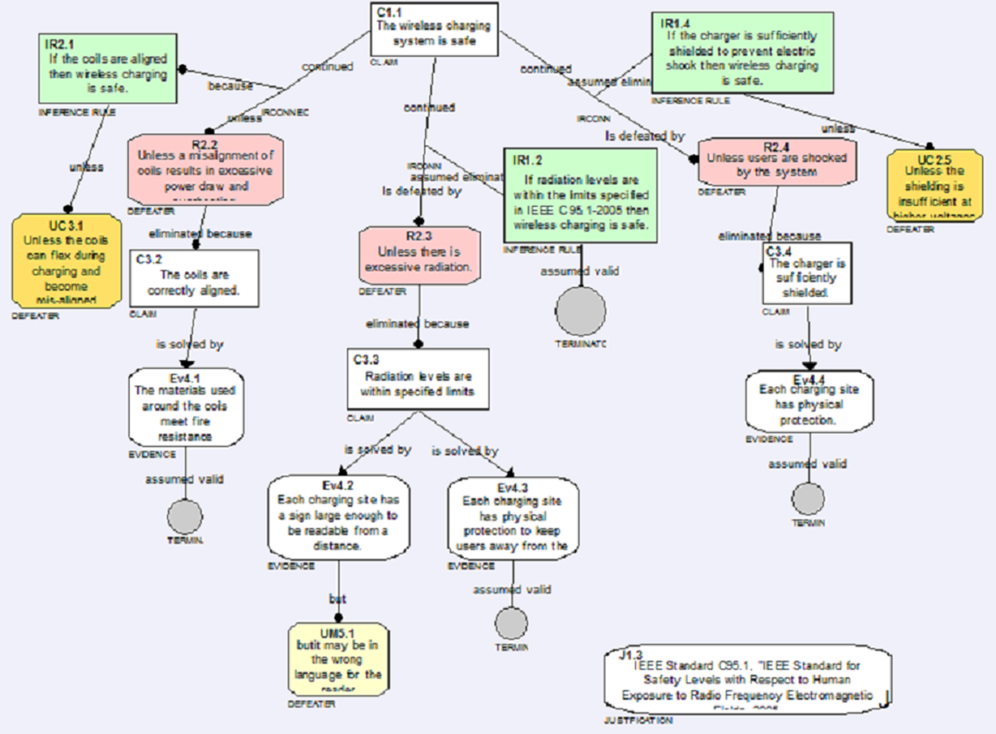
When testing alone simply won’t do
Fault Tree Analysis
Assurance case
Confidence map

Slide 13
Hazard Analysis for Wireless Charging
This paper did a review of the literature and summarized the hazard analyses that have been done.
Three hazards found:
Electric shock
Fire
Radiation
We use this to show the assurance case process
Hai Jiang, Paul Brazis Jr., Mahmood Tabaddor and Joseph Bablo, Safety Considerations of Wireless Charger For Electric Vehicles – A Review Paper, IEEE (2012): "IEEE Symposium on Product Compliance Engineering (ISPCE), 2012", IEEE (ISBN 978-1-4673-1032-1, 97 pages): 51 - 56

Slide 14

Fault tree analysis

Slide 15

Assurance case
An assurance case is defined to be a quadruple of a claim c, a justification j of c, a set es of evidence and an argument g which assures c using es. Let a = (c, j, es, g) be an assurance case; c is defined to be the claim of a; similarly, j is defined to be the justification of a, es to be the set of evidence of a, and g to be the argument of a.
http://ieeexplore.ieee.org/stamp/stamp.jsp?arnumber=06045293

Slide 16
Claims and Evidence
Claim – A claim is a proposition to be assured about the system of concern. It may be accompanied with auxiliary information such as the range of some date mentioned in the proposition or the uncertainty of the proposition.
Evidence is either a fact, a datum, an object, a claim or an assurance case.
Definitions from IEEE Std 15026-2

Slide 17
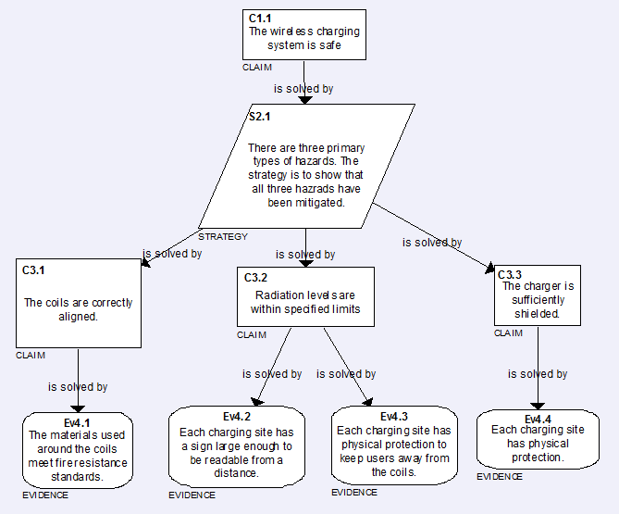
Assurance case

Slide 18
Confidence Map -1
Defeaters
Rebutting defeater – raises a doubt about a claim
Undermining defeater – raises a doubt about a piece of evidence
Undercutting defeater – raises a doubt about an inference rule
Inference rules
Explains why the evidence is seen as supporting the claim

Slide 19
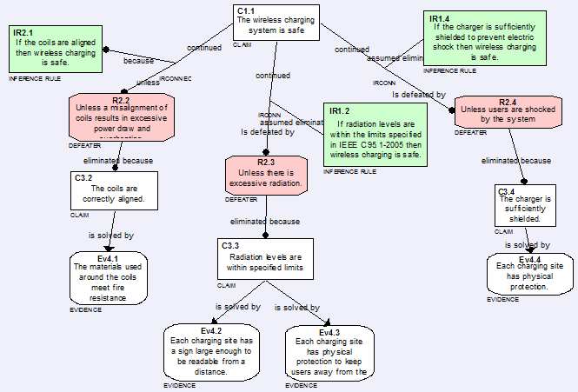
Confidence Map - 2

Slide 20
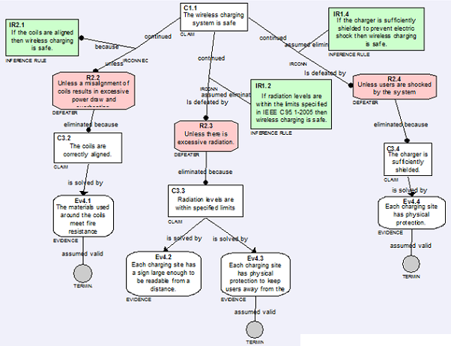
Confidence Map - 3

Slide 21

Confidence Map - 4

Slide 22
Confidence Map - 5
Justification - Given a claim c, a justification j of c is a reason why c has been chosen.

Slide 23
Level of confidence
Starting at the bottom assign probabilities to belief in the evidence
Use standard probability rules to combine the probabilities or use Baconian or use an enumeration

Slide 24
Conclusion
This approach provides a logical argument that can further be refined by stating our confidence in each claim.
It ultimately must convince a certification committee

Slide 25
Here’s what you are going to do…
Research to find hazard analyses related to your app or make an educated guess.
Find at least two hazards
Create the assurance case and confidence map. If you wish use http://www.adelard.com/asce/ to get a trial copy of the ASCE tool and email me for the correct schema to use.
Do another release of your app and include a SONAR run on your src.
Due Nov. 13, 2013 at 11:59pm

