Slide 1

CPSC 871
John D. McGregor
Module 1 Session 3
Assignment

Slide 2
Problem
We will use one problem for the first half of this course. We will expand on it gradually.
Connected vehicles are vehicles that are connected wirelessly to traffic control infrastructure and other vehicles in some cases.
Eventually these vehicles also become autonomous.

Slide 3
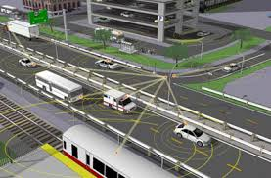
Connected vehicles
proposed project to US DoT
Sensors and radios will be distributed over a portion of I-85 and side streets in Greenville
Intelligent infrastructure will improve traffic flow.

Slide 4
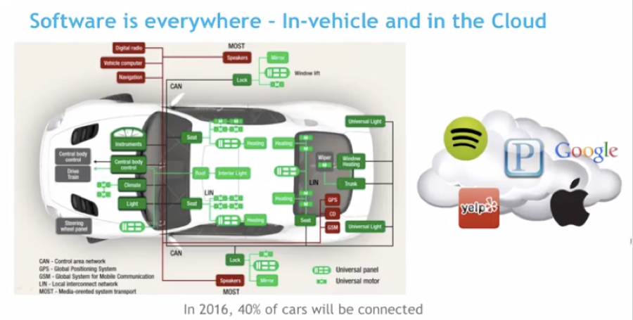
Connected, autonomous vehicles
http://www.iteris.com/cvria/
http://obd2.autoscout24.com/wp-content/uploads/2014/07/Connected_Car_Business_Models.pdf
http://www.genivi.org/
http://www.gsma.com/connectedliving/wp-content/uploads/2012/03/gsma2025everycarconnected.pdf

Slide 5
Problem - 2
Don’t worry about understanding everything right now.
Just begin to analyze the problem. The tools we use for analysis are intended to help you understand.
There are autonomous entities in many places such as tram cars on a track and retrieval robots in a warehouse.

Slide 6
Here is what you are going to do next.
Begin building a model of the problem to be solved. Create a use case diagram.
Due August 31st at 11:59pm via email.
Read in http://www.faa.gov/aircraft/air_cert/design_approvals/air_software/media/AR-08-32.pdf sections 2.1-2.4

