Slide 1

CPSC 871
John D. McGregor
Module 1 Session 4
Requirements Review

Slide 2
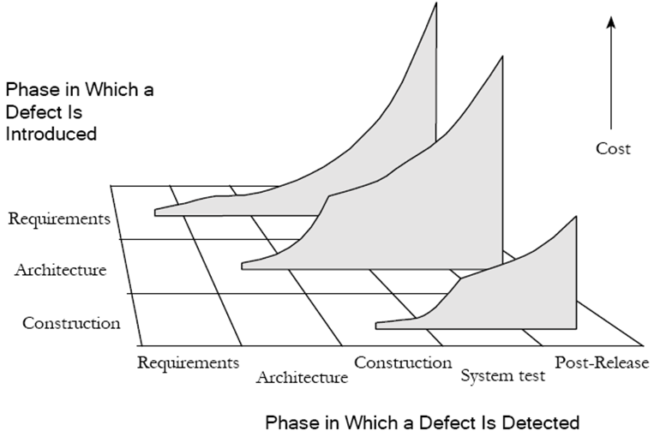
Cost of Defects
Cost to fix defect
Cost to fix defect
Phases in
Which a
Defect is
Introduced
injected
detected
detected
Image from CodeComplete 2nd edition by Steve McConnell

Slide 3
Fault Model for Requirements
1.1 Incomplete decomposition
1.2 Omitted requirement
1.3 Improper translation
1.4 Operational environment incompatibility
1.5 Incomplete requirement description
1.6 Infeasible requirement
1.7 Conflicting requirement
1.8 Incorrect assignment of resources
1.9 Conflicting inter-system specification
1.10 Incorrect or missing external constants
1.11 Incorrect or missing description of initial system state
1.12 Over-specification of requirements
1.13 Incorrect input or output descriptions
Miller, L.A., Groundwater, E.H., Hayes J.E, Mirsky, S.M., “Guidelines for the Verification and Validation of Expert System Software and Conventional Software,” NUREG/CR-6316, SAIC-95/1028, Volume 1.

Slide 4
Peer Review
Peer reviews are reviews of your work by people doing the same level job.
There will also be management reviews as part of the management process.
The software development process will have a number of points at which reviews are performed.
The time (cost) is included in the effort estimates.

Slide 5
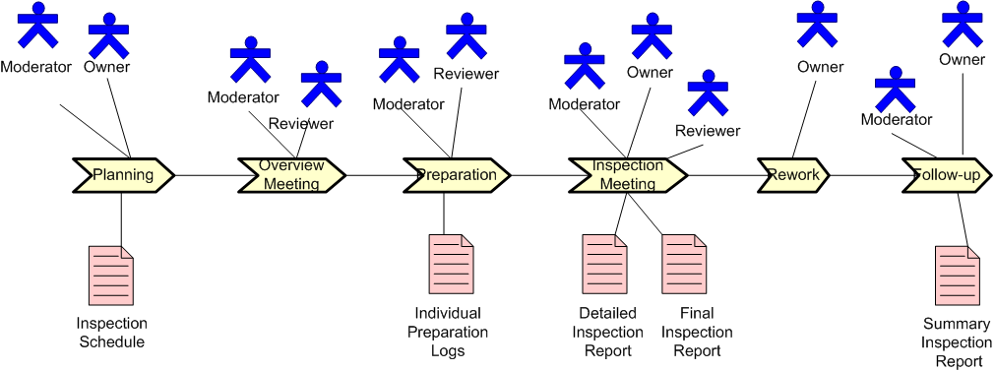
Review process
This is the graphical notation for SPEM.
The moderator is responsible for operating the process.
Reviewers may be chosen from the upstream and downstream groups as well as a parallel group.

Slide 6
Review/Inspection
Summary inspection report – list of action items and list of defects
The Moderator monitors the issues till they are all resolved.
If a sufficient number of faults are found the model may have to be re-reviewed.
At the end the moderator is responsible for computing measures that are reported up to management such as #of Defects/total # of requirements
The Moderator uses Orthogonal Defect Classification to classify the defects.

Slide 7
Orthogonal Defect Classification (ODC)
In order to improve the requirements process the defects are classified and a root cause may be identified.
A set of standard categories has been developed by examining many years of defect data (originally inside IBM)
Each organization develops its own non-overlapping set of categories.
By observing the relative frequency the development process is modified to reduce certain defects.
Better Analysis of Defect Data at NASA. Tim Menzies, Robyn Lutz, and Carmen Mikulski

Slide 8
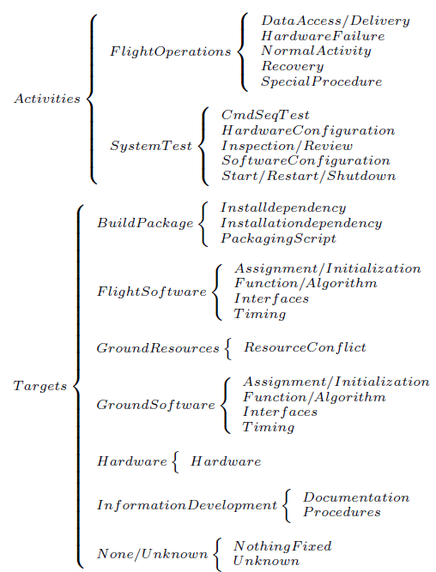
NASA’s ODC

Slide 9
Peer Requirements Review
The “upstream” group is the customers
The “downstream” group is the architects
A “passive” review is one in which reviewers simply read the material looking for faults.
An “active” review is one in which the reviewers are guided through the requirements.
The guidance often includes a series of questions the reviewer is to answer as they read.

