Slide 1

CPSC 871
John D. McGregor
Module 2 Session 2
Fault Analysis

Slide 2
Fault/Failure
A fault is a defect in a workproduct
A failure is a discrepancy from the expected behavior at runtime.
Explicitly identifying what can go wrong and designing for it is an important part of safety design.

Slide 3
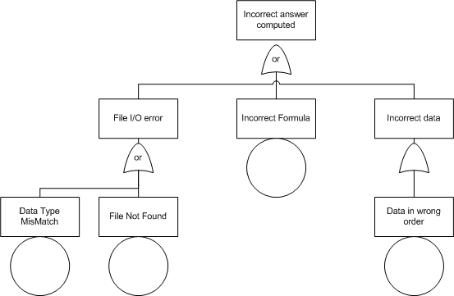
Fault Tree Analysis

Slide 4
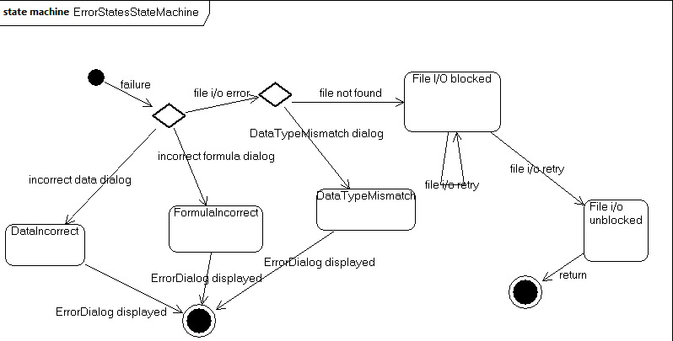
State machine for FHA

Slide 5
Fault tolerant design
We will expand on this later but in the context of understanding the problem:
  The software product should be able to recognize failures
  The software product should be able to either restart itself or correct or notify user of the failure in a graceful manner (no blue screen of death)
We will build as carefully as possible but fault tolerance allows the software to continue some level of operation in the presence of failures.

Slide 6
Fault tolerance and domains
What is an acceptable fault tolerant action varies from one domain to another.
In aircraft, simply stopping the system is not an option while in robotic surgery stopping may be the safest option, not moving forward or backward.

