Slide 1

CPSC 871
John D. McGregor
Change management
Module 2 Session 3

Slide 2
Reference
Please read http://www.computer.org/portal/web/swebok/html/contentsch7#ch7

Slide 3
Work Products
Although many people focus on code, a software development organization generates a number of work products.
Most of those work products are used by multiple people and many are created by a team.
The team has to coordinate their work so that no work is duplicated or overwritten but all work gets done.
Change management provides techniques for coordination.

Slide 4
Coordination
If there were just a couple of people working together they might coordinate by emailing a file back and forth.
Most of the time this is just not sufficient.
Version control software such as subversion allows a team to establish a commonly accessible location for artifacts. The software maintains access controls and history information beyond the simple read, write, execute of the OS.

Slide 5
Coordination - 2
The version control software has R/W and Read-only permissions. Except under certain circumstances there is only one person with R/W access at a time.
This is accomplished by check-in and check-out operations for each unit.
A worker checks out a file and is granted R/W access; she does her work; saves the file; and checks it in. While she has R/W access others who want the file will only be granted R access.

Slide 6
Coordination - 3
The same worker requests to check out a file but someone else already has R/W access. The version control system asks whether she would accept R-only access. Since she was only going to read the file to support a design activity she agrees. Eventually she checks the file back in.
Version control also coordinates over time. Every time the file under control is saved, a copy of the old file is kept as well as the new.
While the default for check-out is the latest saved version, the earlier versions can be accessed and can be made the latest to undo a different direction.

Slide 7
Branching
Sometimes we decide to try a different organization of a document or a different algorithm for a program. There will be multiple versions of this trial and others will continue to develop the original artifact while you try this new direction.
The version control allows a branch, a parallel version path, to be created and accessed.
Below the main trunk is blue. B stands for branch. M is for merge where the branch is joined back into the trunk. R is for release, when the product is shipped to our customer.
R
R
R
R
B
M
B
M

Slide 8
Natural thing to do
For a professional software engineer, use of the version control is a natural thing to do.
Most integrated development environments (IDE) can be directly linked to version control systems.
In Eclipse-based systems a menu to access the version control system appears in the IDE’s menu.

Slide 9
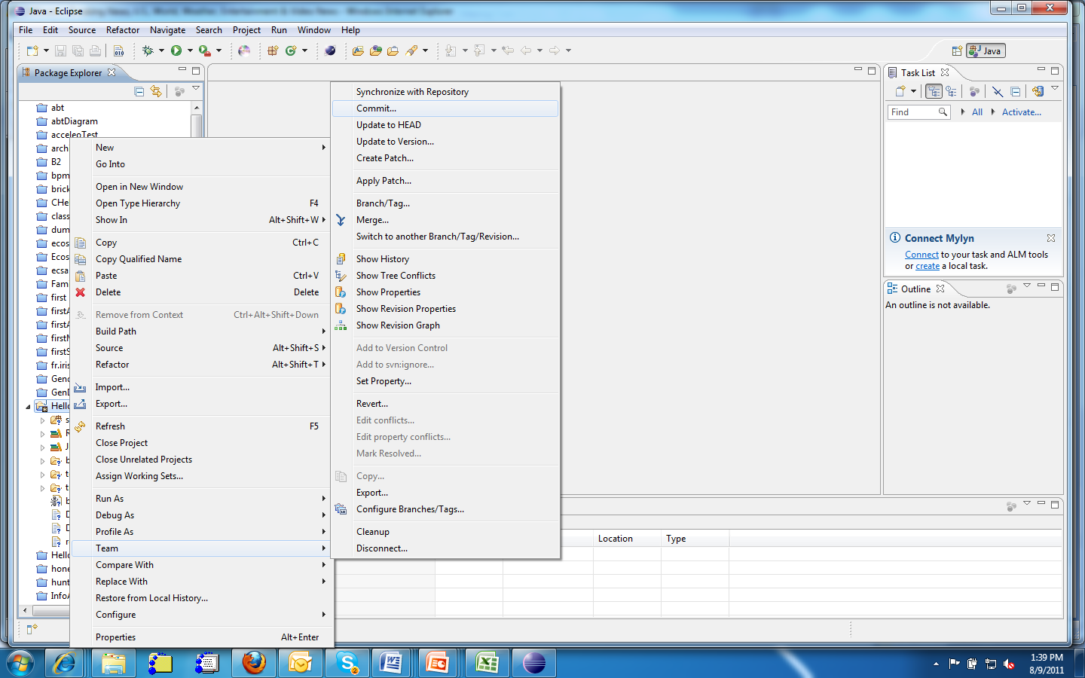
Subclipse menu

Slide 10
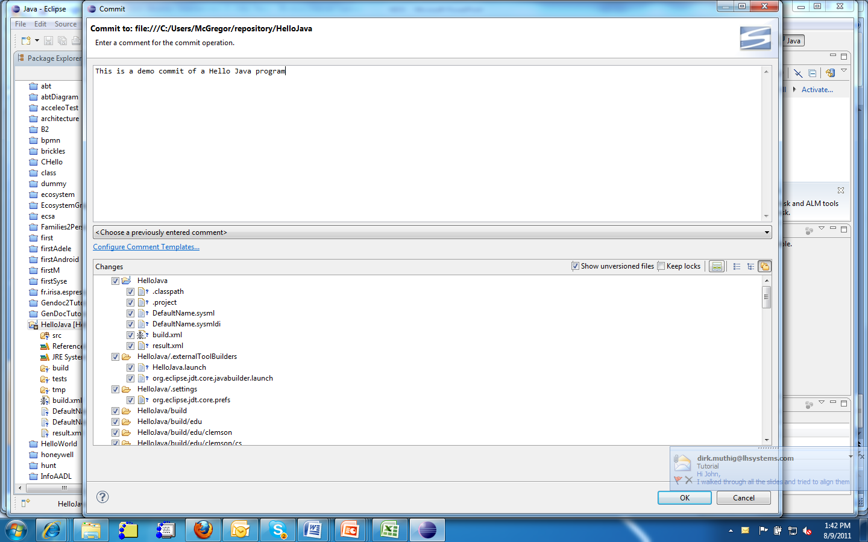
Adding a comment to a version

Slide 11
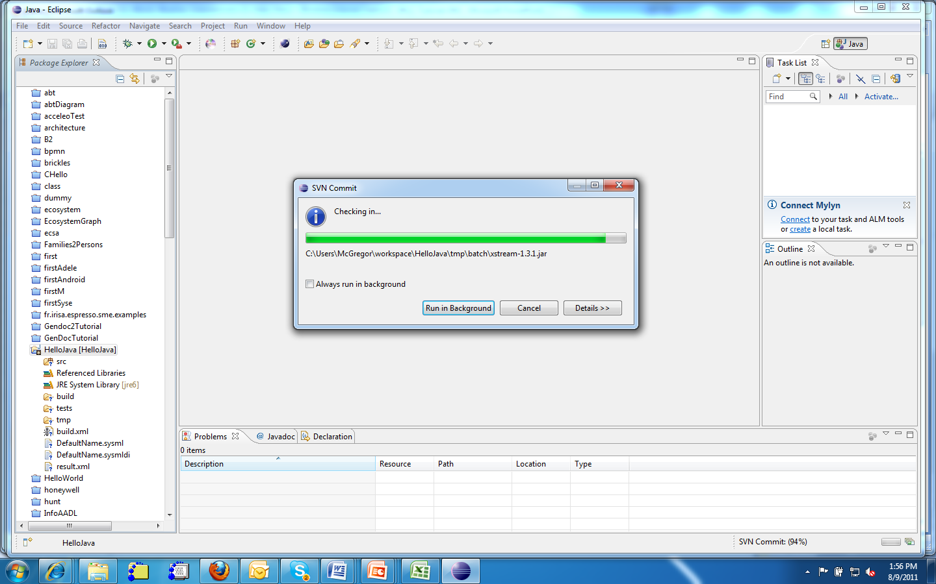
Committing

Slide 12
But tools aren’t enough
Change management is also a process. It is one of the disciplines in RUP.
Once a set of artifacts have reached a point of correctness/completeness/acceptance we declare a “baseline”
After that point any changes to artifacts in the baseline must be approved by a committee referred to as a Change Control Board (CCB).
The CCB meets periodically to approve Change Requests (CRs)

Slide 13
Change management
The purpose of change management is to prevent chaos, or at least keep order.
The CCB provides the opportunity for anyone with a concern about changes to raise objections.
In particular part of making a change request is to conduct a change impact analysis.

Slide 14
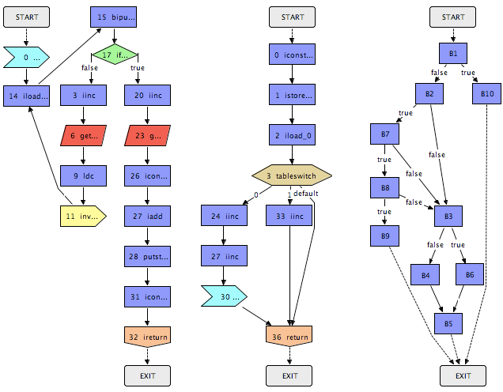
Change impact analysis
A change impact analysis starts at the point in a design or program at which a change is proposed.
The flow of control and flow of design from that point are traced back earlier.
The effects of the change can be seen in the parts of the program that are touched by the trace and by the effort it will take to make all the adjustments necessary to support that change.

Slide 15
Change management
By conducting the impact analysis, the proposed changes are often modified significantly.
The result is a better design/program.

Slide 16
Configuration management
Version control and change management work closely together to manage the pieces that make up the product.
When there is a strategic level of reuse a product is not just the set of files in the version tree of the product.
Tools such as Ant, Make, and Buckminster provide a syntax for defining a program as the composition of a set of pieces.

Slide 17
CM - 2
This definition becomes a program artifact and it is versioned.
These tools, termed product materialization tools, can be used top automate the assembly, compilation, testing, and deployment.
On the next slide is a meta-model for the scheme that the materialization tools use.

Slide 18
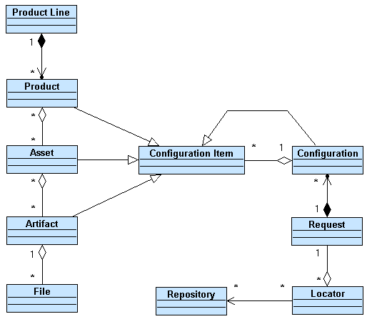
Meta-model for CM
CI
Spec
Assembly
request
Resource
map

Slide 19
Using the meta-model
A product configuration specifies the assets to be integrated to form the product.
A request is generated for each asset.
The separate locator defines where each asset can be found.
The product is assembled.

Slide 20
Product configuration
R
R
R
R
R
R
R
R
R
R
R
R
Assets
R
R
R
R
M
M
M
B
M
B
M
M
B
M
B
M
B
B
B
B
R
Product A
R
R
R
B
M
B
M
R
Product B
R
R
R
B
M
B
M

Slide 21
CM practice
Version control mitigates the risk that work will be lost, destroyed, or intermixed.
CM mitigates the risk that assets must be copied into another directory in order to build a product.

Slide 22
Here’s what you are going to do
Add subclipse or Egit to your OSATE installation
Here are a couple of aids:
  http://agile.csc.ncsu.edu/SEMaterials/tutorials/subclipse/
  http://subclipse.tigris.org/
  http://git-scm.com/
  http://eclipse.org/egit/
For the initial project containing the use cases add that project to the subversion repository.
Submit a screen print of a page that shows the project navigator window with the added annotations from subversion (it will add those automatically when it is committed to the repository.)

