Slide 1

CPSC 871
John D. McGregor
Module 2 Session 4
CMMI & assignment

Slide 2
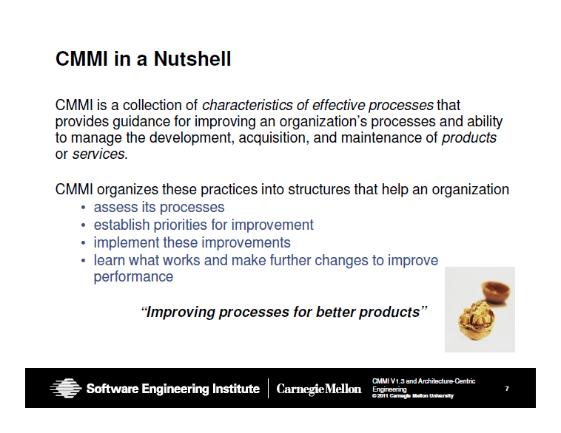
Capability Maturity Model

Slide 3
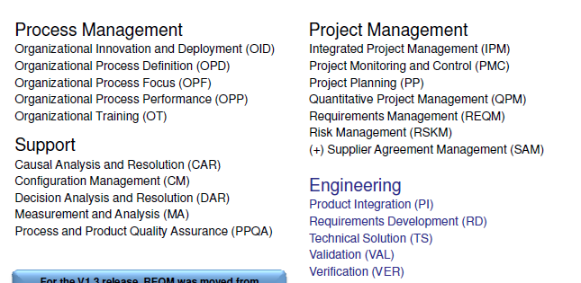

Slide 4
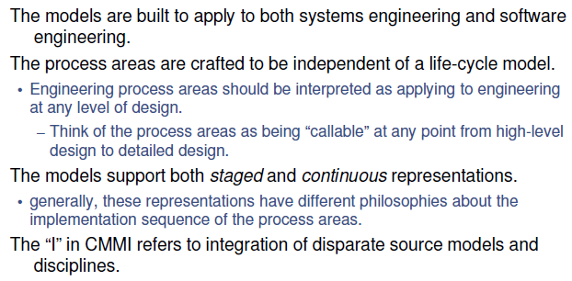

Slide 5
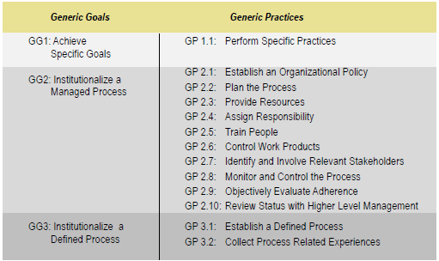

Slide 6
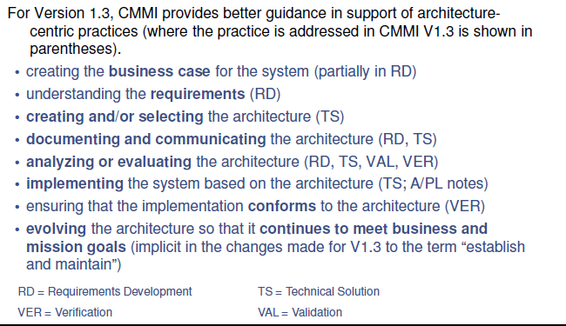

Slide 7
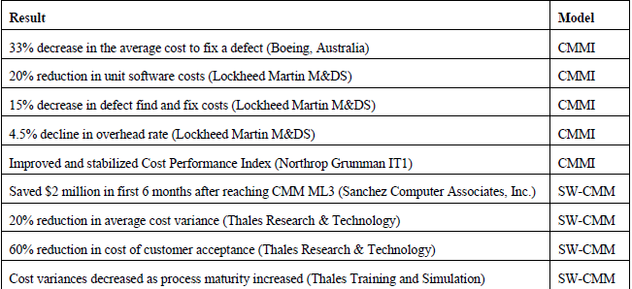
Results on cost

Slide 8
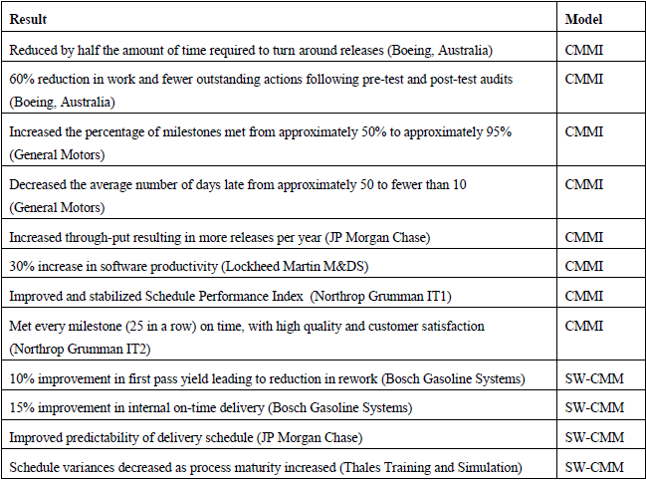
Results on Measures

Slide 9

reference

Slide 10
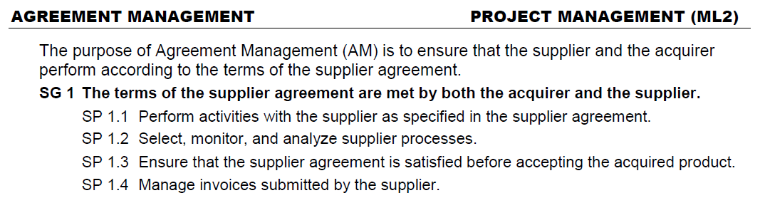

Slide 11
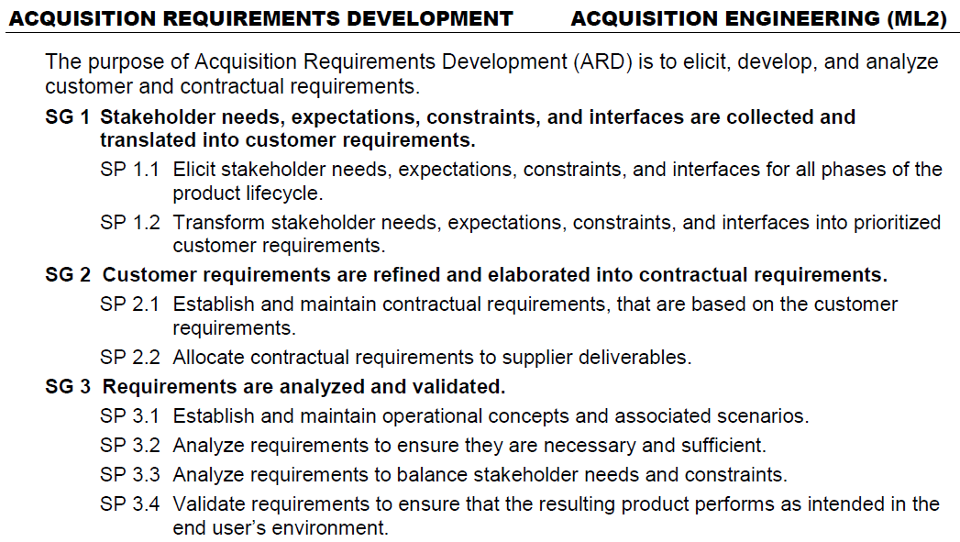

Slide 12
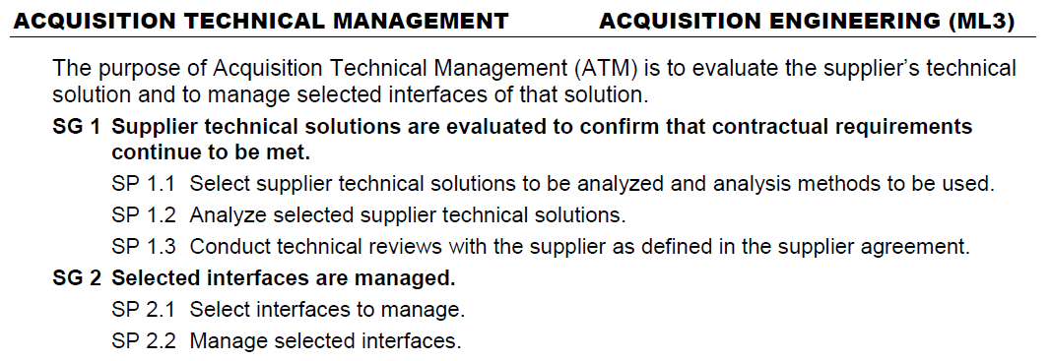

Slide 13
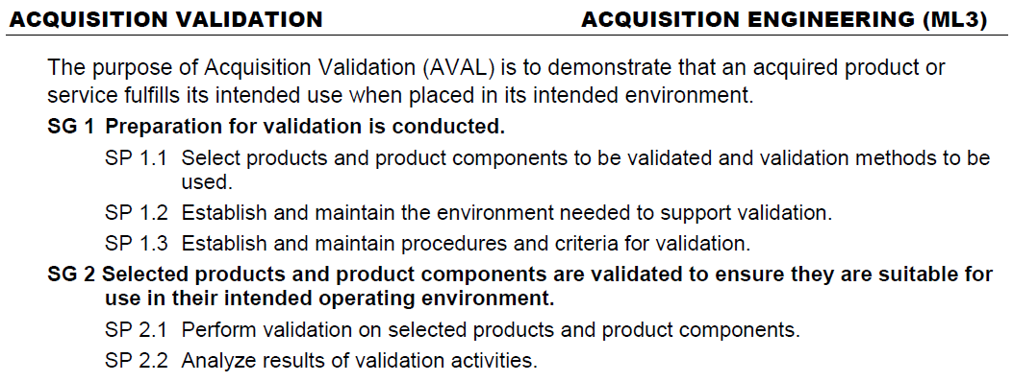

Slide 14
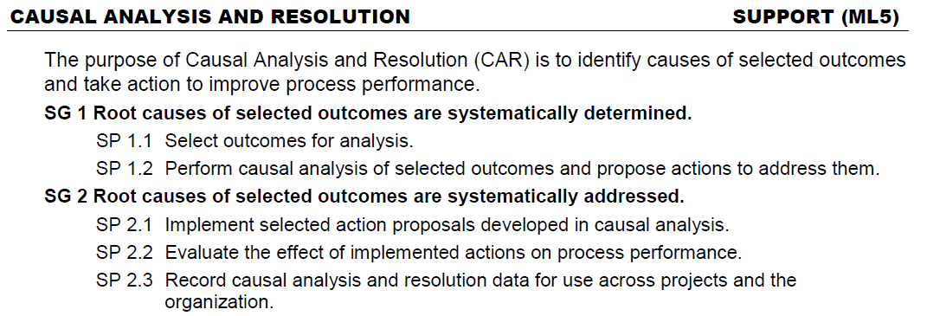

Slide 15
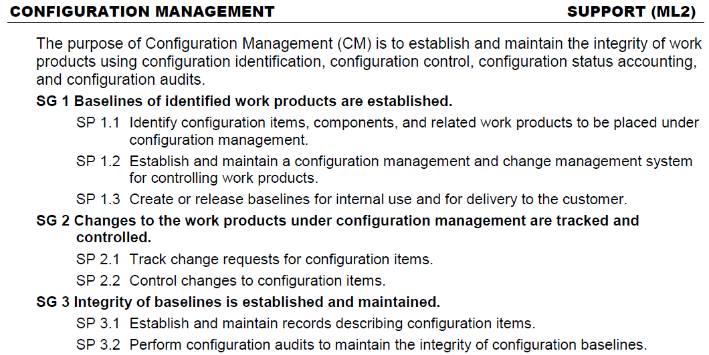

Slide 16
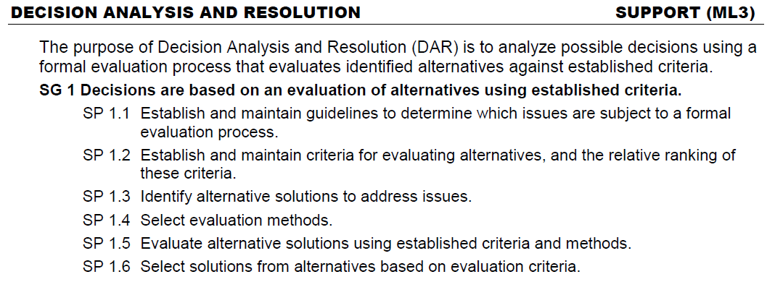

Slide 17
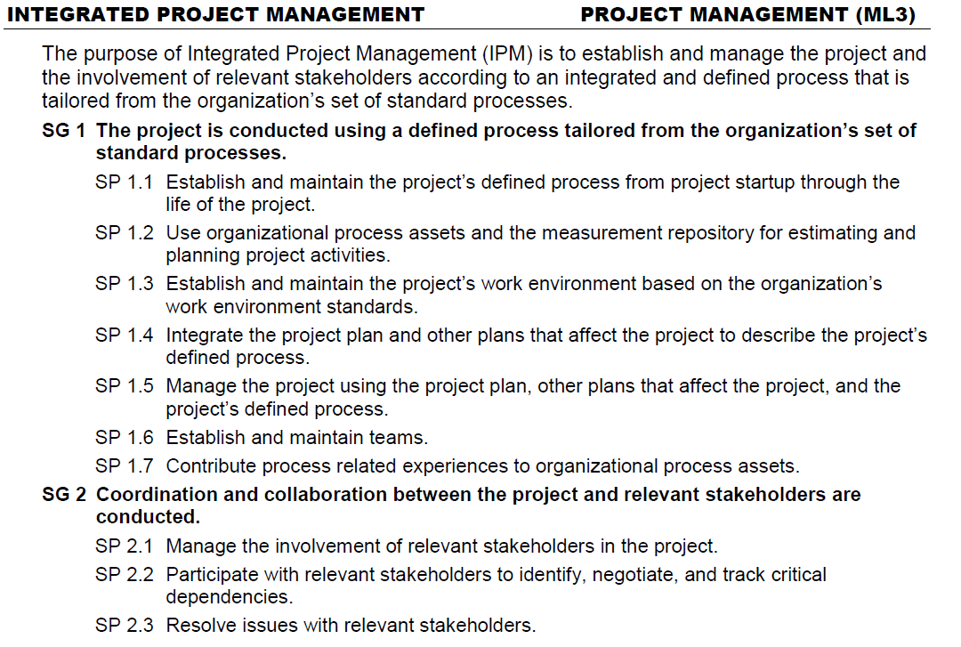

Slide 18
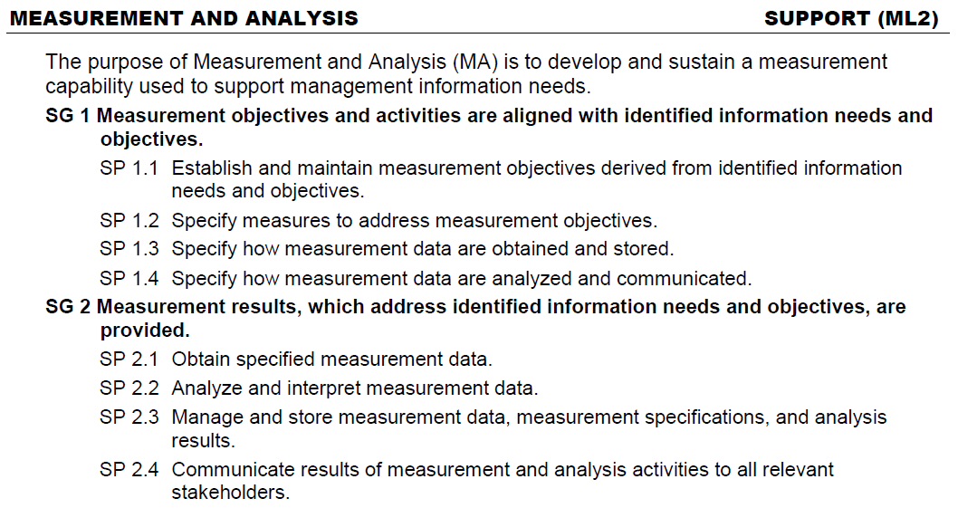

Slide 19
Here’s what you are going to do
Start your own process definition using the EPF tool and the zipped library from the resources page.
Create a new “process” and add to it items from the modules in the library. Review the EPF tutorials as necessary.
Submit a screen print of one of the pages you define.
Place your EPF project under management.
Do a screen print that shows the project navigator with the version control tags.

