Slide 1
From Problem to Solution
Module 3 Session 0

Slide 2
Transitioning
In the “waterfall” method the requirements are formally handed over to the design team.
There is a sign off by the customer that these are the official requirements
In the “iterative, incremental” method the design team begins working with the requirements team learning the domain.
The two teams work in parallel until the requirements stabilize and the design is adequate.

Slide 3
Requirements elicitation
Read, talk, interview …
Capture – using story boards, diagrams and text
Software Requirements Specification (SRS)
It provides feedback to the customer.
It decomposes the problem into component parts.
It serves as an input to the design specification.
It serves as the parent document

Slide 4
Requirements analysis
Take models and knowledge of the domain
Decompose 1 req -> 2 req by breaking apart
Abstract – define new less detailed req and create a dependency
Derive a req from another to take it to a new usually more detailed level but for a different part of the process

Slide 5
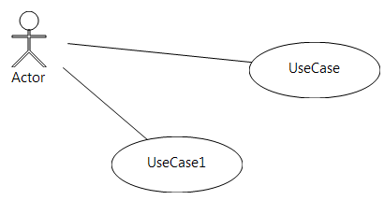
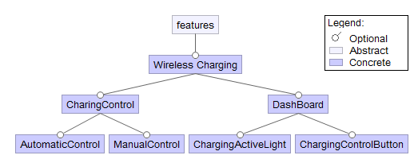
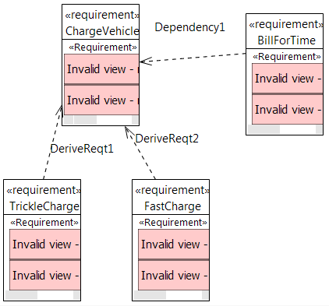
3 levels of formality and completeness

Slide 6
Levels of requirements
Official or not, new requirements are created from the original ones
The new ones are usually more detailed
L1 -> L2 -> L3 -> L4

Slide 7
Requirements work continues
Even as design of a solution is underway work continues on the requirements.
Close contact with the customer is essential.
Listen to the designers

Slide 8
Use cases
Requirements
Decomposition
reconsider
Idea
Requirements
Architecture
Implementation
Retire
Scope
review
feedback
Configuration
management
Process/
notations
Infrastructure

