Slide 1

CPSC 871
John D. McGregor
Module 3 Session 2
AADL

Slide 2
Frank Lloyd Wright
An architect must be forward looking .. If he can’t see at least 10 years into the future then he shouldn’t be called an architect

Slide 3
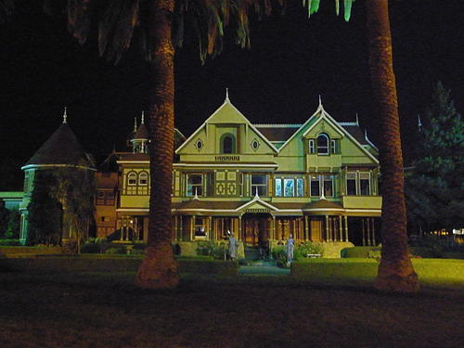
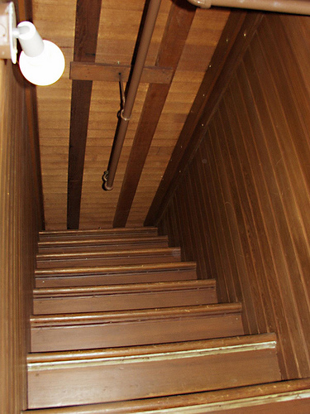
Winchester mansion

Slide 4

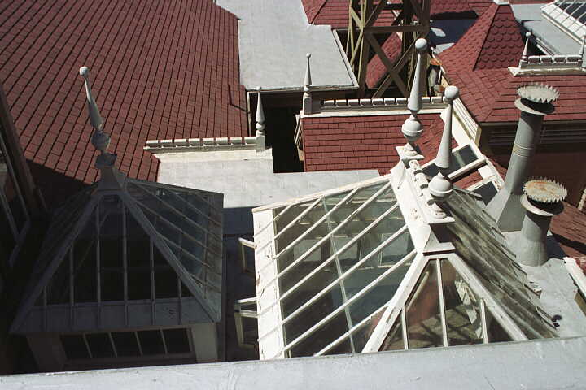

Slide 5
NASA sample architecture – located off my home page www.cs.clemson.edu/~johnmc under resources
Reliability
Correctness
Latency

Slide 6
AADL
The Architecture Analysis and Design Language (AADL) is a systems architecture description language
AADL is a standard of the Society of Automotive Engineers
We will use this language as representative of architecture description languages.
I have used this on projects such as a set of helicopters for the Army.

Slide 7
AADL - 2
The Software Engineering Institute (SEI) has done much to support the development and use of AADL.
The SEI has developed a toolset, OSATE, that supports developing architectural models using AADL. Much information can be found on www.aadl.info

Slide 8
AADL intro
I suggest you scan the tech report at this url to get an overview:
http://www.sei.cmu.edu/reports/07tr014.pdf
And scan this one to get an idea about the error model:
http://www.sei.cmu.edu/reports/07tn043.pdf

Slide 9
Three classes of elements in AADL
1. application software
  a. thread: a schedulable unit of concurrent execution
  b. thread group: a compositional unit for organizing threads
  c. process: a protected address space
  d. data: data types and static data in source text
  e. subprogram: callable sequentially executable code
2. execution platform
  a. processor: components that execute threads
  b. memory: components that store data and code
  c. device: components that interface with and represent the external environment
  d. bus: components that provide access among execution platform components
3. composite
  a. system: a composite of software, execution platform, or system components

Slide 10
Basic pieces
Control and data flow through ports at the interface of each module (system in AADL syntax)
Determined by port type: event port, event data port, data port
pt1
A
System implementation S1.impl
ADL
Process P2
C1
flow path F5
C3
Connection
C5
Process P1
flow path F7
www.sei.cmu.edu

Slide 11
System Type
system GPS
features
speed_data: in data port metric_speed
{arch::miss_rate => 0.001 mps;};
geo_db: requires data access real_time_geoDB;
s_control_data: out data port state_control;
flows
speed_control: flow path
speed_data -> s_control_data
properties
arch::redundancy => 2 X;
end GPS;
The SAE AADL Standard: An Architecture Analysis & Design Language for Developing Embedded
Real-Time Systems by Lewis and Feiler
Notes:
Key points (Objectives of the Slide):
Slide Content Description:
Presentation Script:
The interface of a component specifies ports, required access to shared data, and flow of information through the component.
Properties can be specified for the component itself or its features. In our example we specify the degree of redundancy of the component as a whole to accommodate fault tolerance and characteristics of the data stream to flow through ports.

Slide 12
System Implementation
system implementation GPS.secure
subcomponents
decoder: system PGP_decoder.basic;
encoder: system PGP_encoder.basic;
receiver: system GPS_receiver.basic;
connections
c1: data port speed_data -> decoder.in;
c2: data port decoder.out -> receiver.in;
c3: data port receiver.out -> encoder.in;
c4: data port encoder.out -> s_control_data;
flows
speed_control: flow path speed_data -> c1 -> decoder.fs1
-> c2 -> receiver.fs1 -> c3 -> decoder.fs1
-> c4 -> s_control_data;
modes none;
properties arch::redundancy_scheme => Primary_Backup;
end GPS;
Notes:
Key points (Objectives of the Slide):
Slide Content Description:
Presentation Script:
The interface of a component specifies ports, required access to shared data, and flow of information through the component.
Properties can be specified for the component itself or its features. In our example we specify the degree of redundancy of the component as a whole to accommodate fault tolerance and characteristics of the data stream to flow through ports.

Slide 13
Process
process implementation ProdCons.default
subcomponents
theProd: thread Prod.Impl;
theCons: thread Cons.Impl;
connections
EventConnection1: event port start -> theProd.start;
DataConnection1: data port theProd.val -> theCons.val;
end ProdCons.default;

Slide 14
Thread
Thread
Is a schedulable unit dispatched based on time or arrival of events
Executes on a processor under a specified scheduling protocol
Executes within a protected address space
Interacts with other threads through port connections, server subprogram calls, and shared data access
Remote service calls
Features: port, server subprogram, requires data access, provides data access Flow specs, Properties | Subcomponents: Data Call sequences, Connections, Flow implementations, End-to-end flows, Modes, Properties
Notes:
Key points (Objectives of the Slide):
Threads have completely specified interfaces. Interaction with other components is limited to the features specified in the thread type.
Slide Content Description:
Presentation Script:
Thread: schedulable unit
Periodic, sporadic, aperiodic, and background are dispatch protocols defined by the core AADL
Threads execute in a shared process address space, but their interaction with other threads is controlled by their interface specification.
This allows threads to be relocated to different processors without affecting their interaction with other threads through port communication and remote subprogram calls. In case of shared variable use remote invocation of data access methods can provide distributed processing support.

Slide 15
Thread Dispatch Protocols
5ms
Periodic thread
  represents periodic dispatch of threads with typically hard deadlines.
Aperiodic thread
  represents event-triggered dispatch of threads with typically hard deadlines.
Sporadic thread
  represents dispatching of threads with minimum dispatch separation and typically hard deadlines.
Background thread
  represents threads that are dispatched once and execute until completion.
5ms
B
Notes:
Key points (Objectives of the Slide):
Slide Content Description:
Presentation Script:
Threads have dispatch protocol-specific properties: period, deadline, worst-case execution time.
the time interval between successive dispatches of a thread whose scheduling protocol is periodic
the minimum interval between successive dispatches of a thread whose scheduling protocol is sporadic.
Thread Dispatching
Periodic represents periodic dispatch of threads with hard deadlines.
Aperiodic represents event-triggered dispatch of threads with hard deadlines.
Sporadic represents event-triggered dispatching of threads with minimum spacing of dispatches.

Slide 16
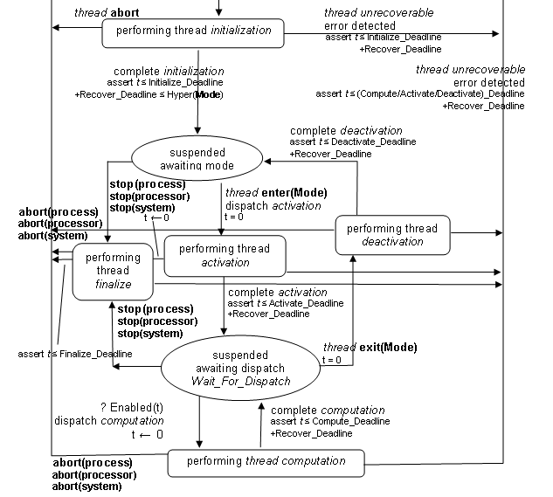
Thread Execution Semantics
Nominal & recovery
Fault handling
Resource locking
Mode switching
Initialization & finalization

Slide 17
Flows in AADL
System S1
Flow Specification
F1: flow path pt1 -> pt2
F2: flow path pt1 -> pt3
A
flow path F1
ADL
pt2
pt1
flow path F2
pt3
A
System implementation S1.impl
pt1
ADL
Process P2
Connection
C1
flow path F5
pt2
Flow Implementation
F1: flow path pt1 -> C1 -> P2.F5 -> C3 -> P1.F7 -> C5 -> pt2
C3
Process P1
C5
pt3
flow path F7
End-To-End Flow Declaration
SenseControlActuate: end to end flow Sensor.FS1 -> C1 ->
Controller.F1 -> C2 -> Actuator.FS1
flow path F1
flow sink FS1
flow source FS1
C1
A
C2
A
Sensor
ADL
Controller
A
Actuator
ADL
ADL
Notes:
A flow specification is a mapping from input ports to output ports.
Flow specifications represent logical flows; port types do not have to match.
Multiple flow specifications can be defined for the same pair of ports.

Slide 18
Port groups
Avionics System
A
ADL
A
Page Content
Manager
A
ADL
A
ADL
ADL
Warning Annunciation
Manager
Flight Manager
A
A
Display
Manager
ADL
ADL
A
Flight
Director
ADL
A
A
Weapons
Manager
ADL
ADL
A
A
A
ADL
Situation
Awareness
A
Comm.
Manager
ADL
ADL
ADL
A
ADL
G PS
Auto-Pilot
Nav Radio
www.sei.cmu.edu

Slide 19
Primary Backup Synchronization
External and internal mode control
Errors reported as events
Supports reasoning about Primary/Backup logic
Primary
Init/restart
20Hz
A
Mode
ADL
20Hz
Primary
A
Backup
ADL
WAM
Primaryfail
init
A
state
ADL
Primaryok
20Hz
A
WAM
20Hz
ADL
Backup
Observer
A
state
ADL
Notes:
Key points (Objectives of the Slide):
Slide Content Description:
Presentation Script:

Slide 20
Redundancy schemes
Passive Backup
Continuous State Exchange
Hot Standby
CSS1
A
CSS1 Primary
A
CSS1 Primary
A
ADL
ADL
ADL
SS1.1
SS1.1
SS1.1
State
SS1.2
SS1.2
SS1.2
A
CSS1 Backup
A
CSS1 Backup
ADL
ADL
Voted Output
SS1.1
SS1.1
A
CSS1
ADL
SS1.2
SS1.2
SS1.1
SS1.2
SS1.3
www.sei.cmu.edu

Slide 21
AADL Components - Graphical
Application Software
Execution Platform
A
data
ADL
device
Thread
process
memory
bus
System Composition
A
processor
ADL
System
Notes:
The next slides use the graphical notation for the AADL components shown here. Additional graphical detail is also added on the following of the slides for connections, bindings, ports, etc. These are the component categories.
The modeling vocabulary of AADL supports modeling of the application systems executing on executing platform with focus on runtime properties of the embedded system.
Application systems can be modeled in terms of concurrently executing components that interact and access data. These components have precise execution semantics. They can be composed into hierarchical systems.
The execution platform consists of processors (for executing threads), memory (for holding code and data), buses, to provide connectivity of execution platform components, and devices to interface with the external environment.

Slide 22
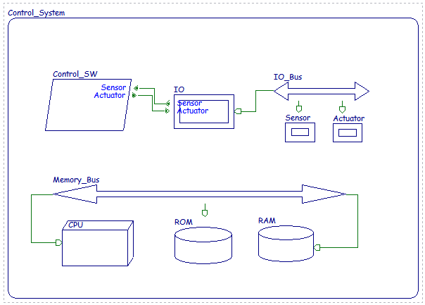
Operational system
SYSTEM Control_System
END Control_System;
SYSTEM IMPLEMENTATION Control_System.others
SUBCOMPONENTS
CPU : PROCESSOR CPU;
Memory_Bus : BUS Memory_Bus;
RAM : MEMORY RAM;
ROM : MEMORY ROM;
Control_SW : PROCESS Control_SW;
IO : DEVICE IO;
IO_Bus : BUS IO_Bus;
Sensor : DEVICE Sensor;
Actuator : DEVICE Actuator;
CONNECTIONS
EVENT DATA PORT Control_SW.Actuator -> IO.Actuator;
EVENT DATA PORT IO.Sensor -> Control_SW.Sensor;
BUS ACCESS Memory_Bus -> CPU.Memory_Bus;
BUS ACCESS Memory_Bus -> RAM.Memory_Bus;
BUS ACCESS Memory_Bus -> ROM.Memory_Bus;
BUS ACCESS IO_Bus -> IO.IO_Bus;
BUS ACCESS IO_Bus -> Sensor.IO_Bus;
BUS ACCESS IO_Bus -> Actuator.IO_Bus;
END Control_System.others;
Prespolei_r_04dec07_ellidiss_1J1kz7.ppt
www.ellidiss.com

Slide 23
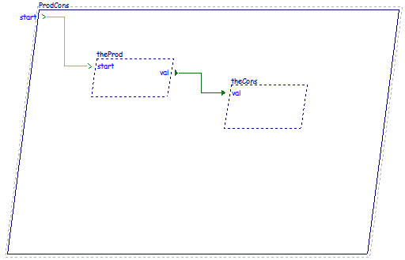
Connections
process implementation ProdCons.default
subcomponents
theProd: thread Prod.Impl;
theCons: thread Cons.Impl;
connections
EventConnection1: event port start -> theProd.start;
DataConnection1: data port theProd.val -> theCons.val;
end ProdCons.default;
Prespolei_r_04dec07_ellidiss_1J1kz7.ppt

Slide 24
Property set
property set Clemson is
MbitPerSec : type units (MPS, GPS => MPS*1000);
Band_width: type aadlinteger units Clemson::MbitPerSec;
Radio_band_width: Clemson::Band_width applies to (all);
Band_width_802_11g: constant Clemson::Band_width => 54 MPS;
Band_width_802_11n: constant Clemson::Band_width => 300 MPS;
Band_width_fast_ethernet: constant Clemson::Band_width => 100 MPS;
end Clemson;

Slide 25
Use of Property Set
package infoSys
public
system Infotainment
features
radio : requires bus access;
end Infotainment;
system implementation Infotainment.basic
properties
Clemson::Radio_band_width => value (Clemson::Band_width_802_11g) applies to radio;
end Infotainment.basic;
end infoSys;

Slide 26
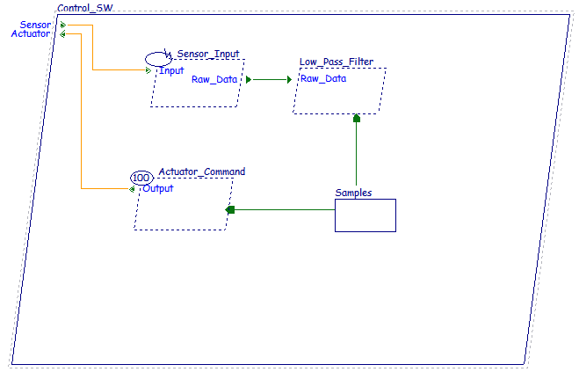
Real time
PROCESS Control_SW
FEATURES
Sensor : IN EVENT DATA PORT T_Flow;
Actuator : OUT EVENT DATA PORT T_Flow;
END Control_SW;
PROCESS IMPLEMENTATION Control_SW.others
SUBCOMPONENTS
Sensor_Input : THREAD Init;
Low_Pass_Filter : THREAD Low_Pass_Filter;
Actuator_Command : THREAD Actuator_Command;
Samples : DATA Samples;
CONNECTIONS
EVENT DATA PORT Sensor -> Sensor_Input.Input;
EVENT DATA PORT Actuator_Command.Output -> Actuator;
DATA PORT Sensor_Input.Raw_Data -> Low_Pass_Filter.Raw_Data;
DATA ACCESS Samples -> Low_Pass_Filter.Samples;
DATA ACCESS Samples -> Actuator_Command.Samples;
END Control_SW.others;
THREAD Actuator_Command
FEATURES
Output : OUT EVENT DATA PORT T_Flow;
Samples : REQUIRES DATA ACCESS Samples;
PROPERTIES
Dispatch_Protocol => Periodic;
Period => 100 ms;
END Actuator_Command;
Prespolei_r_04dec07_ellidiss_1J1kz7.ppt

Slide 27
Simulation
AADL can describe a completely bound system
One that has a complete hardware description as well as software so that a system can be “executed” to the degree of accuracy of the architectural design.

Slide 28
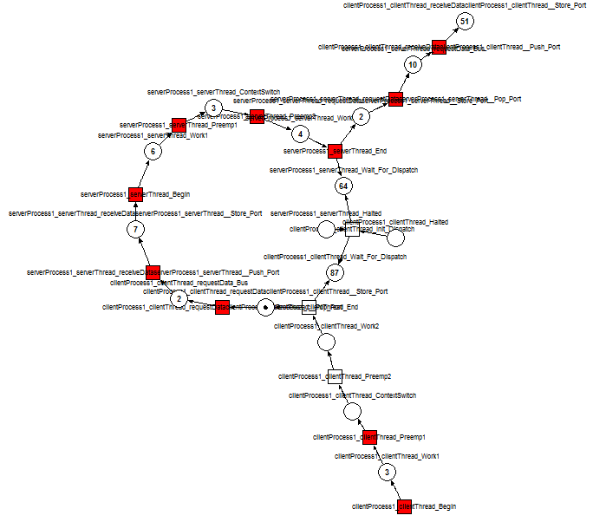
Simulation
Ocarina, a set of plug-ins for Eclipse converts AADL code into timed petri nets.
Existing petri net simulators execute the net by firing tokens and traversing all places in the net.
These executions determine whether the system defined by the AADL code could achieve live lock or dead lock.
www.sei.cmu.edu

Slide 29
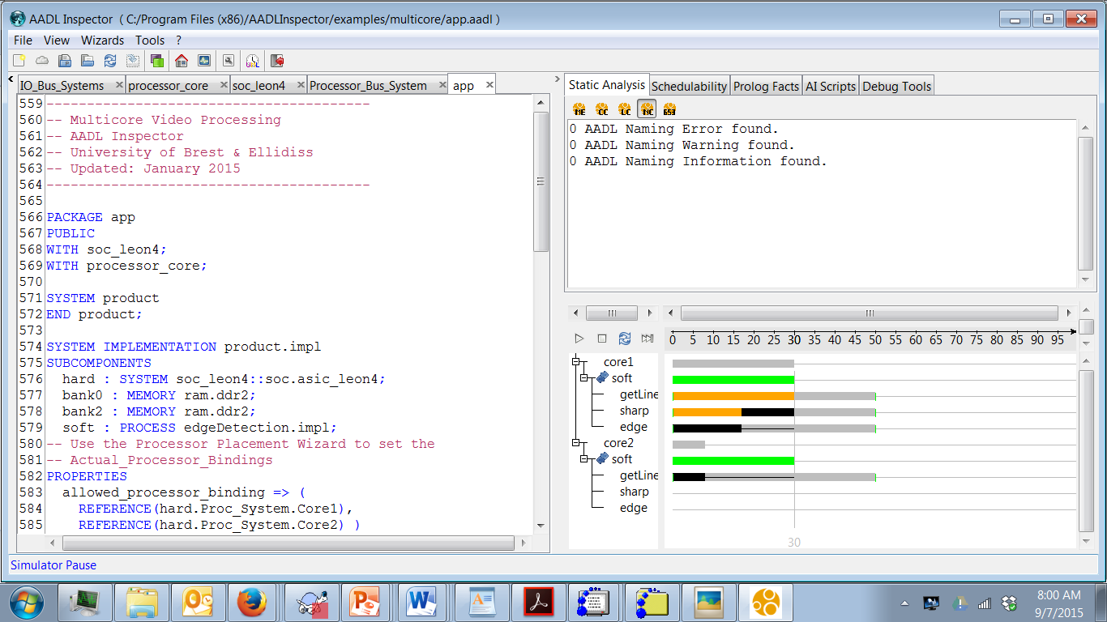

Slide 30
AADL Tutorials
http://www.aadl.info/aadl/documents/AADLpattern82004.pdf
http://people.cs.kuleuven.be/~stefan.vanbaelen/public_html/deptcw/ACES-MB/2009/ACES-MB11.pdf
https://wiki.sei.cmu.edu/aadl/images/7/78/Vogl_Hecht_Lam_Aerotech_09.pdf

