Slide 1

CPSC 871
John D. McGregor
Module 5 Session 1
Design Patterns

Slide 2
Where are we going
Functional architecture
Conceptual architecture
Design architecture <= You are here
Integration architecture

Slide 3
Architectural styles
  Event based
Design patterns
  observer
Language idioms
  J+= 1

Slide 4
Open/Closed Principle
SOFTWARE ENTITIES (CLASSES, MODULES, FUNCTIONS, ETC.)SHOULD BE OPEN FOR EXTENSION, BUT CLOSED FOR MODIFICATION

Slide 5
Open/closed – not a solution
struct Square
{
ShapeType itsType;
double itsSide;
Point itsTopLeft;
};
//
// These functions are implemented elsewhere
//
void DrawSquare(struct Square*)
void DrawCircle(struct Circle*);
typedef struct Shape *ShapePointer;
void DrawAllShapes(ShapePointer list[], int n)
{
int i;
for (i=0; i<n; i++)
{
struct Shape* s = list[i];
switch (s->itsType)
{
case square:
DrawSquare((struct Square*)s);
break;
case circle:
DrawCircle((struct Circle*)s);
break;
}
}
}

Slide 6
Open/closed – not a solution
void DrawAllShapes(ShapePointer list[], int n)
{
int i;
for (i=0; i<n; i++)
{
struct Shape* s = list[i];
switch (s->itsType)
{
case square:
DrawSquare((struct Square*)s);
break;
case circle:
DrawCircle((struct Circle*)s);
break;
}
}
}

Slide 7
The Open/Closed solution
class Shape
{
public:
virtual void Draw() const = 0;
};
class Square : public Shape
{
public:
virtual void Draw() const;
};
class Circle : public Shape
{
public:
virtual void Draw() const;
};
void DrawAllShapes(Set<Shape*>& list)
{
for (Iterator<Shape*>i(list); i; i++)
(*i)->Draw();
}

Slide 8
Liskov's Substitution Principle
If for each object o1 of type S there is an object o2 of type T such that for all programs P defined in terms of T, the behavior of P is unchanged when o1 is substituted for o2 then S is a subtype of T.

Slide 9
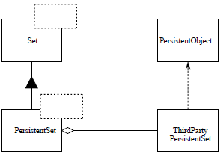
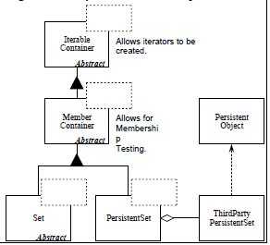
2 possibilities

Slide 10
Capture experience
Design Patterns by Erich Gamma, Richard Helm, Ralph Johnson and John Vlissides
This is the initial effort at patterns
Idea is to capture design experience
It is not a pattern until it has appeared in practice multiple times
Good source - http://www.oodesign.com/

Slide 11
Alexander’s definition
As an element in the world, each pattern is a relationship between a certain context, a certain system of forces which occurs repeatedly in that context, and a certain spatial configuration which allows these forces to resolve themselves.
As an element of language, a pattern is an instruction, which shows how this spatial configuration can be used, over and over again, to resolve the given system of forces, wherever the context makes it relevant.

Slide 12
Pattern format
Pattern Name
Problem
Context
Forces
Solution
Resulting context
Rationale

Slide 13
Does it fit?
My problem
Model
Controller
View
Are the pre-conditions met?
What forces are resolved?

Slide 14
Categories
Creational
Structural
Behavioral

Slide 15
Creational
How does the static type definition get mapped to dynamic instantiations
Forces constrain how the mapping happens
Cardinality must be enforced

Slide 16
Singleton
Pattern Name - Singleton
Problem – The nature of the behavior of the class is such that it is important that there is a sole source for the behavior.
Context – In a program where the number of instances of a class is critical, such as a server.
Forces – The constraint needs to be enforced as locally as possible.

Slide 17
Singleton
Solution – Protect the constructor of the class so that it can only be accessed indirectly
Resulting context – the callers to this class do not have to check to determine if they get the correct object, e.g. server.
Rationale – Hiding the constraint inside the class improves the modularity of the design.

Slide 18
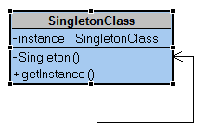
UML diagram

Slide 19
Code
class Singleton
{
private static Singleton instance;
private Singleton()
{
...
}
public static synchronized Singleton getInstance()
{
if (instance == null)
instance = new Singleton();
return instance;
}
...
public void doSomething()
{
...
}
}

Slide 20
Visitor - Behavioral
Pattern Name - Visitor
Problem – How to apply a common operation to a set of objects in a data structure
Context – Which operations are needed changes over time; multiple types of objects in the structure
Forces – The more changes made, the worse the structure of the design.

Slide 21
Visitor
Solution: define a specialization hierarchy that has new algorithms
Resulting context – it is easy to add a new algorithm
Rationale – New implementations of algorithms can be used whenever a new operation is needed

Slide 22
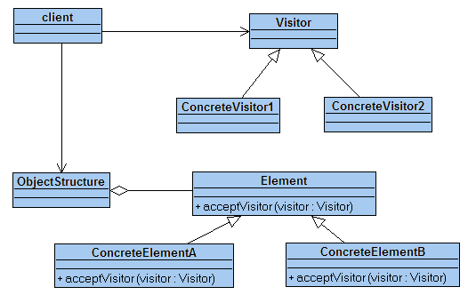
UML:Visitor

Slide 23
Trade-off
The Visitor pattern illustrates the typical trade off situation.
One approach to implementation makes each Visitable Class easy to modify for a new Visitor (a new algorithm) compared to making each Visitor Class easy to modify for a new Vistable Class.
The other approach is just the reverse
The designer has to analyze the situation:
  Which will happen most frequently – new Visitor or new Visitable?
  What is the effect on the quality attributes?
  What are the risks?
  What happens if I am wrong?

Slide 24
code
public abstract class Visitor {
public abstract void visit(Customer customer);
public abstract void visit(Order order);
public abstract void visit(Item item);
public abstract void defaultVisit(Object object);
public void visit(Object object) {
try
{
Method downPolymorphic = object.getClass().getMethod("visit",
new Class[] { object.getClass() });
if (downPolymorphic == null) { defaultVisit(object);
} else {
downPolymorphic.invoke(this, new Object[] {object});
}
}
catch (NoSuchMethodException e)
{
this.defaultVisit(object);
}
catch (InvocationTargetException e)
{
this.defaultVisit(object);
}
catch (IllegalAccessException e)
{
this.defaultVisit(object);
}
}
}

Slide 25
Adapter: Structural
Pattern Name - Adapter
Problem – Two objects need to communicate but their provides/requires interfaces do not match
Context – we may not have source code for one or both of the implementations
Forces – re-implementing one class with a new interface is expensive

Slide 26
Adapter
Solution - Convert the interface of a class into another interface clients expect.
  Adapter lets classes work together, that could not otherwise because of incompatible interfaces.
Resulting context – the two classes work together and any places where one of the original classes worked, it still does
Rationale – the two classes are needed but there is no money/time to redesign

Slide 27
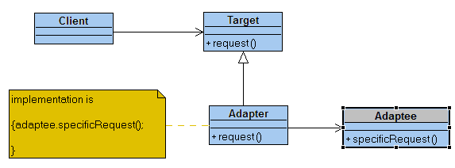
design

Slide 28
It’s a big design space
There are many, many design patterns.
Some better than others
Learn:
  how to find them,
  recognize what will be useful and
  how to apply them

Slide 29
Unified Modeling Language
UML provides a comprehensive design notation
Read these brief introductions to UML:
  http://edn.embarcadero.com/article/31863
  http://www.ibm.com/developerworks/rational/library/769.html
Work through the tutorial at:
  http://sourcemaking.com/design_patterns

Slide 30
Concurrent programming
http://c2.com/cgi/wiki?ConcurrentProgrammingPatterns

