Slide 1

CPSC 871
John D. McGregor
Module 5 Session 2
Software Product Lines

Slide 2
Session Objective
To introduce the concepts related to software product lines and briefly explore the role of systems engineering.

Slide 3

Product Line Definition
A software product line is a set of software-intensive systems sharing a common, managed set of features that satisfy the specific needs of a particular market segment or mission and that are developed from a common set of core assets in a prescribed way.
A frequent misconception is that the core assets, the reusable
pieces, are the product line. As you can see from the definition,
the product line comprises the products.

Slide 4
Product Line Definition - 1
set of software-intensive systems
  The product line is the products
  The product line organization produces the products
Set of airline reservation systems
Software controllers for diesel engines
Ground satellite control software systems

Slide 5
Product Line Definition - 2
common, managed set of features
  Common – identifying ahead of time common features of the products and the variations in products
  Managed – evolution is anticipated, variation is controlled, and the inventory of features is what we sell
Data storage and management actions
Image analysis techniques
Information classification techniques

Slide 6
Product Line Definition - 3
particular market segment or mission
  Focusing makes the percentage of commonality higher
  The culture of the market segment determines specific quality levels
Medical devices
Video games

Slide 7
Product Line Definition - 4
common set of core assets
  A “core” asset is anything used to produce multiple products
    Source code – yes, but also
    Software architecture
    Test infrastructure, test cases, and test data
    Production plans
    ….
  The assets are designed to handle the range of variability defined in the product line scope
  Each asset is accompanied by an attached process, which explains how to use the asset in building a product
Implementation of doppler compensation algorithms
Test scenarios for engine controllers

Slide 8
Product Line Definition - 5
prescribed way
  A production strategy coordinates the business goals with the development of core assets and products
  A production plan describes the way in which each product is to be produced
Architecture-centric management
Traditional programmer-centric code development
Model-driven automatic code generation

Slide 9
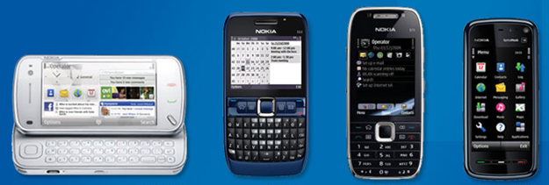
Do these cell phones, all Nokia products, form a SPL?
You can’t tell just by looking whether a group of products is a product line or not. Just because they share features does not mean they were built from a shared set of core assets. It does not mean they were built efficiently and economically.

Slide 10

Strategic reuse
Reuse that will get the CEO’s attention
Reuse that changes the business model
Reuse that blends business strategy and technical strategy

Slide 11
Strategic reuse
Strategic reuse is an integral part of the development culture and embraces all of the actions of the organization.
Reports from companies, such as Rolls Royce, show that less than 10% of the cost of a product is in the code.
If reuse is limited to code then even 100% code reuse will have limited impact.

Slide 12
The payoff
Initiating a software product line strategy requires some amount of up-front investment although it can be minimal.
If the commonality is sufficiently high, payback can happen after a relatively small number of products.
Many organizations have reached the payoff point
Current Practice
Cumulative Costs
With Product Line
Approach
Numbers of Products

Slide 13
Overwatch Textron Systems
Overwatch Intelligence Systems
  Signal intelligence
  Human intelligence
  Imagery intelligence
  Measurement and Signature intelligence
Initial challenges
  Funding
  Organizational structure
Paul Jensen. Experiences With Software Product Line Development, Crosstalk, January 2009.

Slide 14
Overwatch Textron Systems
Funding
  Investment with own funds and with government funds
  Joint ownership of IP enables reuse for the customer that invested but no competition
Achievements
  Roughly improved time to market of 2.5 times
  Reuse factor of 70%
  Core asset base was sold to a government customer

Slide 15
Overwatch Textron Systems
Viper architecture
  Blends SOA and event-driven
  Open architecture using publish/subscribe
Lessons learned
  Senior management support is critical
  Product line architecture is essential
  Product line requirements addressed up front
  Develop a domain analysis process
  Perform domain analysis as soon as possible

Slide 16
Nokia
"…increased efficiency through reuse as well as accelerated product implementation, lowered cost, and increased quality."
"We could not have developed four different products and six annual releases with our given resources without a product line."
Led to improved working conditions - less than 3% turnover, product line highly rated in Nokia's internal survey of working conditions.
http://www-nrc.nokia.com/Vivian/Public/Misc/artMyllVR.pdf

Slide 17
How’s it done?
Essential activities
  Core asset development
  Product development
  Management

Slide 18
Core asset development
What can we profitably reuse?
  How many products will use it?
  How much extra will it cost to make it reusable?
We reuse ANYTHING that makes sense (money)
  Source code – obviously – but non-software assets also
  For example, we decompose a test suite into individual test cases, then compose as needed by a product
Often a team is devoted to providing these assets
This team has a vision that encompasses all products that would use its assets.
An “attached process” accompanies each core asset to facilitate reuse of the asset

Slide 19
Product development
Product development is combining core assets with product-specific artifacts to produce products.
Product development moves faster than in traditional development because of the assets and the small percentage of product-specific artifacts.
A product team may continue to own the product it has built or it may hand it off to a maintenance team.
This team is focused on one product.

Slide 20
Management
A central authority, such as a product line manager, oversees the organization which may cut across multiple business unit boundaries
Coordinates the production of core assets and the assembly of products.
Ensures that resources are available at the right time to optimize operation of the production capability.

Slide 21
Strategic partner
Parent organization
Asset source
$$$
Product team
Open source
Product Line organization
Core asset team
Configuration management
Product management
Product management
Software architecture
Product management
Product team
Product team
Product team
Domain organization
Customer
Reference architecture
requirements
Software product line ecosystem

Slide 22

Activities and practices
Carrying out the activities touches 29 practice areas
Software Engineering
  Architecture Definition
  Architecture Evaluation
  Component Development
  Mining Existing Assets
  Requirements Engineering
  Software System Integration
  Testing
  Understanding Relevant Domains
  Using Externally Available Software
Technical Management
  Configuration Management
  Make/Buy/Mine/Commission Analysis
  Measurement and Tracking
  Process Discipline
  Scoping
  Technical Planning
  Technical Risk Management
  Tool Support
Organizational Management
  Building a Business Case
  Customer Interface Management
  Developing an Acquisition Strategy
  Funding
  Launching and Institutionalizing
  Market Analysis
  Operations
  Organizational Planning
  Organizational Risk Management
  Structuring the Organization
  Technology Forecasting
  Training

Slide 23
Key ingredients
Business case
Software architecture
Variability management

Slide 24
Tie key business goals to technical actions
The business goals guide many decisions
  Is cost more important than speed?
  There can only be one number one priority
A business case
  identifies goals and justifies strategies for achieving them
  formalizes the product line scope
  incorporates marketing and technology forecasts to justify the scope

Slide 25
It is SIMPLE
Structured Intuitive Model of Product Line Economics
Supports cost/benefit analysis of a product line
Besides reduced
costs
Fixed costs
Varies with number of products

Slide 26
Cost functions
    Corg() returns the cost to an organization of adopting the product line approach for its products. Such costs can include reorganization, process improvement, training, and whatever other organizational remedies are necessary.
    Ccab() returns the development cost to develop a core asset base suited to satisfy a particular scope. Ccab takes into account the cost of performing a commonality/variability analysis, defining the product line’s scope the cost of designing and then evaluating a generic (as opposed to one-off) software architecture, and the cost of developing the software so designed. Ccab may be invoked to tell us the cost of developing a core asset base where none currently exists, or it may be invoked to tell us the cost of deriving a desired core asset base from one or more already in place.
    Cunique() returns the software development cost for the part of a product not based on a product line’s core asset base – that is, software unique to a particular product.
    Creuse() returns the development cost to reuse core assets in a core asset base. Creuse includes the cost of locating a core asset, checking it out of the repository, tailoring it for use in the intended application, and performing the extra integration tests associated with reusing core assets.
    B_{ben}() returns the benefits that accrue due to use of the product line strategy

Slide 27
Software architecture
Perhaps the key core asset
Captures early decisions about solving the problem
Communication vehicle among the stakeholders
Explicitly addresses the quality attributes
  Reliability
  Security
  Dependability

Slide 28
Product line architecture
The product line architecture is the architecture for a family of systems
Is more abstract, not every thing is completely defined
There are holes in its specification, but the architecture constrains how the holes can be filled

Slide 29
Variation
Tactical Variation
Variation Point
Variation Point
Core Asset
Strategic Variation
Variation Point
Tactical Variation
Variation Point
Core Asset
Products vary from one another in specific ways - the allowable contents of the holes in the architecture.
Strategic variations at the business unit level.
Tactical variations at the technical manager’s level
Variation points at the implementation level.

Slide 30
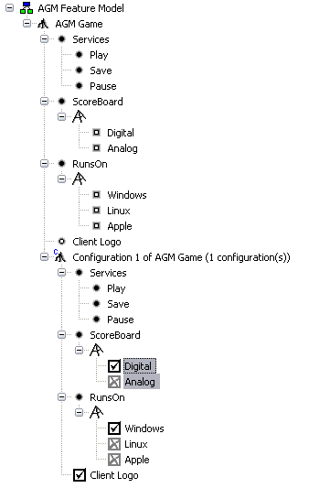
Commonality/Variability Analysis
What do the products in the product line have in common?
How are they different?
A configuration is a selection of inclusive and exclusive OR feature choices to completely define a single member of the product line.

Slide 31
Product architecture
Each hole is plugged by a specific variant determined by the features selected.
3
1
2

Slide 32
Assets and Products
The product line approach may appear to stress assets over products but clearly the ultimate goal is to be able to produce products.
Product managment benefits from the efficiency of analyzing multiple products together as opposed to one product at a time.
This grouping raises the visibility of the product manager’s role and by clearly linking business goals with technical actions the input from the product manager is seen as more relevant by technical personnel.

