Slide 1

CPSC 871
John D. McGregor
Module 6 Session 1
More Design

Slide 2
IBM Design Principles
http://www-01.ibm.com/software/ucd/designconcepts/designbasics.html

Slide 3
Software Product Line Design
Everything you have heard up to now still applies
Plus
Variation mechanisms

Slide 4
So what is good design?
From our work on architecture we know that “good design” is a design that meets its quality attribute goals
Software design is about managing complexity

Slide 5
Designing away complexity
Break the solution down into smaller pieces
Break it down by separating concerns
Satisfy the one concern then move on
Represent the problem in the solution
Ensure that each design is correct as you go
All of this is supported by modeling tools that help visualize the design

Slide 6
Design paradigms
Functional – the work to be done is broken into functions that do specific tasks by calling other more narrowly focused functions. Data is passed around as parameters or globals.
Object-oriented – Functions and the data they work on are grouped inside objects. Classes are defined as “types” so that individual objects are instances of those types.

Slide 7
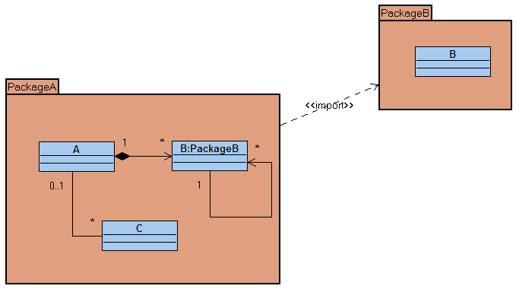
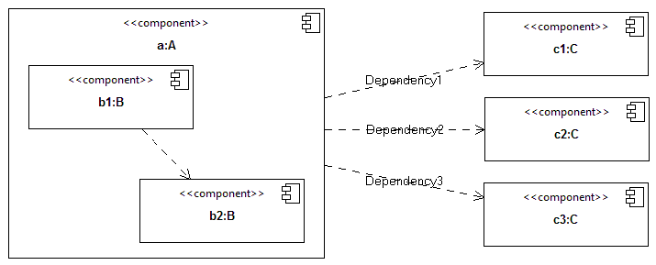
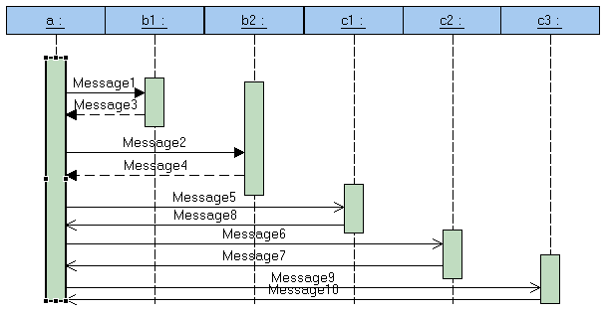
Unified Modeling Language (UML)

Slide 8
UML
Model driven development uses models to record design
The human still makes design decisions but the tools provide means of evaluating design decisions
A model is a set of diagrams that describe the design from a variety of perspectives. Information on the diagrams must be consistent.

Slide 9
UML - 2
We started out with use cases which are one way of representing the requirements.
This gives a picture of the problem.

Slide 10
UML-3
The solution is captured in several diagrams
Package diagram - divides the model into modular sets
Class diagram – static definitions of categories (types) of objects
Sequence diagram – dynamic interactions of the individual objects in the system
State diagram – dynamic picture of significant configurations of property values

Slide 11
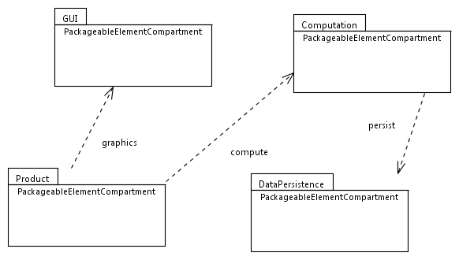
UML-4 - Package

Slide 12
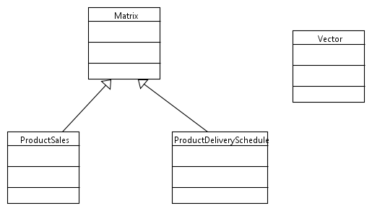
Computation classes

Slide 13
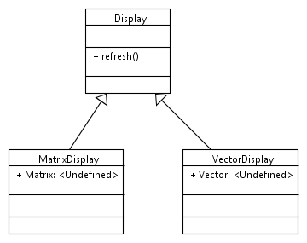
Class diagram

Slide 14
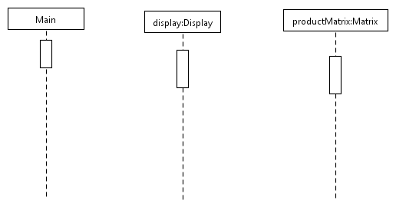
Sequence diagram
refresh
getData

Slide 15
Design issues
Abstraction
Coupling and cohesion
Decomposition and modularization
Encapsulation/information hiding
Separation of specification from implementation
Sufficiency, completeness and primitiveness

Slide 16
Here’s what you are going to do
Use the Papyrus editor to create class and sequence diagrams that begin to capture your design.
For help look at the editor tutorials at:
http://www.topcased.org/index.php?documentsSynthesis=y&Itemid=59

